Slide 1
T1A2: Portfolio
Daisy Lin

Slide 2
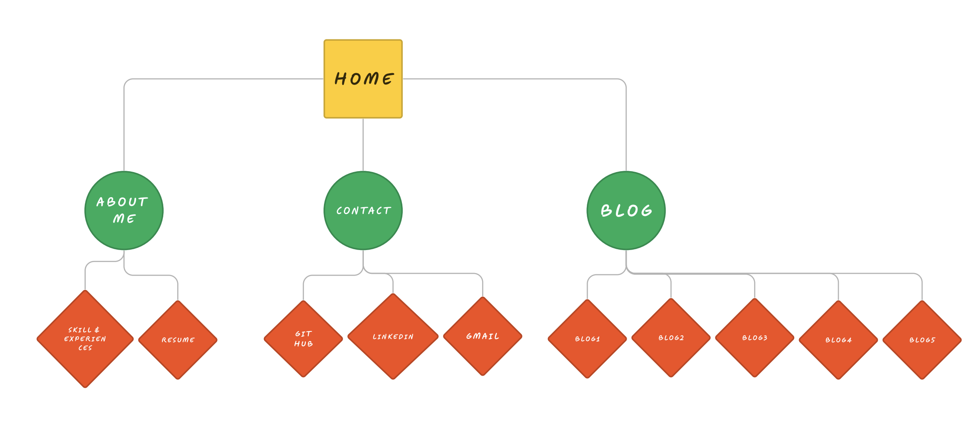
Sitemap

Slide 3
Explanation of Structure
The website features a homepage with convenient navigation options such as the "Home" button on the navbar and the logo in the top left corner, both of which allow users to easily return to the homepage.
There are three main pages accessible from the navbar: "About," "Contact," and "Blog."
On the "About" page, visitors can not only read about my skills and experience but also download my resume directly.
The "Contact" page, which has been updated since the sitemap, now includes fields for name, mobile number, and email, enabling direct contact. Social media links have been relocated to the "Contact" section on the homepage.
The "Blog" page contains a collection of blog entries, and clicking on each entry reveals its associated photo and text content.
The user-friendly navbar and logo links ensure efficient navigation throughout the website, making it accessible and straightforward even for those with basic web browsing skills.

Slide 4
Explanation of Aesthetic
I drew upon my personal style and design sensibilities to create something that is both elegant and pleasing to the eye. The absence of sharp lines, the harmonious colour palette, and the overall design aim to instil a sense of warmth and comfort for users as they explore the website.
The design decisions I implemented for this website are a result of my commitment to delivering the highest-quality product within the given time frame. This website not only showcases my personality and design skills but also demonstrates my technical proficiency. It is an authentic representation of who I am.

Slide 5
Homepage

Slide 6
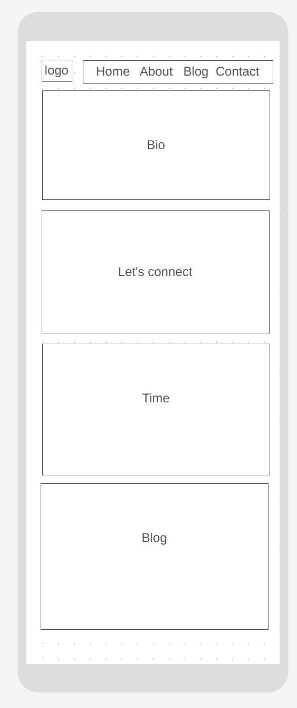
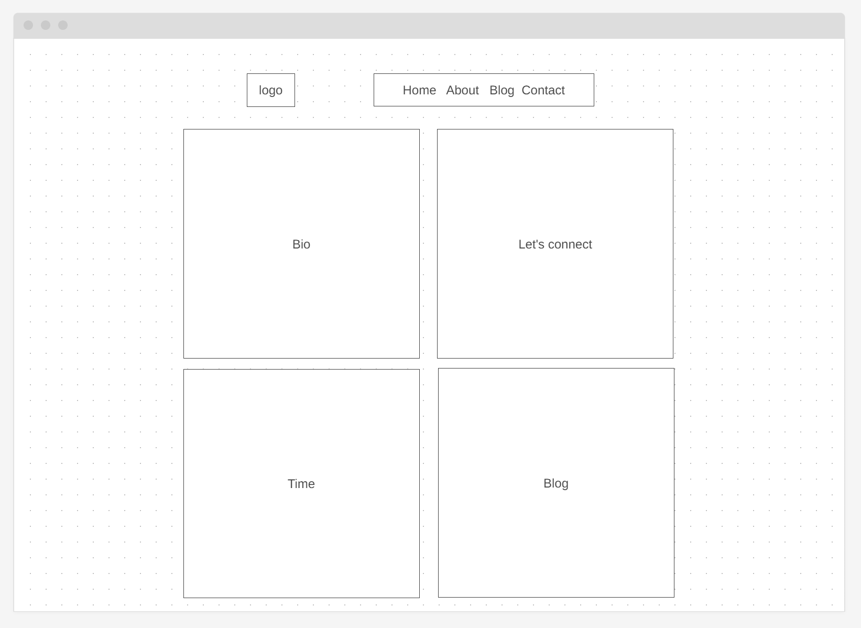
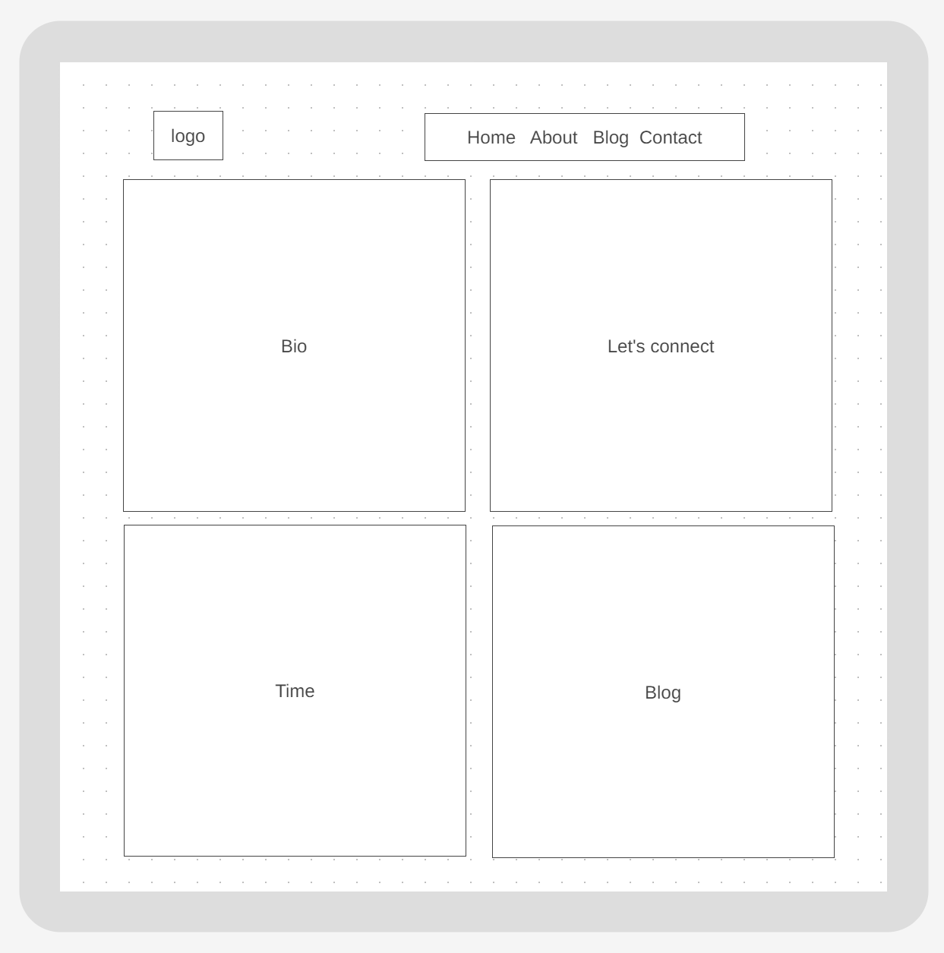
Wireframes

Slide 7
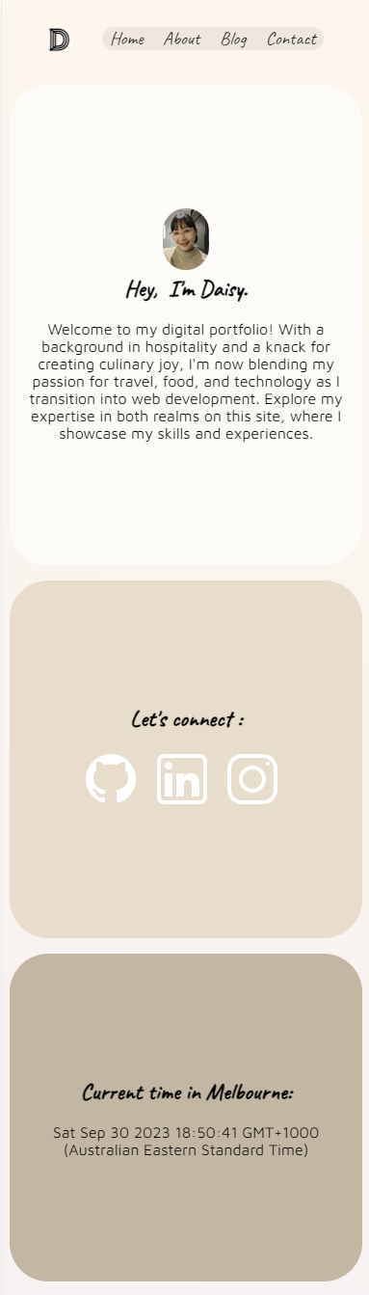
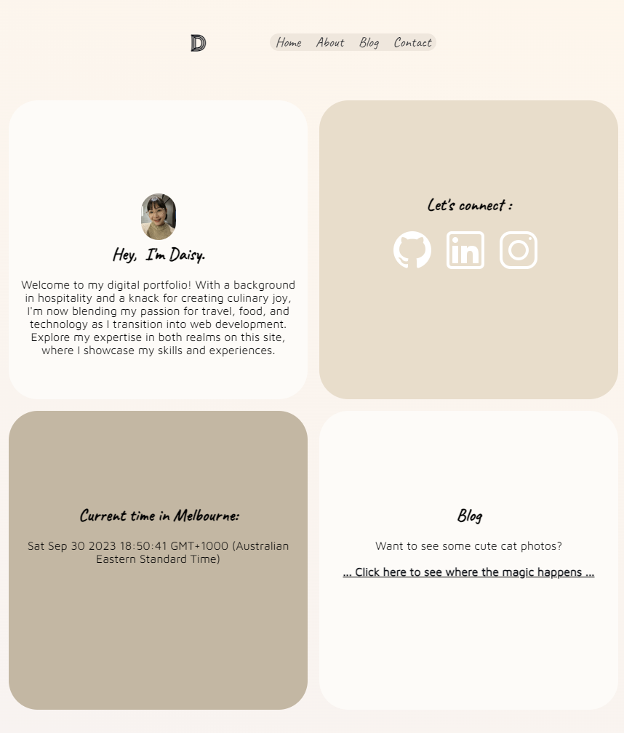
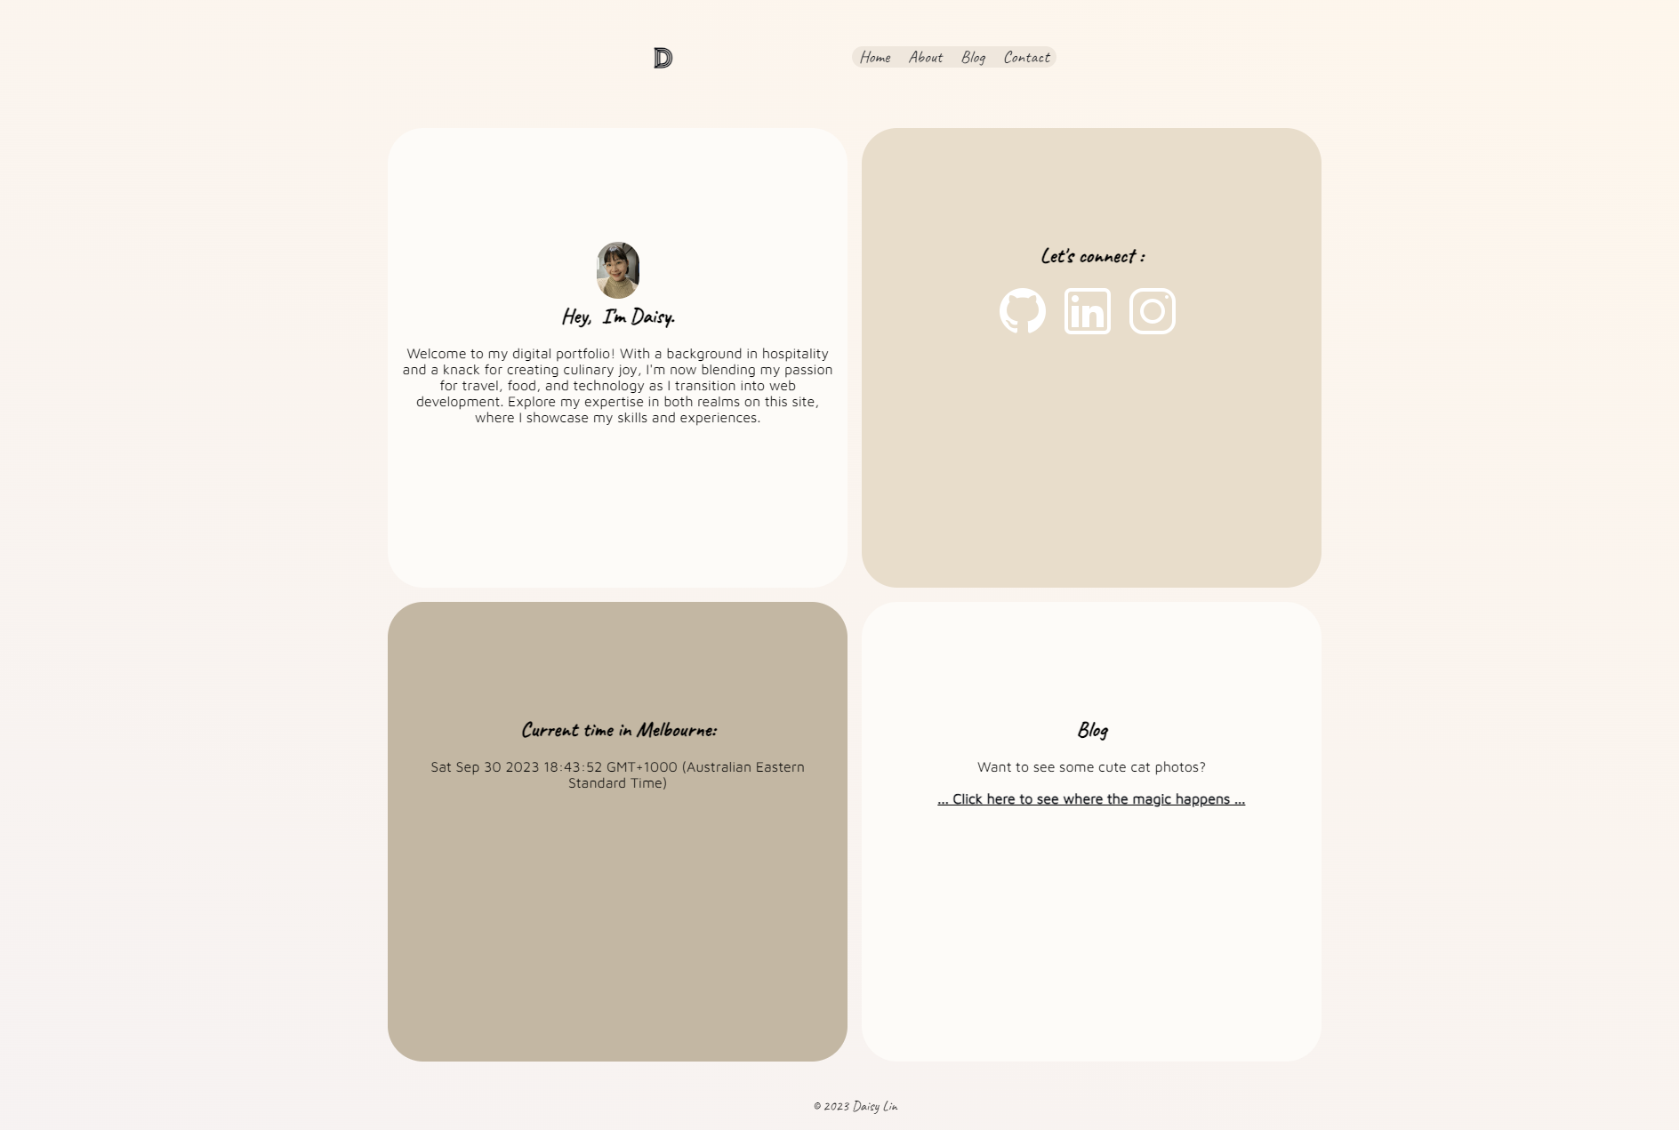
Screenshots

Slide 8


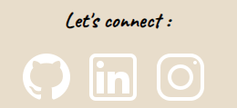
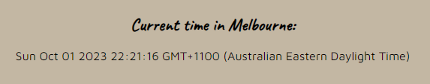

Components
- Logo links back to homepage – Memorable to consumers and user-friendly.
- Navbar – also highlights onhover. Highlight helps the website become more accessible.
- 4 main divs also include onhover highlight
- Icon links to social pages. Users are easily able to engage with me on my social media channels.
- Current time (will update on page load/refresh). A neat feature to show off technical skill.
- Footer. Allows for necessary copyright marking as well as a memory for myself.

Slide 9
About

Slide 10
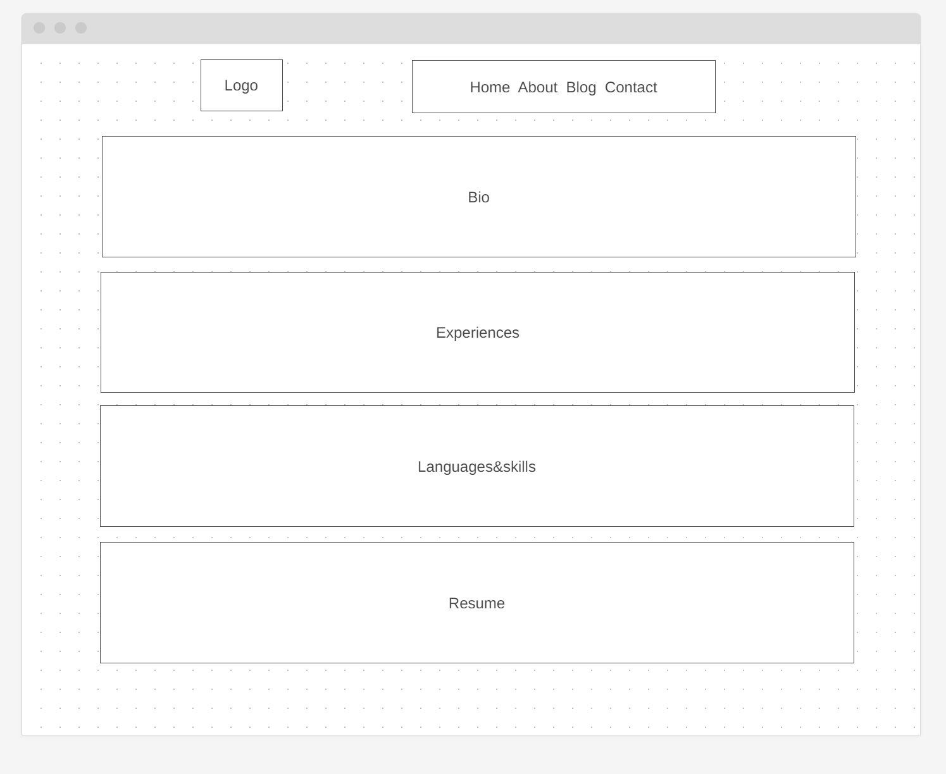
Wireframes

Slide 11
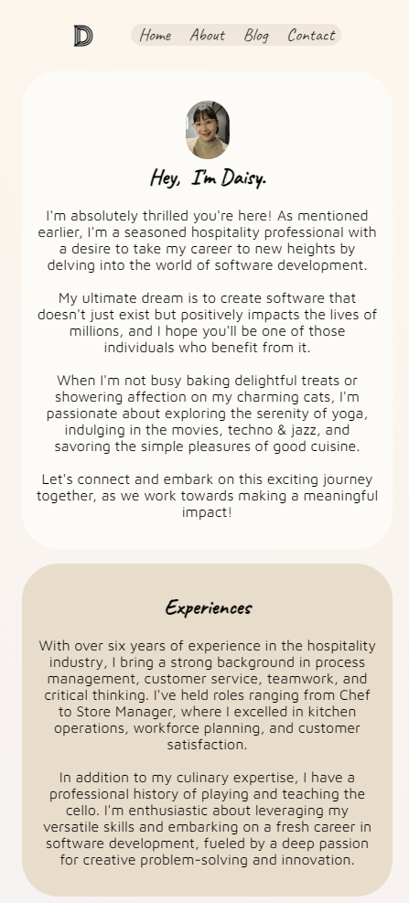
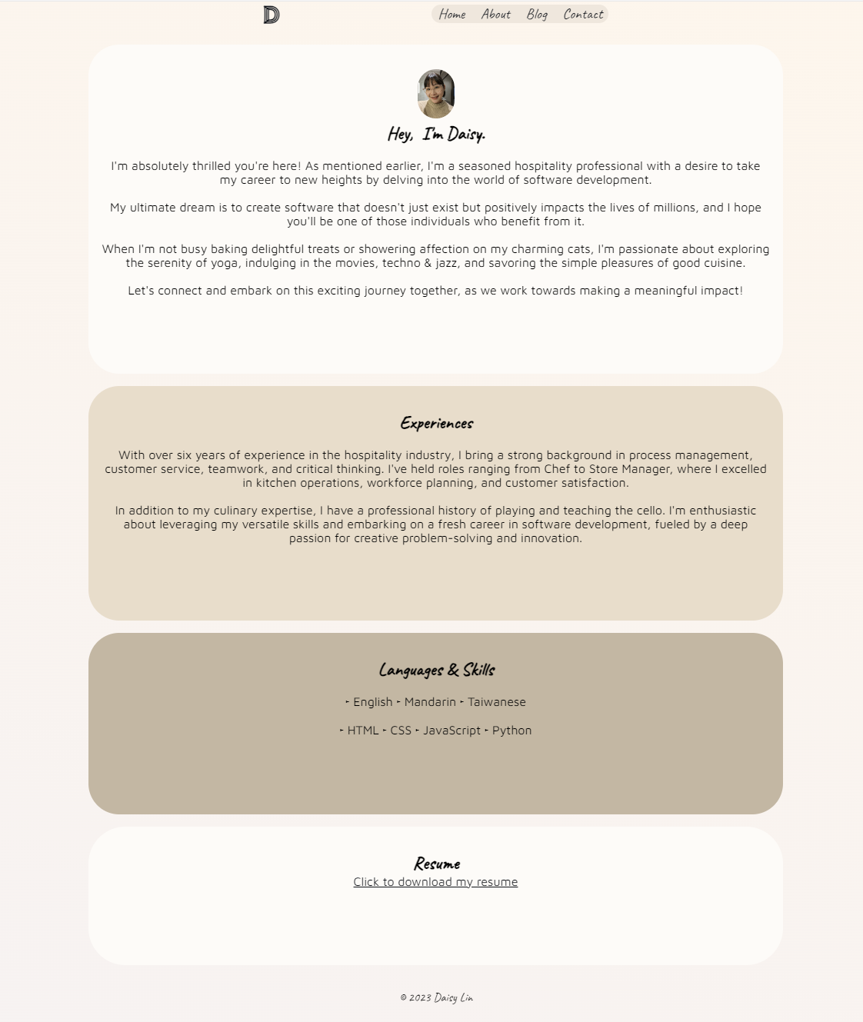
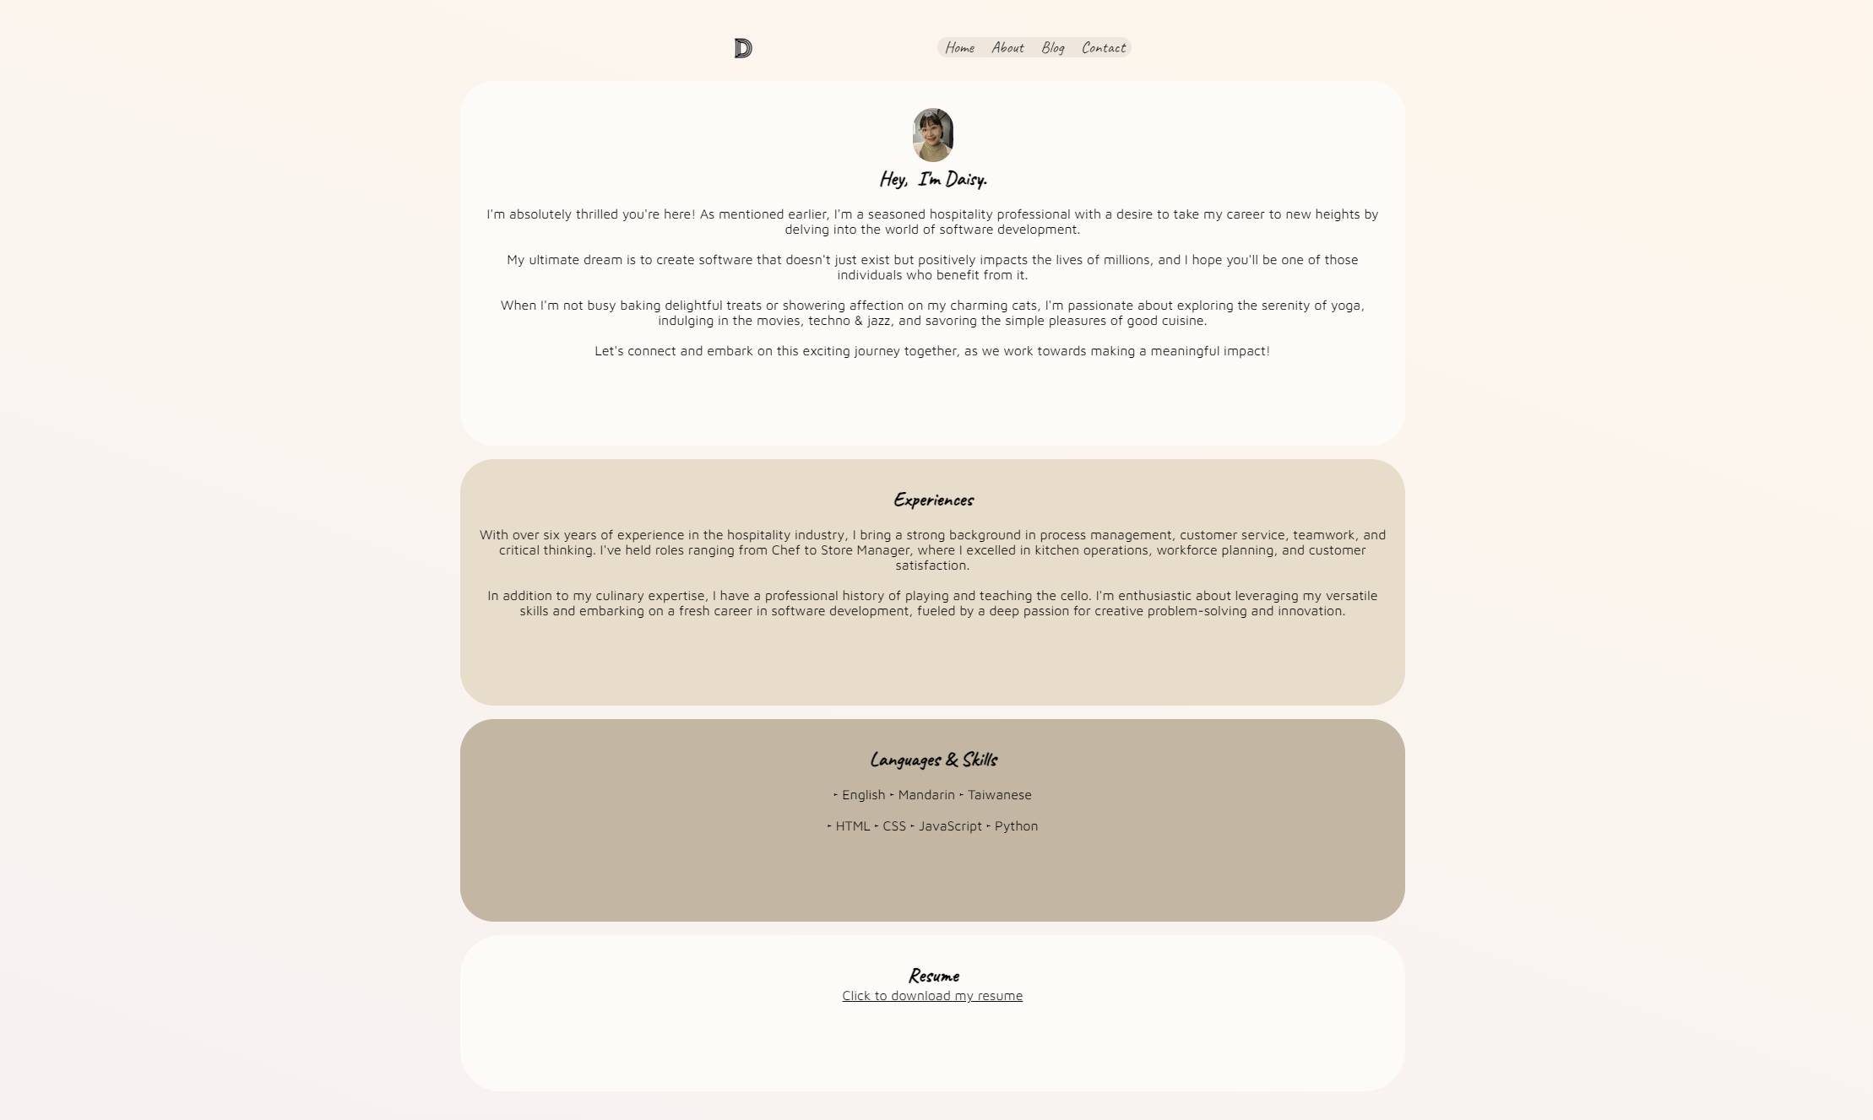
Screenshots

Slide 12
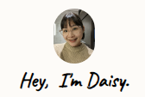
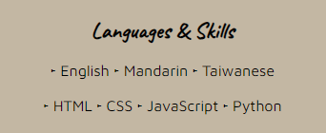

Components
- Friendly Welcome & Photo – Helps users to feel engaged with me and my website and feel at ease.
- HTML Bullet points – Shows off a small technical ability
- Link to download resume – Allows potential future employers to easily view my resume for download and distribution.

Slide 13
Blog

Slide 14
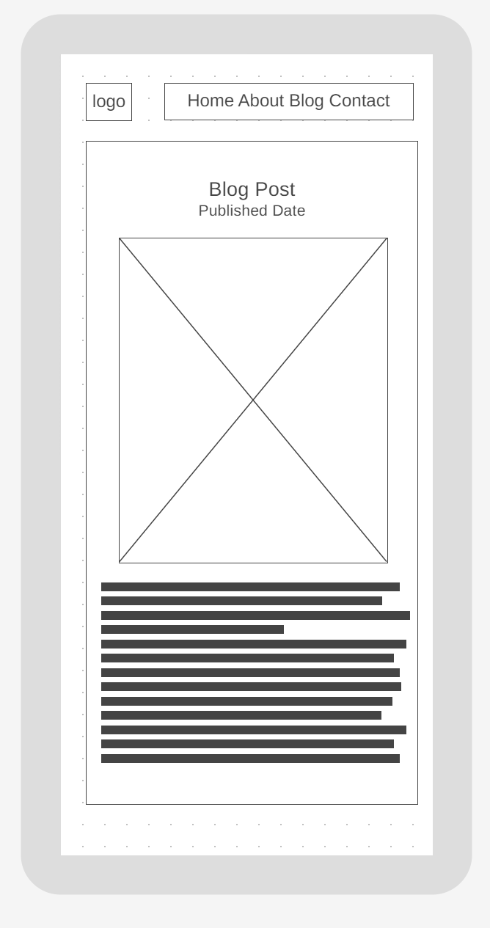
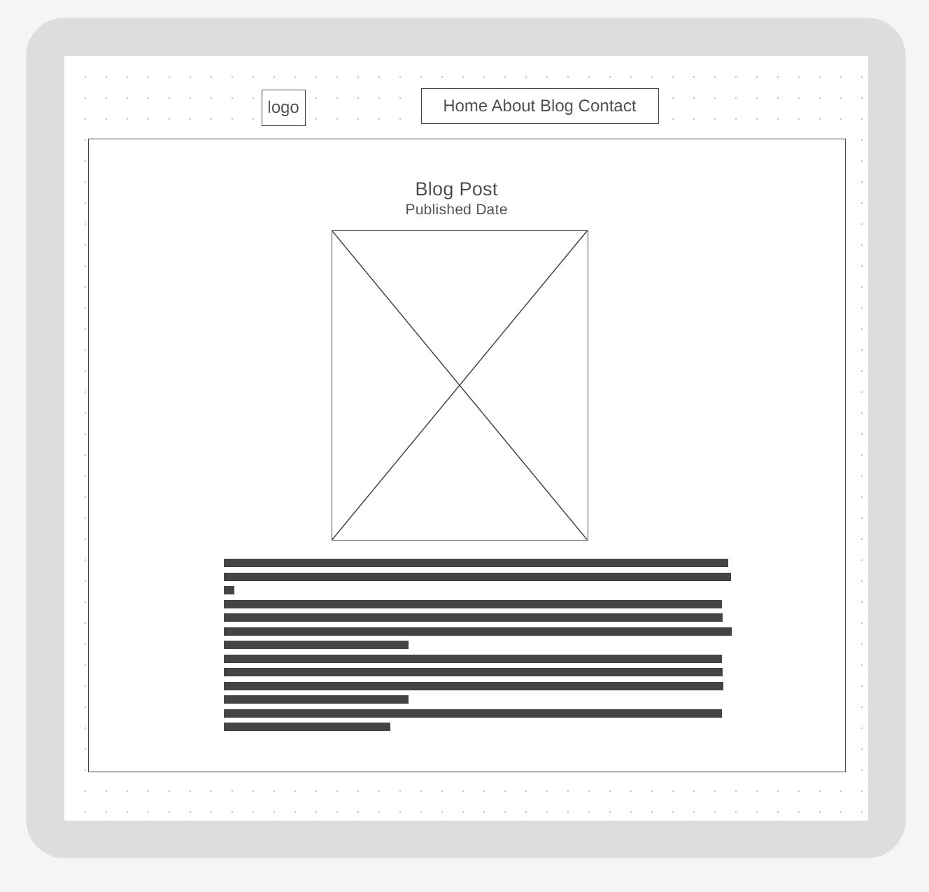
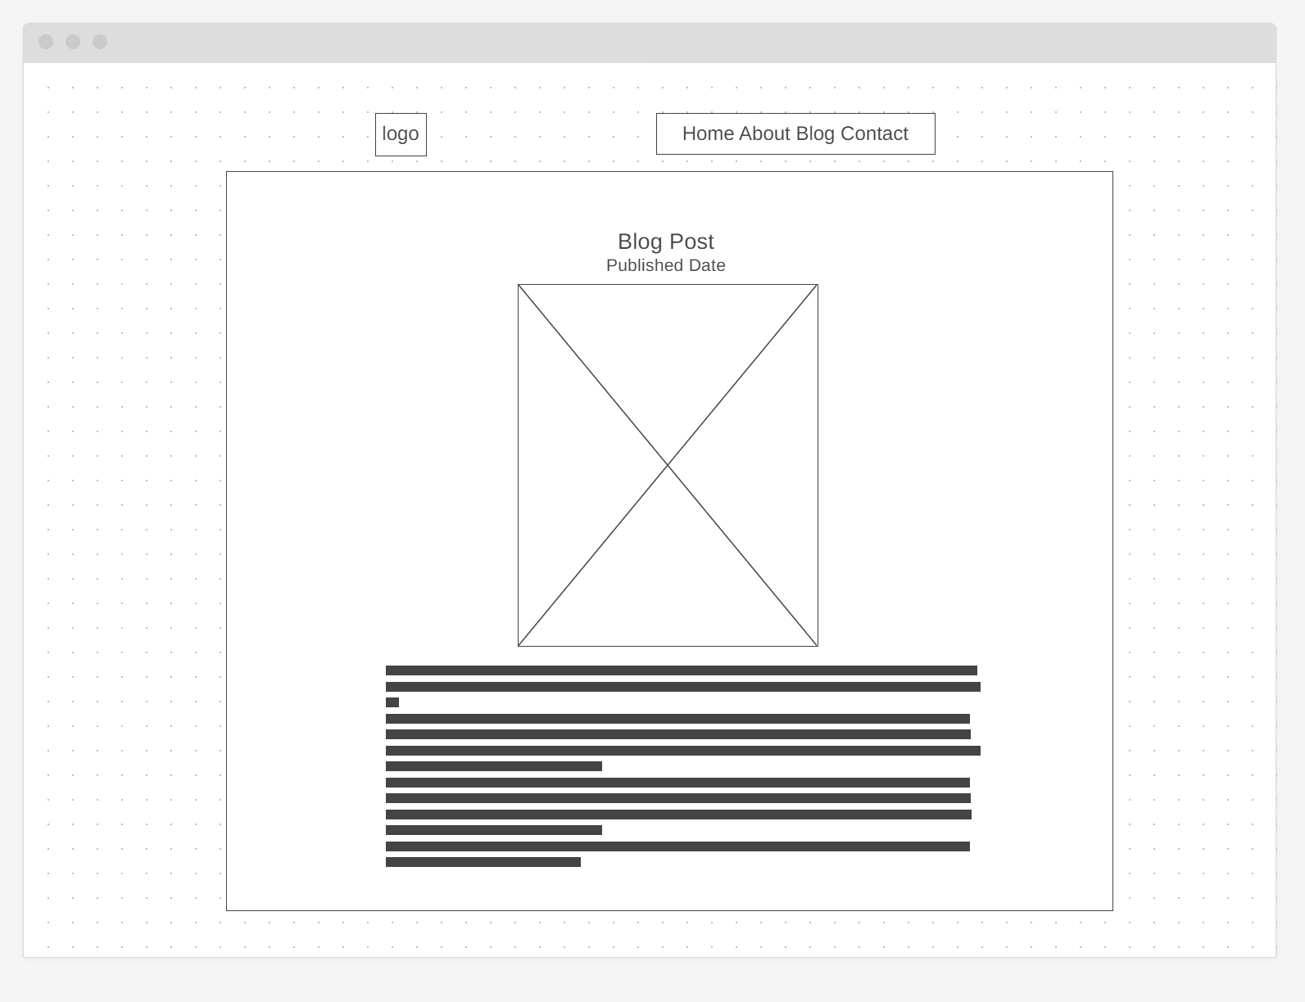
Wireframes

Slide 15
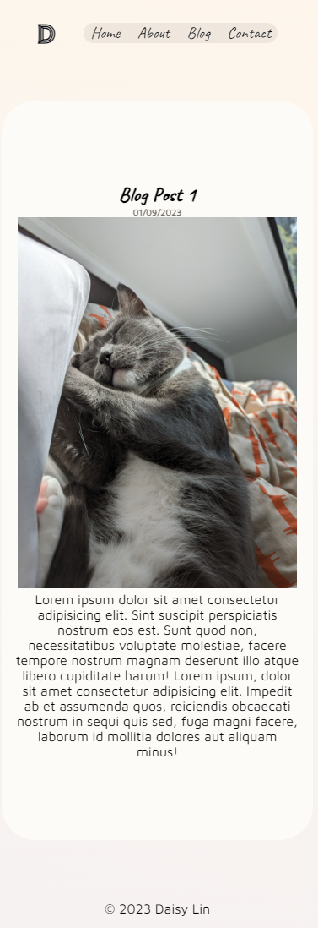
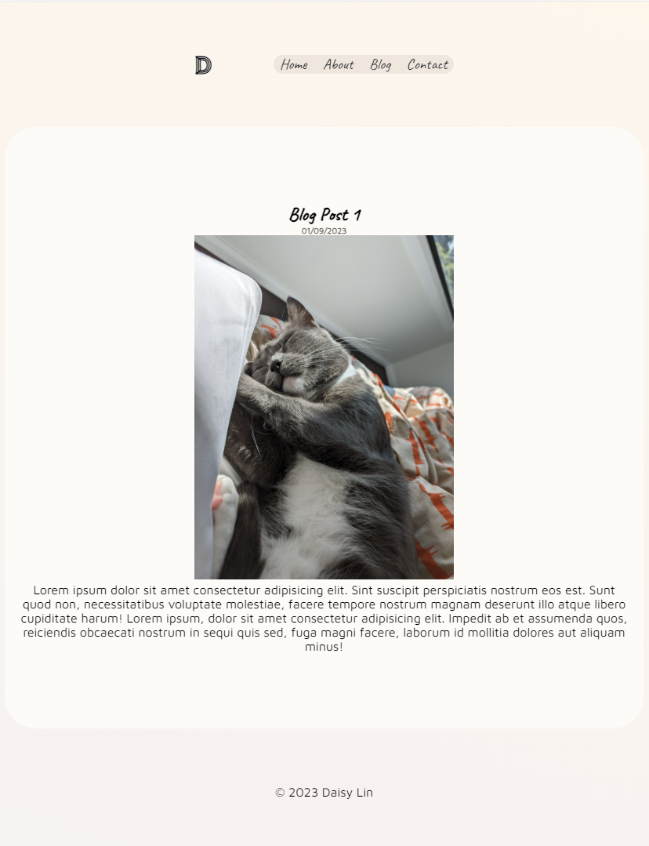
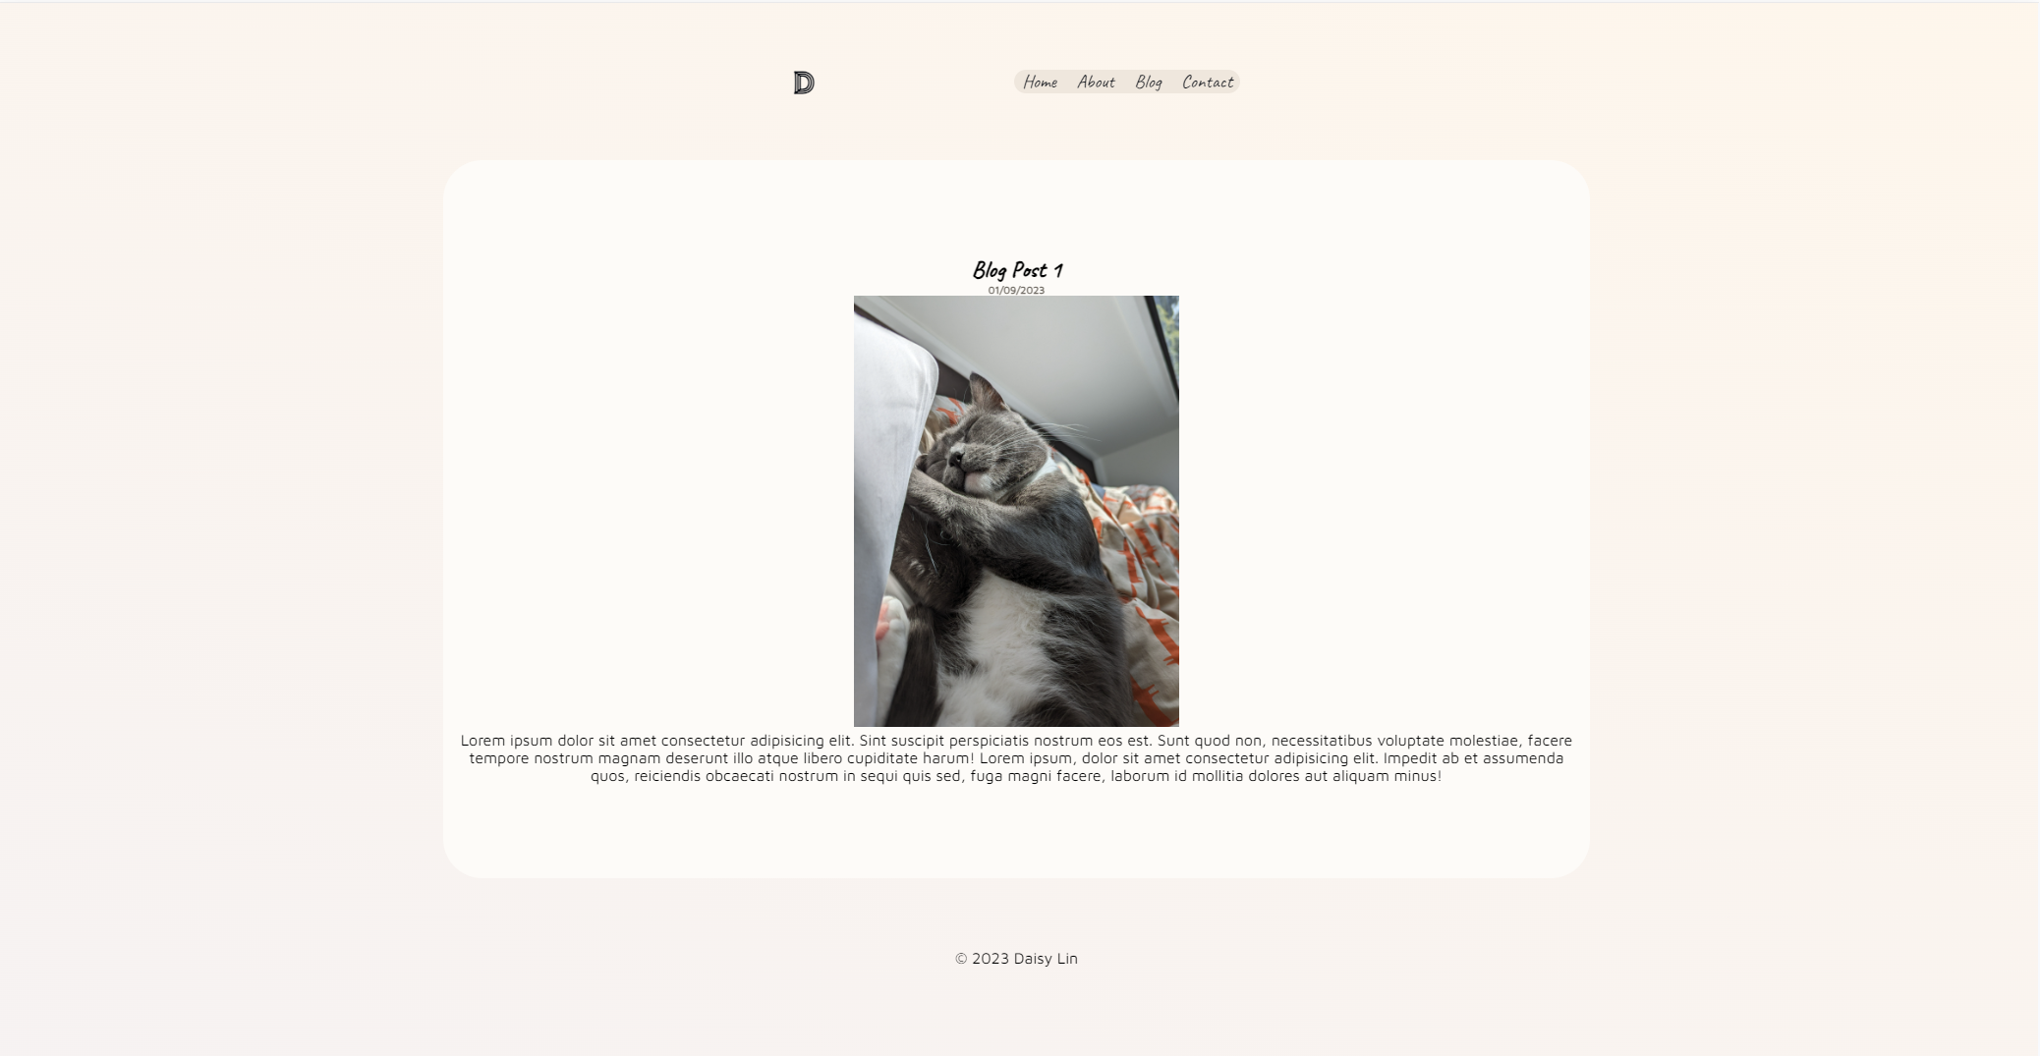
Screenshots

Slide 16
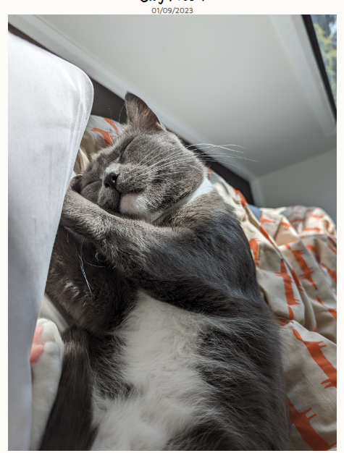
Components
- Date – Keeps track of my progress and life. Gives users a deeper understanding of when my thoughts/photos were uploaded and so they can chronologically connect.
- Blog Photo – This is to make my cat famous so he can start paying off his share of the mortgage.

Slide 17
Contact

Slide 18
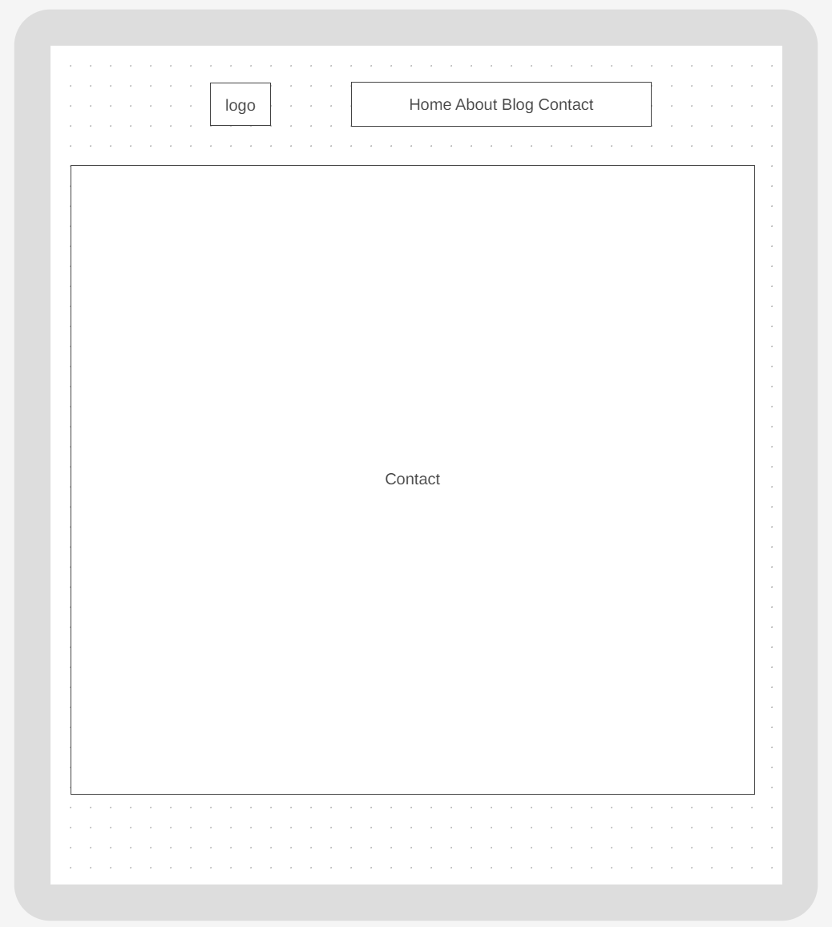
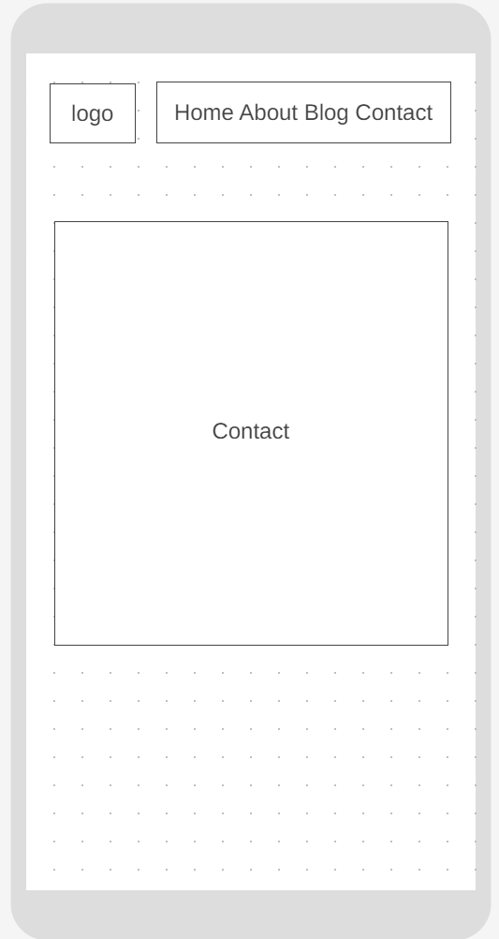
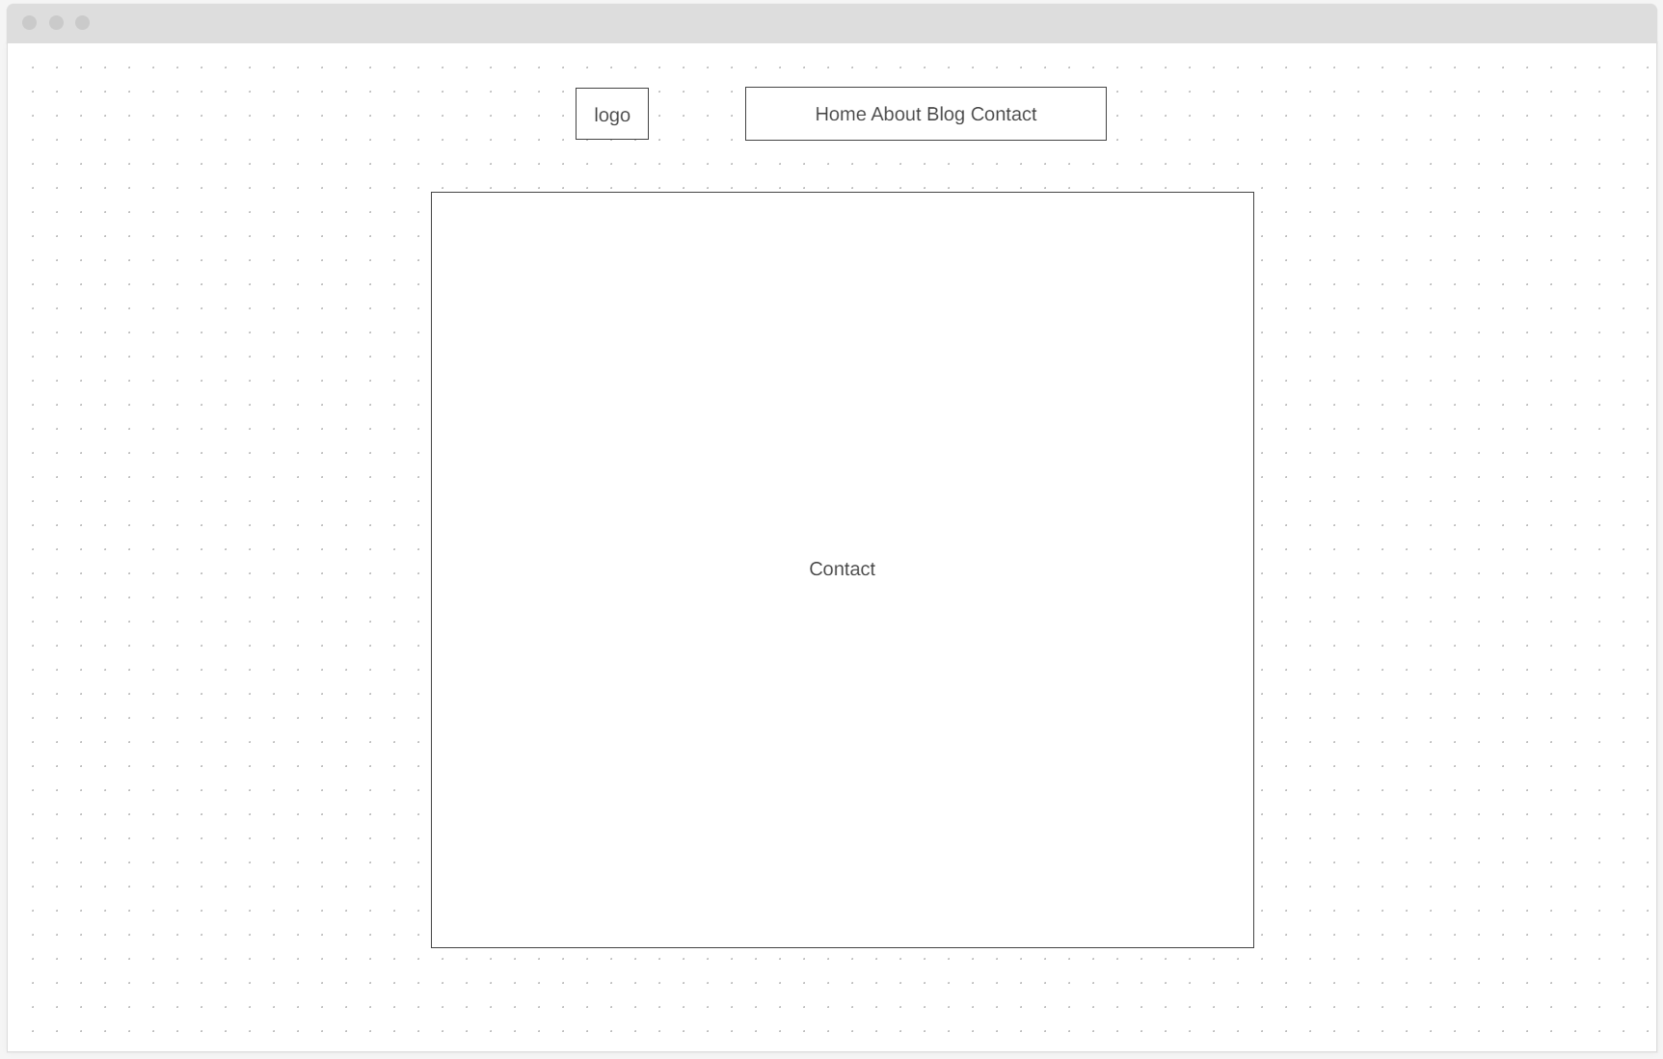
Wireframes

Slide 19
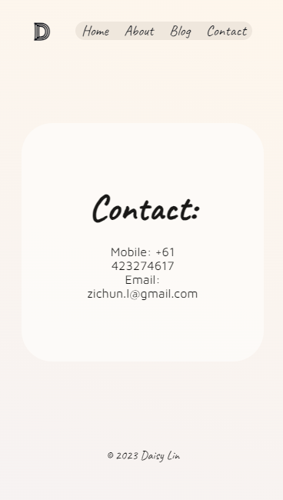
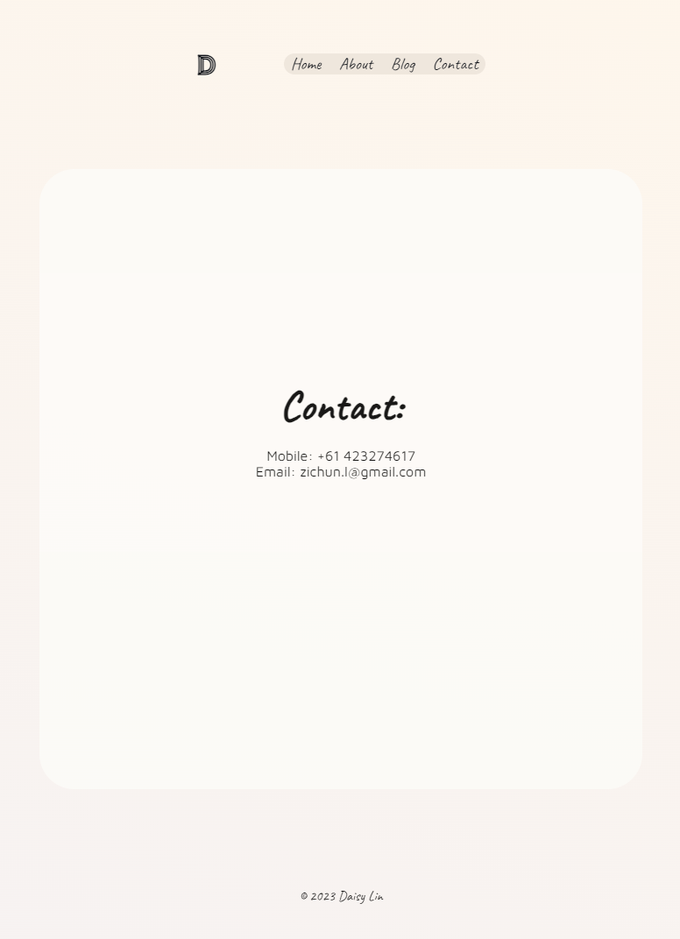
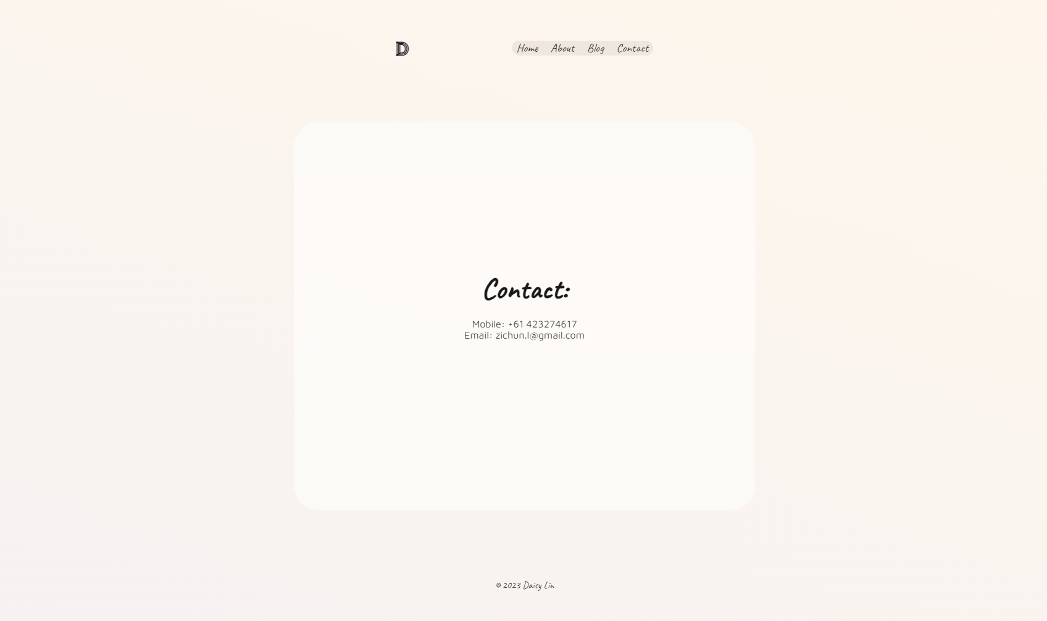
Screenshots

Slide 20

Components
- Contact Details – Users or potential employers or even scammers can easily contact me when required.

Slide 21
Final Thoughts

Slide 22
Reflections
First of all, I thoroughly enjoyed being able to build my own website. I feel accomplished as a budding software engineer now that I have completed this project. The fact I was able to explore my personality through this medium was thrilling and I know it allowed me to connect to myself in a greater way.
There were a few challenges along the way:
Nothing ended up looking how my wireframes suggested initially.
Time & project management are DIFFICULT.
Flexbox is the boss.
Inspect is a very powerful tool to understand webpages on a deeper level.
Deployment sounds more straightforward than it turned out to be. Error 404: Brain not found.
Documentation with English as a second language takes more time than I was expecting.
⚡ This was a fantastic assignment, although tough, it gave me a real sense of what being a web developer is going to be like. Documentation, documentation, and more documentation. ⚡

