Slide 1
T1A2: Portfolio
Daisy Lin

Slide 2
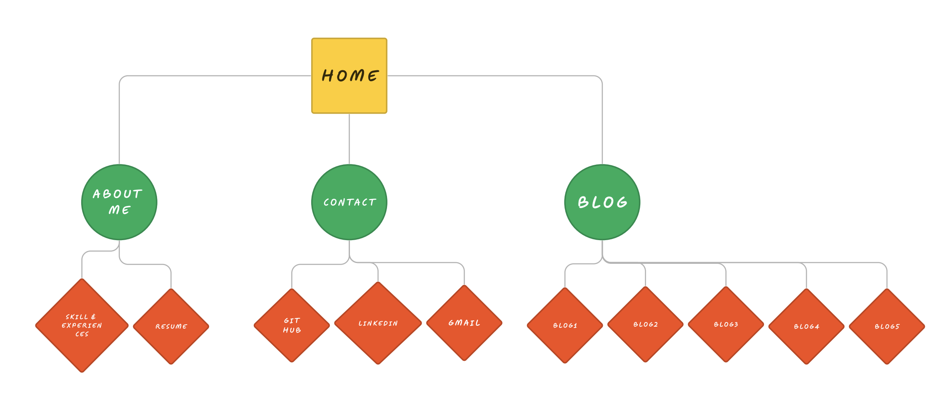
Sitemap

Slide 3
Homepage

Slide 4
Wireframes

Slide 5
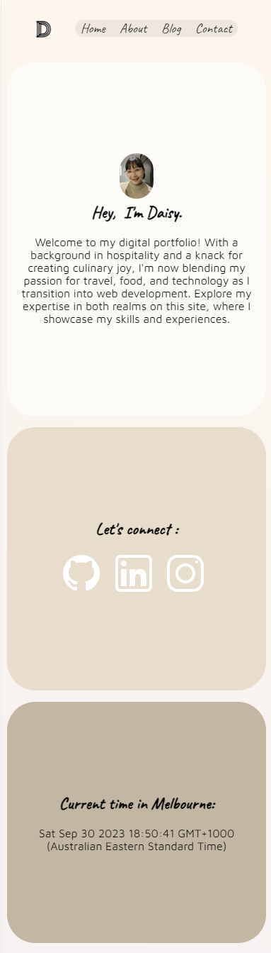
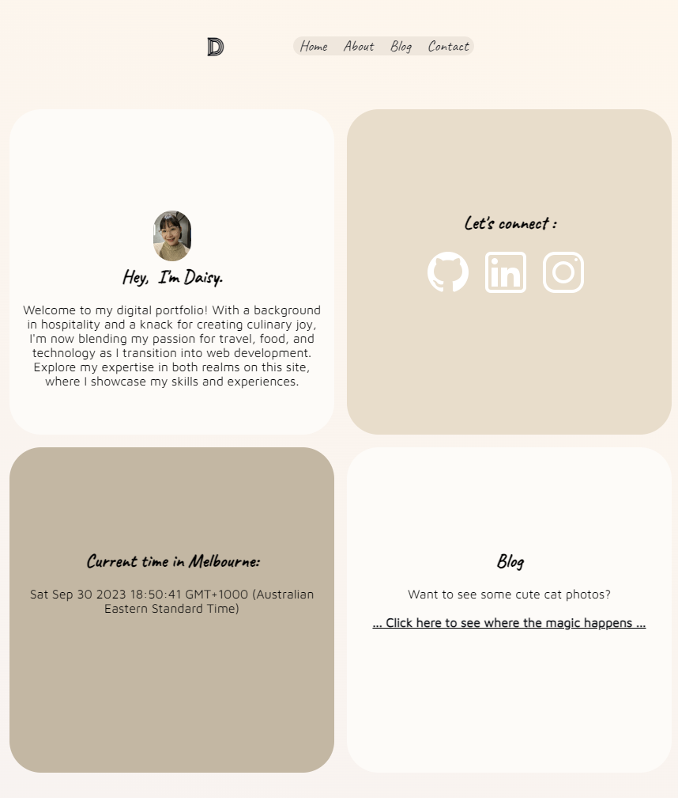
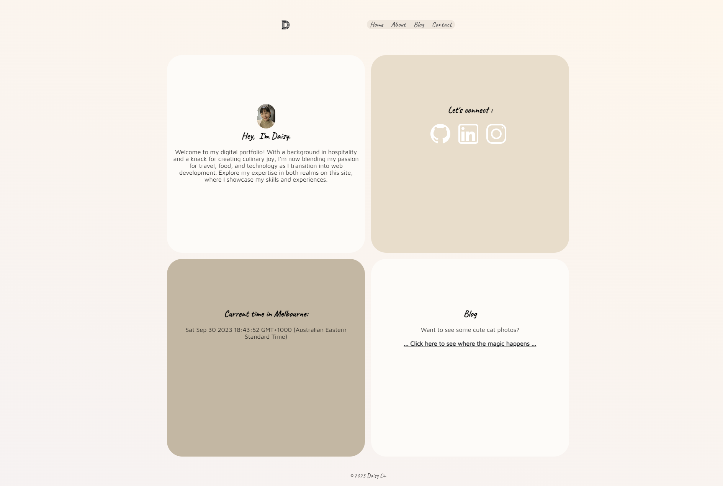
Screenshots

Slide 6
Components

Slide 7
About

Slide 8
Wireframes

Slide 9

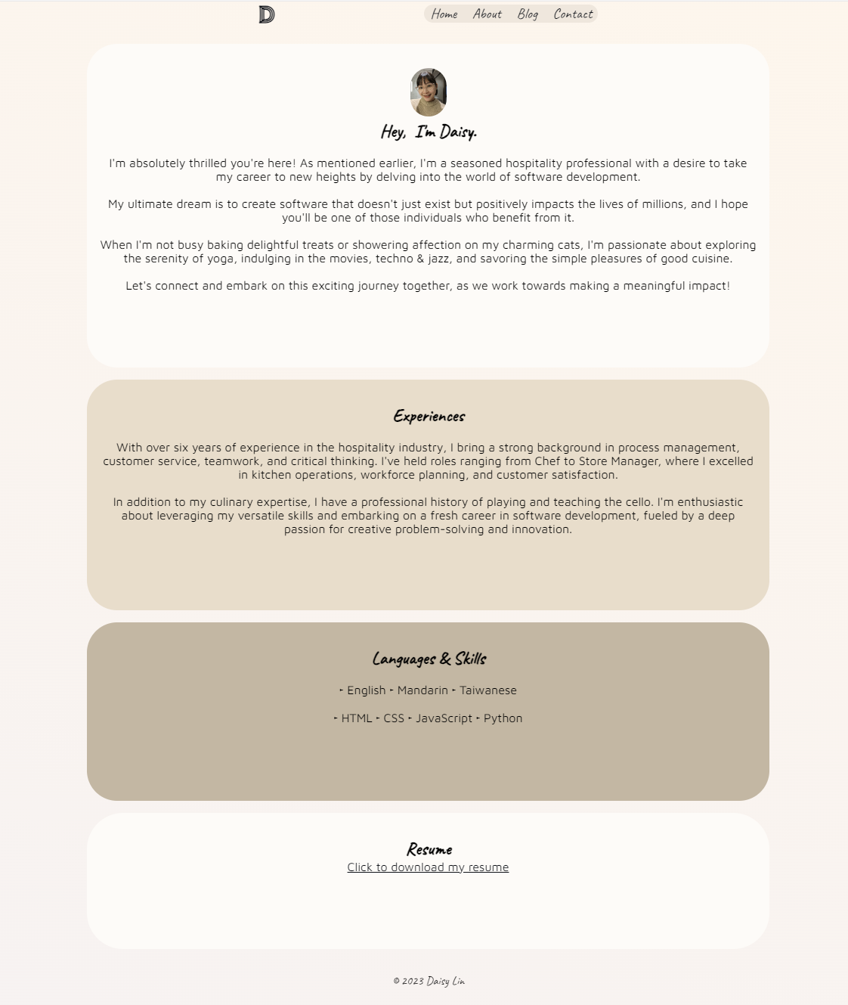
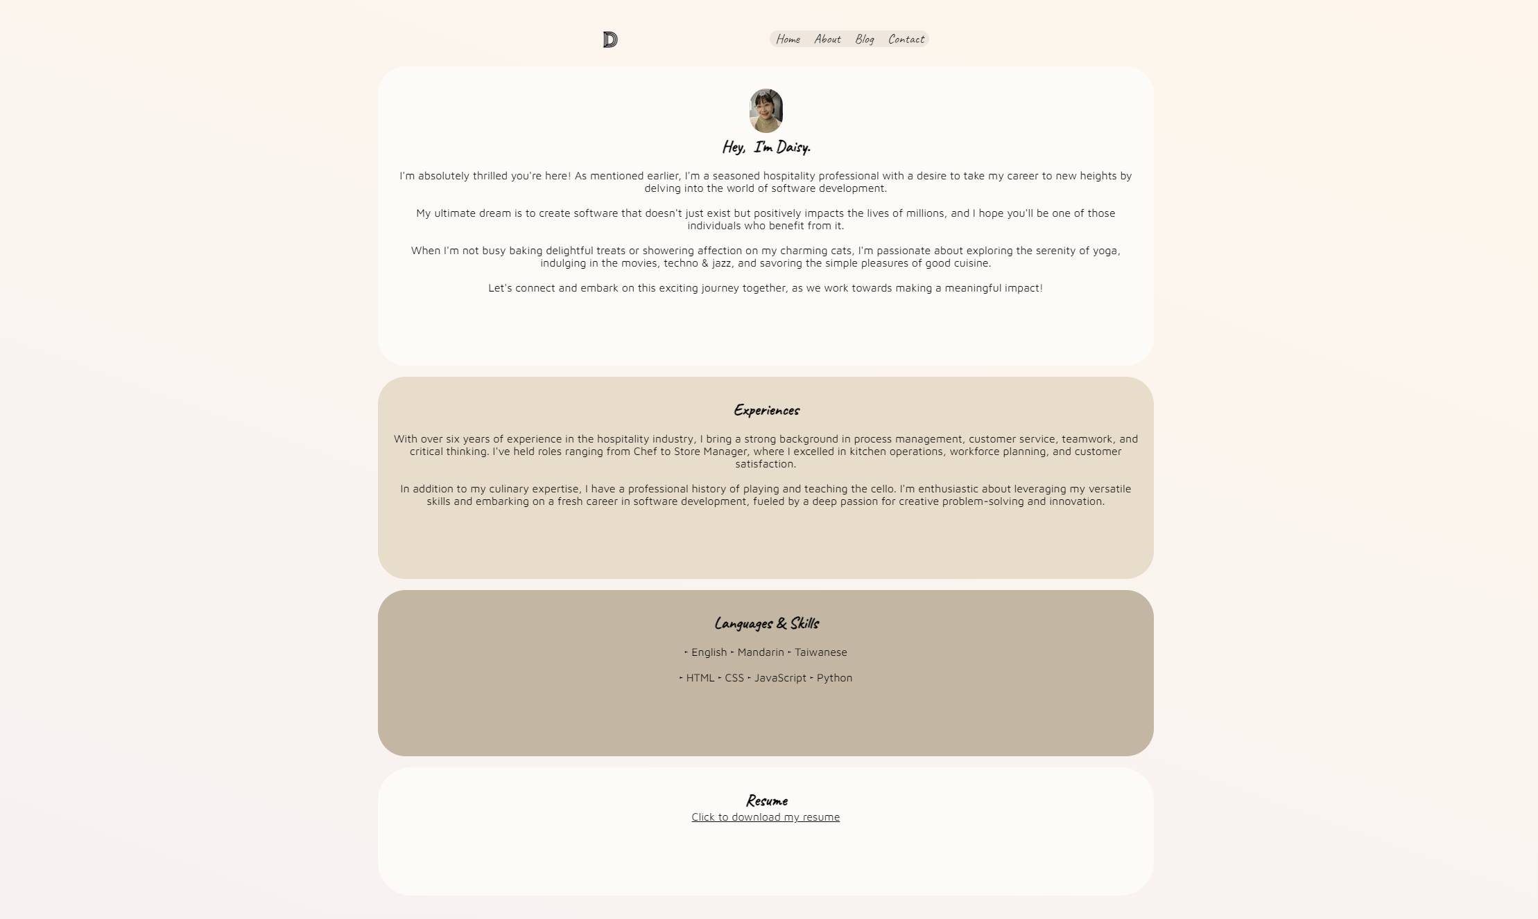
Screenshots

Slide 10
Components

Slide 11
Blog

Slide 12
Wireframes

Slide 13
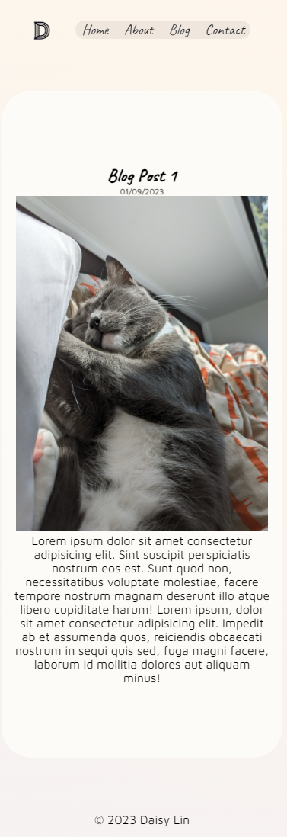
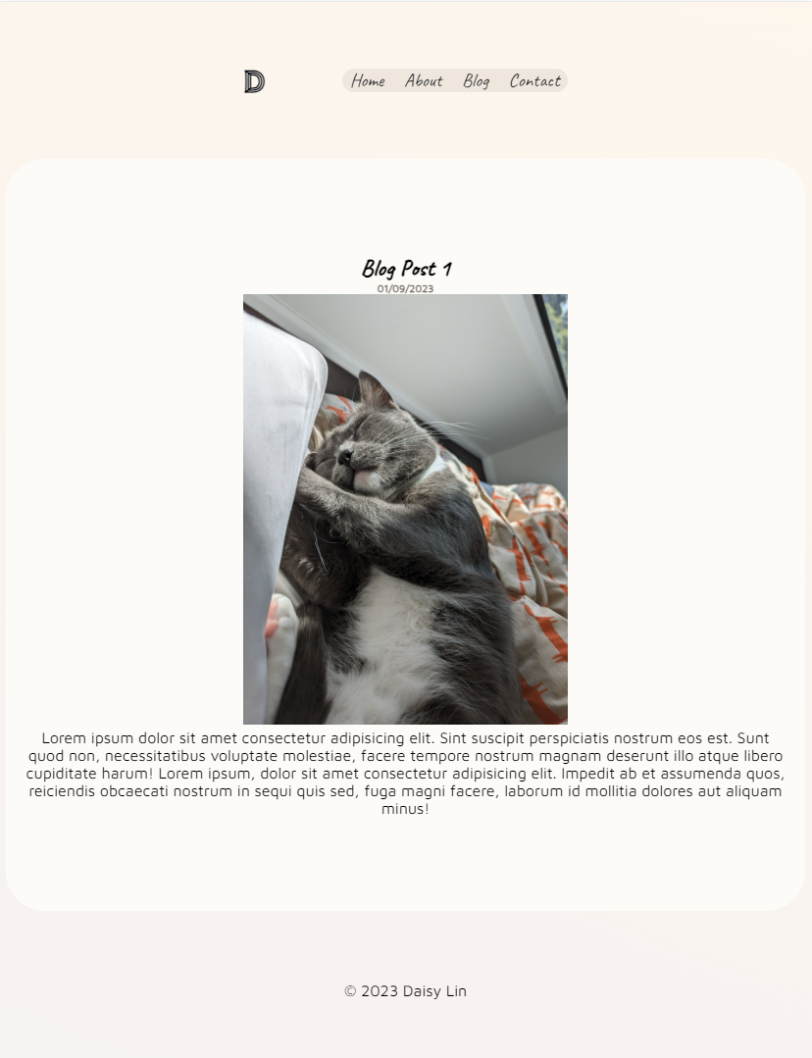
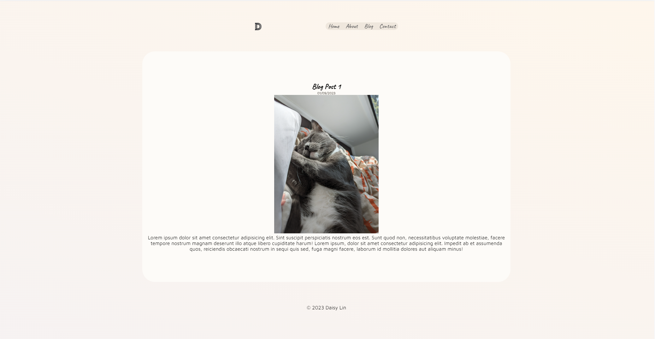
Screenshots

Slide 14
Components

Slide 15
Contact

Slide 16
Wireframes

Slide 17
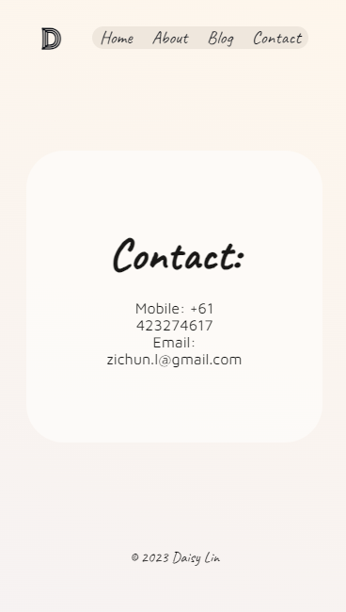
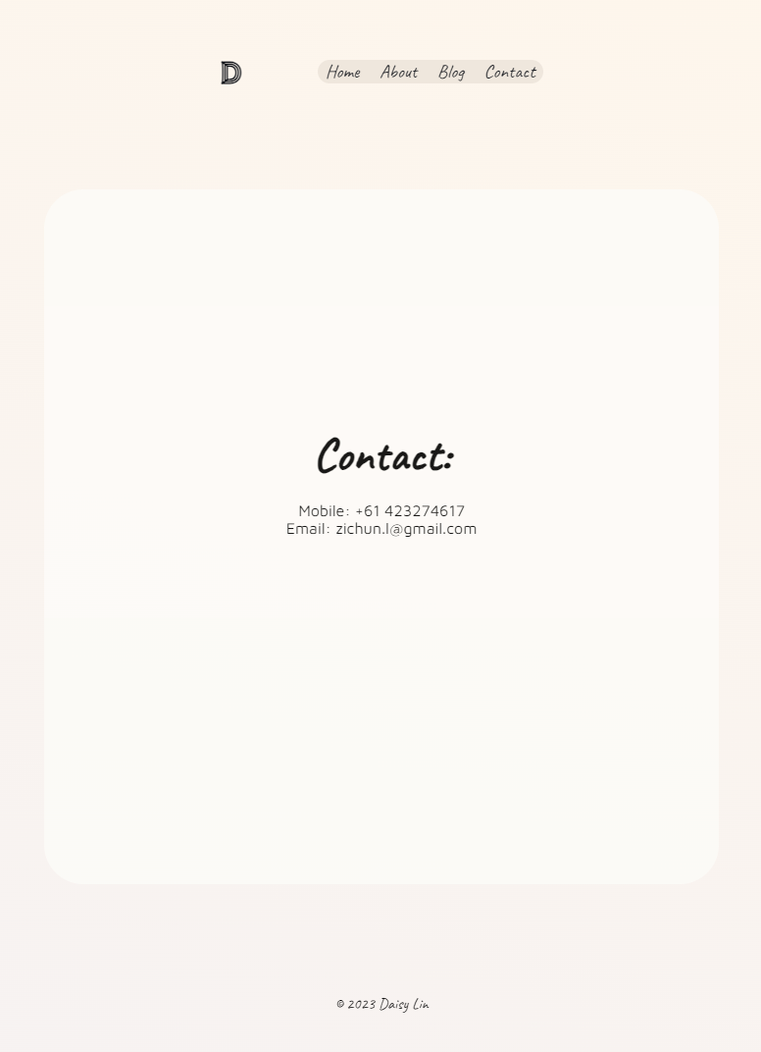
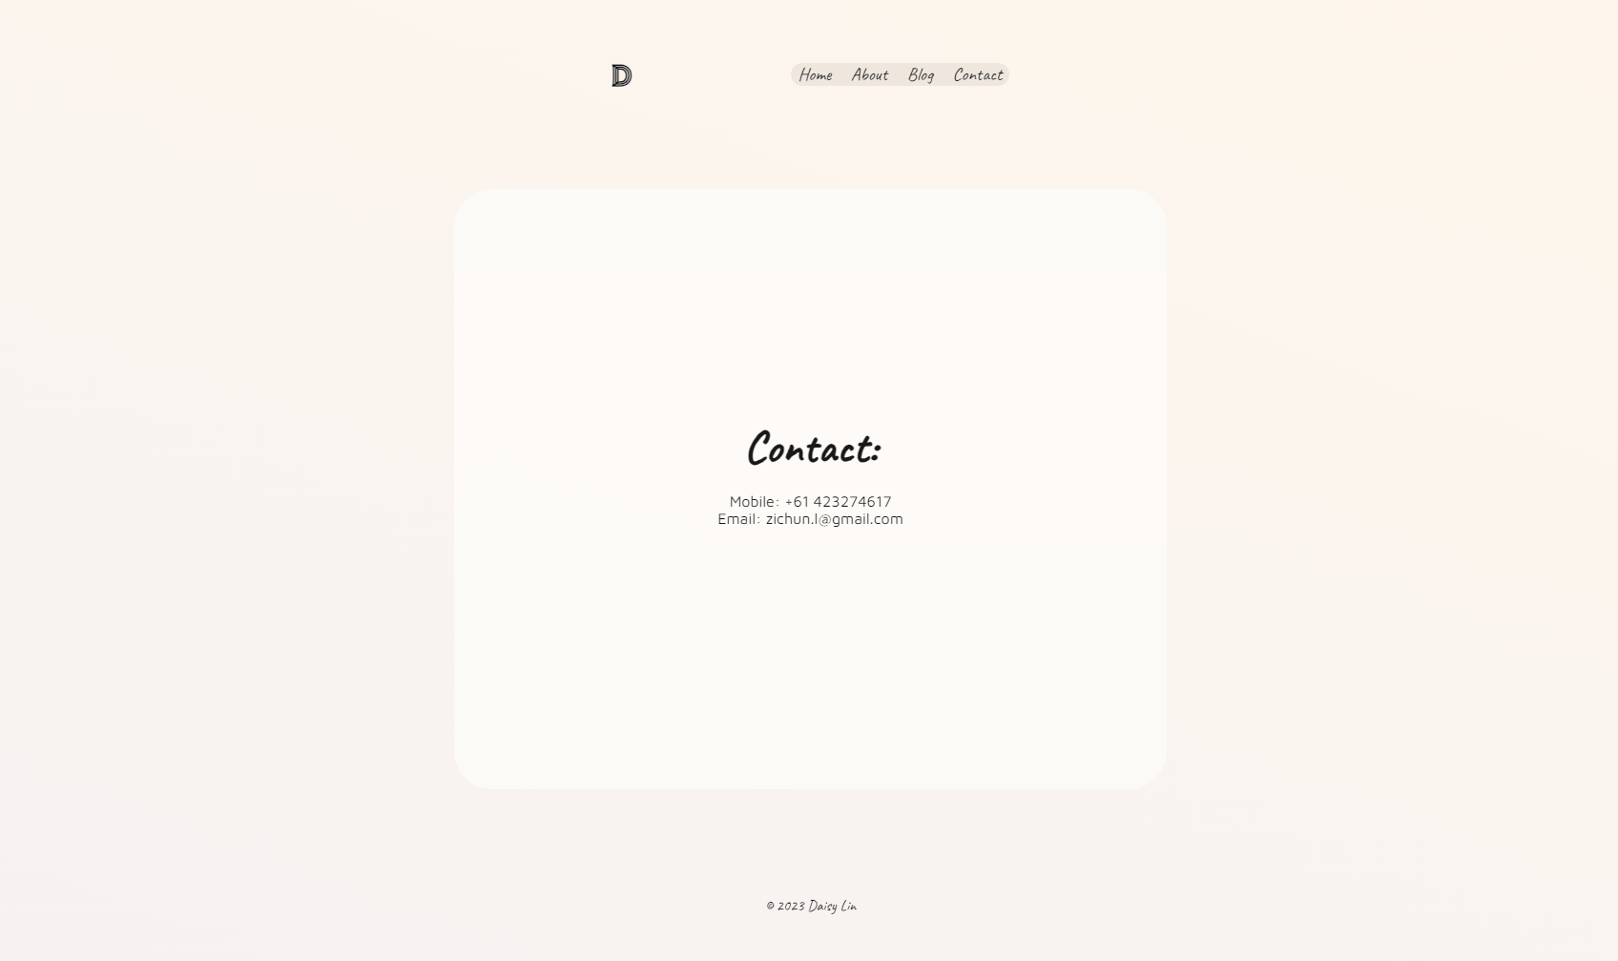
Screenshots

Slide 18
Components

Slide 19
Final Thoughts

Slide 20
Reflections

