Slide 1
3D Geometry for
Computer Graphics
Class 1

Slide 2
General
Office hour: Tuesday 11:00 – 12:00 in Schreiber 002 (contact in advance)
Webpage with the slides, homework: http://www.cs.tau.ac.il/~sorkine/courses/cg/cg2006/
E-mail: sorkine@tau.ac.il

Slide 3
The plan today
Basic linear algebra and
Analytical geometry

Slide 4

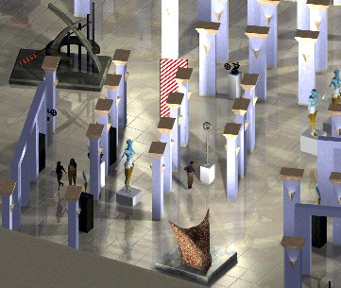
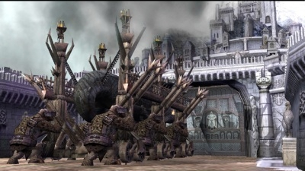
Why??

Slide 5

Manipulation of geometry and color…
Monsters, Inc

Slide 6
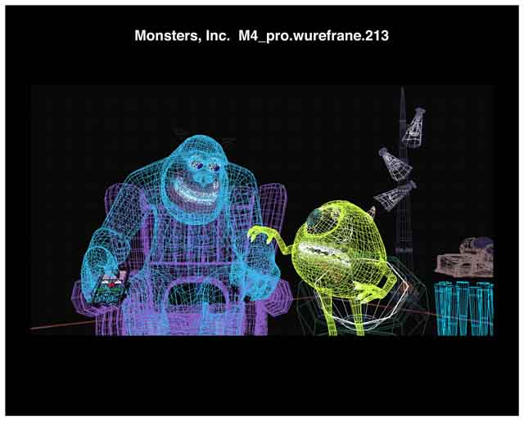
Manipulation of geometry and color…

Slide 7

Manipulation of geometry and color…

Slide 8
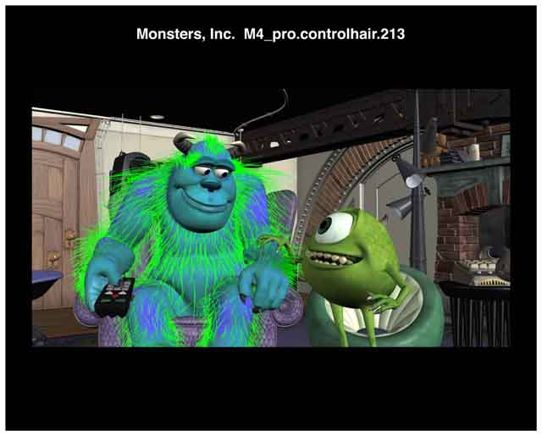
Manipulation of geometry and color…

Slide 9
Manipulation of geometry and color…

Slide 10
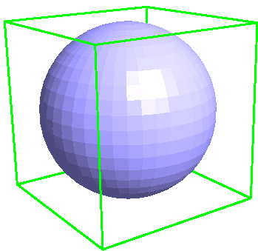
Why??
We represent objects using mainly linear primitives:
  points
  lines, segments
  planes, polygons
Need to know how to compute distances, transformations, projections…

Slide 11
How to approach geometric problems
We have two ways:
  Employ our geometric intuition
  Formalize everything and employ our algebra skills
Often we first do No.1 and then solve with No.2
For complex problems No.1 is not always easy…

Slide 12

Example: distance between 2 lines in 3D
Geometric problem: we have two lines (or segments) in 3D, need to find the distance between them

Slide 13
Example: distance between 2 lines in 3D
Geometric approach:
  If we look from the direction of one of the lines, that line reduces to a point
  So all we need is point-line distance in 2D (the projection plane)
  By projecting, we reduced the problem from 3D to 2D

Slide 14
Example: distance between 2 lines in 3D
Geometric approach:
  We can continue reducing the dimension!
  Project the red point and the blue line on the plane perpendicular to the blue line
  Now we get point-point distance

Slide 15
Example: distance between 2 lines in 3D
But how do we get the actual number?
  Need to represent the lines mathematically
    OK…
  Write down the projection formulae
    Have to wipe the dust off our algebra…
  Compute the point-point distance
    Easy

Slide 16
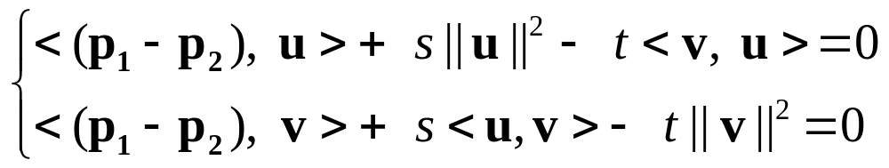
Example: distance between 2 lines in 3D
Alternative:
  (Almost) skip the geometric intuition step…
  Represent the lines mathematically
  We know that the distance is achieved at a segment that is perpendicular to both lines
  Write down the equation for that segment and solve

Slide 17
Conclusion so far:
With or without geometric intuition and good 3D orientation, in any case we need to
review our algebra…

Slide 18
Basic definitions
Points specify location in space (or in the plane).
Vectors have magnitude and direction (like velocity).
Points ≠ Vectors

Slide 19
Point + vector = point

Slide 20
vector + vector = vector
Parallelogram rule

Slide 21
point - point = vector
B – A
B
A
A – B
B
A

Slide 22
point + point: not defined!!

Slide 23
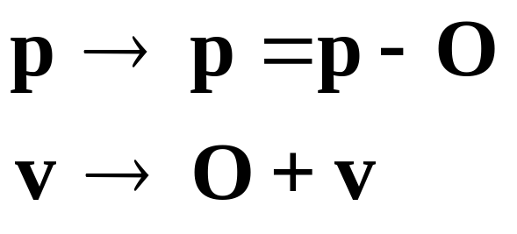
Map points to vectors
If we have a coordinate system with
origin at point O
We can define correspondence between points and vectors:
p
O

Slide 24
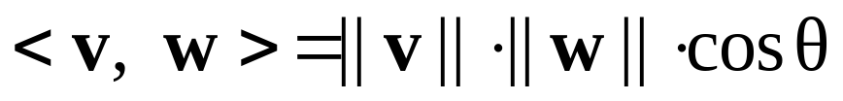
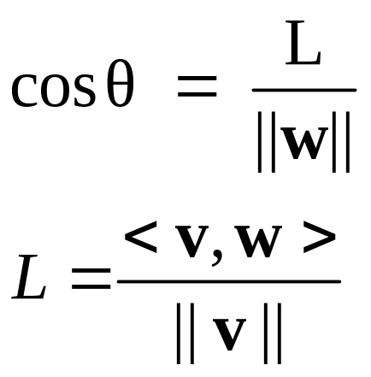
Inner (dot) product
Defined for vectors:
w
θ
v
L
Projection of w onto v

Slide 25
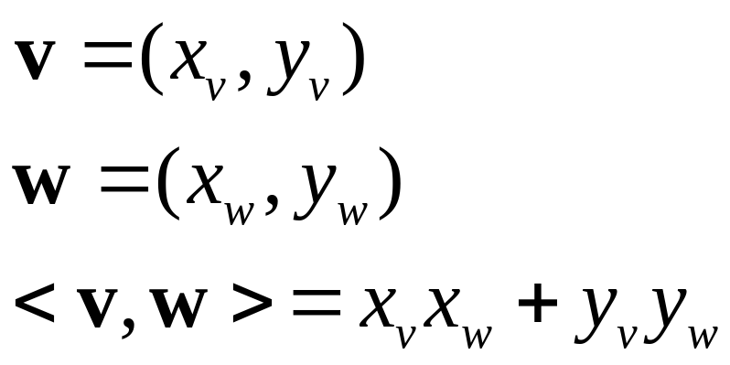
Dot product in coordinates (2D)
y
y_{w}
w
y_{v}
v
x_{w}
x_{v}
x
O

Slide 26
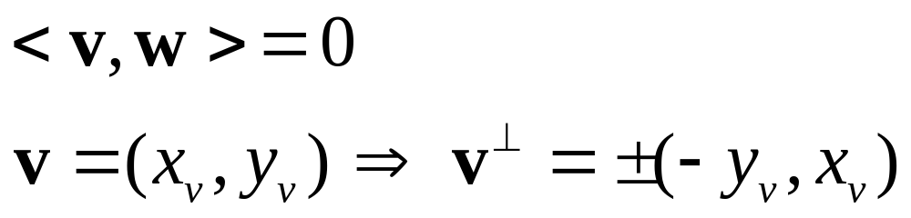
Perpendicular vectors
In 2D only:
v⊥
v

Slide 27
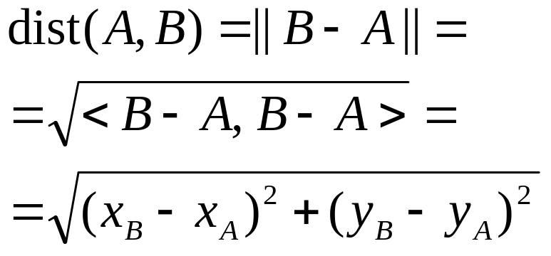
Distance between two points
y
A
y_{A}
y_{B}
B
x_{A}
x_{B}
x
O

Slide 28
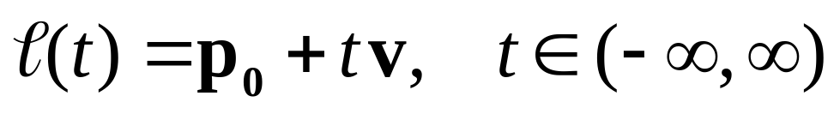
Parametric equation of a line
v
t > 0
p₀
t < 0
t = 0

Slide 29
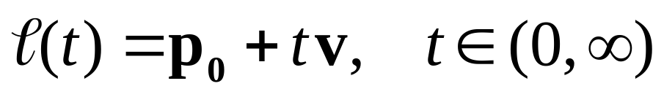
Parametric equation of a ray
v
t > 0
p₀
t = 0

Slide 30
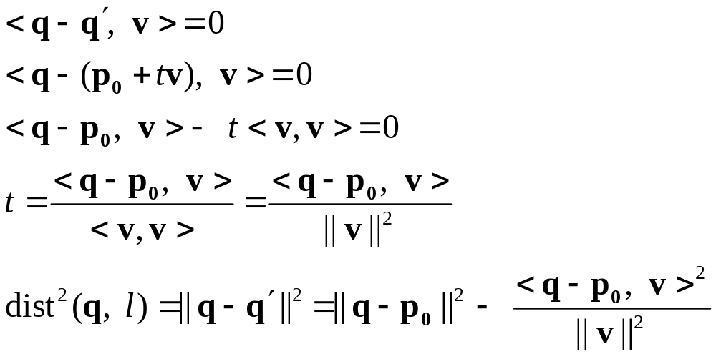
Distance between point and line
q
Find a point q’ such that (q − q’)⊥v
dist(q, l) = || q − q’ ||
l
v
q’ = p₀ +tv
p₀

Slide 31
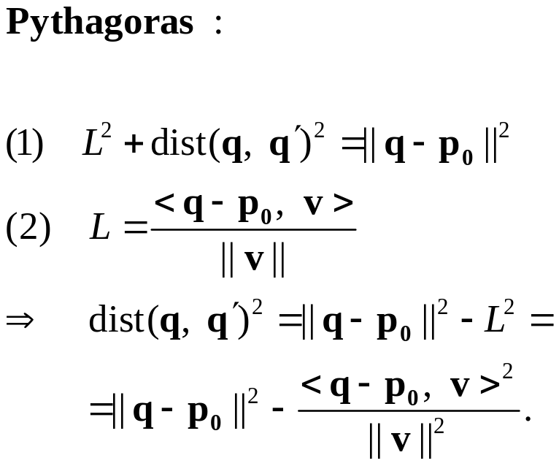
Easy geometric interpretation
q
l
v
q’
p₀
L

Slide 32
Distance between point and line – also works in 3D!
The parametric representation of the line is coordinates-independent
v and p₀ and the checked point q can be in 2D or in 3D or in any dimension…

Slide 33
Implicit equation of a line in 2D
y
Ax+By+C > 0
Ax+By+C = 0
Ax+By+C < 0
x

Slide 34
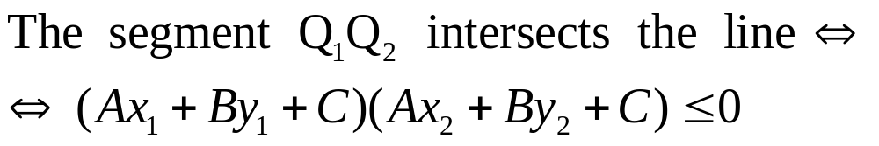
Line-segment intersection
Q₁ (x₁, y₁)
y
Ax+By+C > 0
Q₂ (x₂, y₂)
Ax+By+C < 0
x

Slide 35
Representation of a plane in 3D space
A plane π is defined by a normal n and one point in the plane p₀.
A point q belongs to the plane ⇔ < q – p₀ , n > = 0
The normal n is perpendicular to all vectors in the plane
n
q
p₀
π

Slide 36
Distance between point and plane
Project the point onto the plane in the direction of the normal:
dist(q, π) = ||q’ – q||
n
q
q’
p₀
π

Slide 37
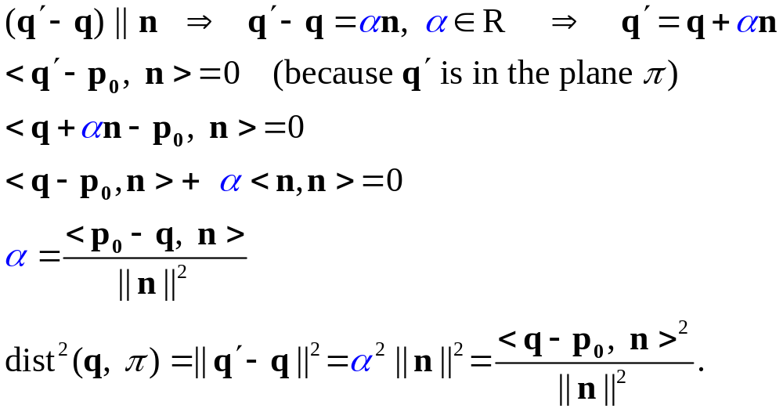
Distance between point and plane
n
q
q’
p₀
π

Slide 38
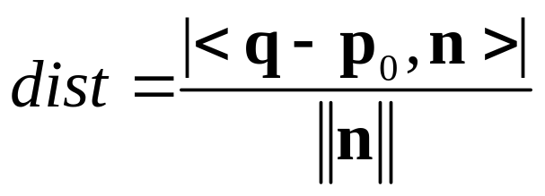
Distance between point and plane
Geometric way:
  Project (q - p₀) onto n!
n
q
p₀
π

Slide 39
Implicit representation of planes in 3D
(x, y, z) are coordinates of a point on the plane
(A, B, C) are the coordinates of a normal vector to the plane
Ax+By+Cz+D > 0
Ax+By+Cz+D = 0
Ax+By+Cz+D < 0

Slide 40
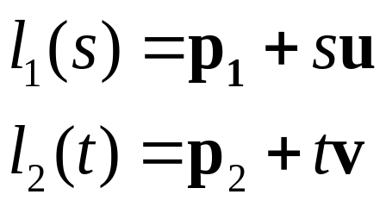
Distance between two lines in 3D
l₁
q₁
p₁
u
d
p₂
v
l₂
q₂
The distance is attained between two points q₁ and q₂
so that (q₁ – q₂) ⊥ u and (q₁ – q₂) ⊥ v

Slide 41
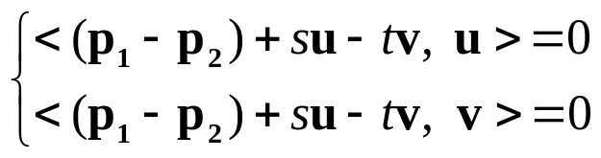
Distance between two lines in 3D
l₁
q₁
p₁
u
d
p₂
v
l₂
q₂

Slide 42
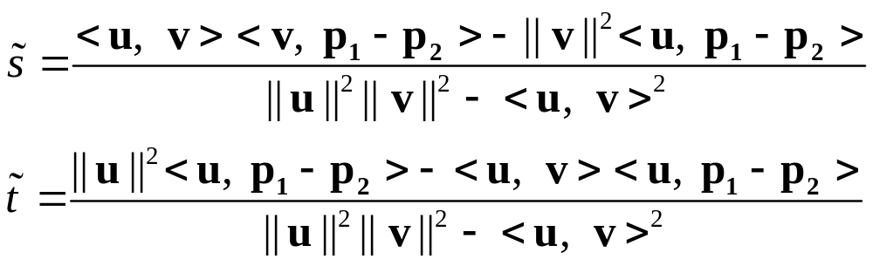
Distance between two lines in 3D
l₁
q₁
p₁
u
d
p₂
v
l₂
q₂

Slide 43
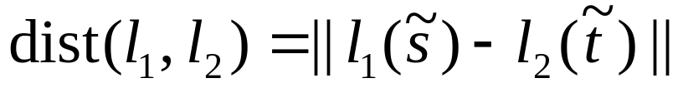
Distance between two lines in 3D
l₁
q₁
p₁
u
d
p₂
v
l₂
q₂

Slide 44
Distance between two lines in 3D
Exercise (תרגיל רשות):
  Develop the distance formula using the geometric intuition we talked about in the beginning of the class
  Compare to the formula we’ve just developed analytically

Slide 45
See you next time!

Slide 46
Barycentric coordinates (2D)
Define a point’s position relatively to some fixed points.
P = αA + βB + γC, where A, B, C are not on one line, and α, β, γ ∈ R.
(α, β, γ) are called Barycentric coordinates of P with respect to A, B, C (unique!)
If P is inside the triangle, then α+β+γ=1, α, β, γ > 0
C
P
A
B

Slide 47
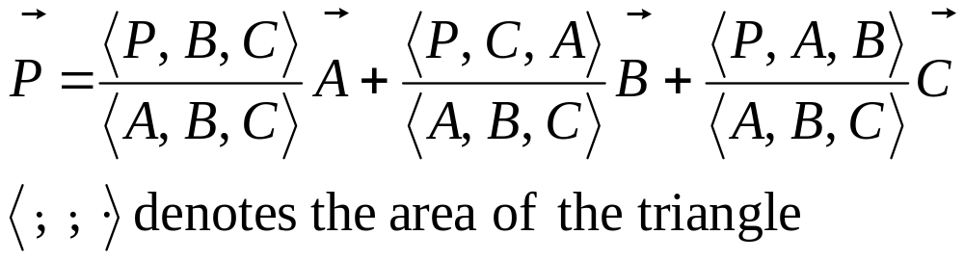
Barycentric coordinates (2D)
C
P
A
B

Slide 48

Example of usage: warping

Slide 49



Example of usage: warping
C
Tagret
B
A
We take the barycentric coordinates α, β, γ
of P’ with respect to A’, B’, C’.
Color(P) = Color(α A + β B + γ C)

