Slide 1
Experimental Convolution Engine
Arrow European FPGA Developer Contest 2020
Using CYC1000 board
https://github.com/tirfil/Experimental-Convolution-Engine
Philippe THIRION
Philippe.Thirion@laposte.net

Slide 2
Project Highlights
The focus is the convolution engine :
only FPGA internal memories are used.
Only 3 x 3 kernel size is used.
For a m x n image , the result is a (m-2) x (n-2) image.
Operations use half precision floating point format (IEEE 754-2008)(float16) https://en.wikipedia.org/wiki/Half-precision_floating-point_format
Three computation units work in parallel to improve efficiency .
SPI interface enables accesses to internal memories.

Slide 3
General Introduction
Introduction
2D-convolution is used in image processing (form or contour detection) and in Deep Learning with convolutional neural network (CNN).
Principles
2D-convolution is an operation between an image (as a set of pixel) and a kernel. The kernel is a small 2-D matrix. Operation consists of a number of multiplications and additions. The kernel contains coefficients (weights).
Next slides explains the behavior using a 3 x 3 kernel.
For more understanding refer to https://towardsdatascience.com/intuitively-understanding-convolutions-for-deep-learning-1f6f42faee1 ( short animation)

Slide 4
3 x 3 window in an image
Im(x-1,y-1) | Im(x-1,y) | Im(x-1,y+1) | Im(x-1,y+2) | Im(x-1,y+3)
Im(x,y-1) | Im(x,y) | Im(x,y+1) | Im(x,y+2) | Im(x,y+3)
Im(x+1,y-1) | Im(x+1,y) | Im(x+1,y+1) | Im(x+1,y+2) | Im(x+1,y+3)
Im(x+2,y-1) | Im(x+2,y) | Im(x+2,y+1) | Im(x+2,y+2) | Im(x+2,y+3)
Im(x+3,y-1) | Im(x+3,y) | Im(x+3,y+1) | Im(x+3,y+2) | Im(x+3,y+3)

Slide 5
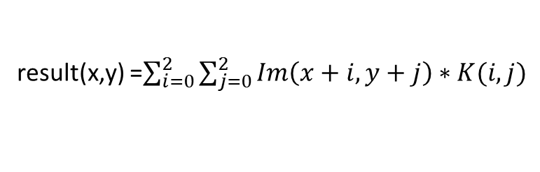

A Single Convolution Computation
Im(x-1,y-1) | Im(x-1,y) | Im(x-1,y+1) | Im(x-1,y+2) | Im(x-1,y+3)
Im(x,y-1) | Im(x,y) * K(0,0) | Im(x,y+1) * K(0,1) | Im(x,y+2) * K(0,2) | Im(x,y+3)
Im(x+1,y-1) | Im(x+1,y) * K(1,0) | Im(x+1,y+1) * K(1,1) | Im(x+1,y+2) * K(1,2) | Im(x+1,y+3)
Im(x+2,y-1) | Im(x+2,y) * K(2,0) | Im(x+2,y+1) * K(2,1) | Im(x+2,y+2) * K(2,2) | Im(x+2,y+3)
Im(x+3,y-1) | Im(x+3,y) | Im(x+3,y+1) | Im(x+3,y+2) | Im(x+3,y+3)
result(x,y) =$\sum_{i=0}^{2}{\sum_{j=0}^{2}{Im\left(x+i,y+j\right)∗K(i,j)}}$

Slide 6
Parallelism : Three Computation Units
Im(x-1,y) | Im(x-1,y+1) | Im(x-1,y+2) | Im(x-1,y+3) | Im(x-1,y+4) | Im(x-1,y+5)
Im(x,y) | Im(x,y+1) | Im(x,y+2) | Im(x,y+3) | Im(x,y+4) | Im(x,y+5)
Im(x+1,y) | Im(x+1,y+1) | Im(x+1,y+2) | Im(x+1,y+3) | Im(x+1,y+4) | Im(x+1,y+5)
Im(x+2,y) | Im(x+2,y+1) | Im(x+2,y+2) | Im(x+2,y+3) | Im(x+2,y+4) | Im(x+2,y+5)
Im(x+3,y) | Im(x+3,y+1) | Im(x+3,y+2) | Im(x+3,y+3) | Im(x+3,y+4) | Im(x+3,y+5)
result(x,y)
result(x,y+1)
result(x,y+2)

Slide 7
Use parallelism : Three Computation Units
Kernel is “moving” from left to right (column by column).
At the same time, each computation unit works with the same image pixels: Im(x,y),Im(x+1,y),Im(x+2,y) but the kernel coefficients are different.
Each computation unit works independently and uses its own multipliers (2x) and adders (3x).
An operation on a kernel needs 9 multiplications and 8 addictions.
This operations lasts 44 clock cycles !
Pipelining is necessary : For a computation unit, the next kernel operations start while the previous ones have not yet been completed !

Slide 8
Computation Unit Timing Sequence
 | 8 clock cycles | 8 clock cycles | 8 clock cycles | 8 clock cycles | 8 clock cycles
Computation Unit 1 | K(0,0)*Im(x,y) + K(1,0)*Im(x+1,y) + K(2,0)*Im(x+2,y) | K(0,1)*Im(x,y+1) + K(1,1)*Im(x+1,y+1) + K(2,1)*Im(x+2,y+1) | K(0,2)*Im(x,y+2) + K(1,2)*Im(x+1,y+2) + K(2,2)*Im(x+2,y+2) | K(0,0)*Im(x,y+3) + K(1,0)*Im(x+1,y+3) + K(2,0)*Im(x+2,y+3) | K(0,1)*Im(x,y+4) + K(1,1)*Im(x+1,y+4) + K(2,1)*Im(x+2,y+4)
Computation Unit 2 | K(0,2)*Im(x,y) + K(1,2)*Im(x+1,y) + K(2,2)*Im(x+2,y) | K(0,0)*Im(x,y+1) + K(1,0)*Im(x+1,y+1) + K(2,0)*Im(x+2,y+1) | K(0,1)*Im(x,y+2) + K(1,1)*Im(x+1,y+2) + K(2,1)*Im(x+2,y+2) | K(0,2)*Im(x,y+3) + K(1,2)*Im(x+1,y+3) + K(2,2)*Im(x+2,y+3) | K(0,0)*Im(x,y+4) + K(1,0)*Im(x+1,y+4) + K(2,0)*Im(x+2,y+4)
Computation Unit 3 | K(0,1)*Im(x,y) + K(1,1)*Im(x+1,y) + K(2,1)*Im(x+2,y) | K(0,2)*Im(x,y+1) + K(1,2)*Im(x+1,y+1) + K(2,2)*Im(x+2,y+1) | K(0,0)*Im(x,y+2) + K(1,0)*Im(x+1,y+2) + K(2,0)*Im(x+2,y+2) | K(0,1)*Im(x,y+3) + K(1,1)*Im(x+1,y+3) + K(2,1)*Im(x+2,y+3) | K(0,2)*Im(x,y+4) + K(1,2)*Im(x+1,y+4) + K(2,2)*Im(x+2,y+4)
At the same time, each computation unit works with the same image pixels (but different kernel coefficients …)

Slide 9
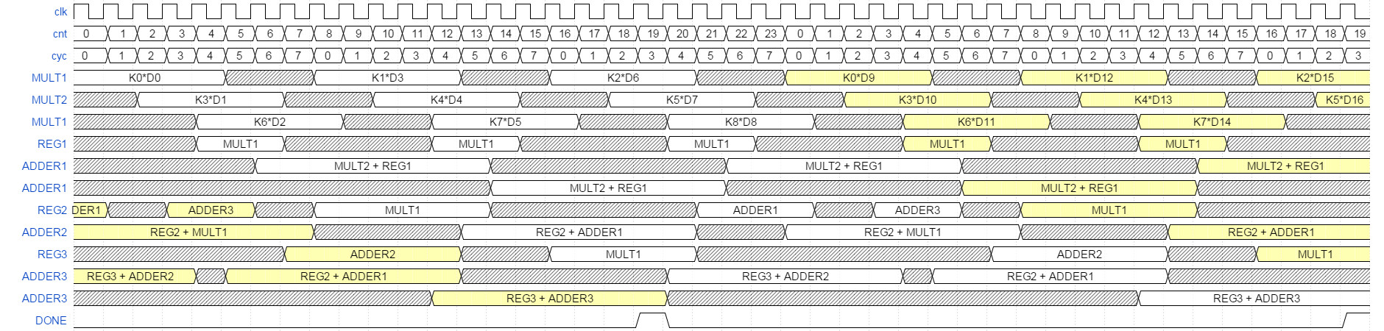
Computation Unit Pipeline Details
Two multipliers : MULT1 and MULT2
Three adders : ADDER1 , ADDER2 and ADDER3
Three 16 bit registers : REG1, REG2 and REG3 to store temporary results
White = current kernel operations ; Yellow = previous and next kernel operations

Slide 10
FPGA block diagram
SPI interface (spimicro.vhd)
Internal memories
Convolution Engine (vcore.vhd)
Kernel RAM (dp16x16.vhd)
Timing + input control (kernel + input RAM) (controller.vhd)
Computation core
Kernel data shift (delay3.vhd)
Kernel data shift (delay3.vhd)
SPI commands decoding (micro.vhd)
Input RAM
(dp16384x16.vhd)
Computation Unit 1 (kernel.vhd)
Computation Unit 2 (kernel.vhd)
Computation Unit 3 (kernel.vhd)
Datapath (kernel9.vhd)
Datapath (kernel9.vhd)
Datapath (kernel9.vhd)
Output RAM
(dp16384x16.vhd)
Multipliers
(fp16mult.vhd x 2)
Multipliers
(fp16mult.vhd x 2)
Multipliers
(fp16mult.vhd x 2)
Output control (output.vhd)
SPI slave module (spislave.vhd)
Adders
(fp16adder.vhd x 3)
Adders
(fp16adder.vhd x 3)
Adders
(fp16adder.vhd x 3)

Slide 11
FPGA implementation
Two main modules: Convolution Engine and SPI interface.
Almost all FPGA internal memories are used (see annex).
Input memory is sequentially read ( same column/three consecutive rows and after next column/three consecutive rows )
Input memory read every two cycles enable to save one multiplier by computation unit.
The delay3 modules enable to shift kernel data between different computation unit (computation unit 1 -> 2 and computation unit 2 -> 3)

Slide 12
SPI commands
Operation | Code (first byte) | Extra byte(s) | Notes
Write Memories Start Address | 0x00 | MSB, LSB | Address Register. Same resource for the three RAM. Auto increment after read or write access.
Write Control Register | 0x01 | 0x01 | Start Convolution Operation
Read Status Register | 0x10 | 0x?? | Data read = 0x00 -> Operation in progress Data read = 0x01 -> Idle (No operation or operation finished)
Write Image Shape (or size) | 0x02 | #row, #column | #row * #size lower or equal to 16384
Read Image Shape | 0x20 | 0x??, 0x??
Write In Input RAM | 0x04 | MSB, LSB, [MSB, LSB …] | Address is Address Register. Address Auto Increment after MSB, LSB sequence.
Read In Input RAM | 0x40 | 0x??, 0x??,[0x??, 0x?? … ] | Address is Address Register. Address Auto Increment after MSB, LSB sequence.

Slide 13
SPI commands (next)
Operation | Code (first byte) | Extra byte(s) | Notes
Write In Output RAM | 0x05 | MSB, LSB, [MSB, LSB …] | Address is Address Register. Address Auto Increment after MSB, LSB sequence.
Read In Output RAM | 0x50 | 0x??, 0x??,[0x??, 0x?? … ] | Address is Address Register. Address Auto Increment after MSB, LSB sequence.
Write In Kernel RAM | 0x06 | MSB, LSB, [MSB, LSB …] | Address is Address Register. Address Auto Increment after MSB, LSB sequence. Kernel matrix must be transposed.
Read In Kernel RAM | 0x60 | 0x??, 0x??,[0x??, 0x?? … ] | Address is Address Register. Address Auto Increment after MSB, LSB sequence. Kernel matrix is transposed.

Slide 14
Standard Usage
Check Status (0x10, 0xFF) → result must be 0x01
Write Image Shape (0x02,m,n)
Set Address Register to 0 (0x00,0x00,0x00)
Write Kernel coefficients (transposed) (0x06, < 2*9 values > )
Set Address Register to 0 (0x00,0x00,0x00)
Write Image in Input RAM (0x04, < 2*m*n values >
Start convolution (0x01, 0x01)
Wait end of convolution (0x10, 0xFF) → until result is 0x01
Set Address Register to 0 (0x00,0x00,0x00)
Read Output RAM (0x50, < 2*(m-2)*(n-2) values >)
Note: Memories could be written or read in several SPI accesses

Slide 15
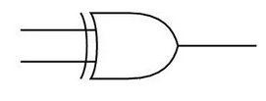
float16 multiplier (3 clock cycles)
SIGN | EXPONENT | MANTISSA
SIGN | EXPONENT | MANTISSA
1&MANTISSA
1&MANTISSA
Adder - 14
Multiplier (10x10)
Normalize (shift left)
Detect zero value on operand
SIGN | EXPONENT | MANTISSA

Slide 16
float16 adder (7 clock cycles )
SIGN | EXPONENT (X1) | MANTISSA (M1)
SIGN | EXPONENT (X2) | MANTISSA (M2)
X1 > X2
No
Yes
Shift right M1
(smaller exponent)
Shift right M2
(smaller exponent)
Manage SIGN (add/subtract)
Normalize (shift left)
SIGN | EXPONENT | MANTISSA

Slide 17
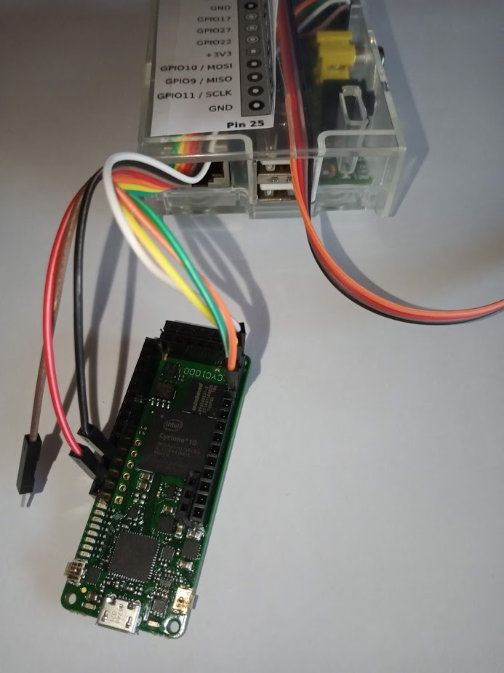
Mock-up
Environment
CYC1000 board
Raspberry PI (3B)
SPI GPIO enabled
Python with numpy, spidev … (use miniconda)
Test (contour detection)
PNG image of Lenna 128x128 BW
Kernel [[ 0, -1, 0 ] [-1, 4, -1] [[ 0, -1, 0 ]]
Computation using FPGA and software

Slide 18
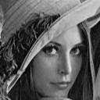


Test result
Input image:
Output image using FPGA:
Output image using only software:

Slide 19
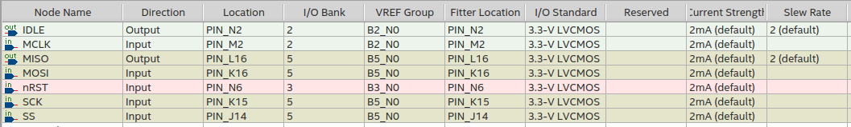
CYC1000 board configuration
PINOUT
Note:
IDLE shows the idle state of convolution engine.
SCK (SPI clock) uses PIN_K15 = DPCLK6

Slide 20
Increase Performance
One of the most obvious way is to increase clock frequency (oscillator 12 MHz → ??? MHz).
Using an internal PLL to increase frequency.
Need Timing Analysis (TimeQuest + sdc file) to verify the fulfillment of timing constraints.
Results:
Higher clock frequency is 120 MHz (PLL x10)
The strongest constraint is the DSP blocks (10x10 basic multiplier) in fp16mult modules.

Slide 21
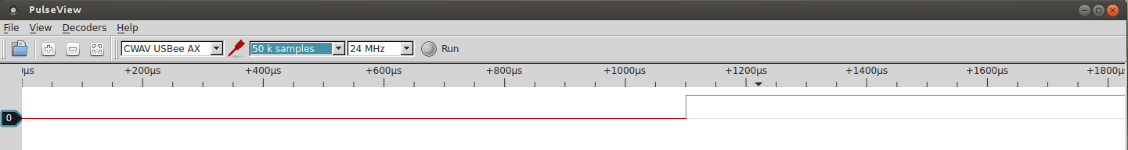
Performance Assessment
= convolution computation time.
By timing calculation (for n x m image):
For a row : ((n-2) * 8 + 44) * clock period
For whole image : (m-2) * ((n-2)*8 + 44) * clock period
Example: 8.4 ns (120 MHz) / 128*128 → 1.11 ms
Logic analyzer ( FPGA IDLE output negative pulse width)
Measurement: about 1.1 ms

Slide 22
Convolution using software
Python 3.7 using scipy.signal.convolve2d (build-in function).
Intel(R) Core(TM) i5-3350P CPU @ 3.10GHz Quad Core.
For a 128 x 128 image: average is 762 μS.
Conclusion:
Yes, the performance is better with a desktop PC but …
FPGA performance is only 44% slower than PC.
Raspberry Pi is estimated to be 60x slower than an i5. (see LINPACK benchmark).
=> FPGA could be a good solution for embedded systems.

Slide 23
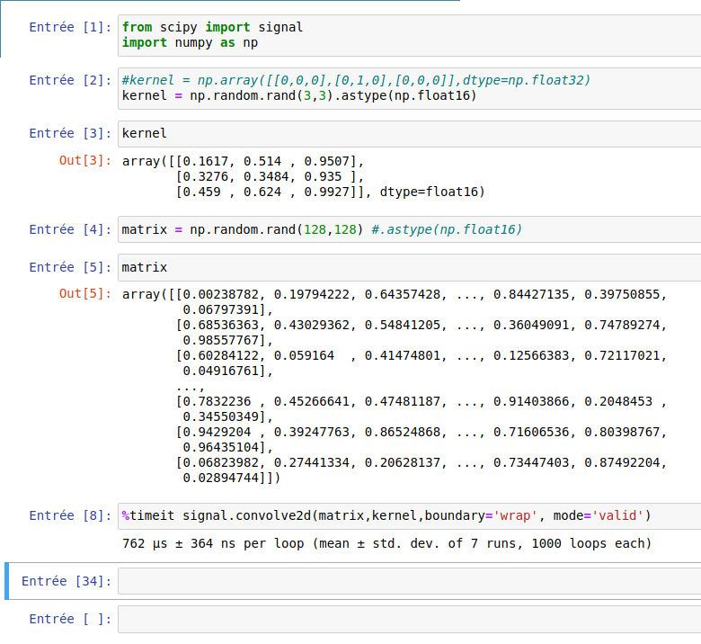
Using Software

Slide 24
Future Improvement
Using SDRAM memory on board in order to process bigger images.
Using 2 banks of internal memories:
A bank accesses to SDRAM on board and
The other bank used by computation units.
Swap functions between banks.
Implementing more computation units to increase performance.
But internal RAM accesses will be less smart to manage.
Recently, I realized the possibility to reduce fp16adder timing (from 7 to 5 clock cycles). This modification needs to review of the computation unit timing. A shorter system timing should concevable.
Using fp16adder and fp16mult pipeline version to avoid temporary register storage in computation unit (https://github.com/tirfil/vhdfp16/tree/master/VERSION2/VHDL).

Slide 25
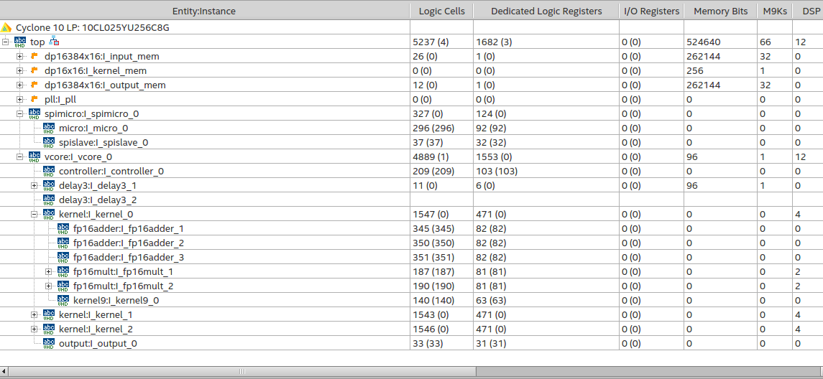
Annex: FPGA module hierarchy

Slide 26
Annex: FPGA report
Flow Status Successful - Sat Jul 25 12:10:21 2020
Quartus Prime Version 19.1.0 Build 670 09/22/2019 SJ Lite Edition
Revision Name top
Top-level Entity Name top
Family Cyclone 10 LP
Device 10CL025YU256C8G
Timing Models Final
Total logic elements 5,237 / 24,624 ( 21 % )
Total registers 1682
Total pins 7 / 151 ( 5 % )
Total virtual pins 0
Total memory bits 524,640 / 608,256 ( 86 % )
Embedded Multiplier 9-bit elements 12 / 132 ( 9 % )
Total PLLs 1 / 4 ( 25 % )

Slide 27
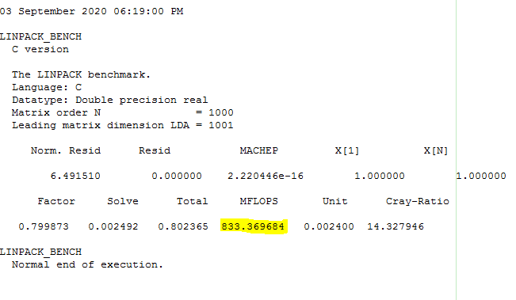
Annex2: LINPACK benchmark
Raspberry 3B:
03 September 2020 01:38:55 PM
LINPACK_BENCH
C version
The LINPACK benchmark.
Language: C
Datatype: Double precision real
Matrix order N = 1000
Leading matrix dimension LDA = 1001
Norm. Resid Resid MACHEP X[1] X[N]
6.491510 0.000000 2.220446e-16 1.000000 1.000000
Factor Solve Total MFLOPS Unit Cray-Ratio
48.016864 0.137178 48.154042 13.885993 0.144030 859.893607
LINPACK_BENCH
Normal end of execution.
Intel Core i5 3350P 3.1 GHz:

Slide 28
More details on:
https://github.com/tirfil/Experimental-Convolution-Engine

