Slide 1

Presentation On Data MANgement system @uni_Hohenheim
@

Slide 2
University of Hohenheim Germany (2017-2020)
Integrated Data Management System
(DFG Project)
Module1: Mass Spectrometry
Modue2: Spectroscopy, NMR
Module3: Analytical Chemistry
Module4: Statistics and Consulting

Slide 3
Project MILESTONES
Phase1: Setup Data Center of 156 TB , Hardware component purchase
Phase2 : Setup OpenBIS data management system
Phase3 : Adaption of the GUI and email notification system from QBiC
Phase4: Automate manual work flows
Phase5: Experimental Design
Phase5: Training /data analysis
Phase6: Continuous Maintenance and Customization
Pahse7: Documentation, Report
2 bioinformatician

Slide 4
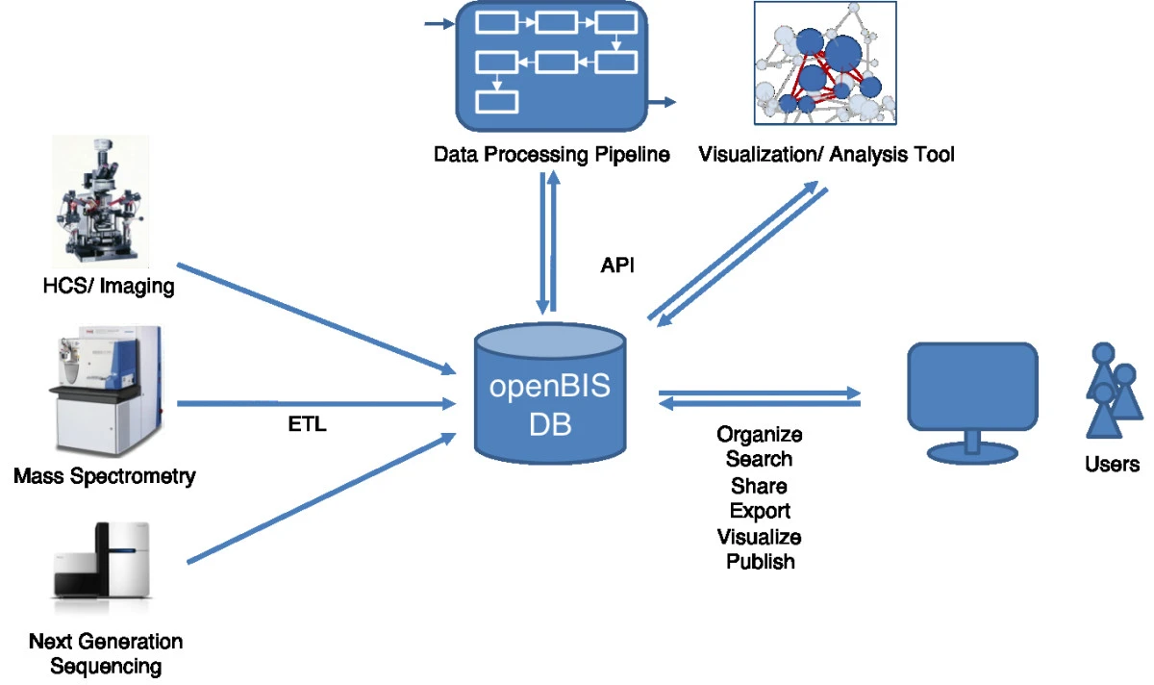
OpenBIS Overview
OpenBIS (Open Biology Information System) is an
open source data management tool developed
by ETH Zurich that supports the entire data lifecycle
from project recording to data production and analysis
ETL :extracts metadata, creates datasets annotated with metadata in the database and adds datasets to the data store

Slide 5
OPENBIS main Features
Implemented in Java and Python
Apache Software License 2.0.
FAIR: Findable, Accessible, Interoperable, and Reusable
Loose Coupling with other workflows through API
hybrid data repository
relational database management system (RDBMS)for metadata and selected results
flat-file data store for bulk data

Slide 6
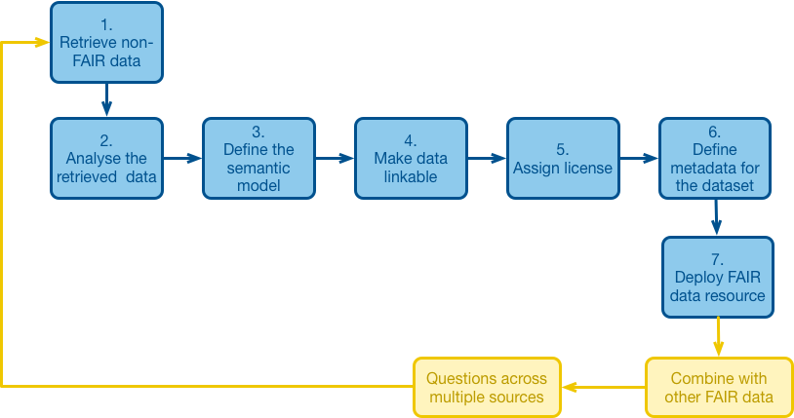
fairIFICATION process

Slide 7
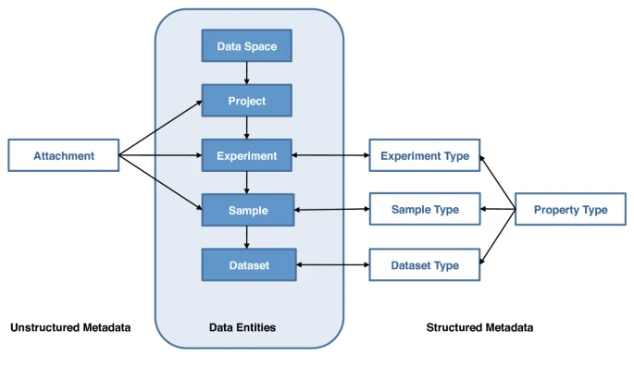
Openbis DATA ORGANISATION
Experiment: an empirical approach that acquire Data
Sample : object being measured in an experiment
Dataset: raw data and processed data
Property Type: Customize metadata
Sample Source/Sample Extract

Slide 8
hierarchical structure
Space
Project
Sub-Project
Sub-Project
Sub-Project
Experiment
Experiment
Experiment
Experiment
Sample
Sample
Sample
Sample
Sample
Sample
Sample
Sample

Slide 9






Deployment MODEL
Application Server (AS)
Firewall
Internal Users
(CFH / Hohenheim)
Linux OS / Ubuntu 16.04
Apache / Java Server
Metadata in PostgreSQL Database
Authentification
User management
fast reading / access
External Users
Web Browser
Mass Spectrometry
Data Store Server 1
(DSS 1) …
… DSS n
Linux OS / Ubuntu 16.04
156 TB gross capacity
Data store
DSS Database
Spectroscopy
Analytical Chemistry
Member Lab
openBIS

Slide 10
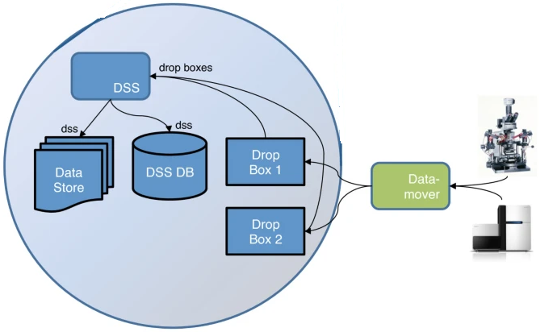
COMPLEMENTARY APPLICATIONS
Web browser limits uploads to 2 GB
Datamover is a Windows service
Locally mounted file share
SSH tunnel or an rsync server for the
actual transfer.
User Authentication( LDAP)

Slide 11
Qportal Main Features
A web-based Portal to Manage Projects and design Experiments through wizards(qWizards)
Inspires from biomedical applications like Galaxy
Developed in University of Tubingen/Germany
Full Integration with OpenBIS
create a full-factorial experimental design
Under GNU general Public license
Developed in web framework VAADIN , Liferay is used to launch portlets

Slide 12
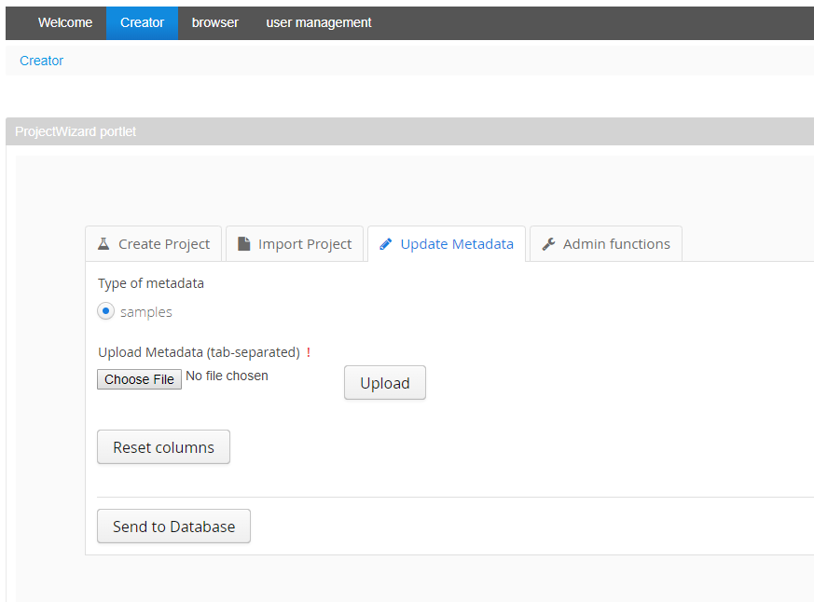
Qportal functionalities
Create Experiment by qWizard
Import project (batch process)
Update Meta Data
Define Users and Previldeges

Slide 13
Roles and Privilege
Users
Register an Expermint
Termin reservation for Sample Delivery
Check the status of project
Download results and files from Portal
Termin reservation for Sample Taking
Lab Technician
Check the status of project
Download/Upload results and files from Portal
Project Leaders
Create Space
Register Arrived Samples manually or through batch import
Register an Expermint manually or throgh Batch import
Assign Samples to Expeiment
Update Metadata
Update the status of project

Slide 14
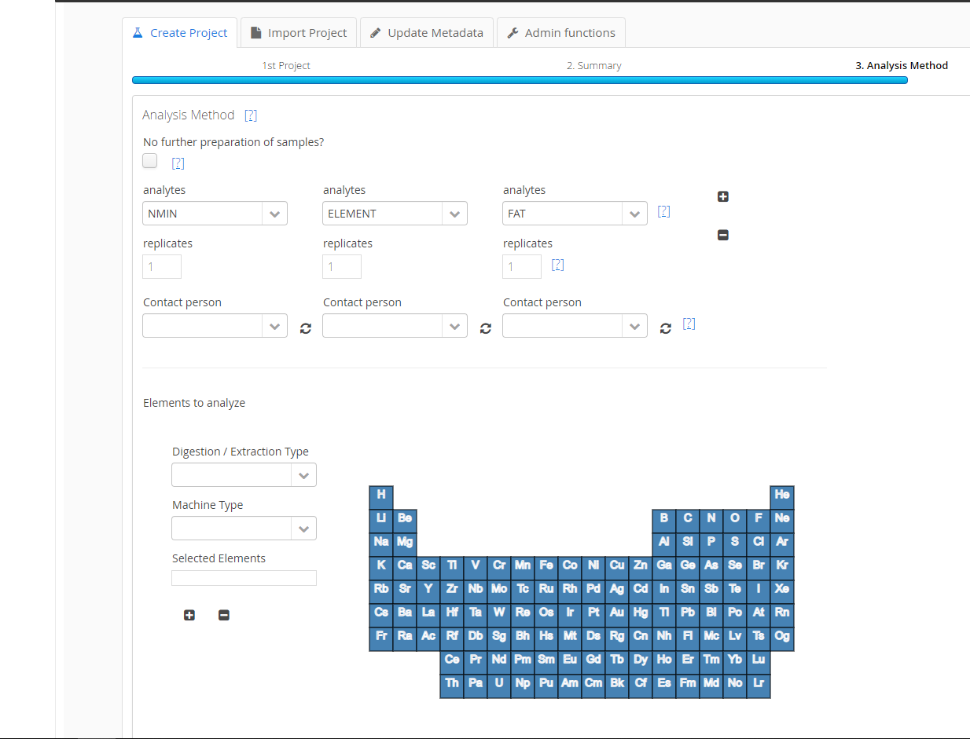
Sample Wizards
Create Projects
Navigate Experimental through Projects
Creating new experiments
Registering samples and results
Assign analysis to Samples
Adding attachment

Slide 15
Create WIZARD
1.Project Description
2.Sample Sources
(NCBI)
4.Sample
Extraction
(Matrix)
6.Analysis Method
7.Register
3.Summary
5.Summary

Slide 16
NeXT Chapter?
Thanks for watching

