Slide 1
{ }
SENG 12233 · LECTURE 5
Exception
Handling
Week 5 — Lab 4: Signal Errors, Let Callers Decide
try · catch · finally · throw · throws · checked vs unchecked
Faculty of Science · University of Kelaniya · Software Engineering Teaching Unit

Slide 2
TODAY
What you will be able to do
• Explain what an exception is and what happens when nobody handles it
• Use try, catch, finally, throw and throws
• Choose checked or unchecked for a new exception
• Write your own exception classes for the LMS
• Apply all of it to Lab 4 (branch week5-exceptions)
SENG 12233 · Lecture 5 · Week 5
2

Slide 3
THE PROBLEM
Printing an error is not handling it
LibraryItem.java (Week 4)
public void loan(Member member) {
if (isBorrowed) {
System.out.println(title + " is already on loan.");
} else { ... }
}
The caller has no idea anything went wrong. A GUI cannot show a dialog; a database layer cannot skip the insert. Errors must be signalled, not printed.
SENG 12233 · Lecture 5 · Week 5
3

Slide 4
IDEA
Three questions about any error
• Who detects it? the method where it happens (loan() knows the item is out)
• Who knows what to do? usually somebody else, further up (the GUI, the controller)
• How does the news travel? an exception object, thrown upward through the call stack
Detecting and deciding are different jobs. Exceptions let them live in different places.
SENG 12233 · Lecture 5 · Week 5
4

Slide 5
MECHANICS
try / catch / finally
Main.java
try {
library.borrowItem("B001", "M002"); // might fail
} catch (ItemNotAvailableException e) {
System.out.println("Cannot borrow: " + e.getMessage());
} finally {
System.out.println("attempt finished"); // always runs
}
throw creates and throws. throws declares. The exception climbs the stack until a matching catch is found; if none is, the program crashes with a stack trace.
SENG 12233 · Lecture 5 · Week 5
5

Slide 6
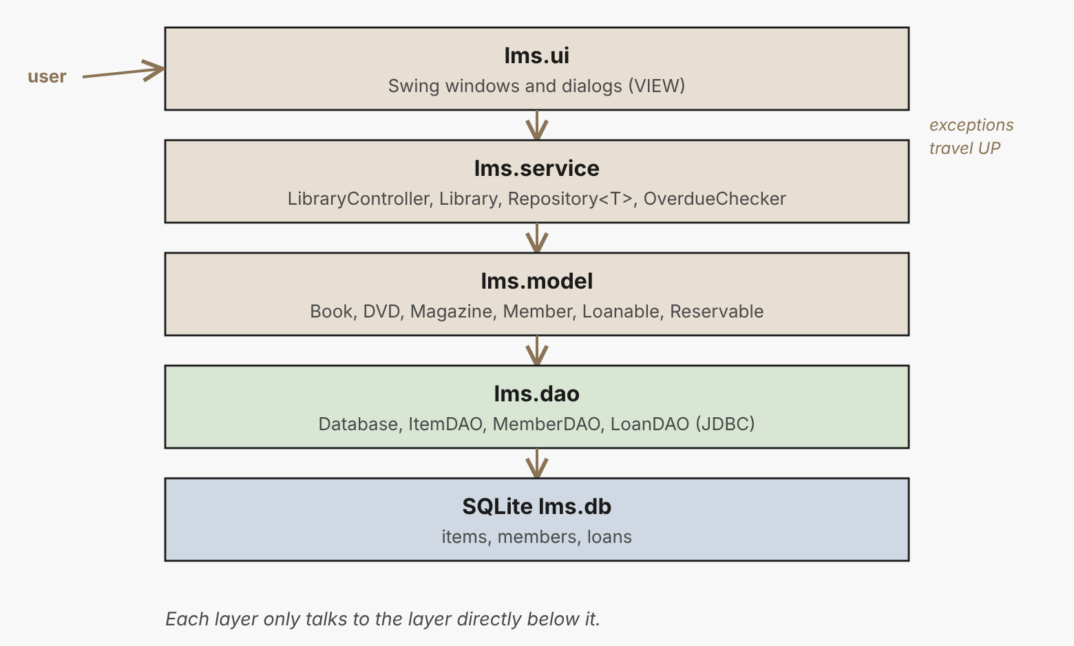
MECHANICS
The call stack: where an exception travels
Thrown deep in the model, caught near the user. Every layer in between can ignore it (unchecked) or must pass it on (checked).
SENG 12233 · Lecture 5 · Week 5
6

Slide 7
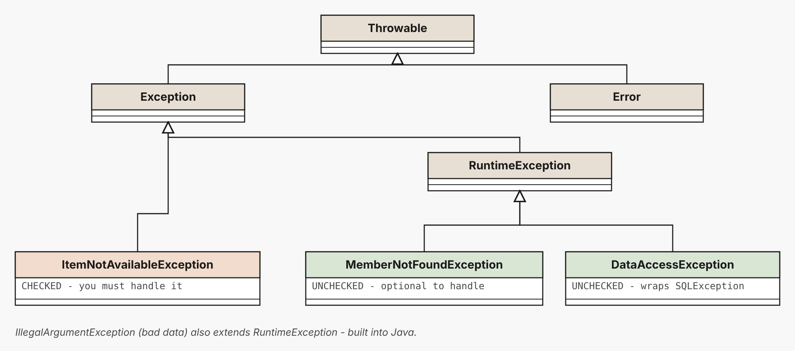
TYPES
Checked vs unchecked
Checked: extends Exception, compiler forces handling. Unchecked: extends RuntimeException, optional.
SENG 12233 · Lecture 5 · Week 5
7

Slide 8
TYPES
Checked or unchecked? Ask: can the caller recover?
 | Checked | Unchecked
Extends | Exception | RuntimeException
Compiler forces handling? | Yes: catch or throws | No
Use for | Recoverable problems | Bugs and bad data
LMS example | ItemNotAvailableException | MemberNotFoundException, IllegalArgumentException
An item already on loan: tell the user, pick another. An unknown member id: usually a bug or bad data.
SENG 12233 · Lecture 5 · Week 5
8

Slide 9
YOUR OWN
Two custom exceptions
lms/exception/
public class ItemNotAvailableException extends Exception { // CHECKED
public ItemNotAvailableException(String message) { super(message); }
}
public class MemberNotFoundException extends RuntimeException { // UNCHECKED
private final String memberId;
public MemberNotFoundException(String memberId) {
super("No member with id '" + memberId + "'");
this.memberId = memberId;
}
public String getMemberId() { return memberId; }
}
SENG 12233 · Lecture 5 · Week 5
9

Slide 10
IN THE LMS
loan() throws instead of printing
LibraryItem.java
@Override
public void loan(Member member) throws ItemNotAvailableException {
if (isBorrowed)
throw new ItemNotAvailableException(title + " is already on loan.");
if (member.getBorrowedCount() >= member.getMaxBorrowLimit())
throw new ItemNotAvailableException(member.getName()
+ " has reached the limit of " + member.getMaxBorrowLimit() + " items.");
isBorrowed = true;
borrower = member;
member.incrementBorrowedCount();
}
The interface Loanable now says throws ItemNotAvailableException too. The compiler points at every caller that must decide.
SENG 12233 · Lecture 5 · Week 5
10

Slide 11
IN THE LMS
One door for the GUI: borrowItem
Library.java
public void borrowItem(String itemId, String memberId) throws ItemNotAvailableException {
Member member = findMember(memberId); // unchecked: MemberNotFoundException
LibraryItem item = findItem(itemId); // checked: ItemNotAvailableException
item.loan(member);
}
findMember declares nothing, findItem declares throws. Both failures end up where we choose to handle them.
SENG 12233 · Lecture 5 · Week 5
11

Slide 12
DEMO
What the caller sees
$ java -cp out lms.Main
--- 2. Already on loan (checked exception) ---
Cannot borrow: Clean Code is already on loan.
(attempt finished: item B001, member M002)
--- 3. Unknown member (unchecked exception) ---
Unknown member: M999
(attempt finished: item D001, member M999)
--- 5. Returning something not on loan ---
Cannot return: Introduction to Algorithms is not on loan.
finally runs every time, success or failure.
SENG 12233 · Lecture 5 · Week 5
12

Slide 13
HABITS
Do and don't
Do | Don't
Catch the most specific exception you can handle | catch (Exception e) {} — swallowing everything
Say what and which value in the message | "Error"
Handle where you can do something about it | Catch and print in every layer
Keep the cause when wrapping | Throw away the original stack trace
SENG 12233 · Lecture 5 · Week 5
13

Slide 14
ORDER
Catch blocks are checked in order
• Put specific types first catch (ItemNotAvailableException e) before catch (Exception e)
• The other way round does not compile: the second catch is unreachable
• finally runs after try/catch whether or not anything was thrown (releases files, connections)
SENG 12233 · Lecture 5 · Week 5
14

Slide 15
LAB PREVIEW
Lab 4 preview: Exception Handling
Branch week5-exceptions · PR "Week 5: Exception Handling"
1. Create package lms.exception with the two exceptions
2. loan() and returnItem() throw instead of print
3. Add findMember, findItem, borrowItem, returnItem to Library
4. Fix the bug: returning an item frees the member's slot
5. Main with eight scenarios, each with try/catch/finally
SENG 12233 · Lecture 5 · Week 5
15

Slide 16
CHECK YOURSELF
Check yourself
1. What happens to a method that throws an exception nobody catches?
2. Why is MemberNotFoundException unchecked and ItemNotAvailableException checked? Do you agree?
3. What does finally guarantee?
4. Why does catch (Exception e) { } catch (ItemNotAvailableException e) { } not compile?
SENG 12233 · Lecture 5 · Week 5
16

