Slide 1
{ }
SENG 12233 · LECTURE 6
Consolidation
& Review
Week 6 — Weeks 1 to 5 on one page
No new lab. Finish, fix, rebuild, practise.
Faculty of Science · University of Kelaniya · Software Engineering Teaching Unit

Slide 2
THIS WEEK
How to use it
• Finish and merge any unfinished PR
• Fix every review comment on your PRs
• Rebuild the LMS from a blank folder, no notes (target: under 45 minutes)
• Practise with today's questions. The midterm is next week
SENG 12233 · Lecture 6 · Week 6
2

Slide 3
RECAP
Five weeks, one table
Week | Big idea | Keywords | LMS artefact
1 | Objects bundle state and behaviour | class, object, field, method, constructor, this | Book
2 | Hide the data, guard the door | private, getter, setter, validation | Book, Member, Library
3 | Reuse and many forms | extends, super, @Override, binding, instanceof | LibraryItem hierarchy
4 | Programme to abilities | abstract, interface, Comparable | Loanable, Reservable
5 | Signal errors, let callers decide | try/catch/finally, checked vs unchecked | ItemNotAvailableException
SENG 12233 · Lecture 6 · Week 6
3

Slide 4
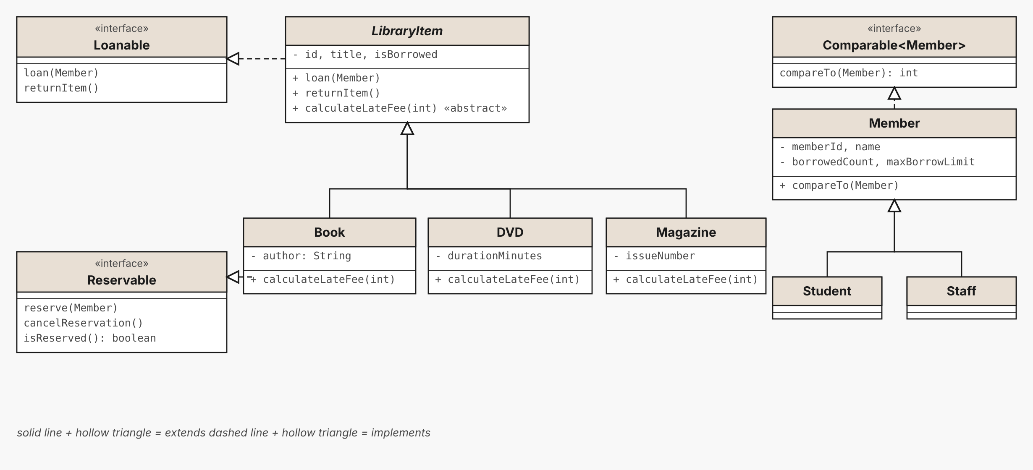
RECAP
The LMS model so far
Two hierarchies, two interfaces, one Comparable.
SENG 12233 · Lecture 6 · Week 6
4

Slide 5
CONFUSIONS
Pairs students mix up
Pair | The clear version
Class vs object | Blueprint vs one thing built with new
Overriding vs overloading | Override: same signature, subclass, decided at run time. Overload: same name, different parameters, decided at compile time
Abstract class vs interface | is-a with shared code vs can-do contract; one parent, many interfaces
Checked vs unchecked | Compiler forces handling vs optional
Declared vs real type | Declared decides what you may call; real decides which override runs
SENG 12233 · Lecture 6 · Week 6
5

Slide 6
TRACE
What does this print?
Trace1.java
LibraryItem a = new Book("B1", "Clean Code", "Martin");
LibraryItem b = new DVD("D1", "Algorithms", 120);
System.out.println(a.calculateLateFee(2));
System.out.println(b.calculateLateFee(2));
Answer: 20.0 and 50.0. Book charges 10 per day, DVD 25. Which binding decided it?
SENG 12233 · Lecture 6 · Week 6
6

Slide 7
TRACE
Which letters print, in which order?
Trace2.java
try {
library.borrowItem("B1", "M1");
System.out.println("A");
library.borrowItem("B1", "M2");
System.out.println("B");
} catch (ItemNotAvailableException e) {
System.out.println("C");
} finally {
System.out.println("D");
}
Answer: A, C, D (assuming M1 and M2 exist and B1 is free at the start). B never prints.
SENG 12233 · Lecture 6 · Week 6
7

Slide 8
SMELL
A poor use of instanceof
Fees.java
double fee(LibraryItem i, int days) {
if (i instanceof Book) return days * 10.0;
else if (i instanceof DVD) return days * 25.0;
else return days * 5.0;
}
How would you fix it with polymorphism? Each subclass overrides calculateLateFee, and the method becomes i.calculateLateFee(days).
SENG 12233 · Lecture 6 · Week 6
8

Slide 9
DRILL
Say it aloud in one minute each
• Why are fields private?
• Why does the constructor call the setters?
• Static vs dynamic binding with an LMS example
• When an interface, when an abstract class?
• Checked vs unchecked, with an LMS example
If you cannot say it, revise it.
SENG 12233 · Lecture 6 · Week 6
9

Slide 10
HOMEWORK
Rebuild challenge
Branch week6-rebuild (do not merge) · PR "(none)"
1. Abstract LibraryItem, Book, DVD
2. Member and Student, with the borrowing limit
3. Library.borrowItem
4. One custom exception
5. A Main that triggers it. Time yourself
SENG 12233 · Lecture 6 · Week 6
10

