Slide 1
{ }
SENG 12233 · LECTURE 8
GUI I:
Layouts & Widgets
Week 8 — Lab 5: The LMS Gets a Window
Swing · JFrame · BorderLayout · GridLayout · FlowLayout · JTable
Faculty of Science · University of Kelaniya · Software Engineering Teaching Unit

Slide 2
TODAY
What you will be able to do
• Open a window with JFrame and fill it with components
• Use BorderLayout, FlowLayout and GridLayout, and nest panels
• Show LMS items in a JTable
• Start Swing correctly on the Event Dispatch Thread
SENG 12233 · Lecture 8 · Week 8
2

Slide 3
WIDGETS
The Swing toolbox
Widget | Purpose
JFrame | The window
JPanel | Invisible container used to group widgets
JLabel | Text or an icon
JTextField | One line of input
JComboBox<String> | Drop-down list
JButton | Clickable button
JTable + DefaultTableModel | Rows and columns
JScrollPane | Adds scrollbars around another widget
SENG 12233 · Lecture 8 · Week 8
3

Slide 4
THE IDEA
You never position widgets by pixel.
You pick a layout manager and let Java do the arithmetic. When the window resizes, the layout re-arranges everything.
SENG 12233 · Lecture 8 · Week 8
4

Slide 5
LAYOUTS
Three layout managers you need
Layout | Arranges | Use for
BorderLayout | NORTH, SOUTH, EAST, WEST, CENTER | The overall window
FlowLayout | Left to right, wrapping | A row of buttons
GridLayout(rows, cols) | Equal-sized cells | A form: label, field, label, field
SENG 12233 · Lecture 8 · Week 8
5

Slide 6
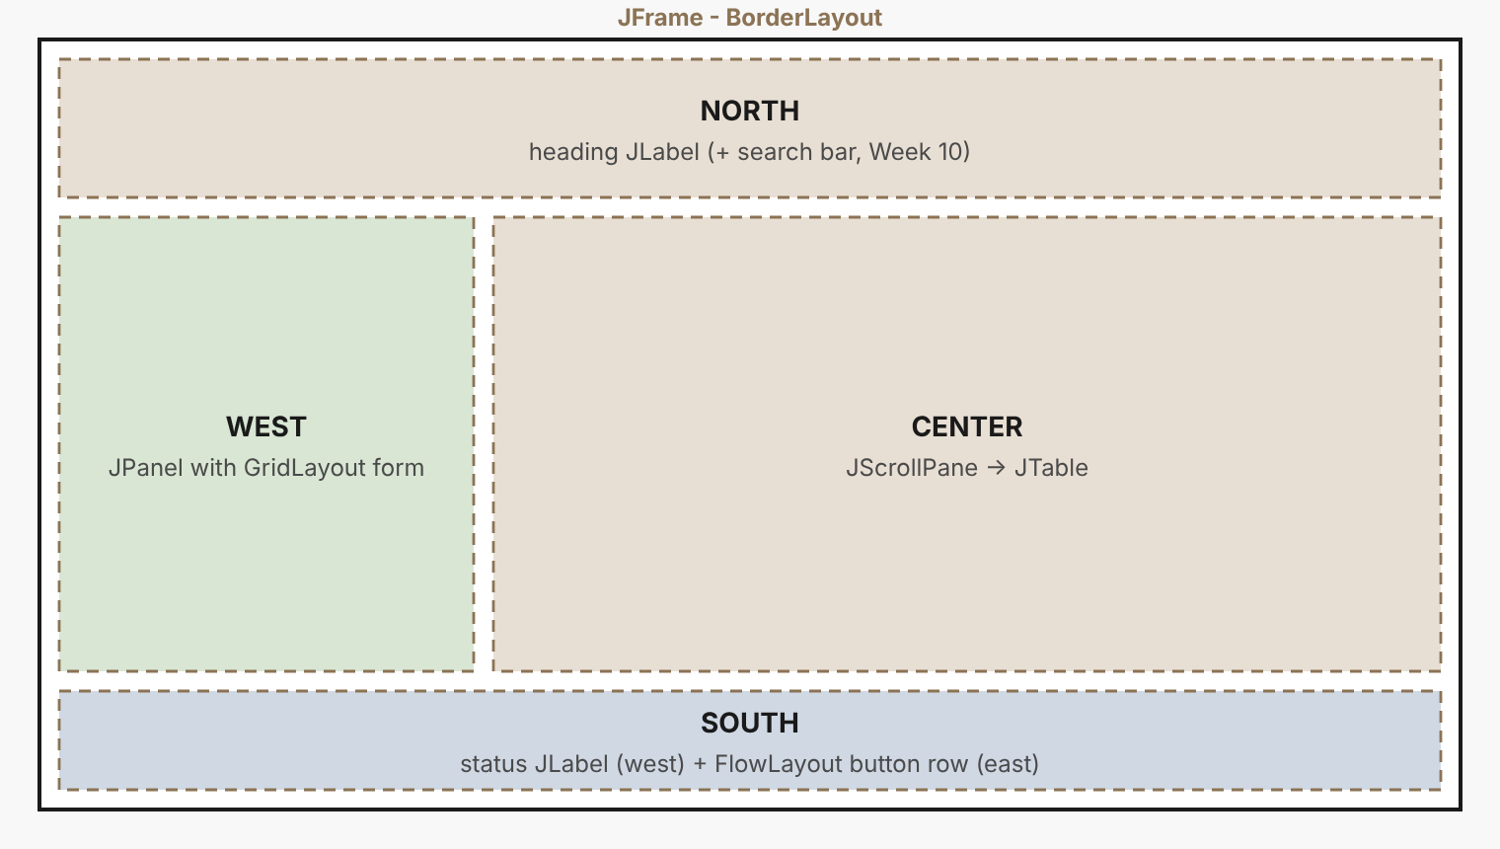
PLAN
The LMS window is five regions
The form on the left is a JPanel with a GridLayout, placed in the WEST region of the frame's BorderLayout. Nest panels.
SENG 12233 · Lecture 8 · Week 8
6

Slide 7
CODE
The frame
MainFrame.java
public class MainFrame extends JFrame {
public MainFrame(Library library) {
super("Library Management System");
setLayout(new BorderLayout());
add(heading, BorderLayout.NORTH);
add(west, BorderLayout.WEST);
add(new JScrollPane(table), BorderLayout.CENTER);
add(south, BorderLayout.SOUTH);
setDefaultCloseOperation(JFrame.EXIT_ON_CLOSE);
setSize(820, 460);
setLocationRelativeTo(null); // centre on screen
}
}
MainFrame extends JFrame: inheritance again, this time reusing a huge library class.
SENG 12233 · Lecture 8 · Week 8
7

Slide 8
CODE
A form with GridLayout
MainFrame.java
JPanel form = new JPanel(new GridLayout(0, 2, 6, 8)); // any rows, 2 columns
form.setBorder(BorderFactory.createTitledBorder("New item"));
form.add(new JLabel("Type:")); form.add(typeBox);
form.add(new JLabel("ID:")); form.add(idField);
form.add(new JLabel("Title:")); form.add(titleField);
form.add(new JLabel("Detail:")); form.add(detailField);
JPanel west = new JPanel(new BorderLayout());
west.add(form, BorderLayout.NORTH); // wrapper keeps the form compact
Add the grid straight to WEST and it stretches to the full height. The wrapper panel is the trick.
SENG 12233 · Lecture 8 · Week 8
8

Slide 9
CODE
A table from your objects
MainFrame.java
private void refreshTable() {
tableModel.setRowCount(0); // clear
for (LibraryItem item : library.getItems()) {
tableModel.addRow(new Object[]{
item.getId(), item.getTitle(),
item.getClass().getSimpleName(),
detailOf(item),
item.isBorrowed() ? "On loan" : "Available"});
}
}
JTable shows what its model holds. Copy your objects into rows. Polymorphism still decides getClass().
SENG 12233 · Lecture 8 · Week 8
9

Slide 10
START
Swing must start on the EDT
GuiMain.java
public static void main(String[] args) {
Library library = new Library();
// ... add sample items and members ...
SwingUtilities.invokeLater(() -> new MainFrame(library).setVisible(true));
}
Swing is not thread-safe. All GUI work happens on one special thread, the Event Dispatch Thread. We return to it in Week 12.
SENG 12233 · Lecture 8 · Week 8
10

Slide 11
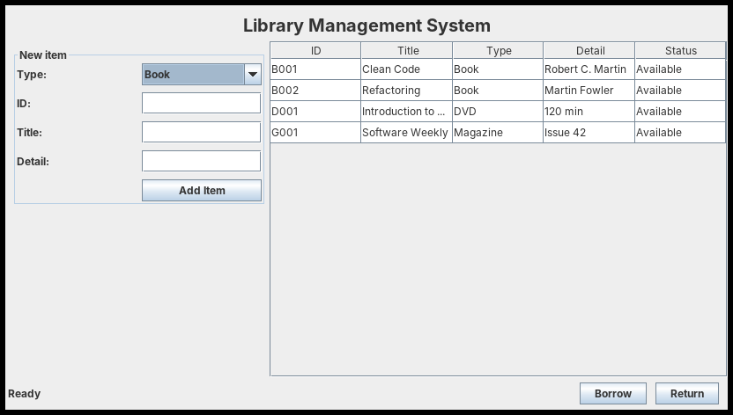
RESULT
The Week 8 window
Buttons do nothing yet. That is deliberate: layout first, behaviour next week.
SENG 12233 · Lecture 8 · Week 8
11

Slide 12
DEBUG
When the window looks wrong
Symptom | Likely cause
Empty or tiny window | Missing setSize() or setVisible(true)
Form stretched to the bottom | Added the grid panel directly to WEST
No table header | No JScrollPane around the JTable
Program does not exit | No setDefaultCloseOperation
Widgets vanish | Added to the wrong container
SENG 12233 · Lecture 8 · Week 8
12

Slide 13
LAB PREVIEW
Lab 5 preview: GUI I
Branch week8-gui-layouts · PR "Week 8: GUI I (Swing Layouts & Widgets)"
1. Sketch the window and the layout manager of each region first
2. MainFrame with five regions, a table and a form
3. GuiMain starts it on the EDT
4. Screenshot to docs/week8-window.png
SENG 12233 · Lecture 8 · Week 8
13

Slide 14
CHECK YOURSELF
Check yourself
1. Which layout for a row of three buttons, and why?
2. Why do we wrap the form in another panel before adding it to WEST?
3. Why does MainFrame use extends JFrame?
4. What goes wrong if Swing code runs off the EDT?
SENG 12233 · Lecture 8 · Week 8
14

