Slide 1
{ }
SENG 12233 · LECTURE 9
GUI II:
Events & MVC
Week 9 — Lab 6: Buttons That Work
Listeners · JOptionPane · Model, View, Controller
Faculty of Science · University of Kelaniya · Software Engineering Teaching Unit

Slide 2
TODAY
What you will be able to do
• Attach listeners so buttons run your code
• Show messages and errors with JOptionPane
• Explain MVC and map it onto the LMS packages
• Keep the model free of System.out and javax.swing
SENG 12233 · Lecture 9 · Week 9
2

Slide 3
THE SHIFT
A console program decides what happens next.
A GUI program waits. The user clicks, types or selects, and Swing calls your code.
SENG 12233 · Lecture 9 · Week 9
3

Slide 4
EVENTS
Three ingredients
Ingredient | In the LMS
Event source | the Borrow JButton
Listener | an ActionListener: code to run when clicked
Registration | borrowButton.addActionListener(...)
ActionListener is an interface with one method (Week 4 again). A lambda is a short way to implement it.
SENG 12233 · Lecture 9 · Week 9
4

Slide 5
EVENTS
Registering listeners
MainFrame.java
private void wireEvents() {
addButton.addActionListener(e -> onAdd());
borrowButton.addActionListener(e -> onBorrow());
returnButton.addActionListener(e -> onReturn());
}
e -> onBorrow() means: when the button is clicked, run onBorrow().
SENG 12233 · Lecture 9 · Week 9
5

Slide 6
EVENTS
A complete handler
MainFrame.java
private void onBorrow() {
String itemId = selectedItemId();
if (itemId == null) return;
String memberId = ((String) memberBox.getSelectedItem()).split(" - ")[0];
try {
controller.borrow(itemId, memberId);
setStatus(itemId + " borrowed by " + memberId);
refreshTable();
} catch (ItemNotAvailableException ex) {
showError("Cannot borrow", ex.getMessage());
} catch (MemberNotFoundException ex) {
showError("Unknown member", ex.getMessage());
}
}
Week 5 pays off: the exceptions we designed become friendly dialogs.
SENG 12233 · Lecture 9 · Week 9
6

Slide 7
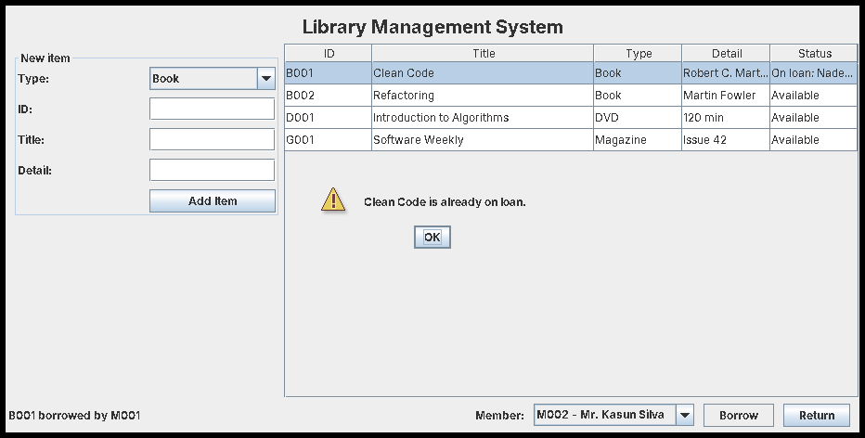
DIALOGS
Success, then an exception as a dialog
JOptionPane.showMessageDialog(this, ex.getMessage(), "Cannot borrow", JOptionPane.WARNING_MESSAGE)
SENG 12233 · Lecture 9 · Week 9
7

Slide 8
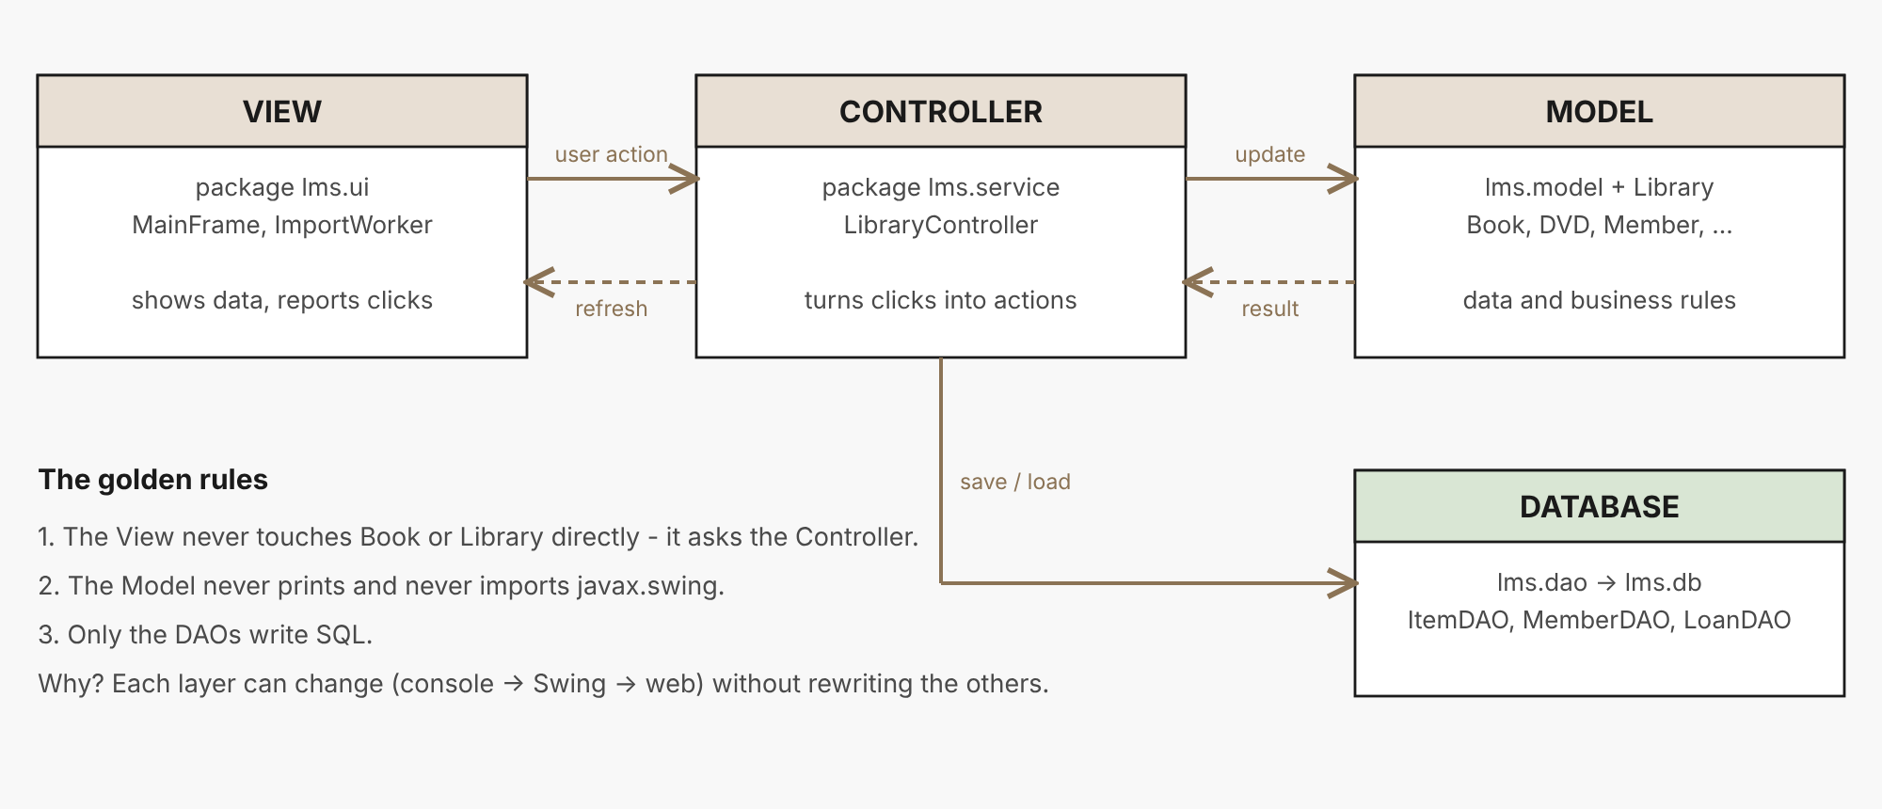
MVC
Three jobs, three places
Model: lms.model + Library. View: lms.ui. Controller: lms.service.LibraryController.
SENG 12233 · Lecture 9 · Week 9
8

Slide 9
MVC
The golden rules
Part | Job | Must not
Model | Data and business rules | print, or import Swing
View | Show things, forward clicks | contain rules or touch Book logic
Controller | Turn user actions into model calls, convert raw text | create widgets
SENG 12233 · Lecture 9 · Week 9
9

Slide 10
CONTROLLER
Convert text, reject bad input
LibraryController.java
public void addItem(String type, String id, String title, String detail) {
if (library.hasItem(id))
throw new IllegalArgumentException("An item with id '" + id + "' already exists");
switch (type) {
case "Book" -> library.addItem(new Book(id, title, detail));
case "DVD" -> library.addItem(new DVD(id, title, parseWholeNumber(detail, "Duration")));
case "Magazine" -> library.addItem(new Magazine(id, title, parseWholeNumber(detail, "Issue number")));
default -> throw new IllegalArgumentException("Unknown item type: " + type);
}
}
The view passes raw strings; the controller builds the objects.
SENG 12233 · Lecture 9 · Week 9
10

Slide 11
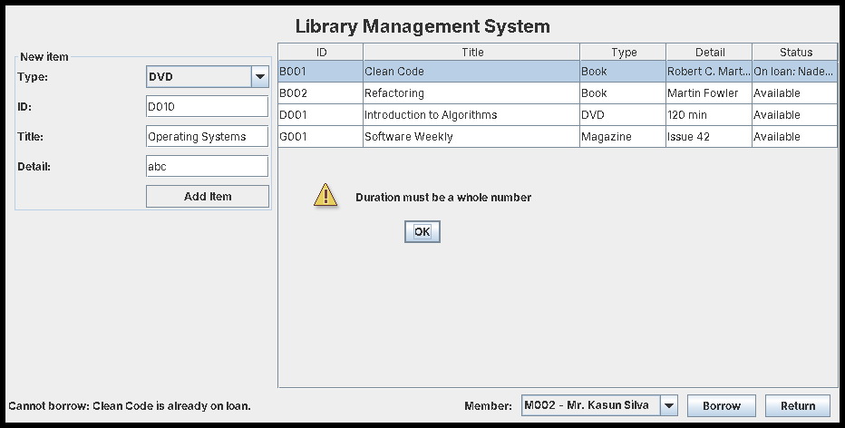
INPUT
Bad input: caught by the controller, shown by the view
Letters in a DVD duration give a dialog, not a crash.
SENG 12233 · Lecture 9 · Week 9
11

Slide 12
REFACTOR
Why bother with MVC?
• Next week the controller gets a search feature
• Week 11 the controller starts talking to a database
• The view and model do not change at all
• Also delete System.out.println from LibraryItem: a model that prints cannot serve a window
SENG 12233 · Lecture 9 · Week 9
12

Slide 13
LAB PREVIEW
Lab 6 preview: Events and MVC
Branch week9-gui-events-mvc · PR "Week 9: GUI II (Events, Dialogs & MVC)"
1. Remove printing from the model
2. Create LibraryController in lms.service
3. MainFrame talks only to the controller
4. Listeners for Add, Borrow and Return; every failure is a dialog
5. Three screenshots: success, an error, bad input
SENG 12233 · Lecture 9 · Week 9
13

Slide 14
CHECK YOURSELF
Check yourself
1. Name the source, listener and registration in refreshButton.addActionListener(e -> reload()).
2. Which MVC part should parse the text "120" into an int?
3. Why is System.out.println inside LibraryItem a problem for a GUI?
4. A teammate imports javax.swing.* into Book. What do you tell them?
SENG 12233 · Lecture 9 · Week 9
14

