Slide 1
{ }
SENG 12233 · LECTURE 10
Generics, Collections
& Streams
Week 10 — Lab 7: One Repository for Everything
Repository<T> · Map · Optional · streams · lambdas
Faculty of Science · University of Kelaniya · Software Engineering Teaching Unit

Slide 2
TODAY
What you will be able to do
• Write a generic class Repository<T>
• Choose between List, Set and Map
• Use Optional instead of null
• Filter, sort and group with streams and lambdas
SENG 12233 · Lecture 10 · Week 10
2

Slide 3
PROBLEM
Two lists, same code
• The LMS keeps items and members both need add, find by id, list all
• Copy-paste ItemList and MemberList: two places to fix every bug
• A list of Object forces casts, and casts crash at run time
A generic class is written once with a type parameter T: 'some type, chosen by the user of the class'.
SENG 12233 · Lecture 10 · Week 10
3

Slide 4
GENERICS
Repository<T>
Repository.java
public class Repository<T> {
private final Map<String, T> store = new LinkedHashMap<>();
private final Function<T, String> idOf; // how to get an id out of a T
public Repository(Function<T, String> idOf) { this.idOf = idOf; }
public void add(T entity) {
String id = idOf.apply(entity);
if (store.containsKey(id)) throw new IllegalArgumentException("An entry with id '" + id + "' already exists");
store.put(id, entity);
}
public Optional<T> findById(String id) { return Optional.ofNullable(store.get(id)); }
public List<T> findAll() { return new ArrayList<>(store.values()); }
}
SENG 12233 · Lecture 10 · Week 10
4

Slide 5
GENERICS
One class, two uses
Library.java
private final Repository<LibraryItem> items = new Repository<>(LibraryItem::getId);
private final Repository<Member> members = new Repository<>(Member::getMemberId);
items.add(new Book("B001", "Clean Code", "Robert C. Martin"));
// items.add(new Student(...)); // COMPILE error: wrong type
Generics move errors from run time to compile time, which is always cheaper.
SENG 12233 · Lecture 10 · Week 10
5

Slide 6
COLLECTIONS
Choosing a collection
Collection | Keeps | Duplicates | Fast at | LMS use
List (ArrayList) | Order, by position | Yes | Looping | Results for the table
Set (HashSet) | No order guarantee | No | Is it in there? | Unique tags
Map (LinkedHashMap) | Key to value | Keys unique | Lookup by key | Items and members by id
SENG 12233 · Lecture 10 · Week 10
6

Slide 7
OPTIONAL
Maybe nothing
Library.java
public Member findMember(String memberId) {
return members.findById(memberId)
.orElseThrow(() -> new MemberNotFoundException(memberId));
}
Optional forces the caller to decide what to do when nothing is found, instead of crashing later with a NullPointerException.
SENG 12233 · Lecture 10 · Week 10
7

Slide 8
STREAMS
Say what, not how
Library.java
public List<LibraryItem> search(String text) {
String q = text.trim().toLowerCase();
return items.search(i -> i.getTitle().toLowerCase().contains(q)
|| i.getId().toLowerCase().contains(q)
|| (i instanceof Book b && b.getAuthor().toLowerCase().contains(q)));
}
A lambda i -> ... is a tiny anonymous function. Repository.search takes a Predicate<T> and applies stream().filter(...).
SENG 12233 · Lecture 10 · Week 10
8

Slide 9
STREAMS
Group and count
Library.java
public Map<String, Long> loansPerMember() {
return items.findAll().stream()
.filter(LibraryItem::isBorrowed)
.collect(Collectors.groupingBy(
i -> i.getBorrower().getName(), TreeMap::new, Collectors.counting()));
}
Read it like a sentence: take the items, keep the borrowed ones, group by borrower name, count each group.
SENG 12233 · Lecture 10 · Week 10
9

Slide 10
STREAMS
The stream vocabulary
Step | Meaning
filter(cond) | keep matching elements
map(fn) | transform each element
sorted(cmp) | order them
collect(...) / toList() | gather results
count(), anyMatch(...) | summarise
SENG 12233 · Lecture 10 · Week 10
10

Slide 11
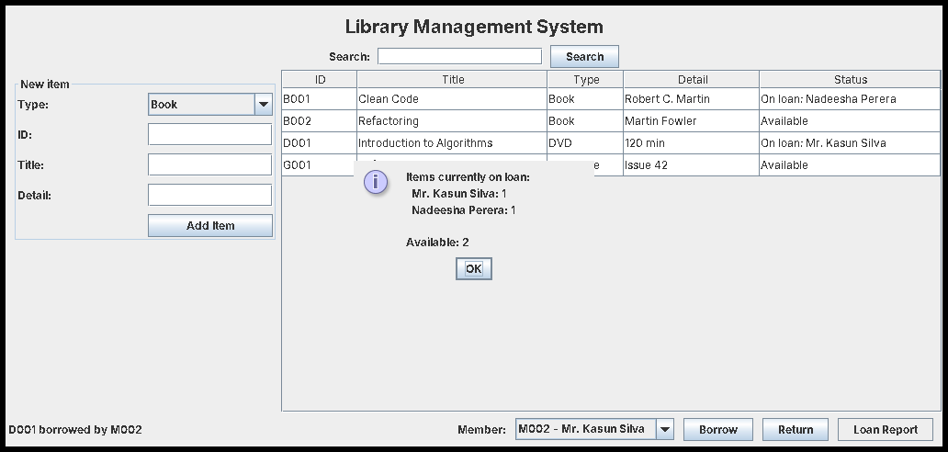
RESULT
Loan report
Grouped by member, using the stream above.
SENG 12233 · Lecture 10 · Week 10
11

Slide 12
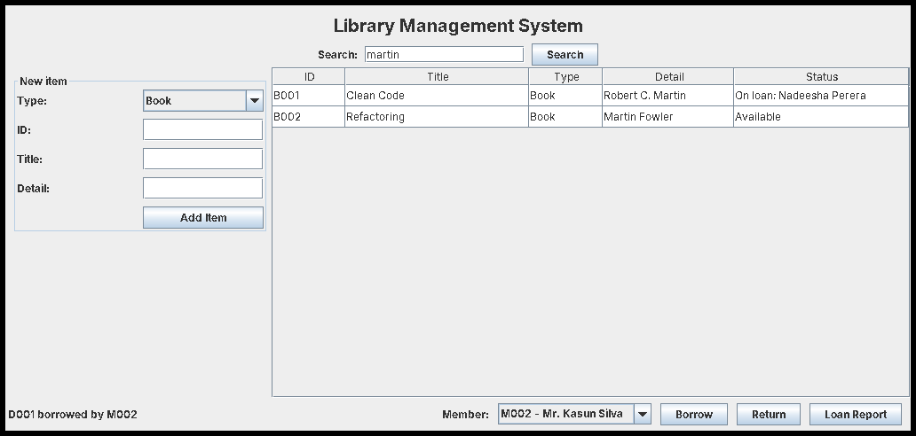
RESULT
Search for "martin"
Matches the author field of the books.
SENG 12233 · Lecture 10 · Week 10
12

Slide 13
LAB PREVIEW
Lab 7 preview: Generics and Streams
Branch week10-generics-streams · PR "Week 10: Generics, Collections & Streams"
1. Repository<T> backed by a LinkedHashMap
2. Library uses Repository for items and members
3. search(), loansPerMember(), availableItems()
4. Search box and Loan Report button in the GUI
5. One stream query of your own
SENG 12233 · Lecture 10 · Week 10
13

Slide 14
CHECK YOURSELF
Check yourself
1. What does Repository<Member> forbid that Repository<Object> would allow?
2. When is a Map better than a List?
3. Rewrite as a stream: titles of all borrowed items, sorted.
4. What does Collectors.counting() count in loansPerMember()?
SENG 12233 · Lecture 10 · Week 10
14

