Slide 1
{ }
SENG 12233 · LECTURE 11
JDBC:
Database Connectivity
Week 11 — Lab 8: The LMS Remembers
Tables · SQL · PreparedStatement · DAO · foreign keys
Faculty of Science · University of Kelaniya · Software Engineering Teaching Unit

Slide 2
TODAY
What you will be able to do
• Design three tables and the keys that link them
• Run INSERT, SELECT and UPDATE from Java with JDBC
• Prevent SQL injection with PreparedStatement
• Organise database code in DAO classes
SENG 12233 · Lecture 11 · Week 11
2

Slide 3
PROBLEM
Close the window and everything is gone
• Objects live in memory they vanish when the program ends
• A database stores data on disk, in tables
• JDBC Java's standard way to talk to any database
• We use SQLite a whole database in one file, no server to install
SENG 12233 · Lecture 11 · Week 11
3

Slide 4
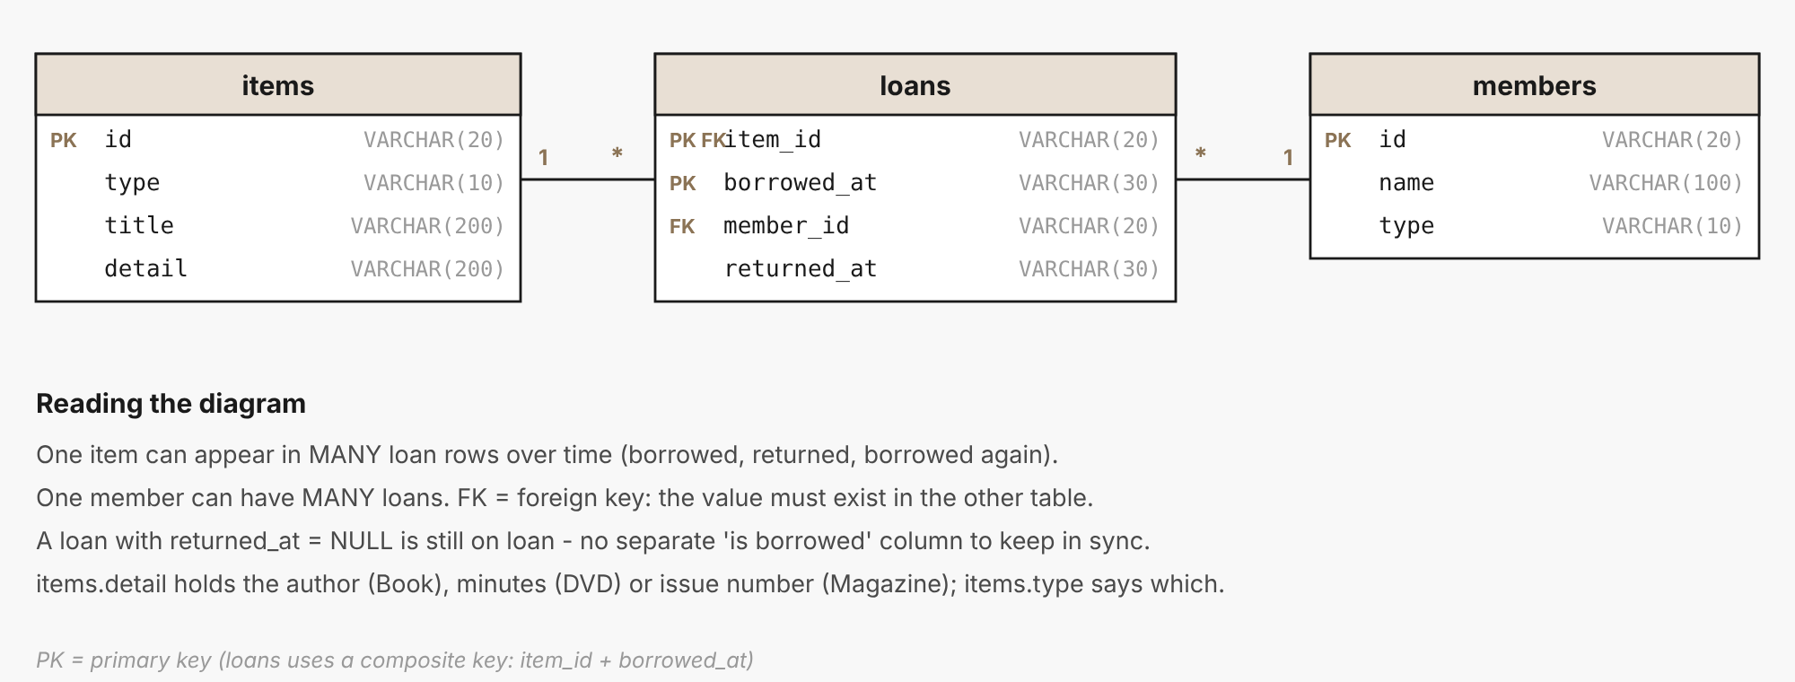
DESIGN
Three tables
items, members and loans. A loan row links one item to one member, with borrowed_at and returned_at.
SENG 12233 · Lecture 11 · Week 11
4

Slide 5
SQL
Creating the tables
Database.java
CREATE TABLE IF NOT EXISTS items (
id TEXT PRIMARY KEY, type TEXT NOT NULL, title TEXT NOT NULL, detail TEXT);
CREATE TABLE IF NOT EXISTS members (
id TEXT PRIMARY KEY, name TEXT NOT NULL, type TEXT NOT NULL);
CREATE TABLE IF NOT EXISTS loans (
item_id TEXT NOT NULL, member_id TEXT NOT NULL,
borrowed_at TEXT NOT NULL, returned_at TEXT,
PRIMARY KEY (item_id, borrowed_at),
FOREIGN KEY (item_id) REFERENCES items(id),
FOREIGN KEY (member_id) REFERENCES members(id));
A foreign key makes the database itself refuse a loan for an item or member that does not exist.
SENG 12233 · Lecture 11 · Week 11
5

Slide 6
JDBC
Connect
Database.java
public static Connection open() throws SQLException {
return DriverManager.getConnection(URL); // jdbc:sqlite:lms.db
}
try (Connection con = Database.open();
Statement st = con.createStatement()) {
st.execute(CREATE_ITEMS);
}
try-with-resources (Week 5) closes the connection even when an error occurs.
SENG 12233 · Lecture 11 · Week 11
6

Slide 7
JDBC
Insert safely
ItemDAO.java
public void insert(LibraryItem item) {
String sql = "INSERT INTO items(id, type, title, detail) VALUES (?, ?, ?, ?)";
try (Connection con = Database.open();
PreparedStatement ps = con.prepareStatement(sql)) {
ps.setString(1, item.getId());
ps.setString(2, item.getClass().getSimpleName());
ps.setString(3, item.getTitle());
ps.setString(4, detailOf(item));
ps.executeUpdate();
} catch (SQLException e) { throw new DataAccessException("Could not insert item", e); }
}
The ? placeholders keep user text out of the SQL command itself.
SENG 12233 · Lecture 11 · Week 11
7

Slide 8
SECURITY
Why PreparedStatement matters
Approach | Title typed: x'); DROP TABLE items;--
"... VALUES ('" + title + "')" | The text becomes SQL. The table can be destroyed.
ps.setString(3, title) | The text stays data, always. Nothing runs.
SENG 12233 · Lecture 11 · Week 11
8

Slide 9
JDBC
Read rows back
ItemDAO.java
public List<LibraryItem> findAll() {
List<LibraryItem> list = new ArrayList<>();
try (Connection con = Database.open();
Statement st = con.createStatement();
ResultSet rs = st.executeQuery("SELECT id, type, title, detail FROM items ORDER BY id")) {
while (rs.next()) {
list.add(build(rs.getString("type"), rs.getString("id"),
rs.getString("title"), rs.getString("detail")));
}
} catch (SQLException e) { throw new DataAccessException("Could not read items", e); }
return list;
}
ResultSet is a cursor: next() moves to the next row, getXxx(column) reads a value.
SENG 12233 · Lecture 11 · Week 11
9

Slide 10
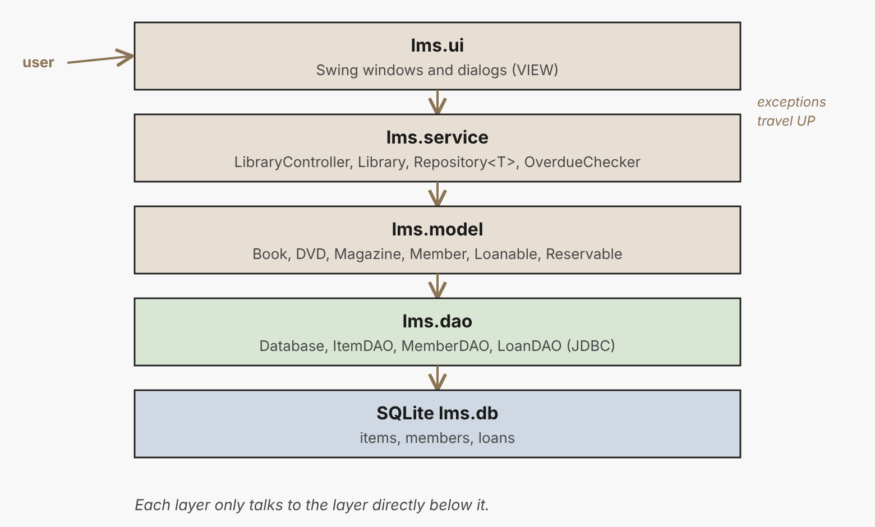
LAYERS
Where each class lives
The controller is the only class that knows about DAOs. The window never sees SQL.
SENG 12233 · Lecture 11 · Week 11
10

Slide 11
DAO
Controller: save, then update memory
LibraryController.java
public synchronized void borrow(String itemId, String memberId) {
library.borrow(itemId, memberId); // business rules first
loanDAO.open(itemId, memberId, LocalDateTime.now()); // then persist
}
If the rule throws ItemNotAvailableException, nothing is written. The exception protects the database.
SENG 12233 · Lecture 11 · Week 11
11

Slide 12
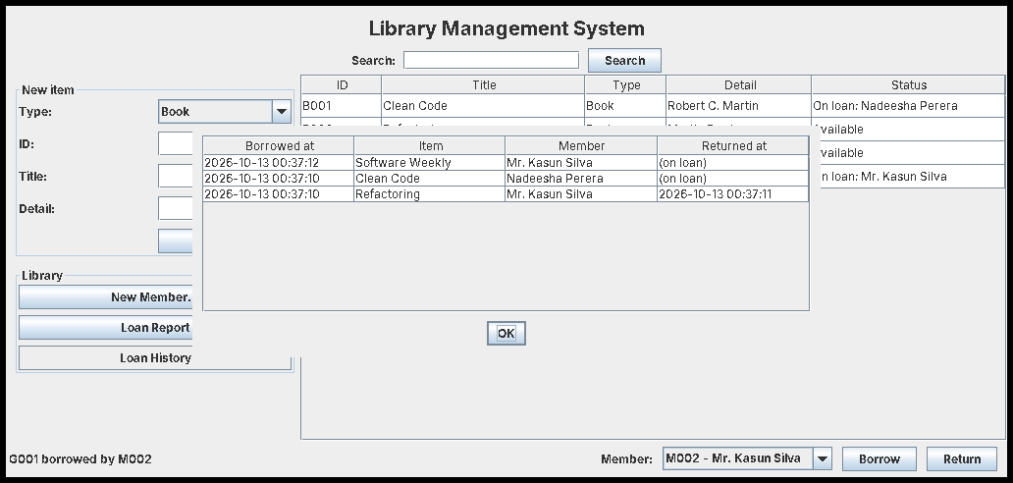
RESULT
History: a three-table JOIN
SELECT ... FROM loans JOIN items ... JOIN members ...
SENG 12233 · Lecture 11 · Week 11
12

Slide 13
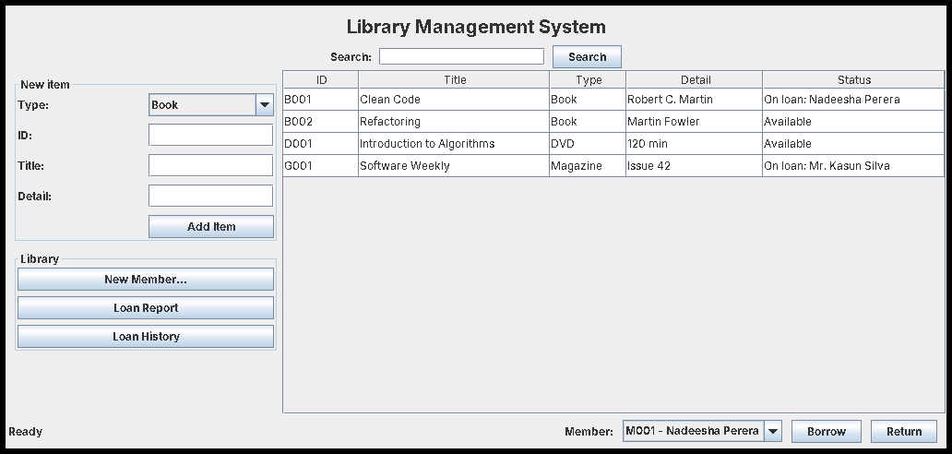
RESULT
Close the program, start again
Items and the open loan are back: loadFromDatabase() replays them.
SENG 12233 · Lecture 11 · Week 11
13

Slide 14
DEBUG
Common JDBC problems
Symptom | Likely cause
No suitable driver | JDBC jar missing from the class path (lib/)
database is locked | A connection was never closed
FOREIGN KEY constraint failed | Inserting a loan before its item or member
Data lost on restart | Used an in-memory URL, or never committed
SENG 12233 · Lecture 11 · Week 11
14

Slide 15
LAB PREVIEW
Lab 8 preview: JDBC
Branch week11-jdbc · PR "Week 11: JDBC (Persistence with the DAO Pattern)"
1. Database.java creates three tables
2. ItemDAO, MemberDAO, LoanDAO with PreparedStatement
3. Controller saves each change; loadFromDatabase() on start
4. History button shows the JOIN
5. Restart screenshot as evidence
SENG 12233 · Lecture 11 · Week 11
15

Slide 16
CHECK YOURSELF
Check yourself
1. What does a foreign key prevent?
2. Why is string concatenation in SQL dangerous?
3. What does rs.next() return, and when is it false?
4. Why does borrow() call library.borrow() before loanDAO.open()?
SENG 12233 · Lecture 11 · Week 11
16

