Slide 1
{ }
SENG 12233 · LECTURE 12
Multithreading &
Final Integration
Week 12 — Lab 9: Responsive and Safe
Thread · SwingWorker · synchronized · race conditions
Faculty of Science · University of Kelaniya · Software Engineering Teaching Unit

Slide 2
TODAY
What you will be able to do
• Explain why long work freezes a window
• Move work to a background thread with SwingWorker
• Demonstrate and fix a race condition with synchronized
• Integrate all twelve weeks into one system
SENG 12233 · Lecture 12 · Week 12
2

Slide 3
FREEZE
One thread draws the window and runs your handlers.
If a handler takes ten seconds, the window cannot repaint or react for ten seconds. Never block the Event Dispatch Thread.
SENG 12233 · Lecture 12 · Week 12
3

Slide 4
SWINGWORKER
Do the slow work in the background
ImportWorker.java
public class ImportWorker extends SwingWorker<Integer, Integer> {
@Override protected Integer doInBackground() throws Exception { // background thread
for (int i = 1; i <= total; i++) {
controller.addItem(...);
Thread.sleep(300); // simulate slow work
publish(i);
}
return total;
}
@Override protected void process(List<Integer> chunks) { // EDT
bar.setValue(chunks.get(chunks.size() - 1));
}
@Override protected void done() { refreshTable(); } // EDT
}
SENG 12233 · Lecture 12 · Week 12
4

Slide 5
RULE
Who runs what
Method | Thread | May touch widgets?
doInBackground() | Worker thread | No
process(chunks) | Event Dispatch Thread | Yes
done() | Event Dispatch Thread | Yes
SENG 12233 · Lecture 12 · Week 12
5

Slide 6
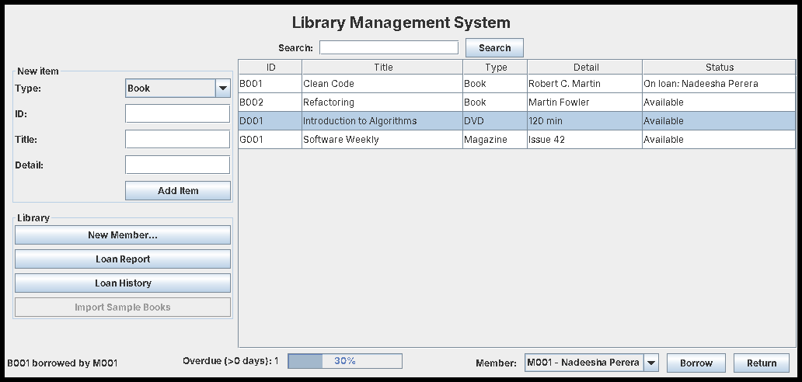
RESULT
While importing: the window is alive
The progress bar moves and the buttons still respond.
SENG 12233 · Lecture 12 · Week 12
6

Slide 7
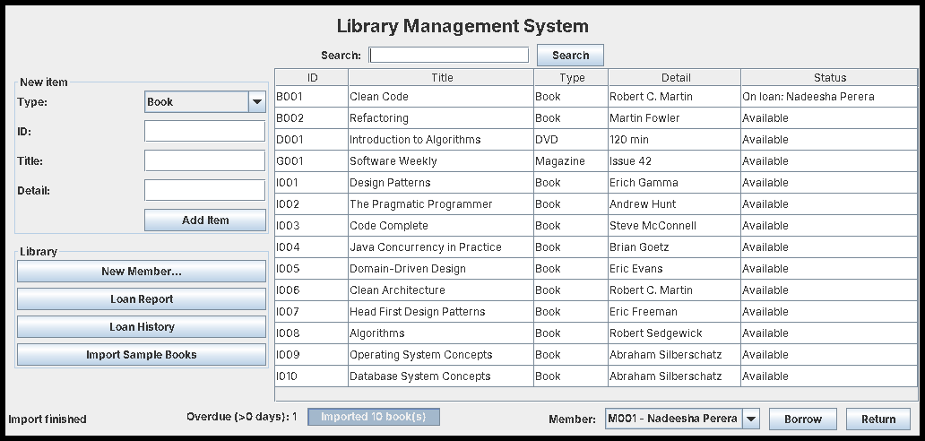
RESULT
Import finished
done() refreshes the table on the EDT.
SENG 12233 · Lecture 12 · Week 12
7

Slide 8
DAEMON
A background overdue checker
OverdueChecker.java
Thread t = new Thread(() -> {
while (true) {
int n = controller.countOverdue(days);
SwingUtilities.invokeLater(() -> onResult.accept(n)); // back to the EDT
try { Thread.sleep(intervalMs); } catch (InterruptedException e) { return; }
}
});
t.setDaemon(true); // do not keep the program alive after the window closes
t.start();
Background threads compute. Only the EDT touches the screen: invokeLater is the bridge.
SENG 12233 · Lecture 12 · Week 12
8

Slide 9
DANGER
Race conditions
• count++ is three steps: read, add, write
• Two threads can read the same value, and one update is lost
• Symptoms wrong totals, rare and different on every run
• Fix make the compound step atomic with synchronized
SENG 12233 · Lecture 12 · Week 12
9

Slide 10
DEMO
RaceDemo
RaceDemo.java
static volatile int unsafe = 0;
Runnable work = () -> { for (int i = 0; i < 1_000_000; i++) unsafe++; };
Thread a = new Thread(work), b = new Thread(work);
a.start(); b.start(); a.join(); b.join();
System.out.println("Expected 2000000, got " + unsafe);
Run it several times: most runs print less than 2000000.
SENG 12233 · Lecture 12 · Week 12
10

Slide 11
FIX
synchronized in the controller
LibraryController.java
public synchronized void borrow(String itemId, String memberId) { ... }
public synchronized void giveBack(String itemId) { ... }
Only one thread at a time may run a synchronized method of this object, so check-then-update cannot be interleaved.
SENG 12233 · Lecture 12 · Week 12
11

Slide 12
RECAP
Twelve weeks, one system
Weeks | What the LMS gained
1-2 | Classes, objects, encapsulation
3 | Inheritance, polymorphism
4 | Abstract classes, interfaces
5 | Exceptions
8-9 | Swing window, events, MVC
10 | Generics, streams
11 | JDBC persistence
12 | Threads, thread safety
SENG 12233 · Lecture 12 · Week 12
12

Slide 13
FINAL
Final project & demo
• Deliver your LMS repository with a clear Git history, one branch per week
• Demo borrow, return, error dialog, search, history, restart, import
• Explain one design decision in each of OOP, MVC and DAO
• Check the README builds and runs from a clean clone
SENG 12233 · Lecture 12 · Week 12
13

Slide 14
LAB PREVIEW
Lab 9 preview: Threads and Final
Branch week12-threads-final · PR "Week 12: Multithreading & Final Integration"
1. ImportWorker with a progress bar
2. OverdueChecker as a daemon thread
3. RaceDemo before and after
4. Final README and tagged release
SENG 12233 · Lecture 12 · Week 12
14

Slide 15
CHECK YOURSELF
Check yourself
1. Why must doInBackground() not touch a JLabel?
2. What does setDaemon(true) change?
3. Why can count++ lose updates?
4. Which part of the LMS would you demo to show polymorphism?
SENG 12233 · Lecture 12 · Week 12
15

