Slide 1
Lecture 01
SENG 41283 · Distributed and Cloud Computing
Characterization of
Distributed Systems
Definition · Concurrency · No Global Clock · Independent Failures
Core Properties
System Types
Trends
Challenges
Transparency
Dept. of Software Engineering · University of Kelaniya · Academic Year 2018/2019
Ref: Coulouris et al., Distributed Systems: Concepts and Design (5th ed.)

Slide 2
1. Definition & Three Core Characteristics
Definition
A distributed system is one in which components located at networked computers communicate and coordinate their actions only by passing messages (Coulouris et al.)
Computers may be spatially separated by any distance — same room or different continents
Concurrency
In a network of computers, concurrent program execution is the norm
Resources such as web pages or files are shared when necessary; capacity increased by adding more computers
Coordination of concurrently executing programs sharing resources is a critical design challenge
No Global Clock
Programs coordinate by exchanging messages; close coordination depends on a shared idea of time
There are limits to the accuracy with which computers can synchronise their clocks
There is NO single global notion of the correct time — a direct consequence of communication only by message passing
Independent Failures
Faults in the network isolate computers but do NOT stop them running
Programs on isolated computers may not detect whether the network has failed or has become unusually slow
Failure of a computer or process crash is NOT immediately known to other components
Each component can fail independently, leaving the others still running
SENG 41283 · University of Kelaniya
Lecture 01

Slide 3
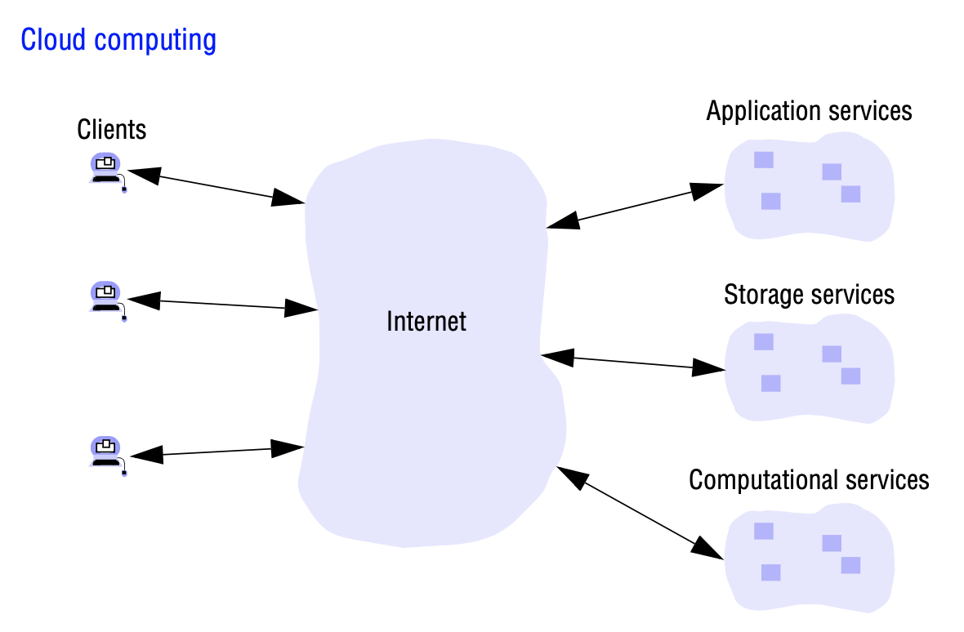
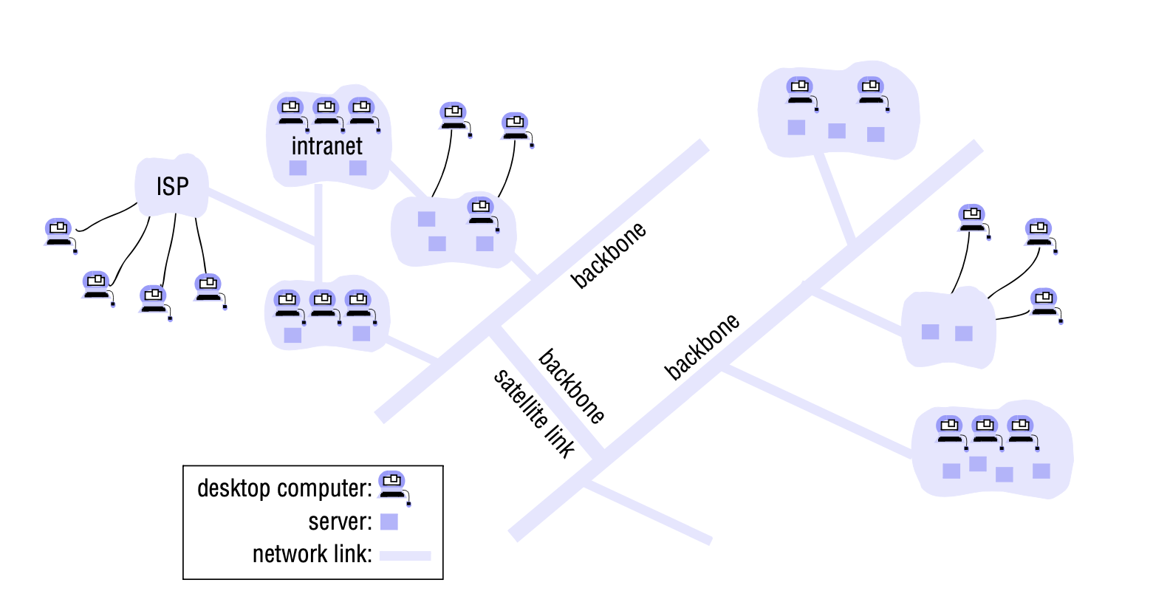
1. Networks & Ubiquitous Computing — Diagrams from Source
From the Lecture Notes
The Internet is a very large distributed system. It enables users wherever they are to access services such as the World-Wide-Web, email, and file transfer
Intranets are subnetworks protected by firewalls and linked together by backbones — network links with high transmission capacity employing satellite connections and fibre optic cables
Mobile Computing
Users away from their home intranet are still provided with access to resources via the devices they carry
Location-aware and context-aware computing: users utilise nearby resources (printers, point-of-sale terminals)
Ubiquitous Computing
Small cheap computational devices present in users' physical environments
Devices become so pervasive in everyday objects they are scarcely noticed — computation tied to physical function
Internet topology: intranets linked by backbone networks (satellite, fibre optic) via ISPs
Ubiquitous and mobile computing: devices carried by the user connect to nearby infrastructure
SENG 41283 · University of Kelaniya
Lecture 01

Slide 4
2. Desired Properties of a Distributed System
Fault-Tolerant
Can recover from component failures without performing incorrect actions
Highly Available
Can restore operations and resume services even when some components have failed
Recoverable
Failed components can restart themselves and rejoin the system after the cause of failure is repaired
Consistent
Can coordinate actions by multiple components in the presence of concurrency and failure; underlies the ability to act like a non-distributed system
Scalable
Can operate correctly even as some aspect of the system is scaled to a larger size; increasing network size, number of users/servers, or overall load should not have significant effect
Predictable Performance
The ability to provide desired responsiveness in a timely manner
Secure
The system authenticates access to data and services
Quality of Service
Not sufficient to provide access to services — must also provide guarantees regarding qualities such as performance, security, and reliability
SENG 41283 · University of Kelaniya
Lecture 01

Slide 5
3. Types of Distributed Systems
Architecture Types
Trends in Distributed Systems
Client-Server
Clients contact the server for data; format and display to end-user; changes committed back to server to make permanent
Three-Tier
Information about the client stored in a middle tier rather than on the client; simplifies application deployment; most common for web applications
N-Tier
Used when an application or server needs to forward requests to additional enterprise services on the network
Peer-to-Peer
No additional machines used to provide services or manage resources; responsibilities uniformly distributed among machines; each peer serves as either client or server
Examples from the Lecture Notes
World-Wide-Web · Web Search · Massive Multiplayer Games · Financial Trading
Pervasive Networking
Internet enables access to WWW, email, file transfer from anywhere
Firewalls filter messages entering and leaving intranets; ISPs provide broadband links
Ubiquitous Computing
Small cheap devices in users' physical environments — scarcely noticed; computation tied to physical function
Mobile Computing
Users carry devices that connect to networks in different places; location-aware computing
Multimedia Services
Support discrete media (text, pictures) AND continuous media (audio, video) with temporal integrity
Video needs given frame rate; maximum delivery latency must be maintained; late frames are dropped
Distributed Systems as Utility
Rent storage and compute (Amazon, Google); OS virtualisation is the key enabling technology
Software services as utilities: email, calendars (Google Workspace)
SENG 41283 · University of Kelaniya
Lecture 01

Slide 6
4. Challenges in Building Distributed Systems
Heterogeneity
Must accommodate different networks, OS, hardware, programming languages
Internet protocols mask network differences; middleware deals with the rest
Openness
Systems should be extensible — publish interfaces; Internet RFCs since early 1980s
Security
Confidentiality (against disclosure) · Integrity (against alteration) · Availability (against denial of access)
Unsolved: Denial-of-Service attacks; security of mobile code
Scalability
Scalable if cost of adding a user is constant amount in resources; algorithms avoid bottlenecks
DNS uses hierarchical structure rather than a single flat master file; IPv4 shortage → IPv6
Failure Handling
Detecting (checksums, timeouts) · Masking (retransmit; RAID) · Tolerating (inform user; let them try again later)
Recovery (rollback permanent data to consistent state) · Redundancy (multiple routes; replicated DNS tables; replicated databases)
Concurrency
Multiple concurrent users create races; each resource must be safe in concurrent environment
Example: two concurrent auction bids interleaved without control may be stored with wrong values
Transparency
Access · Location · Concurrency · Replication · Failure · Mobility · Performance · Scaling
Goal: make distribution invisible to application programmers so they focus on their own application
Exercise
Blog post based on last digit of index: [0]Blockchain [1]Hadoop [2]Redis [3]CDN [4]HBase [5]Spark [6]Kafka [7]DNS [8]Google [9]Torrent
SENG 41283 · University of Kelaniya
Lecture 01

