Slide 1
Lecture 02
SENG 41283 · Distributed and Cloud Computing
System Models
Physical · Architectural · Fundamental Models
Physical Models
Architectural Models
Fundamental Models
Interaction
Failure
Security
Dept. of Software Engineering · University of Kelaniya · Academic Year 2018/2019
Ref: Coulouris et al., Distributed Systems: Concepts and Design (5th ed.)

Slide 2
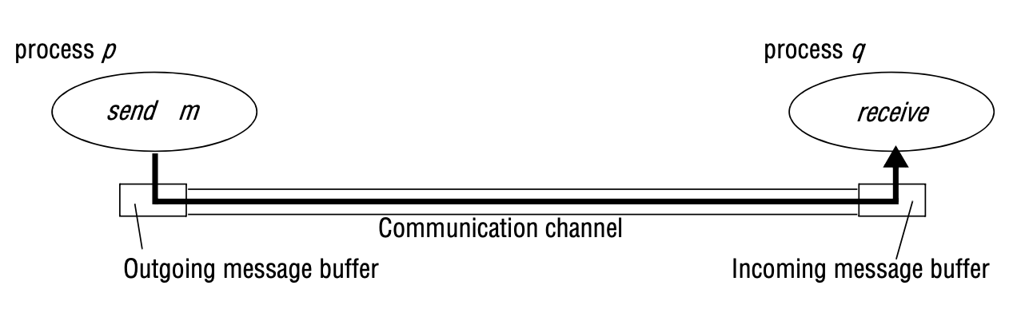
1. Physical Models — Three Generations
Why System Models?
Systems must function correctly in the widest possible range of circumstances and threats
Three types: Physical (hardware) · Architectural (structure) · Fundamental (interaction/failure/security)
Generation 1 – Early Systems (1970s–80s)
10–100 nodes on a LAN (usually Ethernet); limited Internet connectivity
Services: shared printers, file servers, email, file transfer
Generation 2 – Internet-Scale (1990s+)
Dramatic Internet growth (Google launched 1996); significant heterogeneity
Led to emphasis on open standards and associated middleware technologies
Generation 3 – Contemporary
Mobile computing: nodes move between locations (service discovery needed)
Ubiquitous computing: computers embedded in everyday objects
Cloud computing: cluster architectures — pools of nodes together provide a service
Baseline physical model: extensible set of computer nodes interconnected by a network for passing messages
SENG 41283 · University of Kelaniya
Lecture 02

Slide 3
2. Architectural Models — Communicating Entities & Paradigms
Communicating Entities
Communication Paradigms
4 Key Questions
What entities communicate?
What communication paradigm is used?
What roles and responsibilities do they have?
How are they mapped onto the physical infrastructure?
Processes
Primary communicating entity; distributed system = processes + IPC paradigms
Objects
Enable OOP approaches; accessed via interfaces defined in IDL; natural units of decomposition
Components
Like objects but also specify required interfaces (dependencies that must be present)
Web Services
Integrated into WWW; use HTTP, WSDL, SOAP, REST for interface specification and discovery
IPC (Interprocess Communication)
Low-level support: socket API to UDP/TCP; multicast; building block for all higher-level mechanisms
Remote Invocation
Most common paradigm; two-way exchange resulting in calling a remote operation
Request-reply protocols: pairwise client-server message exchange
RPC (Birrell & Nelson 1984): procedures called as if local; stubs handle marshalling
RMI: object-oriented extension; calling object invokes method on remote object
Indirect Communication
Through a third entity; no direct coupling between sender and receiver
Space uncoupling: sender need not know receiver identity
Time uncoupling: sender and receiver need not exist simultaneously
Mechanisms: Group communication · Pub-Sub · Message Queues · Tuple Spaces · DSM
SENG 41283 · University of Kelaniya
Lecture 02

Slide 4
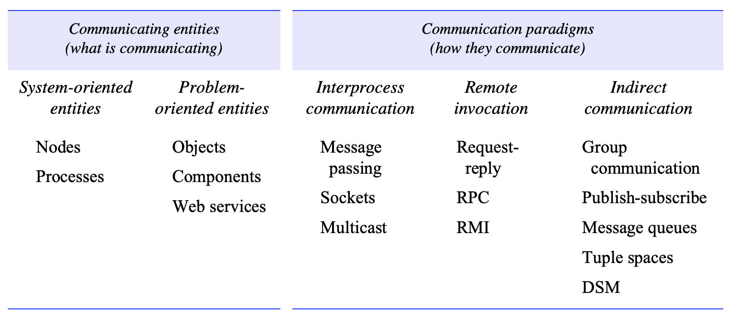
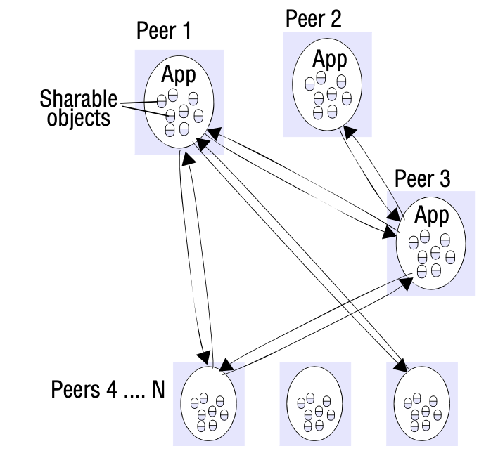
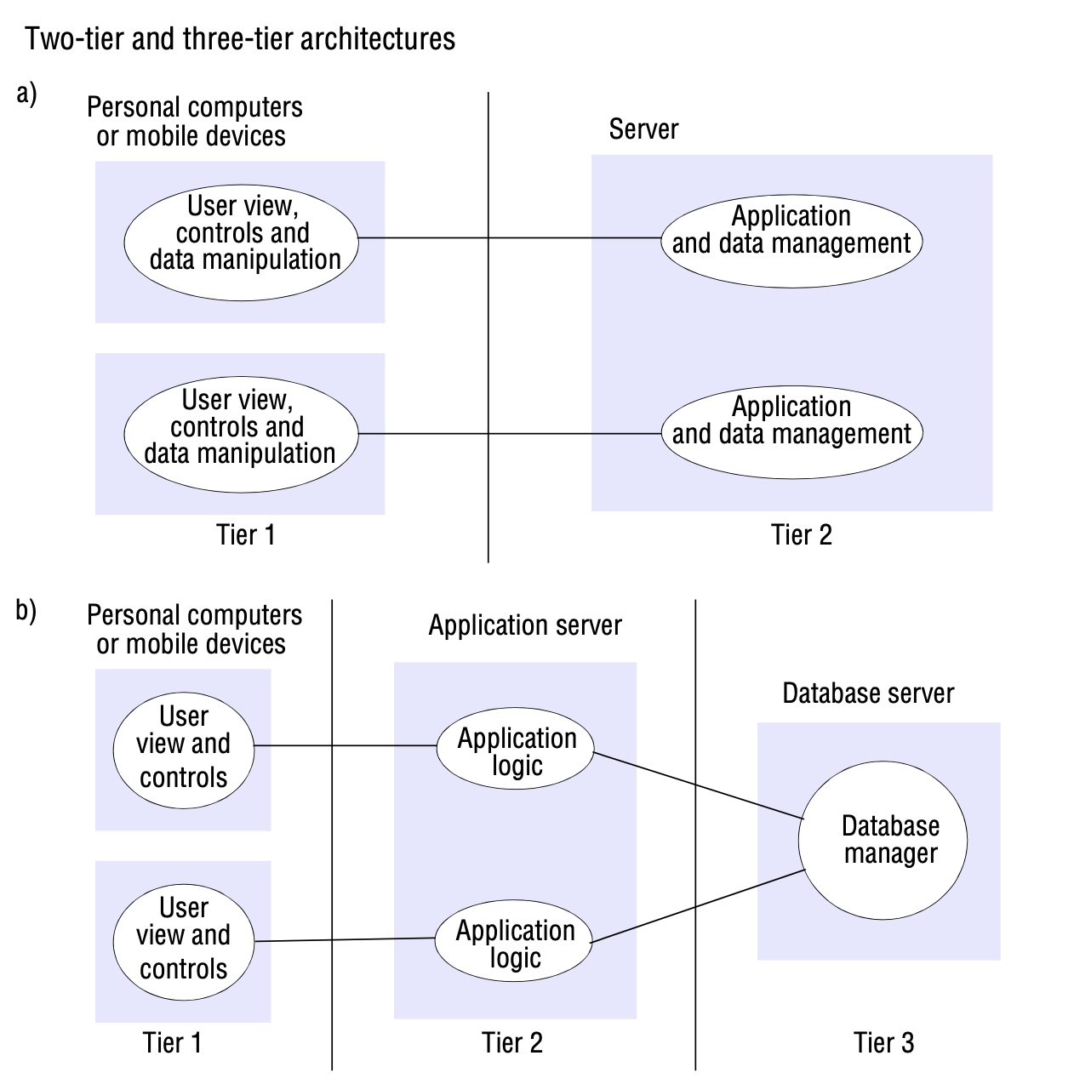
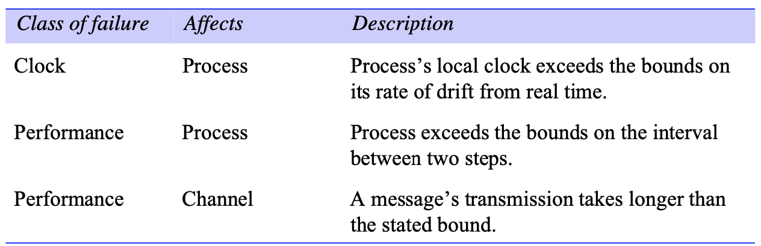
2. Architectural Models — Client-Server, P2P & Placement
Client-Server model: clients access shared resources held by servers
Peer-to-Peer model: all processes play equivalent roles
Layering and tiered architectural patterns
Placement strategies: multiple servers, caching, mobile code, mobile agents
SENG 41283 · University of Kelaniya
Lecture 02

Slide 5
3. Fundamental Models — Interaction, Failure & Security
Interaction Model
Latency: delay from start of message transmission to beginning of receipt; includes network transit + OS overhead
Bandwidth: total amount of information transmissible in a given time; shared by all communication channels
Jitter: variation in delivery time — critical for multimedia (varying intervals produce distorted audio)
Synchronous: known bounds on process execution steps, message delivery time, clock drift rates
Asynchronous: no bounds on any of the above — more realistic for the Internet
Failure Model
Process omission (crash): halts and executes no further steps; fail-stop means other processes can detect it
Communication omission: message not transported from sender's outgoing to receiver's incoming buffer
Arbitrary (Byzantine): any type of error; process may return wrong values; cannot be detected by checking responses
Timing failures: response falls outside specified time window (synchronous systems only)
Masking: build reliable services from failing components; checksums convert arbitrary → omission failures
Security Model
Access rights specify who is allowed to perform operations on an object
Principal (user or process) must be authenticated; access rights checked
Defeating threats: cryptography + authentication + secure channels
Secure channel properties: known identity on each side · privacy and integrity · timestamps prevent replay
SENG 41283 · University of Kelaniya
Lecture 02

Slide 6
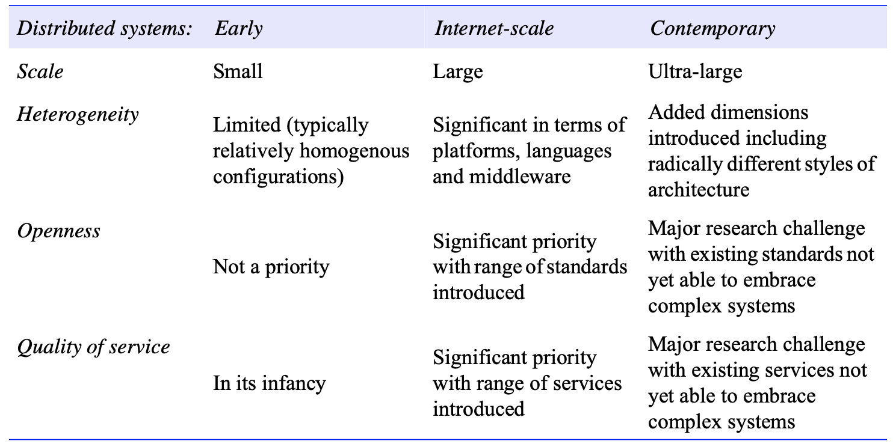
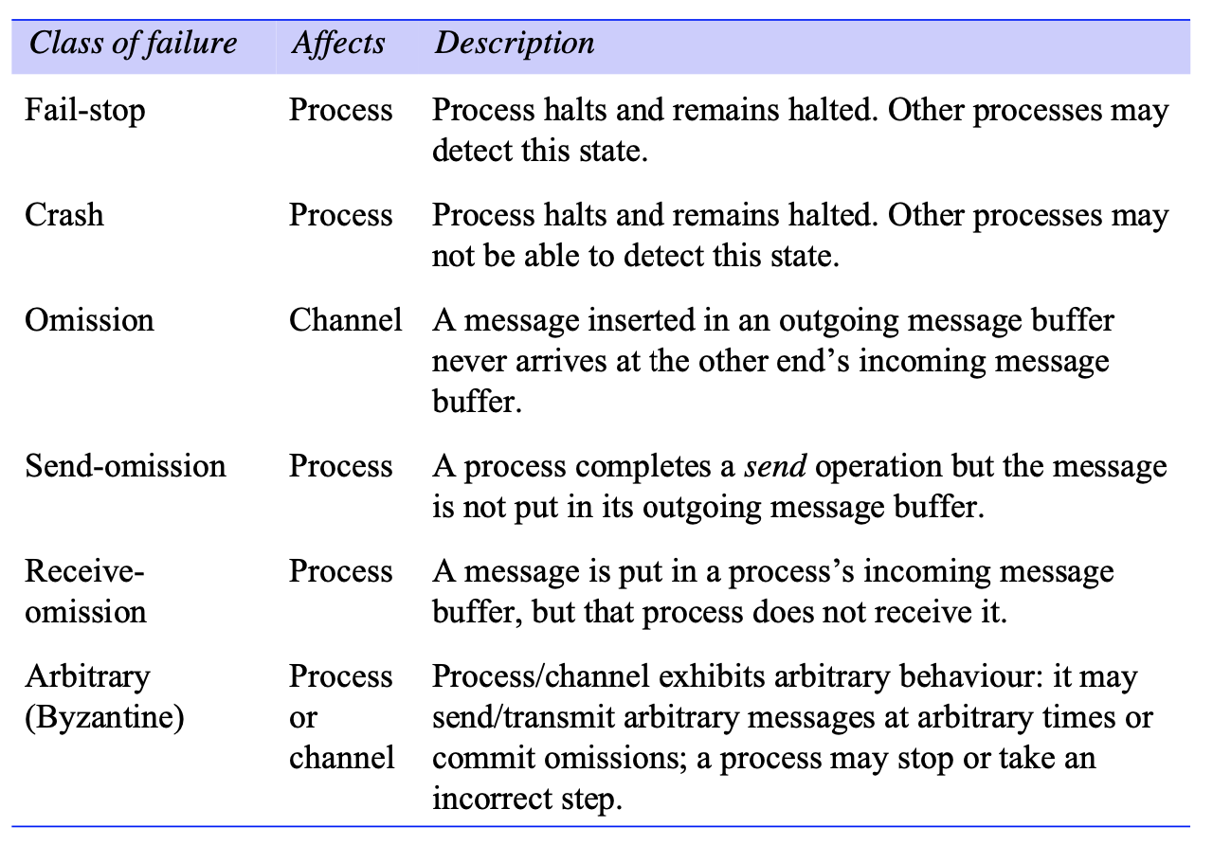
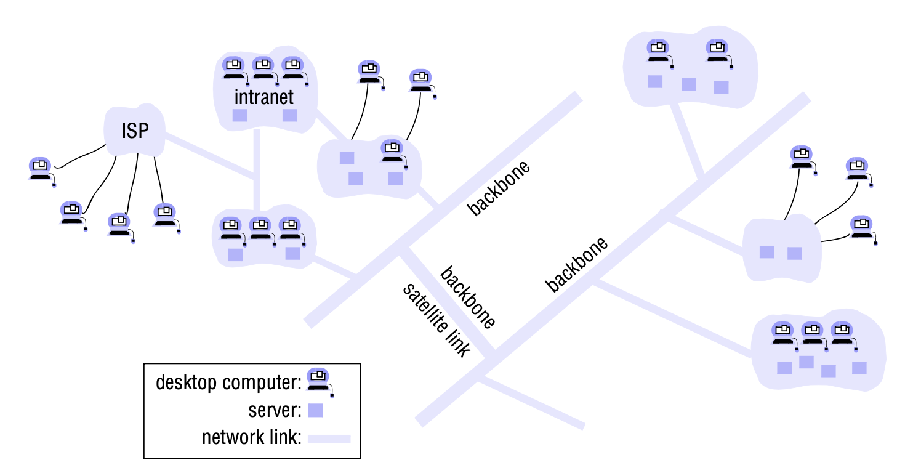
3. Fundamental Models — Diagrams from Lecture Notes
Failure model: taxonomy of process and communication failures
Security model: protecting objects and securing process interactions
Interaction model: synchronous vs asynchronous distributed systems
SENG 41283 · University of Kelaniya
Lecture 02

