Slide 1
Lecture 03
SENG 41283 · Distributed and Cloud Computing
Networking and Internetworking
Performance · Types · Protocols · Routing
Performance
Network Types
Packet Switching
OSI Protocol Stack
Routing
IP Multicast
Dept. of Software Engineering · University of Kelaniya · Academic Year 2018/2019
Ref: Coulouris et al., Distributed Systems: Concepts and Design (5th ed.)

Slide 2
1. Networking Issues for Distributed Systems
Performance
Latency: delay after a send operation before data starts arriving; measured as time to transfer an empty message
Data transfer rate: speed once transmission begins, quoted in bits per second
Message transmission time = latency + (message length ÷ data transfer rate)
Internet round-trip latencies: 5–500 ms (means 20–200 ms) — 10–100× slower than fast local networks
Scalability
IPv4 → IPv6 transition to handle addressing growth; not designed for current scale but performed remarkably well
Reliability
Most physical transmission media highly reliable; errors usually due to software failures (buffer overflow)
Security
Firewall on gateway: filters ALL messages per security policy; VPN and cryptographic techniques for remote access
Mobility
Mobile devices move between subnets; Internet addressing not adapted to intermittent connection at different points
Quality of Service
Ability to meet deadlines for real-time multimedia; requires guaranteed bandwidth and bounded latency
Multicasting
Need for one-to-many communication; many network technologies support simultaneous transmission to multiple recipients
SENG 41283 · University of Kelaniya
Lecture 03

Slide 3
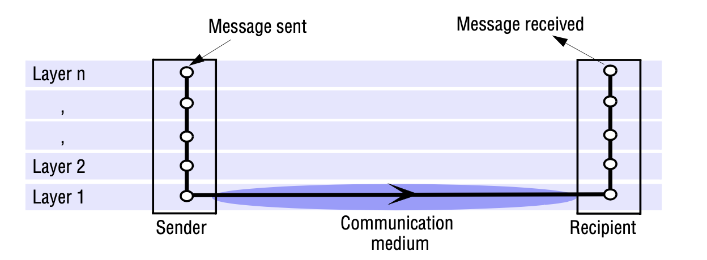
2. Types of Network
PAN – Personal Area Network
Connects personal digital devices carried by a user; WPANs increasingly important (Bluetooth)
LAN – Local Area Network
High-speed messages on single medium (twisted copper, coaxial, fibre); segments by switches/hubs
WAN – Wide Area Network
Lower speed; large distances; dedicated router computers; routing introduces delay at each hop
MAN – Metropolitan Area Network
High-bandwidth copper and fibre; up to 50 km; technologies from Ethernet to ATM
WLAN – IEEE 802.11 (WiFi)
10–100 Mbps over ranges up to 1.5 km; replaces or supplements wired LANs
WMAN – IEEE 802.16 (WiMAX)
Alternative to wired connections to buildings; supersedes WiFi in some applications
WWAN – GSM / 3G / LTE / 5G
Most mobile phone networks based on digital wireless technology
Network types by geographic scope: PAN, LAN, WAN, MAN, WLAN, WMAN, WWAN
SENG 41283 · University of Kelaniya
Lecture 03

Slide 4
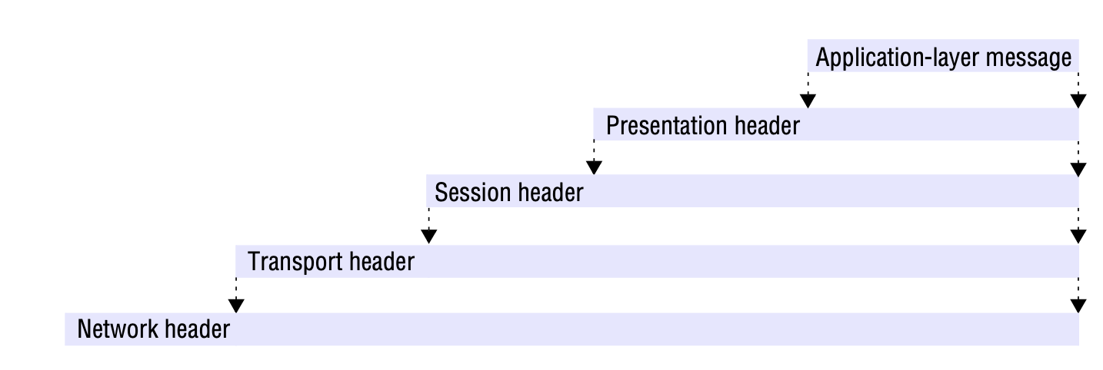
3. Packet Switching & Switching Schemes
Packet Switching
Basis for all computer networks since 1960s; packets queued at each node; communication is ASYNCHRONOUS
Restricted packet size: allocate buffer storage for largest possible packet; avoid undue delays for long messages
Broadcast
Everything transmitted to every node; receivers detect messages addressed to them (Ethernet, wireless)
Circuit Switching
Dedicated connection for duration of call; switched through exchanges (traditional telephone network)
Packet Switching
Store-and-forward; no circuit setup; each node stores then transmits packet towards destination
Frame Relay
Switches small frames on the fly by examining their first few bits; overcomes full-packet-receive-before-forward delay
Data Streaming
Real-time audio/video; video requires ~1.5 Mbps (compressed); play time = time at which element must be displayed
Example: at 24 fps, frame N has play time N/24 seconds after stream start; late frames are DROPPED
Packet switching: store-and-forward operation at each node — packets queued and transmitted when link available
SENG 41283 · University of Kelaniya
Lecture 03

Slide 5
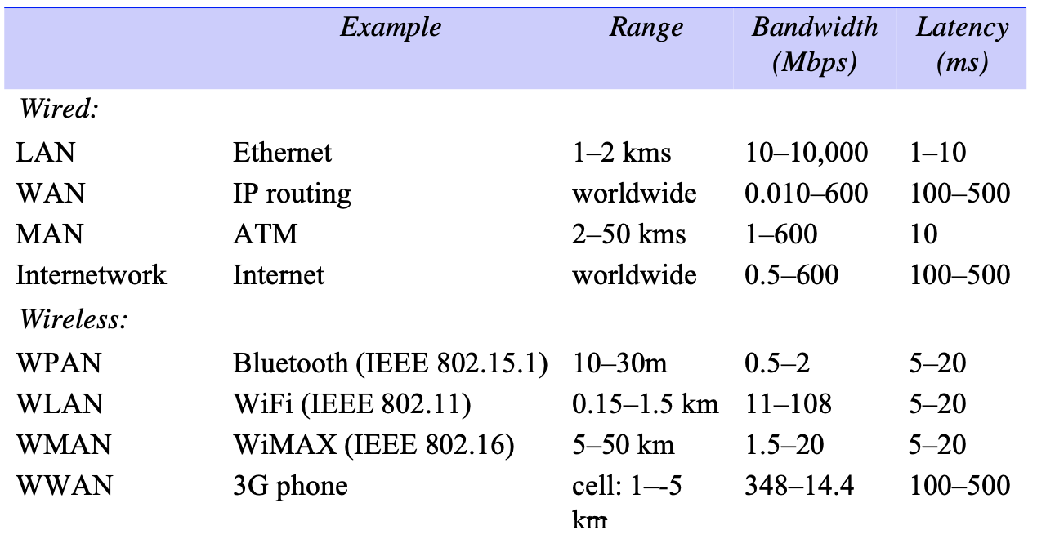
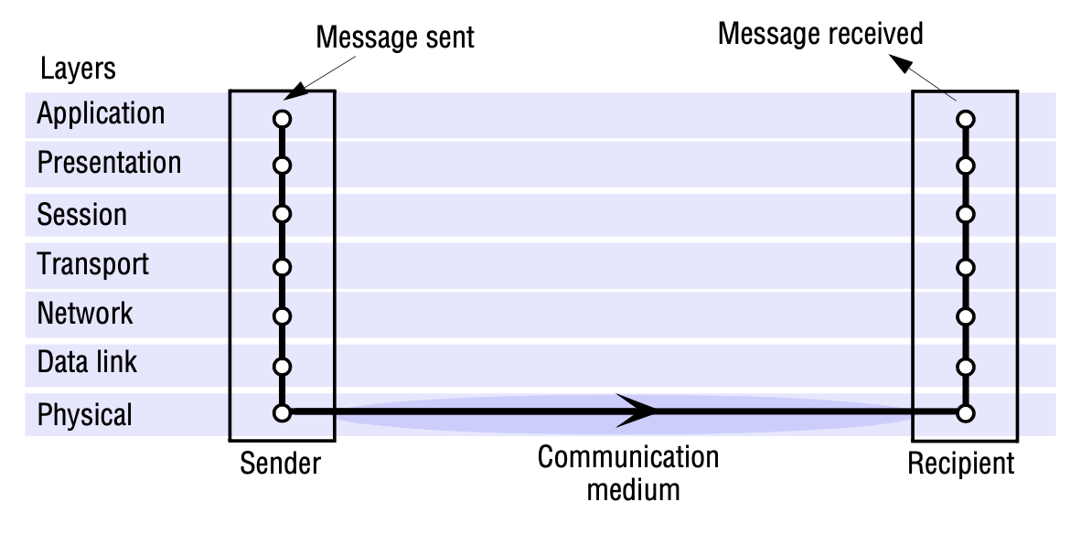
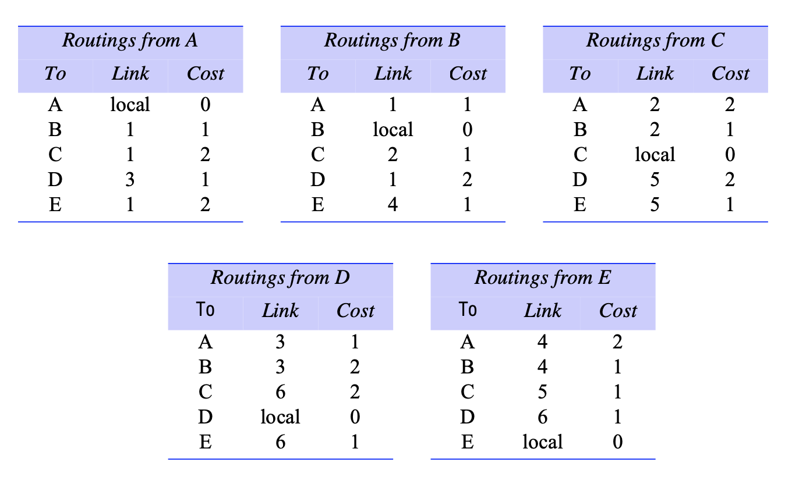
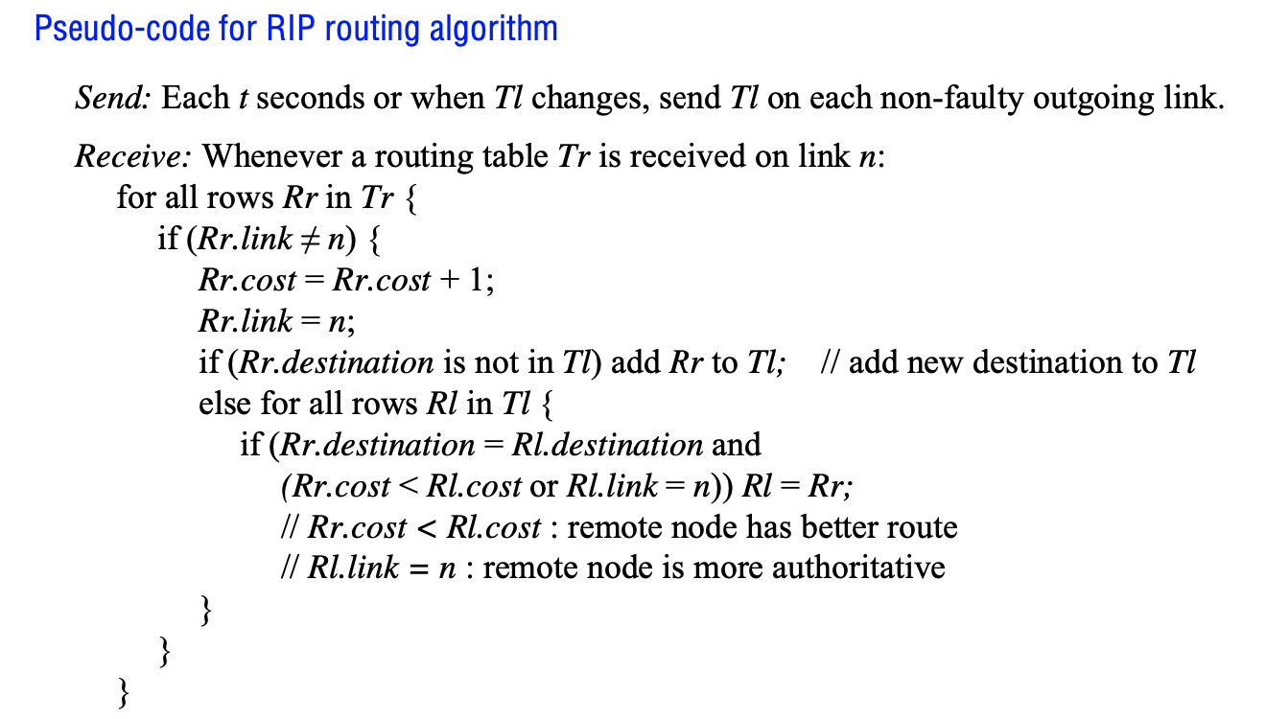
4. OSI Protocol Stack & IP Packet
OSI protocol model: seven-layer stack from Physical to Application
Protocol stack: encapsulation at the sender; decapsulation at the receiver
IPv4 packet header: version, TTL, protocol, source/destination addresses
Routing table: how routers determine next hop for each destination
SENG 41283 · University of Kelaniya
Lecture 03

Slide 6
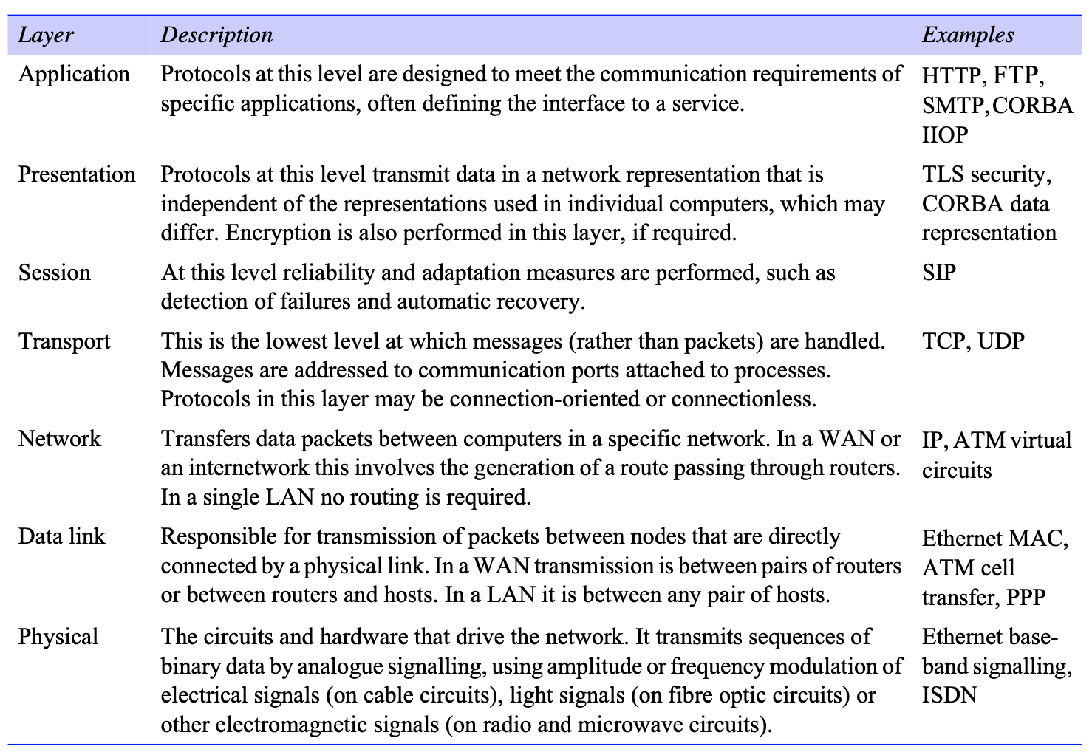
5. Routing & IP Multicast
Routing algorithm in action: path selection across a multi-hop network
SENG 41283 · University of Kelaniya
Lecture 03

Slide 7
5. Routing, IP Multicast & Overlay Networks
Routing
Adaptive routing: best route re-evaluated periodically for current traffic and faults
Routing algorithm: (1) determines route for each packet; (2) dynamically updates knowledge of the network
IP Multicast
Available only via UDP at application level; join multicast group by making socket join the group
Class D addresses (224.0.0.0–239.255.255.255) managed by IANA; TTL field limits propagation distance
Uses: fault tolerance via replicated services · service discovery · replicated data propagation · event notifications
Overlay Networks
Virtual network of nodes and virtual links sitting on top of an underlying network
Provides tailored services not otherwise available: multicast, security, content distribution
Disadvantage: extra level of indirection (performance penalty) and added complexity
Exercises from the Lecture Notes
1. Estimate transmission time for 200-byte request / 5000-byte response: UDP, TCP, same machine [latency:5ms, rate:10Mbps, MTU:1000 bytes, server processing:2ms]
2. How does Internet routing handle routing tables that are too large for any single router?
3. Compare UDP and TCP for: Telnet, FTP, rwho/finger, HTTP, and RPC
SENG 41283 · University of Kelaniya
Lecture 03

