Slide 1
Lecture 04
SENG 41283 · Distributed and Cloud Computing
Interprocess Communication
Sockets · UDP · TCP · Marshalling · Multicast
Synchronous/Asynchronous
Sockets
UDP Datagrams
TCP Streams
Marshalling
IP Multicast
Dept. of Software Engineering · University of Kelaniya · Academic Year 2018/2019
Ref: Coulouris et al., Distributed Systems: Concepts and Design (5th ed.)

Slide 2
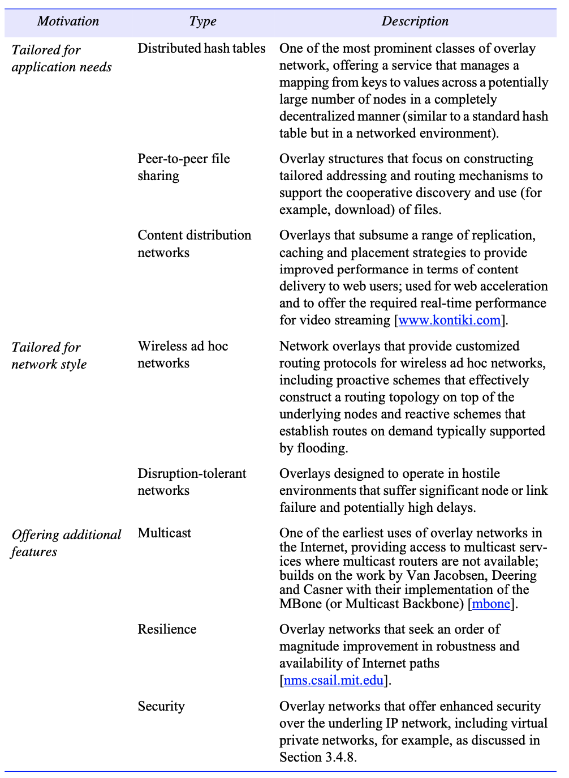
1. IPC Overview
Introduction
UDP provides a message passing abstraction — independent packets called datagrams
TCP provides the abstraction of a two-way stream between pairs of processes — no message boundaries
TCP: producer–consumer communication; data queued until consumer ready
Synchronous Communication
Both send and receive are BLOCKING; processes synchronise at every message
Sending process blocked until corresponding receive is issued
Asynchronous Communication
send is NON-BLOCKING: proceeds as soon as message copied to local buffer
receive blocking variant: blocks until message arrives
receive non-blocking variant: buffer filled in background; notification by polling or interrupt
Message Destinations
Messages sent to (Internet address, local port) pairs
Local port has exactly ONE receiver but can have MANY senders; servers publicise port numbers
Reliability & Ordering
Reliable: guaranteed delivery; uncorrupted and non-duplicated
Some applications require messages in sender order — out-of-order delivery regarded as failure
IPC overview diagram: UDP datagrams, TCP streams, socket API, external data representation, and IP multicast
SENG 41283 · University of Kelaniya
Lecture 04

Slide 3
2. UDP vs TCP — A Detailed Comparison
UDP Datagram Communication
TCP Stream Communication
Transmitted WITHOUT acknowledgement or retries; failure means message may not arrive
Non-blocking sends; blocking receives (unless timeout set)
Issues
Message size: most environments impose 8 KB limit; larger messages must be fragmented
Blocking: server creates separate threads — one for work, one for waiting for clients
Timeouts: prevent indefinite blocking when sender has crashed or message was lost
Failure Model
Omission failures: messages dropped (checksum error or no buffer space)
Ordering failures: messages can be delivered out of sender order
Use Cases
DNS lookups · Voice over IP (VoIP)
Avoids overheads: no state storage; no extra messages; no sender latency
Two-way stream between pairs of processes; connection established before communicating
connect from client → accept creates new socket for that client; listening socket retained
Key Guarantees
Lost messages: ACK scheme; sender retransmits on timeout
Flow control: if writer too fast for reader, writer is BLOCKED
Duplication/ordering: sequence numbers detect duplicates; reorder arrivals
Failure Model
Integrity: checksums + sequence numbers
Validity: timeouts + retransmissions guarantee delivery despite packet loss
Use Cases
HTTP (80/443) · FTP (22) · Telnet (23) · SMTP (25/587)
Matching
Both ends must agree on types of data in stream (e.g. one writes int then double; other must read int then double)
SENG 41283 · University of Kelaniya
Lecture 04

Slide 4
3. External Data Representation, Marshalling & Multicast
External Data Representation
Data structures must be flattened (converted to bytes) before transmission and rebuilt on arrival
Issue: computers may store integers differently — BIG-ENDIAN or LITTLE-ENDIAN; floating-point representations differ
Marshalling
Taking a collection of data items and assembling them into a form suitable for transmission in a message
Unmarshalling
Disassembling received bytes to produce an equivalent collection of data items at the destination
Three Approaches
1. CORBA CDR (Common Data Representation): external representation for structured and primitive types for CORBA RMI
2. Java Object Serialisation: flattening/representation of any single object or tree of objects; FOR JAVA USE ONLY
3. XML (Extensible Markup Language): textual format for structured data; used in web services messages
IP Multicast
Available only via UDP at application level; join multicast group by making socket join the group
Class D addresses (224.0.0.0–239.255.255.255) managed by IANA; TTL field limits propagation
Uses of Multicast in Distributed Systems
Fault tolerance via replicated services (all members receive and execute requests)
Discovering services in spontaneous networking · Better performance through replicated data
Propagation of event notifications (Facebook status change → all friends receive notification via multicast)
Exercise
Compare and contrast CORBA CDR, Java Object Serialisation, and XML; write a descriptive blog article
SENG 41283 · University of Kelaniya
Lecture 04

