Slide 1
Lecture 05
SENG 41283 · Distributed and Cloud Computing
Remote Invocation
Request-Reply · HTTP · RPC · RMI
Request-Reply Protocol
Failure Handling
Exchange Protocols
HTTP Methods
RPC
RMI
Dept. of Software Engineering · University of Kelaniya · Academic Year 2018/2019
Ref: Coulouris et al., Distributed Systems: Concepts and Design (5th ed.)

Slide 2
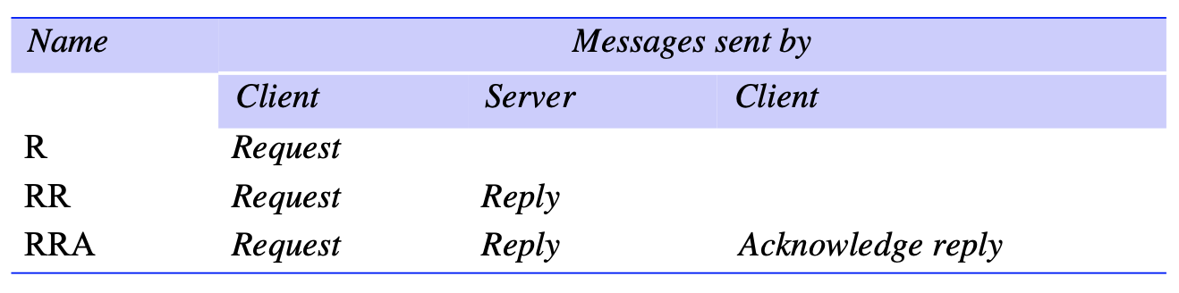
1. Request-Reply Protocol
Overview
Pattern on top of message passing supporting two-way exchange in client-server computing
Synchronous: client BLOCKS until reply arrives; Reliable: reply IS the acknowledgement
Why Built Over UDP Rather Than TCP?
Acknowledgements are redundant — requests are followed by replies
Establishing TCP connection involves two extra message pairs beyond request-reply pair
Flow control is redundant for majority of invocations passing only small arguments and results
API
doOperation(RemoteRef, operationId, arguments) → byte[]: sends request; blocks for reply
getRequest(): server acquires client request via server port
sendReply(reply, clientHost, clientPort): server sends reply; unblocks doOperation
Request-reply protocol: client blocks until reply arrives from server — reply serves as acknowledgement
SENG 41283 · University of Kelaniya
Lecture 05

Slide 3
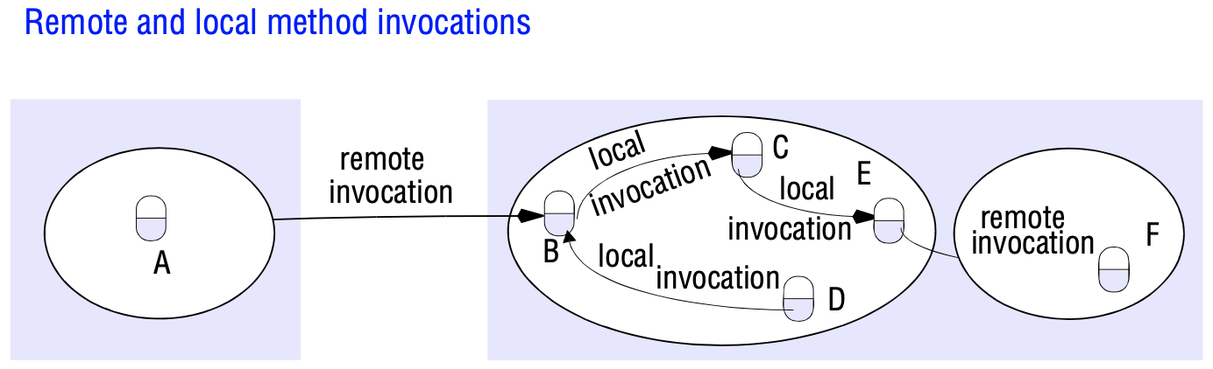
1. Request-Reply — Message Structure
Message Fields
messageType: indicates whether message is a Request or a Reply
requestId: message identifier generated by doOperation
Part 1: increasing sequence of integers unique to sender; reset at 2³²–1
Part 2: sender process identifier (port + Internet address) — unique in distributed system
remoteReference: identifies target remote server object (Internet address and port)
operationId: identifier for operation to invoke (numbered 1,2,3... or reflection-based)
Failure Handling
Omission failures: messages may be dropped (checksum error or no buffer space)
Timeouts: doOperation retransmits until reply received or server assumed failed
Duplicate filtering: recognises successive messages from same client with same requestId → FILTERS DUPLICATES
Idempotent operations: same effect regardless of how many times executed (e.g. add element to set)
History: (requestId, message, clientId) stored for retransmission without re-execution
Message structure: messageType, requestId, remoteReference, and operationId
SENG 41283 · University of Kelaniya
Lecture 05

Slide 4
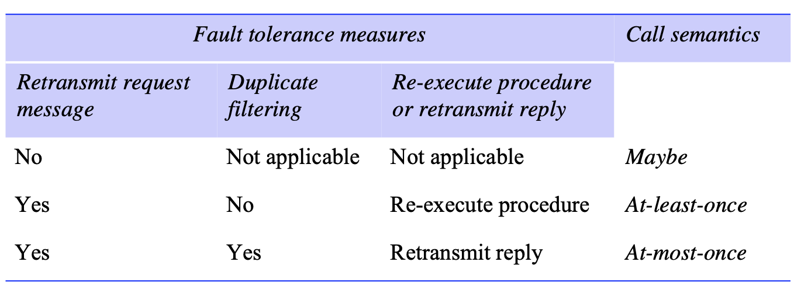
2. Exchange Protocols — R, RR, and RRA
Exchange protocols: R (request only), RR (request-reply), RRA (with acknowledge reply enabling history purging)
SENG 41283 · University of Kelaniya
Lecture 05

Slide 5
2. Exchange Protocols & HTTP Methods
R – Request Protocol
Single Request message; NO reply; client proceeds immediately after sending
Used when: no return value from operation; client needs no confirmation; suffers same UDP failures
RR – Request-Reply Protocol
Most useful for client-server exchanges; server reply IS acknowledgement
Failures masked by: retransmission + duplicate filtering + saving replies in history
RRA – Request-Reply-Acknowledge Reply
Three messages: request → reply → acknowledge-reply
Acknowledge reply contains requestId from the reply being acknowledged
Enables server to DISCARD entries from its history
HTTP — Example Request-Reply Protocol
Implemented over TCP
HTTP Methods (from the lecture notes)
GET: retrieve resource at given URL; no side effects
HEAD: same as GET but transfers status line and headers only — no body
POST: send data to server; may change server state (form submission, mailing list, database append)
PUT: store data at given URL; modification of existing resource or new resource
DELETE: server deletes resource at given URL; server may not always allow this
OPTIONS: server returns list of methods allowed for given URL
TRACE: server sends back the request message — used for diagnostic purposes
Status codes: 1xx Informational · 2xx Success · 3xx Redirection · 4xx Client Error · 5xx Server Error
SENG 41283 · University of Kelaniya
Lecture 05

Slide 6
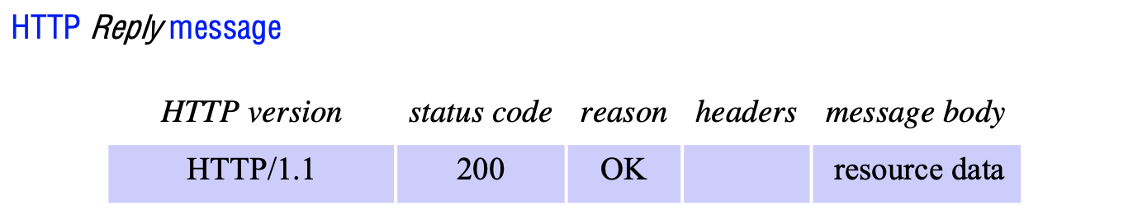
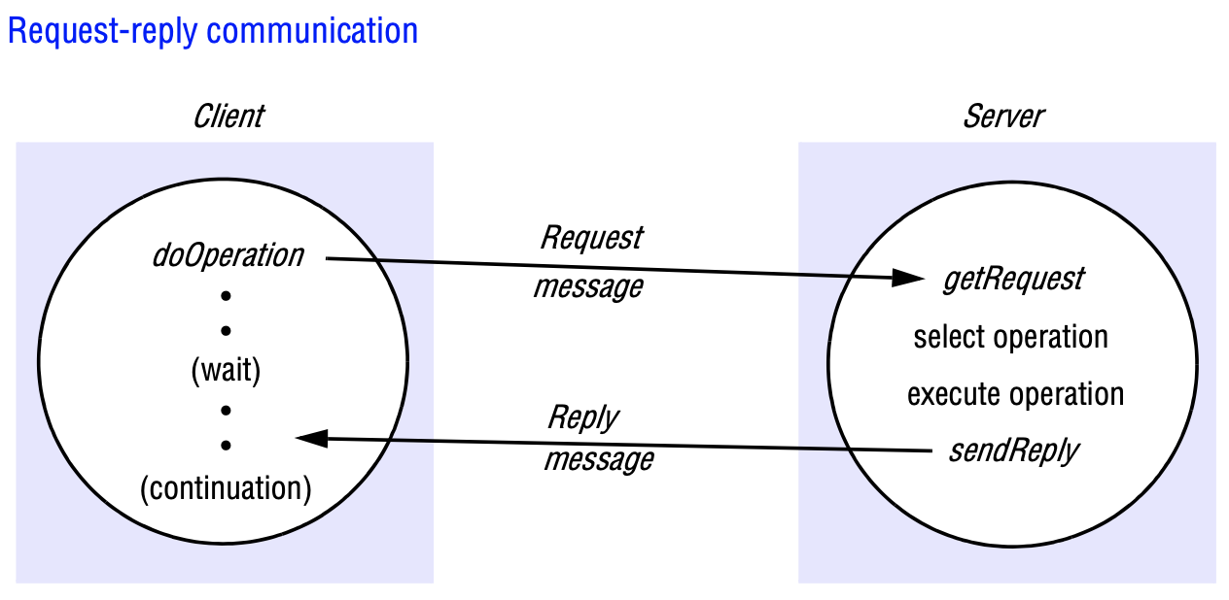
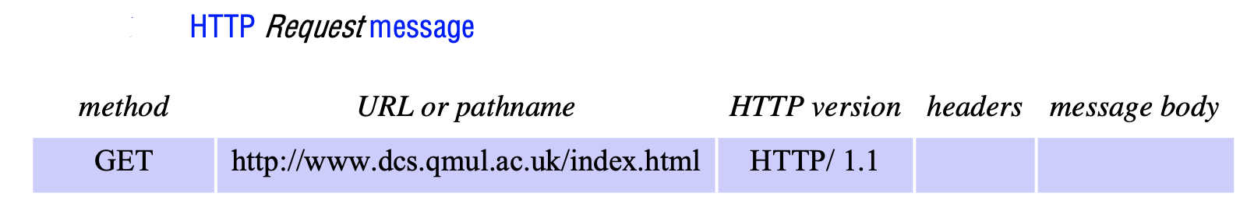
2. HTTP — Request and Response Structure
HTTP request message structure: method, URL, HTTP version, headers, optional body
HTTP response message structure: status line, headers, response body
HTTP status code ranges: 1xx, 2xx, 3xx, 4xx, 5xx
SENG 41283 · University of Kelaniya
Lecture 05

Slide 7
3. Remote Procedure Calls (RPC)
Interfaces & Semantics
RPC Implementation
Interfaces in Distributed Systems
Service interface: specification of procedures offered by a server; defines types of the arguments
Benefits: abstraction · language/platform independence · natural support for software evolution
Parameters: input (sent in request) or output (returned in reply) — not by value/reference across processes
Addresses in one process NOT valid in another — cannot pass as arguments
RPC Call Semantics
Maybe: executed once or not at all; no fault tolerance
At-least-once: retransmission masks omission; may execute > once; risky for non-idempotent operations
At-most-once: retries + duplicate filtering; most common — executed exactly once or not at all
Client Stub
One per procedure; behaves like local procedure to client
Marshals procedure ID + arguments; sends to server; unmarshals results on reply
Dispatcher
One per service; selects server stub by procedure identifier in request
Server Stub
One per procedure; unmarshals arguments; calls service procedure; marshals return values
Service Procedures
Implement the actual procedures in the service interface
Auto-Generation
Client stubs + server stubs + dispatcher generated automatically by interface compiler from interface definition
Python RPC Example (rpyc from the source notes)
import rpyc
conn = rpyc.classic.connect('localhost')
conn.execute("print('Hello from RPC')")
# Output: Hello from RPC
SENG 41283 · University of Kelaniya
Lecture 05

Slide 8
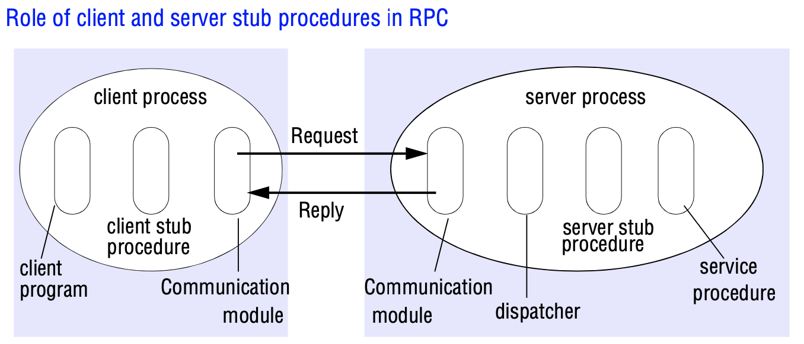
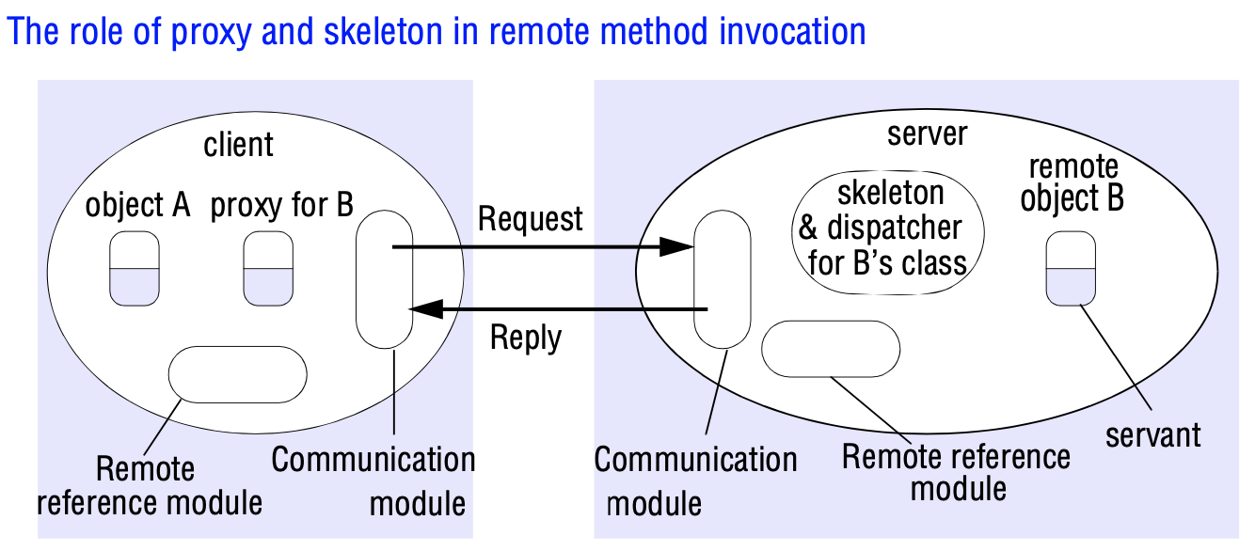
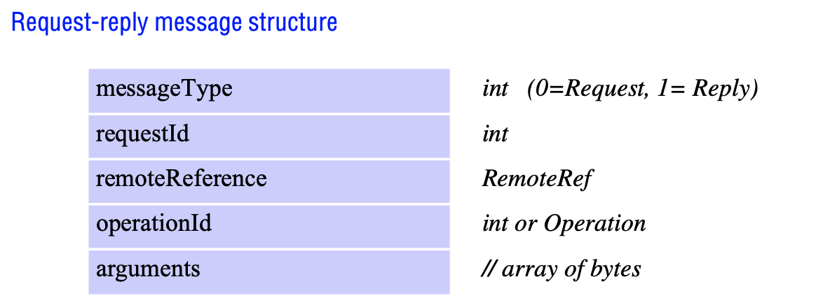
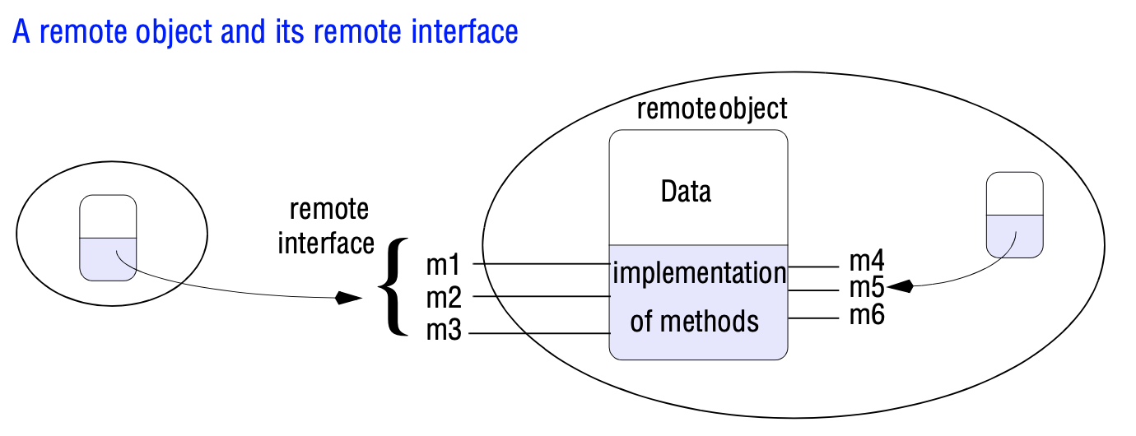
3. RPC & RMI — Implementation Diagrams
RPC implementation: client stub, dispatcher, server stub, service procedures
RMI architecture: proxy, dispatcher, skeleton, servant, communication module
Distributed object model: objects B and F with remote interfaces across two processes
RMI component interactions: client proxy, communication module, remote reference module
SENG 41283 · University of Kelaniya
Lecture 05

Slide 9
4. Remote Method Invocation (RMI)
Commonalities with RPC
RMI Implementation Components
Both support programming with interfaces, with the resultant benefits
Both constructed on top of request-reply protocols; offer at-least-once and at-most-once semantics
Both offer similar transparency — local and remote calls use same syntax; remote interfaces expose distributed nature
Added Expressiveness
Full OOP: objects, classes, inheritance, OOP design methodologies and tools
Unique object references for ALL objects whether local or remote; references can be PASSED AS PARAMETERS
RMI allows passing parameters by object reference — attractive for large or complex parameters
Distributed Object Model
Each process: objects some receiving local AND remote invocations; others only local
Remote objects (B, F): have remote object references and remote interfaces
Remote interface: specifies which methods can be invoked remotely
Communication Module
Carries out request-reply protocol; selects dispatcher for the class of the object
Remote Reference Module
Translates between local and remote object references; maintains remote object table
Servant
Instance of a class providing the body of a remote object; handles remote requests from skeleton
Proxy
Makes remote method invocation transparent to clients; hides marshalling, message sending, remote reference
Dispatcher
Receives request from communication module; selects skeleton method by operationId
Skeleton
Implements methods of remote interface; unmarshals arguments; invokes servant; marshals result into reply
Exercises
1. Design HelloWorld system incorporating Java RPC; publish Medium article (plagiarism checked); Ref: javatpoint.com/jax-ws-example-rpc-style
2. Try out Java RMI example; publish Medium article (plagiarism checked); Ref: javatpoint.com/RMI
SENG 41283 · University of Kelaniya
Lecture 05

