Slide 1
Lecture 06
SENG 41283 · Distributed and Cloud Computing
Monolithic Architecture
vs Microservices
Design · Benefits · Drawbacks · Kubernetes
Monolithic Architecture
Benefits & Drawbacks
Microservices Architecture
Kubernetes
Dept. of Software Engineering · University of Kelaniya · Academic Year 2018/2019
Ref: Coulouris et al., Distributed Systems: Concepts and Design (5th ed.)

Slide 2
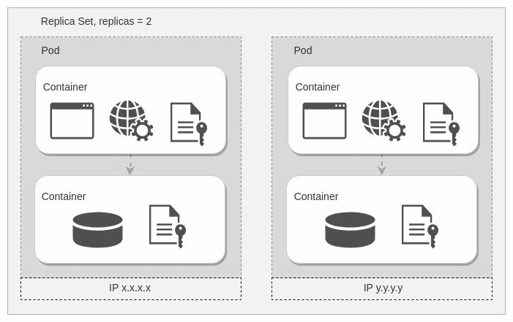
1. Monolithic Architecture
Definition
A monolithic application is a single-tiered software application in which different components are combined into a single program from a single platform
Built and deployed as ONE application for all platforms (desktop, mobile, tablet)
Uses RDBMS as data source; all modules share the same database
Components (from the lecture notes)
Authorisation: authenticates and authorises a user
Presentation: handles HTTP requests; responds with HTML or JSON/XML
Business logic: the core application business logic
Database layer: data access objects responsible for accessing the database
Application integration: integration with other services via messaging or REST API
Notification module: responsible for sending email notifications
E-Commerce Example
Authorises customers, takes orders, checks inventory, authorises payment, ships products — all as ONE unit
Monolithic architecture: all components built and deployed as a single unit sharing one database
SENG 41283 · University of Kelaniya
Lecture 06

Slide 3
1. Monolithic — Benefits & Drawbacks
Benefits
Drawbacks
Simple to develop — at the beginning of a project it is much easier to use a monolithic architecture
Simple to test — implement end-to-end testing by simply launching the application and testing the UI with Selenium
Simple to deploy — copy the packaged application to a server
Simple to scale horizontally — run multiple copies behind a load balancer
Maintenance becomes difficult when the application is too large and complex to understand entirely
The size of the application can slow down the start-up time
Must redeploy the ENTIRE application on each update
Challenging to scale when different modules have conflicting resource requirements
Reliability — a bug in any module (e.g. memory leak) can potentially bring down the entire process; since all instances are identical, that bug impacts availability of the ENTIRE application
Difficulty adopting new and advanced technologies — changes in languages or frameworks affect the entire application
Costly in both time and efforts to work with the application in detail
SENG 41283 · University of Kelaniya
Lecture 06

Slide 4
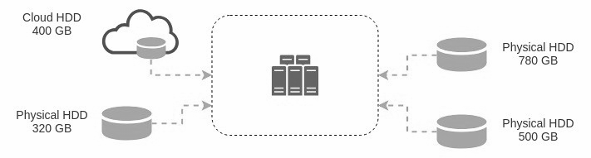
2. Microservices Architecture
Definition
Large application built as a suite of modular, loosely coupled services
Each module supports a specific business goal with a simple, well-defined interface
Each microservice has its OWN database — essential for loose coupling
E-Commerce Microservices (from the lecture notes)
Authorisation Service: authorises customers
Order Service: takes an order and processes it
Catalogue Service: manages products and checks product inventory
Cart Service: manages user cart; can utilise Catalogue service as a data source
Payment Service: manages and authorises payments
Shipping Service: ships ordered products
Microservices architecture: separate services with independent databases communicating via well-defined APIs
SENG 41283 · University of Kelaniya
Lecture 06

Slide 5
2. Microservices — Benefits & Drawbacks
Benefits
Drawbacks
Enables continuous delivery and deployment of large, complex applications
Better testability — services are smaller and faster to test
Better deployability — services can be deployed independently
Enables organisation of development effort around multiple teams; each team develops, deploys, and scales their services independently
Each microservice is relatively small — comfortable for a developer to understand; IDE is faster; application starts faster
Improved fault isolation — a memory leak in one service only affects that service; other services continue handling requests
Eliminates long-term commitment to a technology stack — new service can use a new stack; major changes can be rewritten
Developers must deal with additional complexity of creating a distributed system
Developer tools and IDEs are oriented on building monolithic applications; no explicit support for distributed applications
Testing is more difficult compared to monolithic applications
Developers must implement inter-service communication mechanisms
Implementing use cases that span multiple services without distributed transactions is difficult
Deployment complexity — in production there is additional operational complexity of managing many different service types
Increased memory consumption — N monolith instances are replaced by N×M service instances, with the overhead of containers
SENG 41283 · University of Kelaniya
Lecture 06

Slide 6
3. Kubernetes — Overview & Key Benefits
What is Kubernetes?
Open-source orchestrator for deploying containerised applications; originally developed by Google
Inspired by a decade of experience deploying scalable, reliable systems via application-oriented APIs
Velocity
Immutability: entirely new complete image built; update replaces whole image in single operation (no incremental changes)
Declarative configuration: everything in Kubernetes is a declarative configuration object representing desired state
Online self-healing: continuously takes actions to ensure actual state matches desired state; guards against failures
Scaling
Kubernetes achieves scalability by favouring decoupled architectures; APIs and load balancers isolate each component
Increasing the capacity of one component does not require any reconfiguration of other components
Abstracting Infrastructure
APIs provide a buffer between implementer and consumer
Load balancers provide a buffer between running instances of each service
Efficiency
Containers are immutable; replica count is a number in declarative config; change it and Kubernetes handles the rest
Auto-scaling is available with job optimisers such as Escalator
SENG 41283 · University of Kelaniya
Lecture 06

Slide 7
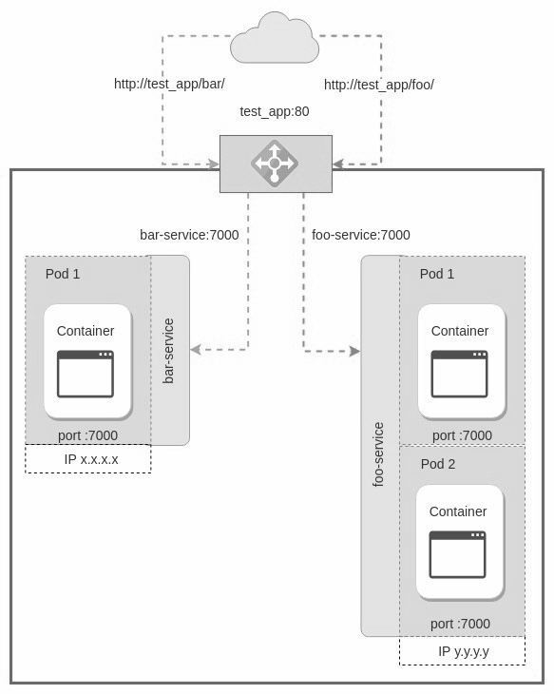
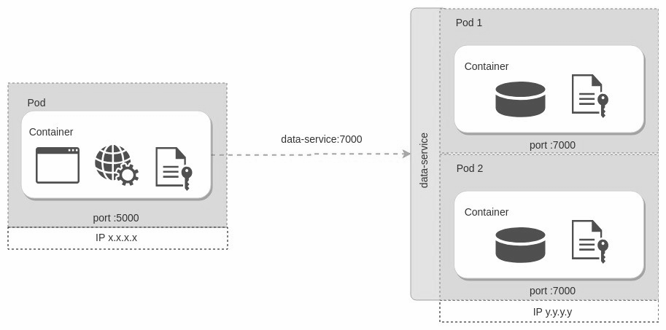
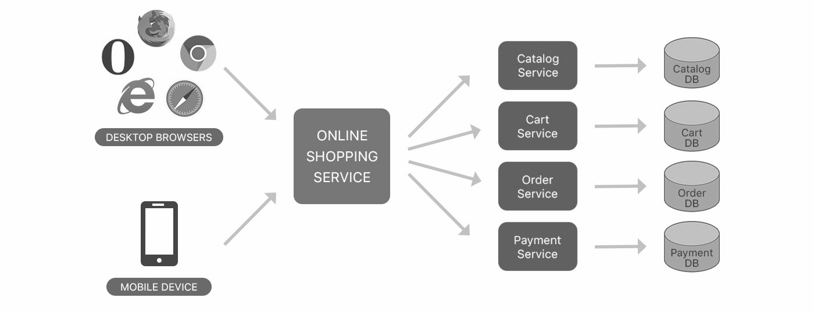
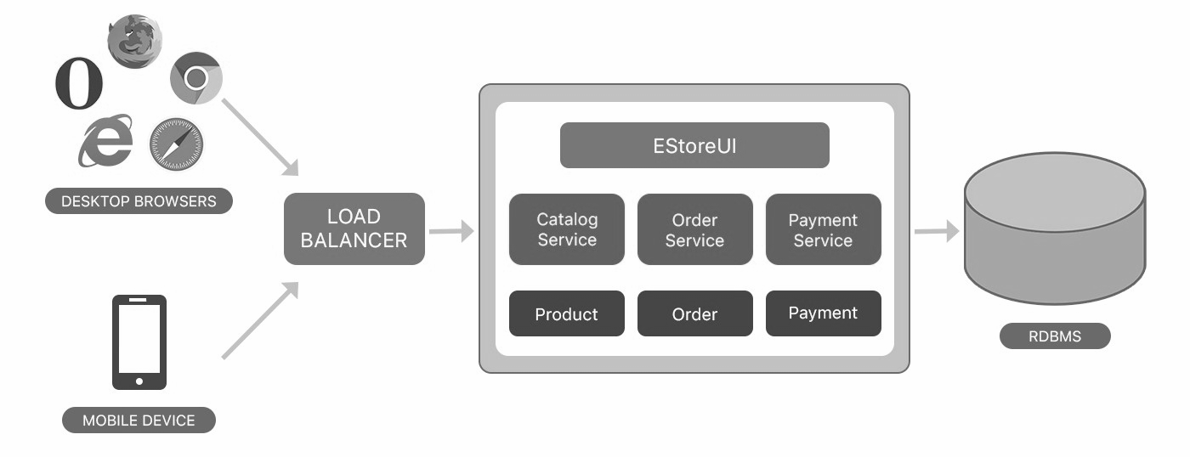
3. Kubernetes — Hardware, Software & Network Concepts
Kubernetes overview: cluster of nodes providing automated deployment, scaling, and management
Node: smallest unit — a single physical or virtual machine
Cluster: collection of nodes; shift workload on add/remove
Persistent Volume: cluster-level storage not tied to any specific node
SENG 41283 · University of Kelaniya
Lecture 06

Slide 8
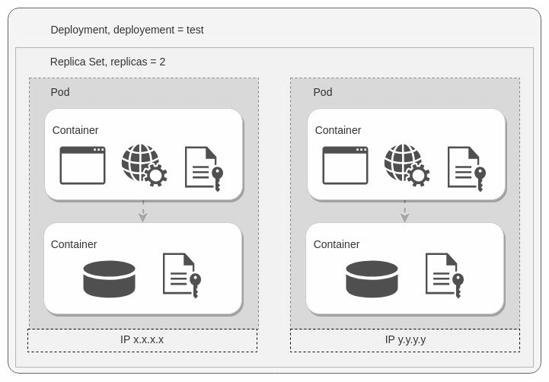
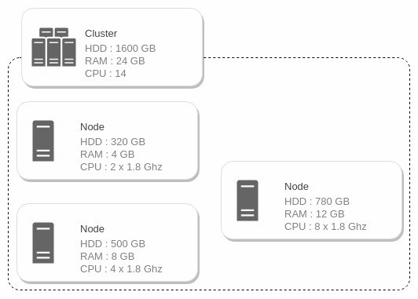
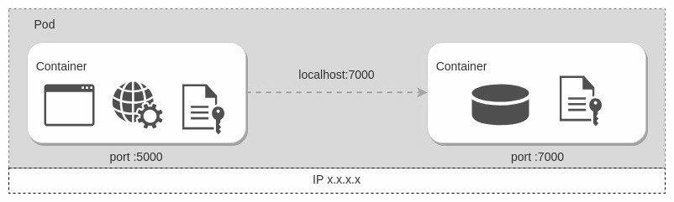
3. Kubernetes — Pod, Replica Set, Deployment & Service
Pod: wraps one or more containers sharing resources and network namespace
Replica Set: creates multiple Pod instances based on traffic load
Deployment: highest-level abstraction; restarts pods if they fail
SENG 41283 · University of Kelaniya
Lecture 06

