Slide 1
Lecture 07
SENG 41283 · Distributed and Cloud Computing
Indirect Communication
Space/Time Uncoupling · Group Comm · Pub-Sub · Queues · DSM · Tuples
Space/Time Uncoupling
Group Communication
Publish-Subscribe
Message Queues
DSM
Tuple Spaces
Dept. of Software Engineering · University of Kelaniya · Academic Year 2018/2019
Ref: Coulouris et al., Distributed Systems: Concepts and Design (5th ed.)

Slide 2
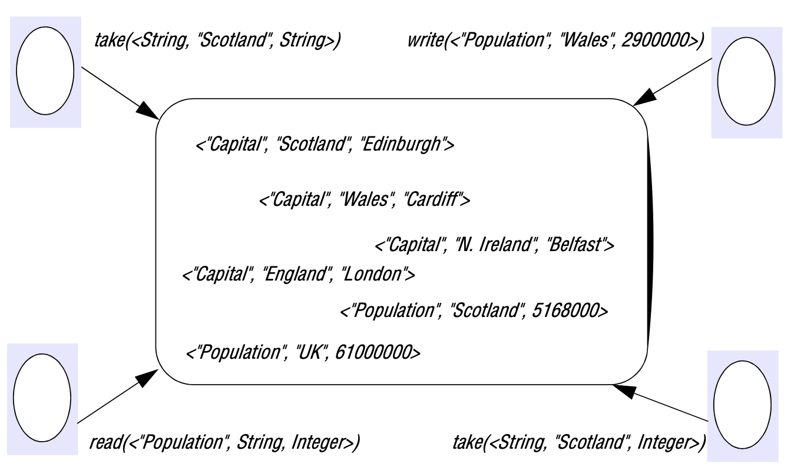
1. Indirect Communication — Definition & Group Communication
Definition
Communication between entities through an intermediary with NO direct coupling
Space uncoupling: sender does not know or need to know the identity of the receiver(s)
System developer has many degrees of freedom: participants can be replaced, updated, replicated, or migrated
Time uncoupling: sender and receiver(s) can have INDEPENDENT LIFETIMES
Do not need to exist at same time to communicate — important in volatile environments
Group Communication
Message sent to a group delivered to ALL members; sender not aware of individual receiver identities
Implemented over IP multicast or overlay network; adds group membership management, failure detection, ordering guarantees
Key Areas of Use
Reliable dissemination to large numbers of clients (financial industry: up-to-date information sources)
Collaborative applications: events disseminated to multiple users (multiuser games)
Fault-tolerance: consistent update of replicated data; highly available replicated servers
System monitoring and management: e.g. load balancing strategies
Group communication: a message sent to the group is delivered to all members; sender unaware of individual identities
SENG 41283 · University of Kelaniya
Lecture 07

Slide 3
1. Group Communication — Model & Group Types
Programming Model
Reliability & Membership
Central Concept
A group with associated membership; processes may join or leave the group
Processes send a message to the group → propagated to ALL members with reliability and ordering guarantees
Java: aGroup.send(aMessage) instead of issuing multiple individual send operations
Closed Groups
Only members may multicast to it; process delivers to itself any message it multicasts
Useful for cooperating servers to exchange messages that only they should receive
Open Groups
Processes OUTSIDE the group may send to it
Useful for delivering events to groups of interested processes
Overlapping Groups
Entities may be members of MULTIPLE groups (realistic in real-life systems)
Non-Overlapping Groups
Any process belongs to at most one group
Reliability Properties
Integrity: message received same as sent; no duplicates
Validity: any outgoing message eventually delivered
AGREEMENT: if delivered to ONE process → delivered to ALL processes in the group
Membership Management
Interface for changes: create/destroy groups; add/withdraw processes
Failure detection: monitors members for crashes AND unreachability
Marks processes as Suspected or Unsuspected; excludes suspected-failed from membership
Notifying members: notifies when process added or excluded
Group address expansion: membership service expands group identifier to current membership for delivery
Coordinates multicast delivery with membership changes by controlling address expansion
SENG 41283 · University of Kelaniya
Lecture 07

Slide 4
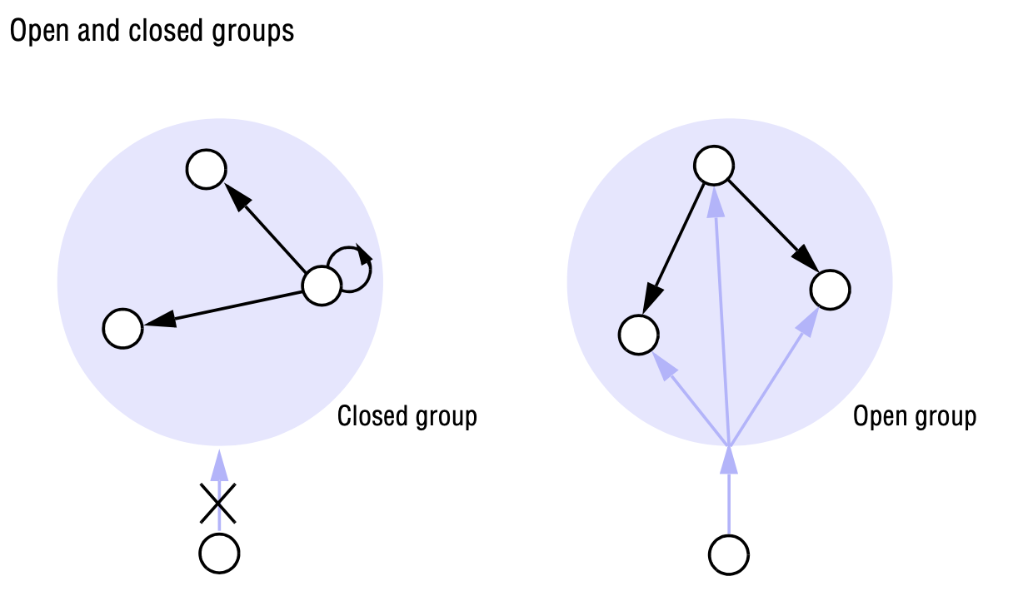
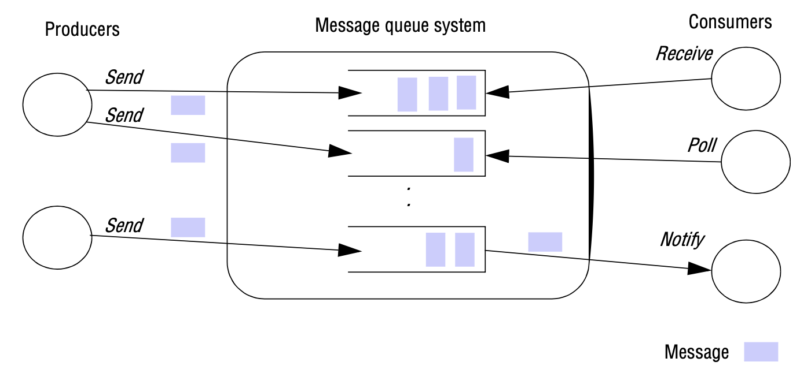
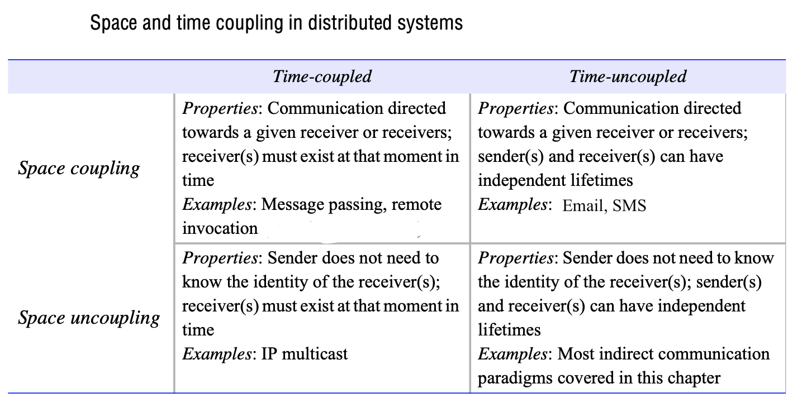
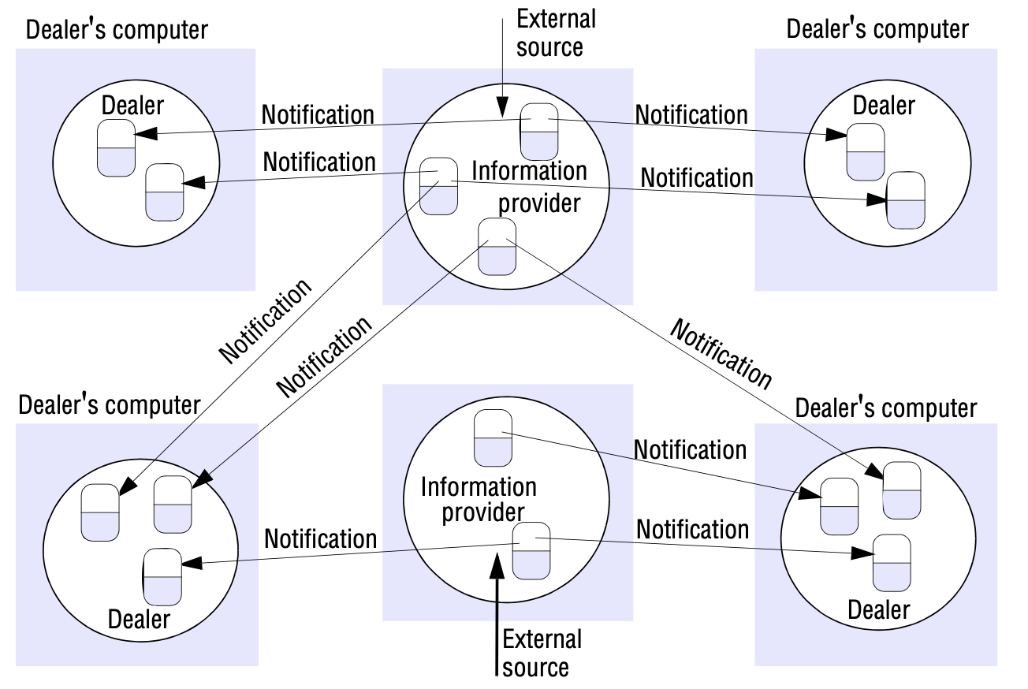
1. Group Communication — Ordering Guarantees
FIFO ordering: messages from Pi received at all Pj in the order they were sent
Causal ordering: captures cross-sender causality chains
Total ordering: all processes see the same FIFO sequence of messages
Token passing ring: token circulates; process may only access resource when holding token
SENG 41283 · University of Kelaniya
Lecture 07

Slide 5
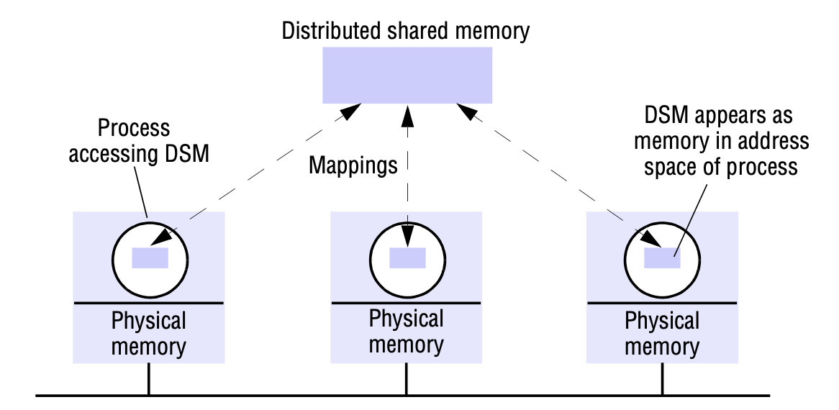
2. Publish-Subscribe System
Definition
Publishers publish structured events to an event service
Subscribers express interest through subscriptions (arbitrary patterns over structured events)
System matches subscriptions against events and ensures correct delivery — ONE-TO-MANY paradigm
Programming Model
publish(e): publisher disseminates event e
subscribe(f): subscriber expresses interest; f = filter (pattern over all possible events)
unsubscribe(f): subscriber revokes interest
notify(e): events delivered to subscriber when matching subscription found
Subscription Models
Channel-based: subscribe to named channel; receive all events sent to that channel
Topic-based (subject-based): subscriptions defined in terms of topic of interest
Content-based: query over compositions of constraints over event attribute values
Type-based: subscriptions in terms of types or subtypes of events
Implementation
Centralised: single event broker — simple but single point of failure and bottleneck
Distributed: network of cooperating brokers — survives node failure; Internet scale
Routing
Flooding · Filtering-based routing · Rendezvous · Informed Gossip
Publish-subscribe system: publishers, event service, and subscribers with filter-based matching
SENG 41283 · University of Kelaniya
Lecture 07

Slide 6
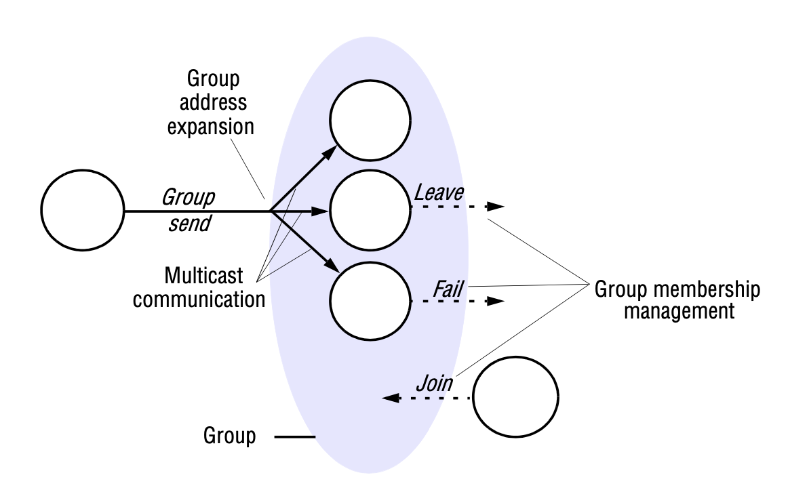
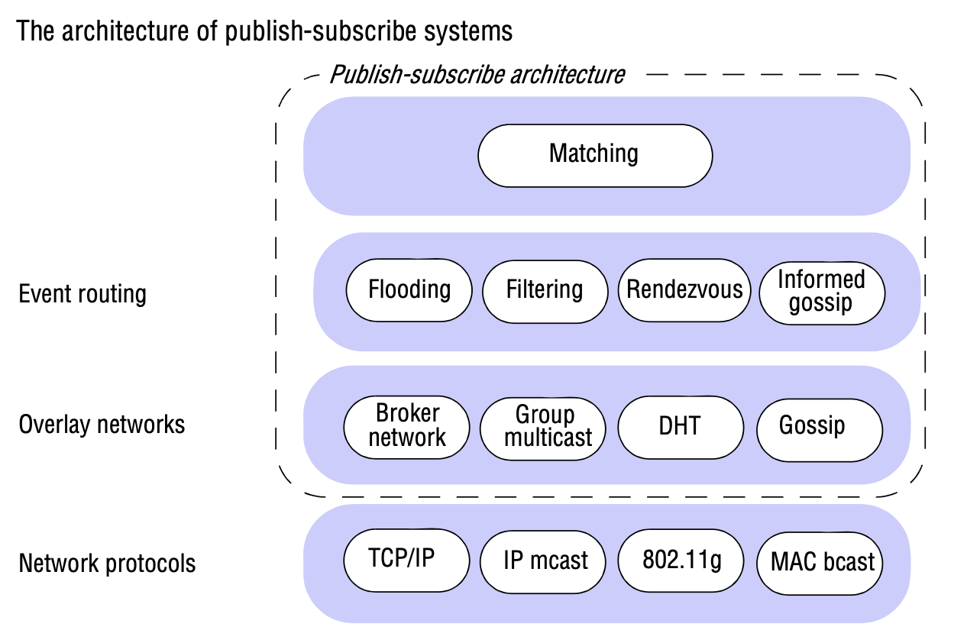
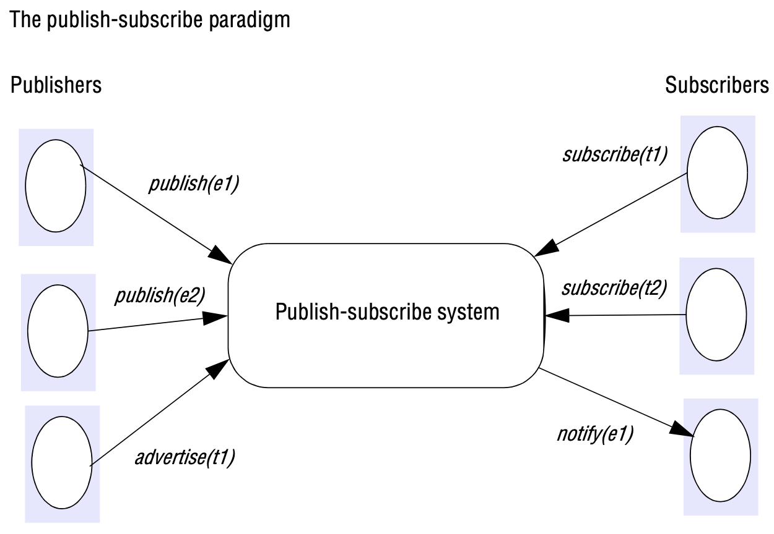
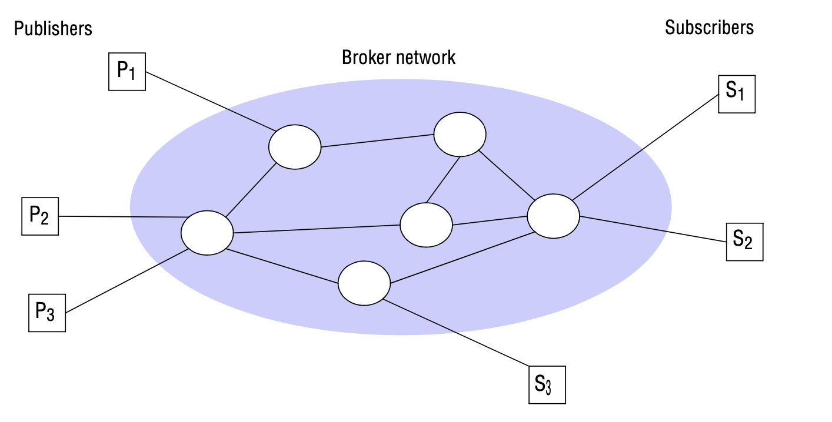
3. Message Queues, DSM & Tuple Spaces
Message queues: producer sends to queue; consumer receives with blocking, polling, or notify
Distributed Shared Memory: processes at different computers share a virtual address space
Tuple space: write, read, and take operations; accessed by pattern matching on content
Pub-sub routing: distributed broker network with filtering-based event routing
SENG 41283 · University of Kelaniya
Lecture 07

Slide 7
3. Message Queues, DSM & Tuple Spaces
Message Queues (Message-Oriented Middleware)
Point-to-point service using a queue as indirection; achieves space and time uncoupling
Sender places message into queue; a single consumer process removes it
Blocking receive: blocks until appropriate message available
Non-blocking receive (polling): checks queue status; returns 'not available' if empty
Notify operation: issues event notification when message becomes available
Queuing policy: normally FIFO; most implementations support priority (higher priority messages delivered first)
Consumer processes can select messages from queue based on message properties
Distributed Shared Memory (DSM)
Abstraction for sharing data between computers WITHOUT shared physical memory
Processes access DSM by reads and writes to what appears to be ordinary memory in their address space
Underlying runtime ensures transparently that processes at different computers observe each other's updates
Tuple Space Communication
Processes communicate indirectly by placing tuples in a tuple space; others read or remove them
Tuples have NO address — accessed by PATTERN MATCHING on content
write: adds a tuple · read: returns matching tuple without removing it · take: returns and removes matching tuple
Assignment
Try out RabbitMQ Work Queue example in any preferred language; write Medium blog article on important concepts of message queues. Ref: https://www.rabbitmq.com/getstarted.html
SENG 41283 · University of Kelaniya
Lecture 07

