Slide 1
Lecture 08
SENG 41283 · Distributed and Cloud Computing
Security in Distributed Systems
Threats · Cryptography · Authentication · Signatures · Certificates
Threat Model
Cryptography
Authentication
Digital Signatures
Certificates
Firewalls
Dept. of Software Engineering · University of Kelaniya · Academic Year 2018/2019
Ref: Coulouris et al., Distributed Systems: Concepts and Design (5th ed.)

Slide 2
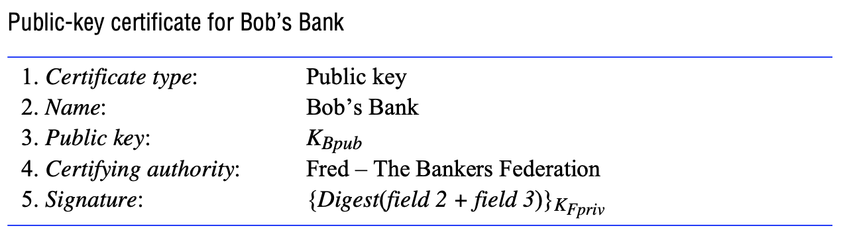
1. Introduction & Threat Model
Introduction
Processes encapsulate resources; principals authorised to operate on resources which must be protected
Enemies can access the network, copy any message, and inject arbitrary messages
Digital cryptography provides the basis for most computer security mechanisms
CIA Triad
Confidentiality: protection against disclosure to unauthorised individuals
Integrity: protection against alteration or corruption of information
Availability: protection against interference with the means to access resources
Threat Classes
Leakage: acquisition of information by unauthorised recipients
Tampering: unauthorised alteration of information
Vandalism: interference with proper system operation without direct gain
Attack Methods
Eavesdropping: obtaining copies of messages without authority
Masquerading: using another principal's identity without their authority
Message tampering / Man-in-the-middle: intercept, alter, and re-send messages
Replaying: storing intercepted messages and sending them later — effective even against authenticated messages
Denial of Service: flooding a channel to deny access to legitimate users
Threat model: the main categories of attack on a distributed system
SENG 41283 · University of Kelaniya
Lecture 08

Slide 3
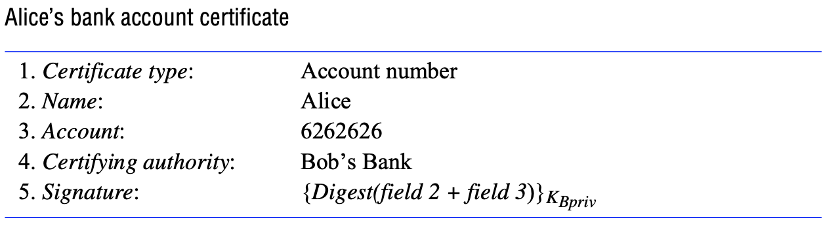
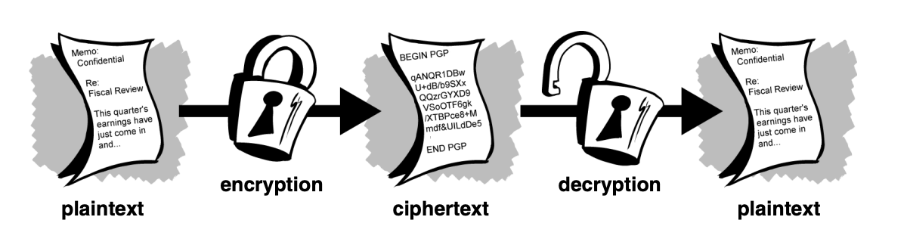
2. Cryptography — Fundamentals
Encryption overview: plaintext + key + algorithm produces ciphertext; decryption reverses the process
Secret communication with shared key K_AB: Alice encrypts; Bob decrypts with same key
SENG 41283 · University of Kelaniya
Lecture 08

Slide 4
2. Cryptography — Classes & Uses
Encryption Classes
Three Roles of Cryptography
Encryption and Decryption
Plaintext (cleartext): data readable without special measures
Encryption: disguising plaintext so substance is hidden — produces ciphertext
Decryption: reverting ciphertext to original plaintext
Cryptographic key: parameter in algorithm; encryption cannot be reversed without the key
Shared Secret Keys (Symmetric)
One key for both encryption and decryption; must be kept secret
Benefits: very fast; excellent for data at rest
Public/Private Key Pairs (Asymmetric)
Sender uses recipient's PUBLIC KEY to encrypt
Recipient uses PRIVATE KEY to decrypt
Computationally INFEASIBLE to deduce private key from public key
No private key is ever transmitted or shared
1. Secrecy and Integrity
Protect data during transmission across networks vulnerable to eavesdropping
Alice uses E(K_AB, M) to encrypt; Bob decrypts using D(K_AB, M)
2. Authentication
Verify identities of communicating pairs of principals
Kerberos-style: Sara holds K_A (for Alice) and K_B (for Bob)
1. Alice → Sara: unencrypted request
2. Sara → Alice: {{Ticket}K_B, K_AB}K_A
3. Alice decrypts with K_A (from password; not transmitted; deleted after use)
4. Alice → Bob: {Ticket}K_B, identity, request R
5. Bob decrypts ticket with K_B; gets authenticated identity and session key K_AB
3. Digital Signatures
Verify to third party that message is unaltered copy produced by signer
Encrypt message digest using signer's PRIVATE KEY; verify with PUBLIC KEY
SENG 41283 · University of Kelaniya
Lecture 08

Slide 5
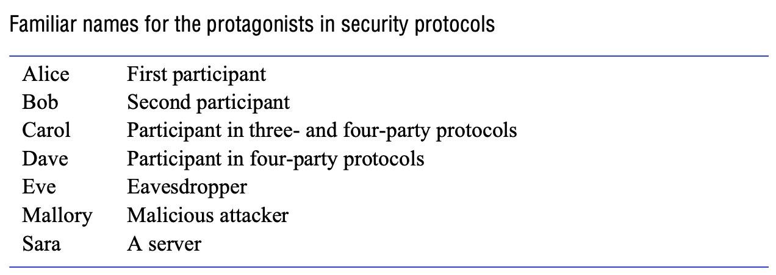
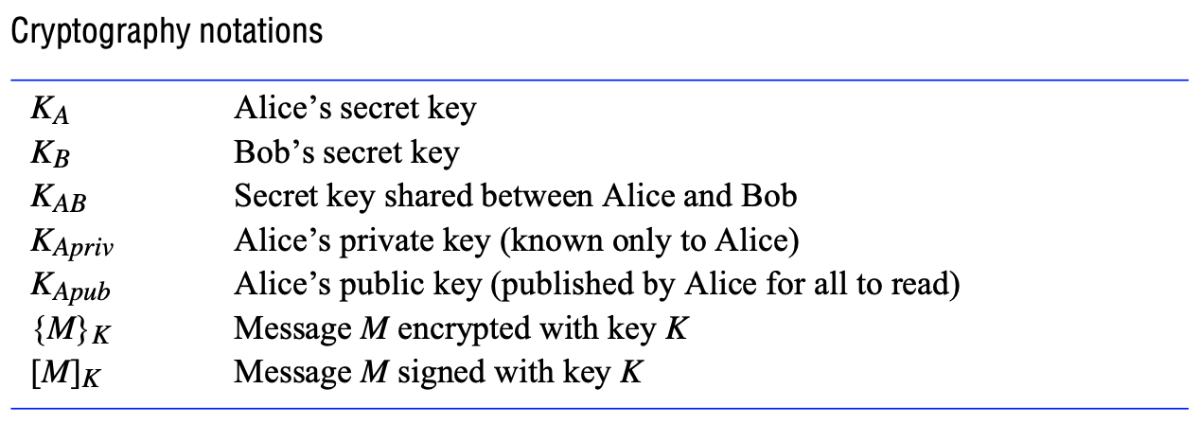
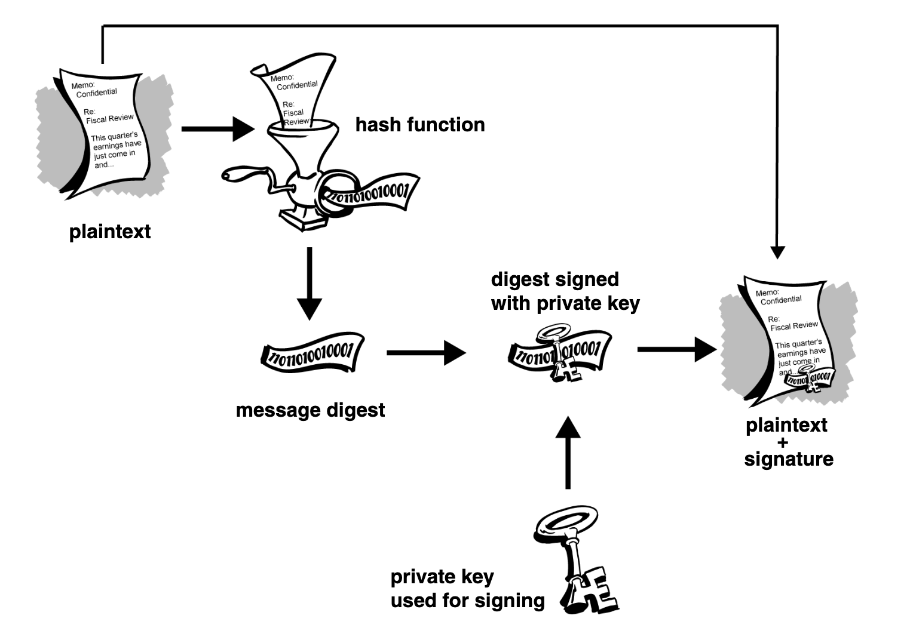
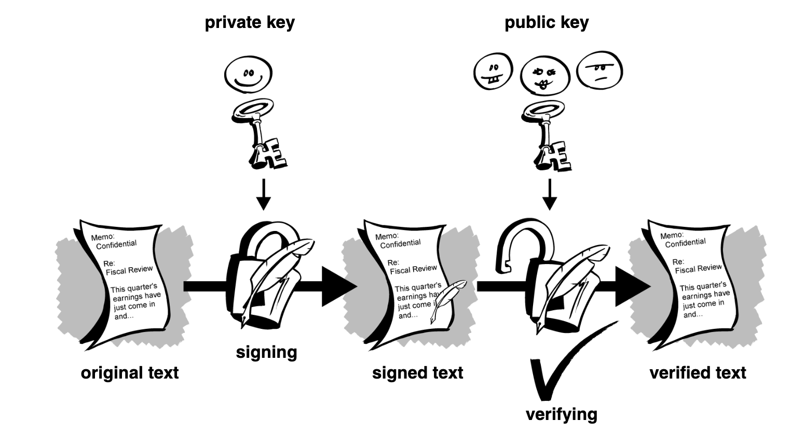
3. Authentication & Digital Signatures — Diagrams
Authenticated communication with public keys: Alice obtains Bob's public key from a certificate
Digital signature scenario: Alice encrypts digest with private key; Bob verifies with Alice's public key
Digital certificate structure: public key, identity information, and digital signature from CA
Firewall: gateway computer filters all inbound and outbound messages per the security policy
SENG 41283 · University of Kelaniya
Lecture 08

Slide 6
4. Digital Certificates, Firewalls & Digest Functions
Digital Certificates
Users must be vigilant to ensure encrypting to CORRECT person's key
Man-in-the-middle attacks are a potential threat when freely exchanging keys via public servers
A digital certificate consists of three things:
(1) A public key
(2) Certificate information — identity information about the user (name, user ID, etc.)
(3) One or more digital signatures
The signature vouches ONLY that signed identity information is BOUND TO the public key
Firewalls
Protect intranets by filtering incoming and outgoing communications
Messages forwarded to local recipient only for explicitly authorised communications
NOT effective against attacks from inside the organisation; crude control of external access
NOT particularly effective against DoS attacks such as IP spoofing
Secure Digest Functions
If information changed in ANY way — even ONE bit — entirely different output value produced
Cannot take a signature from one document and attach it to another
Slightest change to a signed document causes digital signature verification to FAIL
Exercises
1. Research Secret-Key (Symmetric) algorithms; write Medium article: 'Secret Key Algorithms in Cryptography'
2. Research Public-Key (Asymmetric) algorithms; write Medium article: 'Public Key Algorithms in Cryptography'
3. Research Digest Functions; explain MD5 and SHA-1; write Medium article: 'Secure Digest Functions'
SENG 41283 · University of Kelaniya
Lecture 08

