Slide 1
Lecture 09
SENG 41283 · Distributed and Cloud Computing
Replication
Performance · Availability · Fault Tolerance · Passive & Active Replication
Motivations
System Model
Five Phases
Ordering
Passive Replication
Active Replication
Dept. of Software Engineering · University of Kelaniya · Academic Year 2018/2019
Ref: Coulouris et al., Distributed Systems: Concepts and Design (5th ed.)

Slide 2
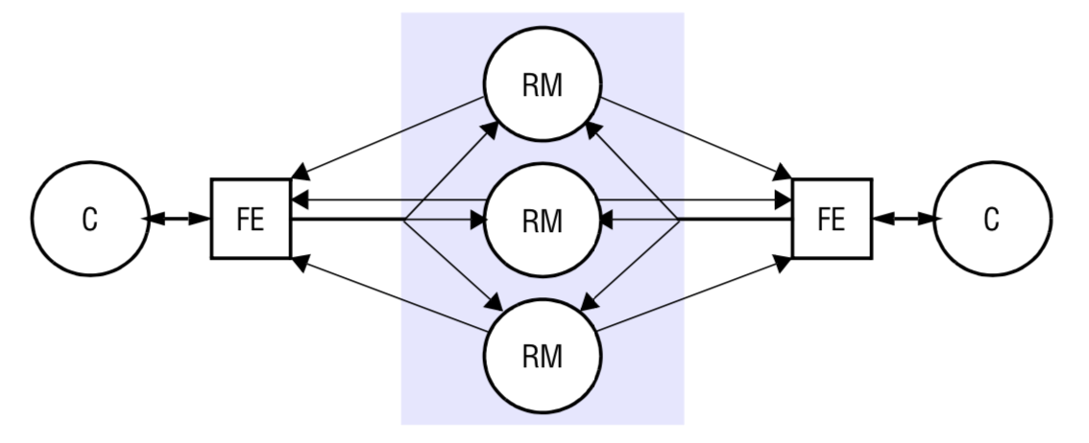
1. Motivations & System Model
Performance Enhancement
Caching avoids latency of fetching from originating server
DNS round-robin distributes workload; replication of immutable data is trivial
Increased Availability
Service must be accessible close to 100% of the time
Availability = 1 – p^n; Example: p=5%, n=2 servers → 1 – 0.05² = 99.75%
Note: caches do not necessarily hold complete collections — caching ≠ availability guarantee
Fault Tolerance
Highly available data ≠ strictly correct data (may be out of date; conflicting updates after partition)
Fault-tolerant service: ALWAYS guarantees strictly correct behaviour despite certain faults
Replication Transparency
Clients should NOT normally be aware multiple physical copies exist
System Model
Asynchronous system; processes fail only by crashing; no network partitions (default)
Replica managers: components containing replicas; operations applied RECOVERABLY
Replication system model: front ends, replica managers, and the five-phase request cycle
SENG 41283 · University of Kelaniya
Lecture 09

Slide 3
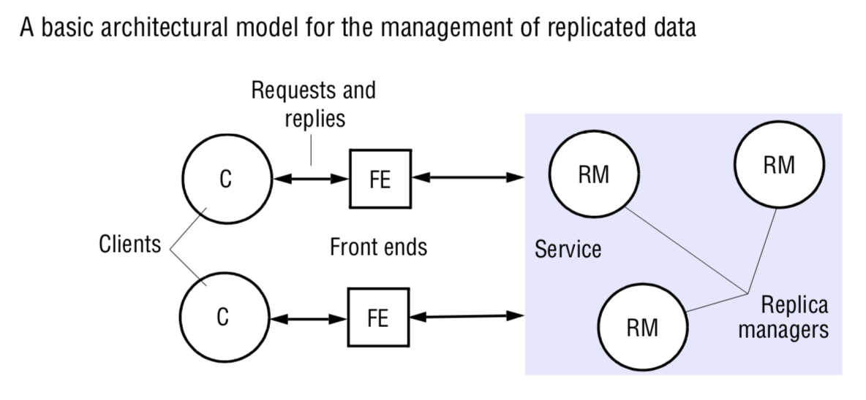
2. Five Phases & Ordering Guarantees
Five Phases
1. Request: front end issues request to one or more replica managers
2. Coordination: managers coordinate; agree on whether to apply request; agree on ordering
3. Execution: replica managers execute the request
4. Agreement: managers reach consensus on effect (e.g. abort or commit in transactional system)
5. Response: one or more managers respond to front end; front end synthesises single response
FIFO Ordering
Messages from Pi received at all Pj in order they were sent
Causal Ordering
If r happened-before r', any manager handling r' handles r first; stronger than FIFO
Total Ordering
All processes see exactly the same FIFO sequence of messages
Central lock server: coordinator C; processes send lock → granted if free, else queued
Token passing ring: logical ring; single token circulates; enter critical section only when possessing token
Five phases of a single request: request, coordination, execution, agreement, response
SENG 41283 · University of Kelaniya
Lecture 09

Slide 4
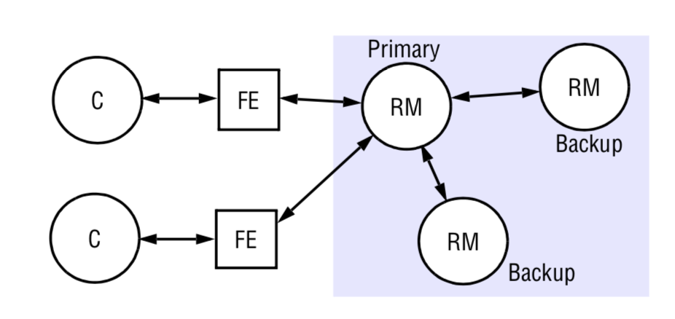
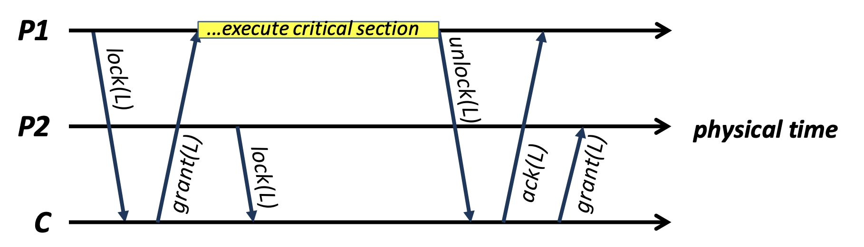
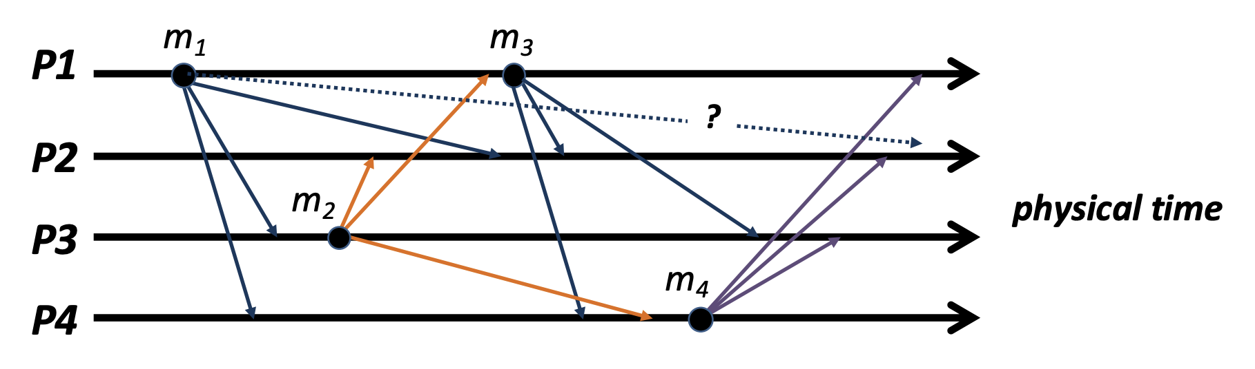
2. Ordering — Diagrams from Lecture Notes
FIFO, causal, and total ordering across replica managers
Central lock server solution for mutual exclusion and total ordering
Token passing ring: token circulates; process may only access resource when holding token
SENG 41283 · University of Kelaniya
Lecture 09

Slide 5
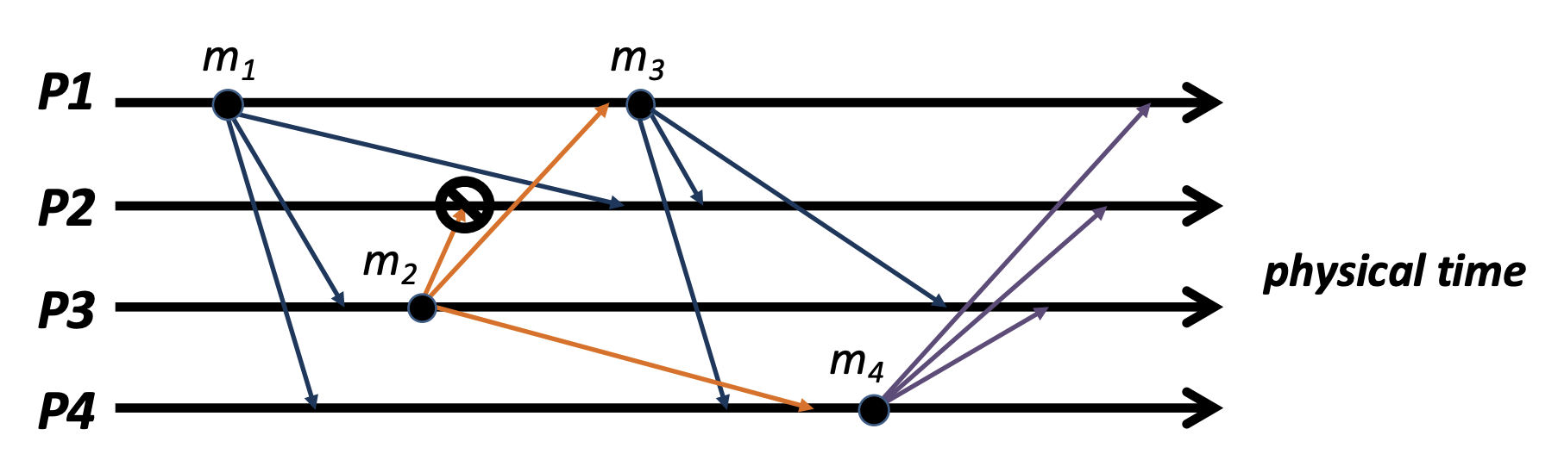
3. Passive (Primary-Backup) Replication
Model
Single PRIMARY + one or more secondary (backup/slave) managers
Front ends communicate ONLY with primary (in pure form)
Primary executes operations; sends updated state to backups; if primary fails one backup promoted
Request Sequence
1. Request: front end sends request with unique identifier to primary
2. Coordination: primary takes requests atomically; checks for duplicate IDs
3. Execution: primary executes request and stores response
4. Agreement (if update): primary sends updated state + response + ID to ALL backups; backups ACK
5. Response: primary responds to front end; front end hands response back to client
Linearisability
Obviously linearisable if primary is correct — sequences all operations
View-synchronous semantics: either ALL backups or NONE deliver update before new view
New primary chosen by any function of the new view (e.g. first member in view)
Passive replication: primary processes requests and propagates updated state to all backups
SENG 41283 · University of Kelaniya
Lecture 09

Slide 6
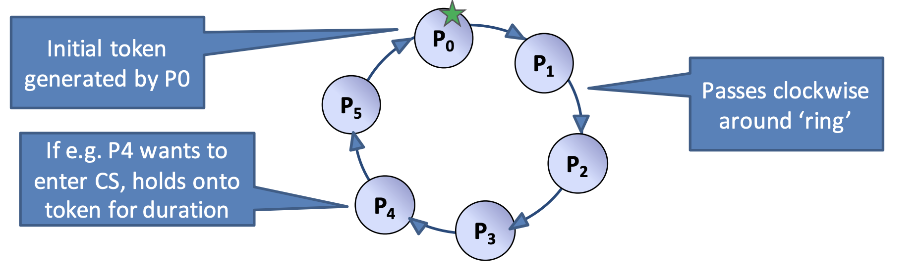
4. Active Replication
Model
Replica managers are STATE MACHINES playing equivalent roles in a group
Front ends MULTICAST requests to group; all managers process INDEPENDENTLY but IDENTICALLY
Any manager crash has NO impact — remaining managers continue responding normally
Request Sequence
1. Request: front end attaches unique ID; multicasts using TOTALLY ORDERED RELIABLE multicast
2. Coordination: group communication delivers request to every correct manager in SAME TOTAL ORDER
3. Execution: every manager executes request IDENTICALLY (state machines + same total order)
4. Agreement: NO agreement phase needed — multicast delivery semantics guarantee this
5. Response: each manager sends response; front end passes FIRST response to client; discards rest
Consistency
All correct managers process same sequence → same state → SEQUENTIAL CONSISTENCY
Transactions with Replicated Data
2PC becomes two-level nested 2PC when replica managers are involved
Read-one/write-all: write at ALL managers (write lock each); read at single manager (read lock)
Active replication: front end multicasts to all managers; each processes independently but identically
SENG 41283 · University of Kelaniya
Lecture 09

