Slide 1
Lecture 10
SENG 41283 · Distributed and Cloud Computing
Distributed Transactions
Flat & Nested · Coordinator · 2PC · Nested 2PC
Flat Transactions
Nested Transactions
The Coordinator
1PC & 2PC
Drawback
Nested 2PC
Dept. of Software Engineering · University of Kelaniya · Academic Year 2018/2019
Ref: Coulouris et al., Distributed Systems: Concepts and Design (5th ed.)

Slide 2
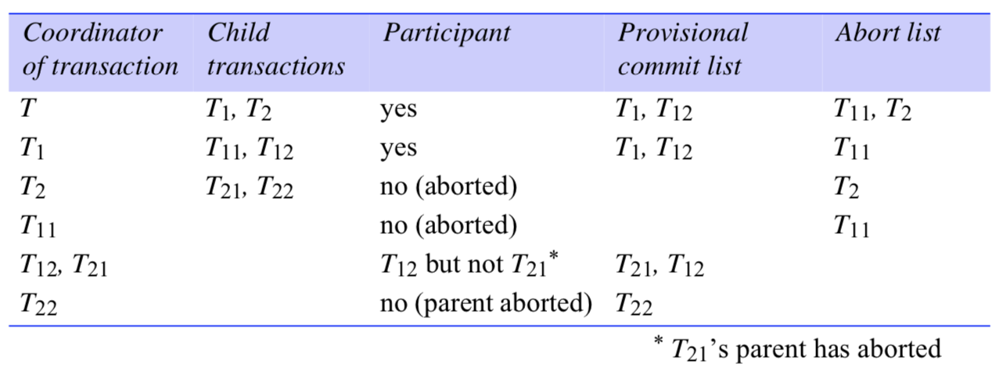
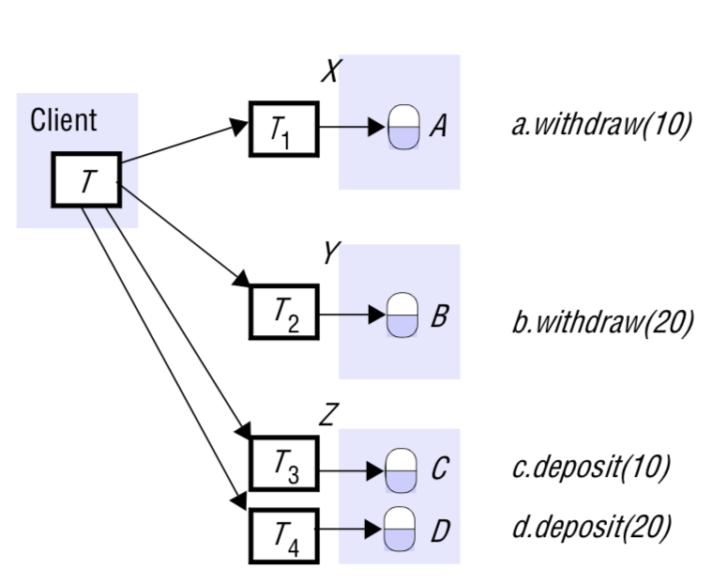
1. Flat & Nested Transactions — Diagrams from Notes
Nested transactions: T1, T2, T3, T4 subtransactions running in parallel inside top-level transaction T
Coordinator of a distributed transaction: coordinator, participants, and the join protocol
SENG 41283 · University of Kelaniya
Lecture 10

Slide 3
1. Flat & Nested Transactions — Coordinator
Flat Transaction
Client makes requests to more than one server; completes each before going to next
Accesses servers' objects SEQUENTIALLY; when using locking: waiting for ONE object at a time
Nested Transaction
Top-level transaction can open subtransactions; each can open further to any depth of nesting
Example from the Lecture Notes
Client transfers £10 from A to C and £20 from B to D
Accounts A, B at separate servers X, Y; accounts C, D at server Z
Structured as FOUR nested transactions (two deposits + two withdrawals) — run IN PARALLEL
Better performance than sequential flat transaction
The Coordinator
Client sends openTransaction to coordinator; coordinator returns unique Transaction Identifier (TID)
TID: (1) identifier of creating server (e.g. IP address) + (2) number unique to that server
Coordinator RESPONSIBLE for committing or aborting at the end
Each server managing an accessed object is a PARTICIPANT; keeps track of all recoverable objects involved
join operation: new participant joins; coordinator records it in participant list
By the time client calls closeTransaction: coordinator has references to ALL participants
A participant may call abortTransaction on the coordinator if it is unable to continue
SENG 41283 · University of Kelaniya
Lecture 10

Slide 4
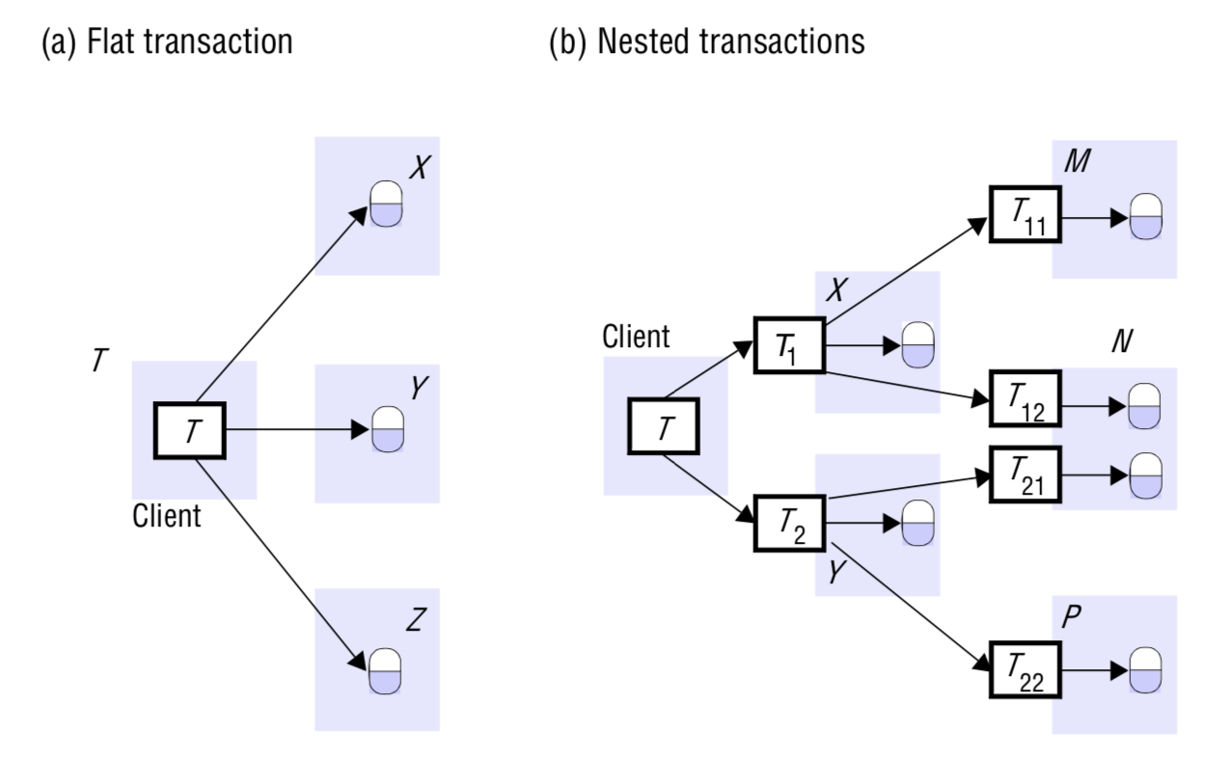
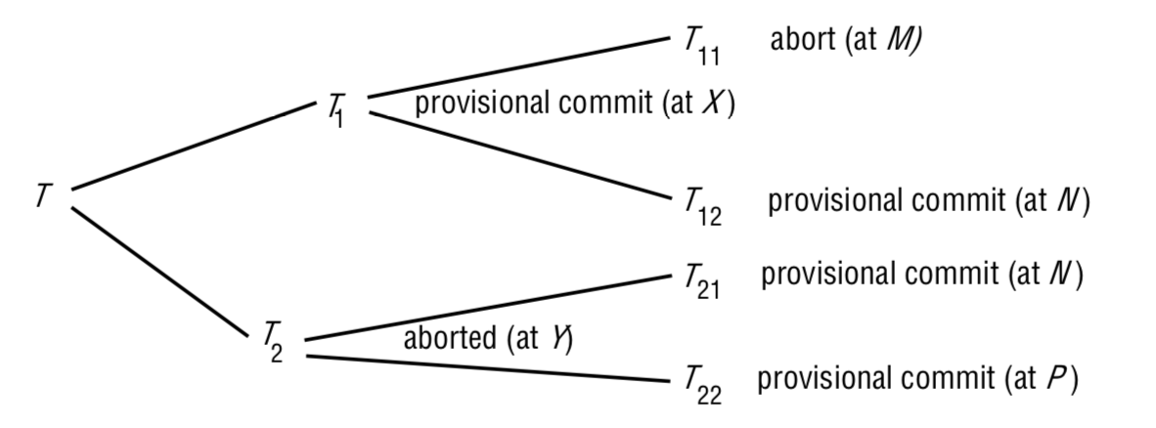
2. Atomic Commit Protocols — 2PC Diagrams
Two-phase commit: Phase 1 voting and Phase 2 completion message flow between coordinator and participants
2PC protocol operations: canCommit?, doCommit, doAbort, haveCommitted, getDecision
SENG 41283 · University of Kelaniya
Lecture 10

Slide 5
2. Atomic Commit Protocols — 1PC & 2PC
Atomicity Requirement
When distributed transaction ends: EITHER all operations carried out OR none of them
One-Phase Commit (1PC)
Coordinator communicates commit or abort to all participants; repeats until all acknowledge
Does NOT allow server to make unilateral decision to abort when client requests commit
Fails when: deadlock resolution silently aborts; validation fails in optimistic CC; server crashes and replaced
Two-Phase Commit Protocol (2PC)
Designed to allow ANY participant to abort its part
Before voting Yes: participant SAVES all altered objects to permanent storage + status 'prepared'
Prepared state: will eventually be able to commit even if it crashes and is replaced
Phase 1 (Voting)
1. Coordinator sends canCommit?(trans) to each participant
2a. Vote Yes: prepares to commit (saves objects to permanent storage); sends Yes
2b. Vote No: aborts immediately; sends No to coordinator
Phase 2 (Completion)
3a. All Yes and no failures: coordinator sends doCommit(trans) to each participant
3b. Otherwise: coordinator sends doAbort(trans) to all participants that voted Yes
4. Participants that voted Yes wait for doCommit or doAbort
On commit: participant calls haveCommitted(trans, participant) to confirm to coordinator
getDecision(trans): participant asks coordinator when voted Yes but no reply received after delay
SENG 41283 · University of Kelaniya
Lecture 10

Slide 6
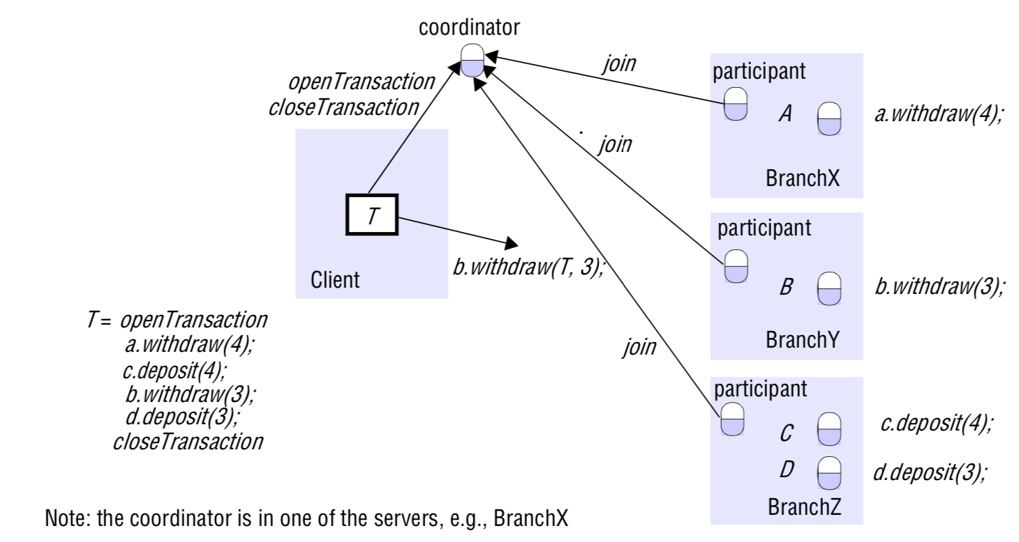
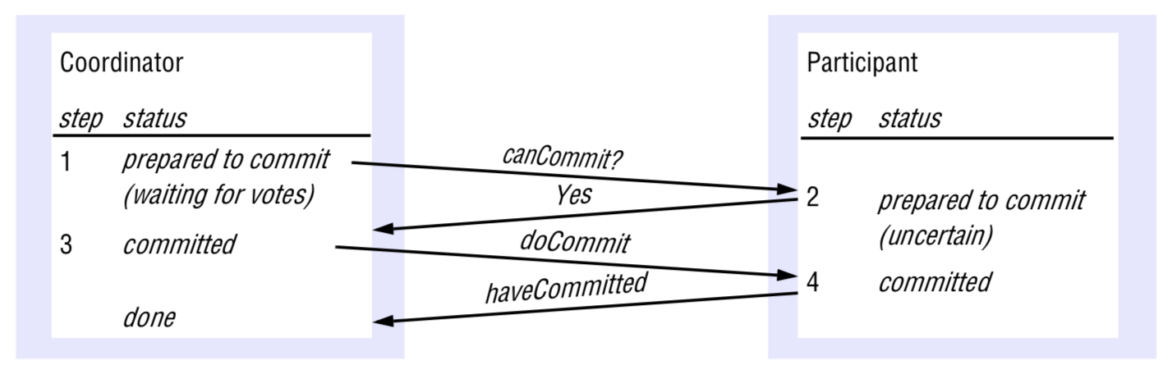
3. Drawback & Nested 2PC — Diagrams
Nested 2PC tree: subtransaction tree showing provisional commits and propagation of aborts
Subtransaction state transitions: open, provisionally committed, committed, and aborted
SENG 41283 · University of Kelaniya
Lecture 10

Slide 7
3. 2PC Drawback & Two-Phase Commit for Nested Transactions
Drawback — The Blocking Problem
Participant that voted Yes and is waiting is in an UNCERTAIN state
Cannot proceed any further until it gets outcome from coordinator
Cannot decide unilaterally — objects used by transaction CANNOT be released for other transactions
If coordinator has FAILED — cannot get decision until coordinator is replaced → EXTENSIVE DELAYS
Two-Phase Commit for Nested Transactions
When subtransaction completes: commits PROVISIONALLY or aborts
Provisional commit ≠ prepared to commit: NOTHING backed up in permanent storage
If server crashes: replacement server CANNOT commit the transaction
Being prepared guarantees commit; provisional commit only means the operation finished correctly
After all subtransactions complete: provisionally committed ones participate in full 2PC
Servers of provisionally committed subtransactions with aborted ancestor will abort
Nested TID: must be extension of parent's TID; parent TID determinable from subtransaction TID
All subtransaction identifiers must be globally unique
Example from the Lecture Notes
T21 and T22 provisionally committed but T2 has aborted → T21 and T22 MUST also abort
When nested transaction provisionally commits: reports status and descendants to parent
When nested transaction aborts: reports only abort to parent (no descendant information)
Top-level transaction receives list of ALL subtransactions in tree with status of each
SENG 41283 · University of Kelaniya
Lecture 10

