Slide 1
Lecture 11
SENG 41283 · Distributed and Cloud Computing
Cryptography
Conventional · Caesar Cipher · Public Key · PGP · Signatures · Certificates
Conventional Cryptography
Caesar's Cipher
Public Key
PGP
Keys
Digital Signatures
Hash Functions
Dept. of Software Engineering · University of Kelaniya · Academic Year 2018/2019
Ref: Coulouris et al., Distributed Systems: Concepts and Design (5th ed.)

Slide 2
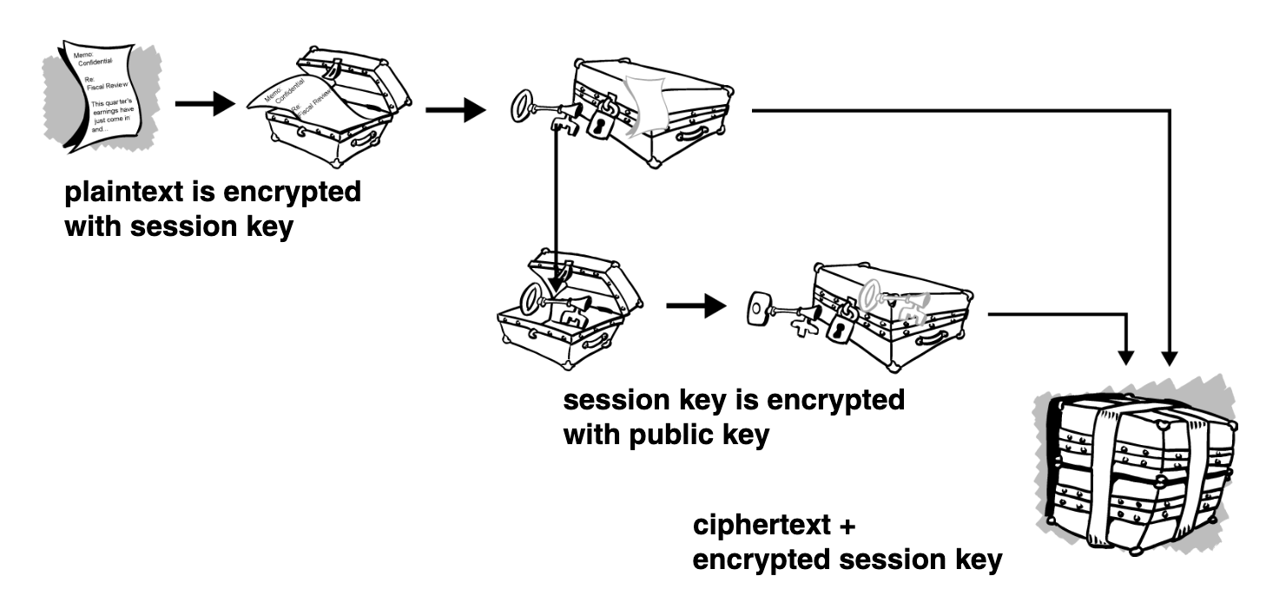
1. Fundamentals & Conventional Cryptography
What is Cryptography?
Science of using mathematics to encrypt and decrypt data
Enables storing or transmitting sensitive information on insecure networks
Cryptanalysis: science of analysing and breaking secure communication
How It Works
Cryptographic algorithm (cipher) works with a key (word, number, or phrase)
Same plaintext encrypts to DIFFERENT ciphertext with different keys
Security depends on: (1) strength of algorithm, (2) secrecy of the key
Conventional (Symmetric) Cryptography
ONE key used for BOTH encryption and decryption
Benefits: very fast; excellent for data at rest
Drawback: difficulty of secure key distribution is expensive
Caesar's Cipher (from the lecture notes)
Original: A B C D E F G H I J K L M N O P Q R S T U V W X Y Z
Shift +3: D E F G H I J K L M N O P Q R S T U V W X Y Z A B C
S→V E→H C→F R→U E→H T→W
'SECRET' encrypts as 'VHFUHW'
Conventional cryptography: a single shared key is used for both encryption and decryption
SENG 41283 · University of Kelaniya
Lecture 11

Slide 3
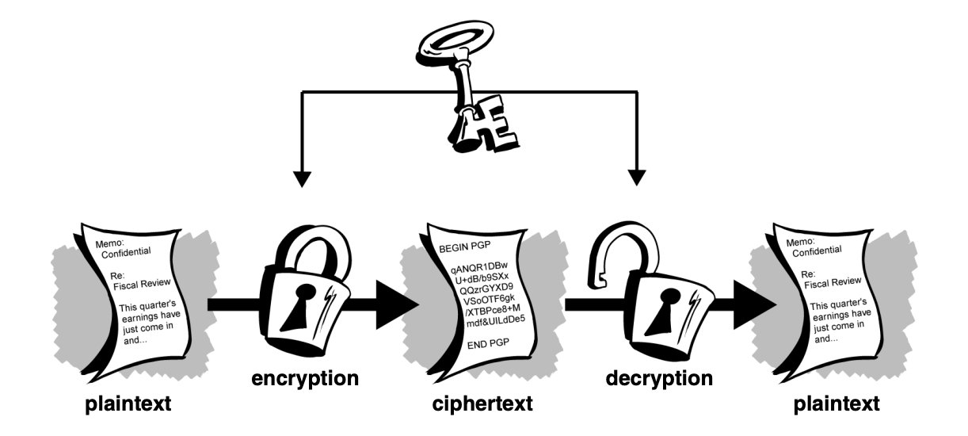
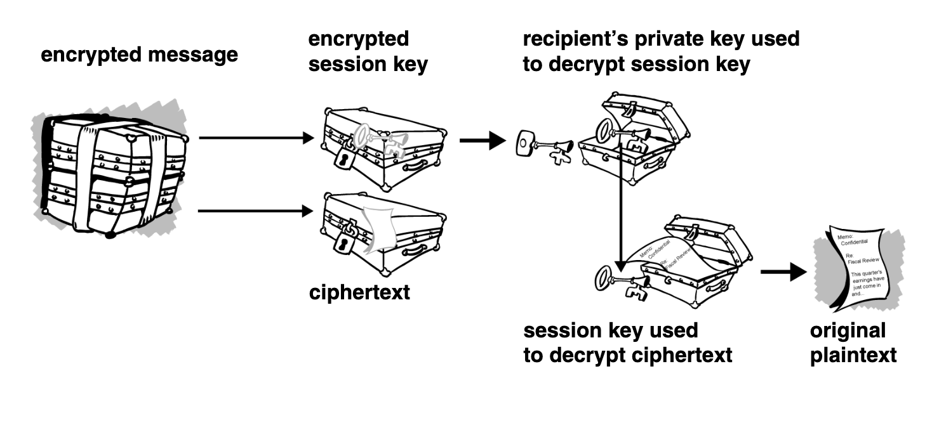
2. Public Key Cryptography & PGP — Diagrams
Public key cryptography: sender uses recipient's public key to encrypt; recipient uses private key to decrypt
PGP encryption process: compress, create session key, encrypt message, encrypt session key with public key
SENG 41283 · University of Kelaniya
Lecture 11

Slide 4
2. Public Key Cryptography & PGP
Public Key Cryptography
PGP — Pretty Good Privacy
The Solution (Diffie & Hellman, 1975)
Problems of key distribution solved by public key cryptography
Asymmetric scheme using a PAIR OF KEYS:
Public key: encrypts data; published to the WORLD
Private key (secret key): decrypts data; kept SECRET by owner
Anyone with public key can encrypt — ONLY person with private key can decrypt
Computationally INFEASIBLE to deduce private key from public key
PRIMARY BENEFIT: allows parties with NO preexisting security arrangement to exchange messages securely
Examples
ElGamal · RSA (Rivest, Shamir, Adleman) · Diffie-Hellman · DSA (David Kravitz)
Overview
Hybrid cryptosystem combining conventional and public key cryptography
Encryption Process (from the lecture notes)
1. Compress plaintext (reduces patterns that cryptanalysis exploits)
2. Create one-time session key from random mouse movements and keystrokes
3. Encrypt plaintext with session key using a fast conventional algorithm → ciphertext
4. Encrypt session key using recipient's PUBLIC KEY
5. Transmit: encrypted session key + ciphertext to recipient
Decryption Process
Recipient uses PRIVATE KEY to recover session key
Recipient uses session key to DECRYPT ciphertext
Keys
Keys are very large numbers; key size measured in bits
Larger key → more secure; must be large enough to be secure yet small enough to apply quickly
SENG 41283 · University of Kelaniya
Lecture 11

Slide 5
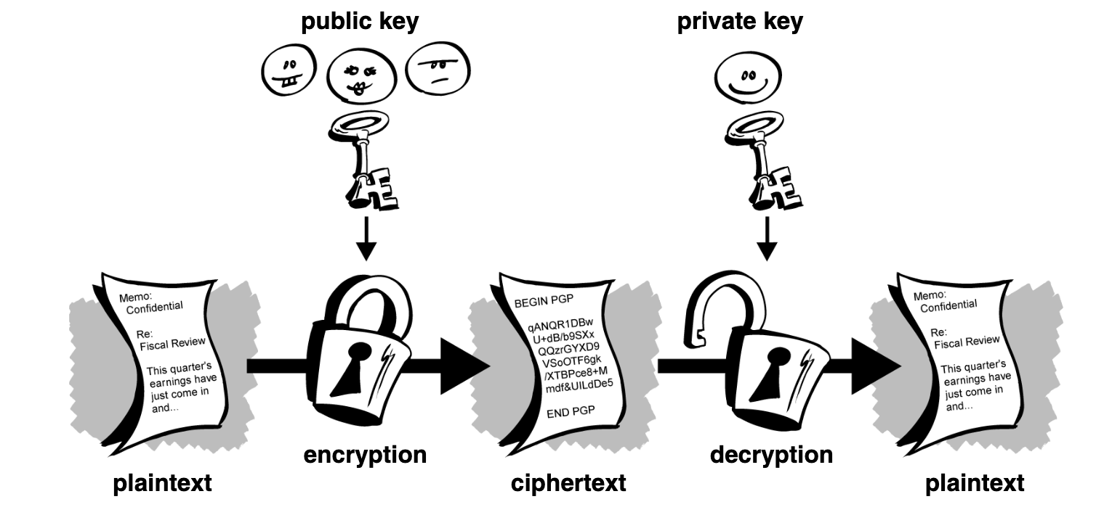
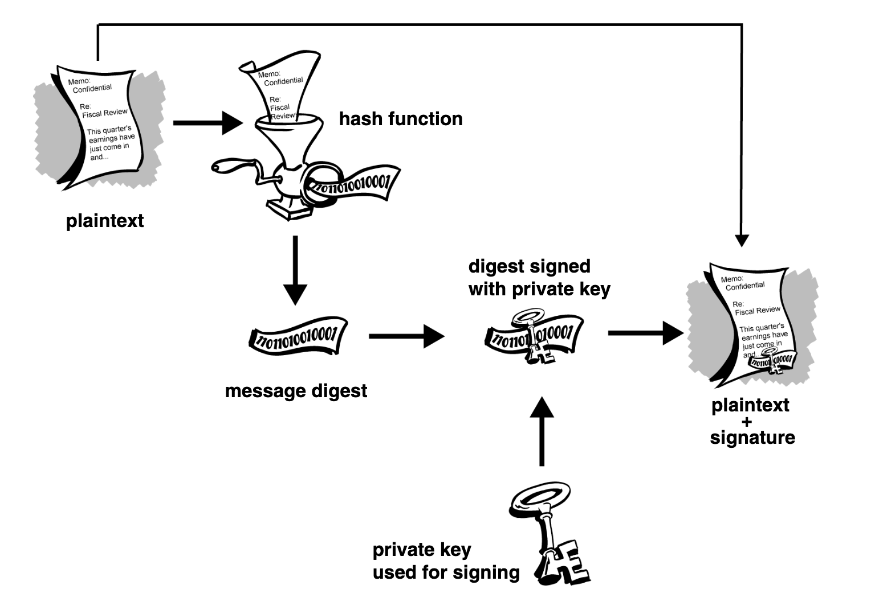
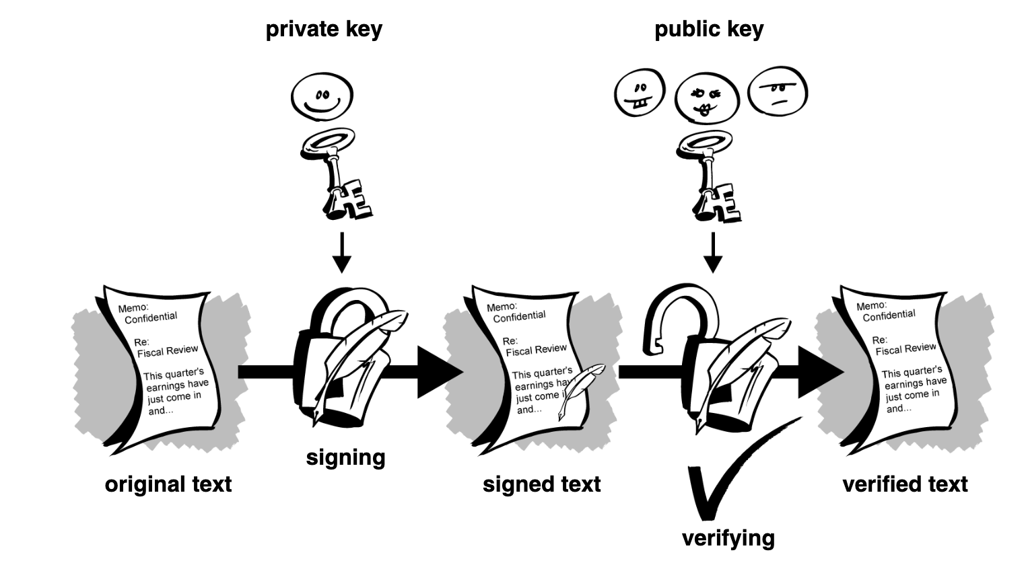
3. Digital Signatures, Hash Functions & Certificates
Digital signature: Alice encrypts message digest with private key; Bob verifies using Alice's public key
Digital certificate structure: public key, identity information, and digital signature from a CA
Secure hash function: small change in input produces completely different output hash
SENG 41283 · University of Kelaniya
Lecture 11

Slide 6
3. Digital Signatures, Hash Functions & Certificates
Digital Signatures
Major benefit of public key cryptography: provides method for digital signatures
Allow recipient to verify: (1) authenticity of information's origin, (2) information not altered in transit
Instead of encrypting using someone else's public key — encrypt with YOUR OWN PRIVATE KEY
If information can be decrypted with your public key → it MUST have originated with you
Hash Functions
If information changed in ANY way — even ONE bit — entirely different output value produced
Cannot take a signature from one document and attach it to another
Slightest change to a signed document causes digital signature verification to FAIL
Digital Certificates
Users must be vigilant to ensure encrypting to CORRECT person's key
Man-in-the-middle attacks are a potential threat when freely exchanging keys via public servers
A digital certificate consists of three things:
(1) A public key
(2) Certificate information — identity information about the user (name, user ID, etc.)
(3) One or more digital signatures
Purpose of digital signature on certificate: states identity information has been attested to by some trusted entity
Digital signature does NOT attest to authenticity of certificate as a whole
Vouches ONLY that signed identity information is BOUND TO the public key
SENG 41283 · University of Kelaniya
Lecture 11

