Slide 1
Lecture 12
SENG 41283 · Distributed and Cloud Computing
Remote Invocation — Deep Dive
Message IDs · Failure · History · R/RR/RRA · HTTP · RPC · RMI
Message Identifiers
Failure Model
History
Exchange Protocols
HTTP Methods
RPC Implementation
Dept. of Software Engineering · University of Kelaniya · Academic Year 2018/2019
Ref: Coulouris et al., Distributed Systems: Concepts and Design (5th ed.)

Slide 2
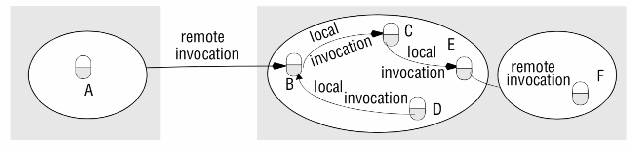
1. Request-Reply Protocol & Message Identifiers
Overview (from Remote_Invocation.docx)
Designed to support roles and message exchanges in typical client-server interactions
Synchronous: client process blocks until reply arrives; reliable: reply IS the acknowledgement
Why Build Over UDP?
Acknowledgements are redundant — requests are followed by replies
TCP connection involves two extra pairs of messages beyond request-reply pair
Flow control is redundant for majority of invocations with small arguments and results
Message Identifiers
Every message needs a unique identifier for reliable message delivery
Part 1: requestId — increasing sequence of integers unique to sender; reset at 2³²–1
Part 2: identifier for sender process (port + Internet address) — unique in distributed system
Message identifier structure: requestId (unique to sender) + sender process identifier (unique in distributed system)
SENG 41283 · University of Kelaniya
Lecture 12

Slide 3
1. Failure Handling — Timeouts, Duplicate Filtering & History
Timeouts
Client retransmits request repeatedly until reply received or server assumed failed
doOperation returns without reply: indicates to client by EXCEPTION that no result was received
Discarding Duplicate Request Messages
Retransmission can cause server to receive same request more than once
Protocol: recognises successive messages from same client with same requestId → FILTERS OUT DUPLICATES
If server has not yet sent reply: no special action needed — will transmit reply when operation finishes
Idempotent Operations
Can be performed repeatedly with same effect as if performed exactly once
Example idempotent: add element to a set — always has same effect
Example non-idempotent: append item to sequence (extends sequence each time) — special measures required
History
For servers requiring retransmission without re-execution: maintain a HISTORY
History entry: (request identifier, message, client identifier to whom it was sent)
Purpose: allows server to retransmit reply messages when client requests retransmission
Problem: memory cost — history becomes very large unless server can tell when messages no longer needed
R – Request Protocol
Single Request message; NO reply; client proceeds immediately; suffers UDP failures
RR – Request-Reply Protocol
Server reply IS acknowledgement; failures masked by retransmit + dup-filter + history
RRA – Request-Reply-Acknowledge Reply
Three messages; Acknowledge reply enables server to DISCARD history entries
SENG 41283 · University of Kelaniya
Lecture 12

Slide 4
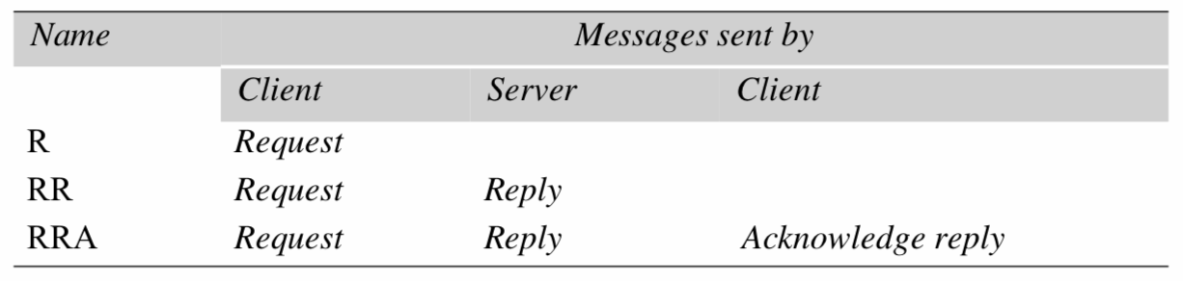
2. Exchange Protocols & HTTP Methods
Exchange protocols: R (request only), RR (request-reply), RRA (with acknowledge reply)
SENG 41283 · University of Kelaniya
Lecture 12

Slide 5
2. HTTP Methods (from Remote_Invocation.docx)
HTTP Methods
Each request specifies the method to be applied to a resource and the URL
GET
Requests resource at given URL; if URL refers to data: server returns data; if program: server runs and returns output
HEAD
Identical to GET but does NOT return data; returns information about data (modification time, type, size)
POST
Specifies URL of resource to deal with data in request body; used when action may change server data
Submitting web forms to servlet · posting to mailing list · extending database with append operation
PUT
Request server to store data at given URL; modification of existing resource or new resource
DELETE
Server deletes resource at given URL; server may not always allow this; reply indicates failure
OPTIONS
Server supplies client with list of methods it allows for given URL and special requirements
TRACE
Server sends back the request message — used for diagnostic purposes during development
RPC — Interfaces in Distributed Systems
Service interface: specification of procedures offered by server; defines types of arguments
Benefits: abstraction · language/platform independence · natural support for software evolution
SENG 41283 · University of Kelaniya
Lecture 12

Slide 6
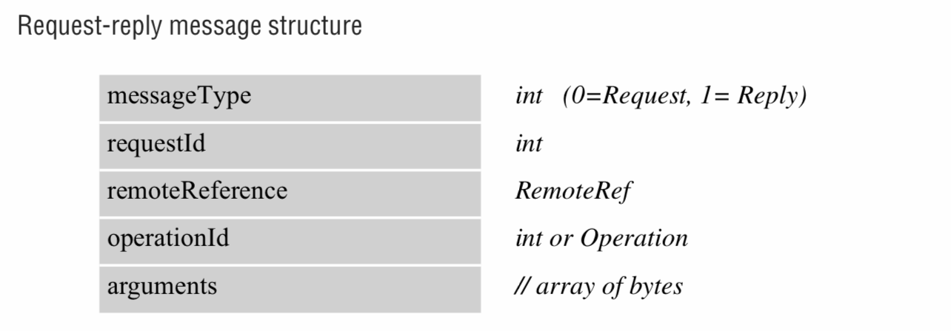
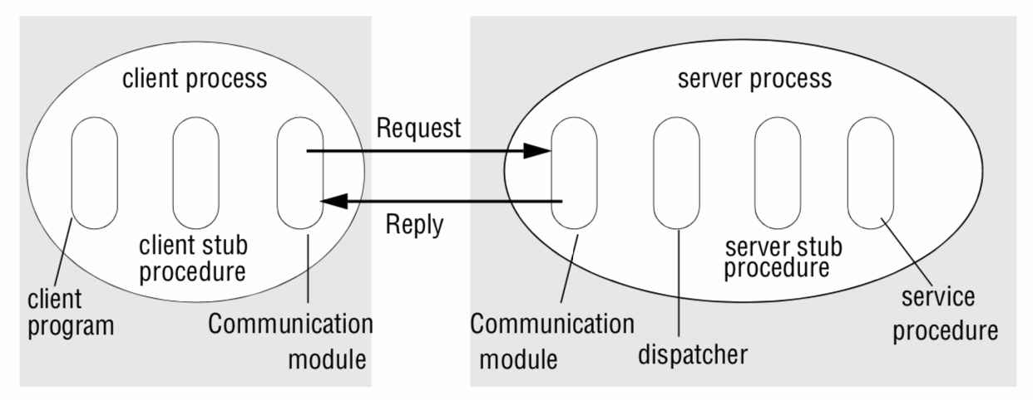
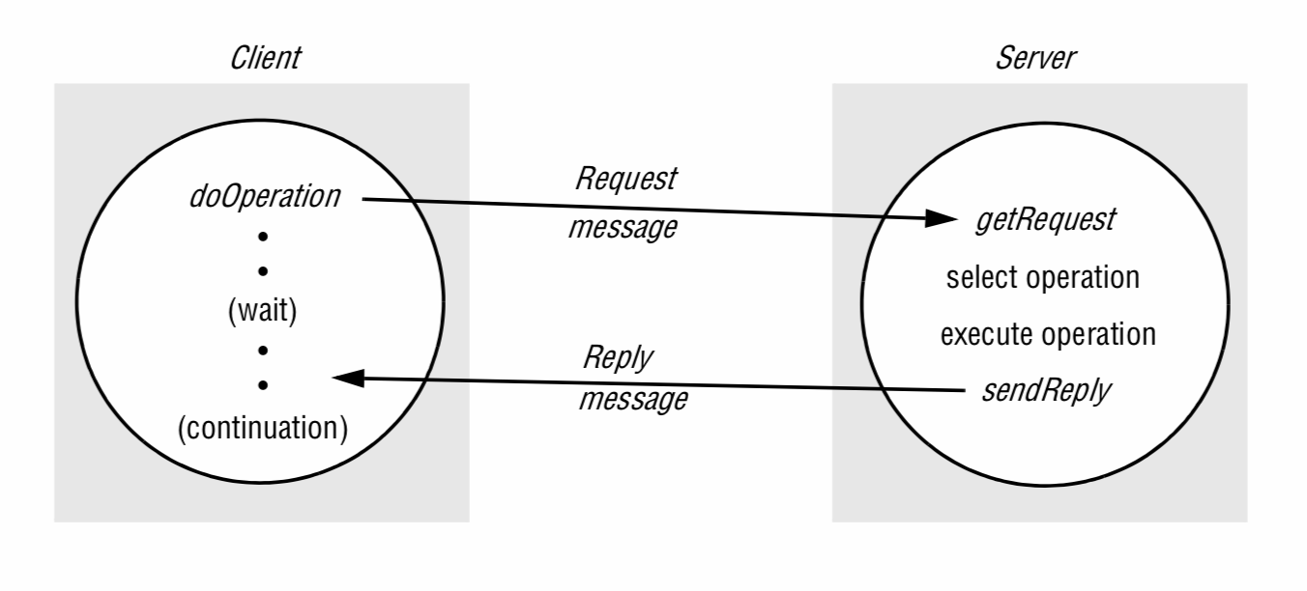
3. RPC Implementation & RMI Diagrams
RPC implementation: client stub, dispatcher, server stub, service procedures — auto-generated from interface definition
RMI design: object references, interfaces, actions, exceptions, and garbage collection
Distributed object model: objects with remote interfaces across two separate processes
SENG 41283 · University of Kelaniya
Lecture 12

Slide 7
3. RPC Implementation & RMI Design
RPC Implementation
RMI Design Concepts
Client Stub
One per procedure; behaves like local procedure; marshals procedure ID + arguments; sends; unmarshals results
Dispatcher
One per service; selects server stub by procedure identifier in request message
Server Stub
One per procedure; unmarshals arguments; calls service procedure; marshals return values
Service Procedures
Implement the actual procedures in the service interface
Stubs + dispatcher GENERATED AUTOMATICALLY by interface compiler from interface definition
Python rpyc Example (from source notes)
import rpyc
conn = rpyc.classic.connect('localhost')
conn.execute("print('Hello from RPC')")
# Output: Hello from RPC
Commonalities with RPC
Both support programming with interfaces; both built on request-reply protocols
Both offer at-least-once and at-most-once semantics; similar transparency
Added Expressiveness
Full OOP: objects, classes, inheritance, design methodologies
Unique object references for ALL objects (local or remote); references can be PASSED AS PARAMETERS
Design RMI (from the source document)
Object references: invoke method via object reference + method name + arguments
Interfaces: definition of method signatures without specifying implementation
Actions: invocation includes arguments; receiver executes method and returns result
Exceptions: clean way to handle errors (inconsistent variables, file/network failures)
Garbage collection: must free space occupied by objects when no longer needed
Distributed Object Model
Method invocations between objects in different processes: REMOTE method invocations
Method invocations between objects in same process: LOCAL method invocations
SENG 41283 · University of Kelaniya
Lecture 12

