Slide 1
SENG 42293 · BIG DATA ANALYTICS · WEEK 5
Descriptive Analytics
Summarising what happened: statistics, groups, trends and honest rankings
LO3 | Level 4 · 3 credits

Slide 2
WHERE WE ARE
Recap and Today's Agenda
Weeks 1–4 recap
Today
Big data and the 4 Vs
Sampling and collection
Data quality in pandas
Semi-structured data and PySpark cleaning
1
Four types of analytics
2
Centre, spread and shape
3
Group-by, pivots and heatmaps
4
Trends and correlation
5
The small-sample ranking trap
6
KPI dashboard and Spark at scale
2

Slide 3
PART II · ANALYTICS CORE
Four Questions Analytics Can Answer
Each question needs a different method and increasing judgement.
Descriptive
Diagnostic / Predictive
Prescriptive
Specialised
What happened? Summaries, charts, KPIs. Today.
Why? What will happen? Models learn from history (Week 6).
What should we do? Optimise decisions under constraints (Week 7).
Survival, text, network, web: when the data has special structure (Weeks 8–11).
Our running case The Travel-Review pipeline: 17,266 clean reviews, 15,183 with a valid rating.
3

Slide 4
TOOLKIT
The Descriptive Toolkit
Question | Tool | Pitfall
What is typical? | Mean, median, mode | Mean is pulled by skew
How much variation? | SD, IQR, range | SD hides shape
How is it shaped? | Histogram, skewness | Bin width changes the story
How do groups differ? | group-by, pivot, heatmap | Group sizes differ
Do two things move together? | Correlation | Not causation
How does it change? | Time series, rolling mean | Seasonality vs trend
Describe first, always: every later model rests on understanding the data.
4

Slide 5
CENTRAL TENDENCY AND SPREAD
The Rating Distribution in Numbers
3.60
3.5
0.99
−0.35
mean rating
median
standard deviation
skewness (left tail)
Mean and median are close, so the distribution is only mildly skewed: a few low ratings pull the mean slightly below the typical value.
IQR is 3.0 to 4.5: half of all ratings fall in a 1.5-star band.
Report centre and spread together; one number alone misleads.
5

Slide 6
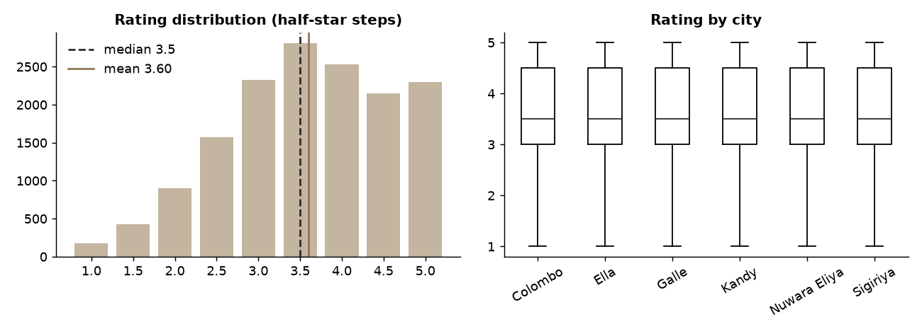
SHAPE
Distribution of Ratings
Ratings are bounded (1–5) and lumpy (half-stars)
Longer tail on the low side explains the negative skew
Always plot before summarising
Source: Week 5 notebook, section 2
6

Slide 7
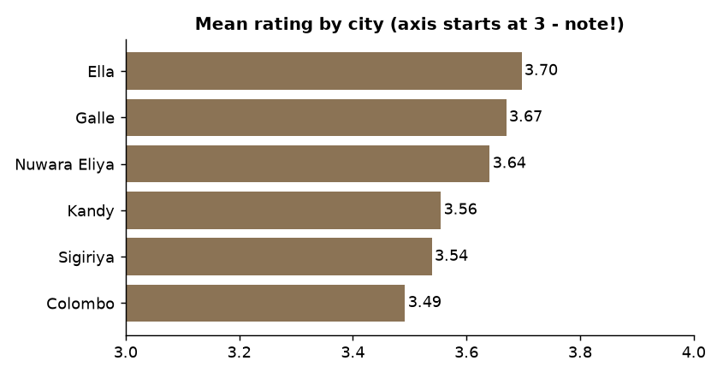
GROUP AGGREGATION
Which City Rates Best?
Ella is highest and Colombo lowest
The whole gap is only 0.21 stars, against an SD of 0.99
A difference can be real yet small: ask whether it matters to a decision
Source: Week 5 notebook, section 3
7

Slide 8
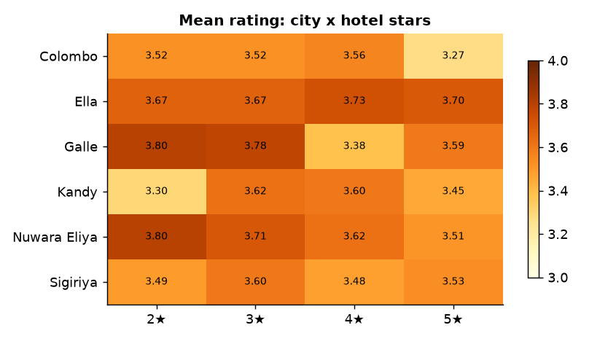
PIVOT TABLES
City × Star-class Heatmap
A pivot turns a long table into a matrix; colour lets the eye find patterns in seconds.
8

Slide 9
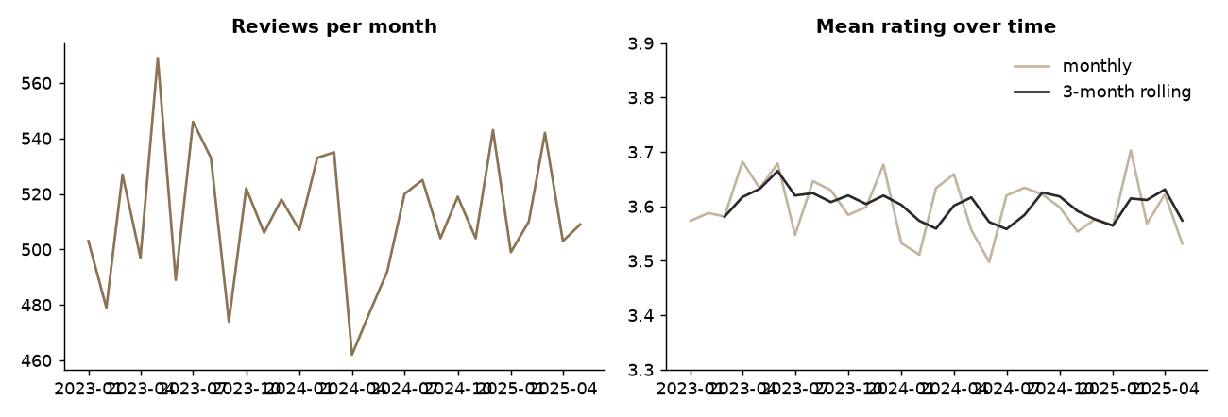
TIME TRENDS
Monthly Mean Rating
Monthly means stay between 3.5 and 3.7
Wiggles of this size are largely noise: check n per month before storytelling
Use rolling means to see the trend, not the jitter
Source: Week 5 notebook, section 5
9

Slide 10
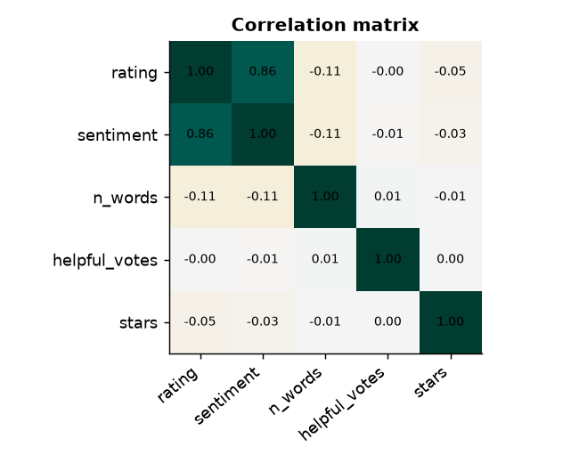
ASSOCIATION
Correlation Is Not Causation
Rating and text sentiment correlate strongly (r = 0.86)
Rating and hotel star class barely correlate (r = −0.05): luxury does not guarantee happy guests
Correlation measures linear co-movement only; it never proves a cause
Source: Week 5 notebook, section 6
10

Slide 11
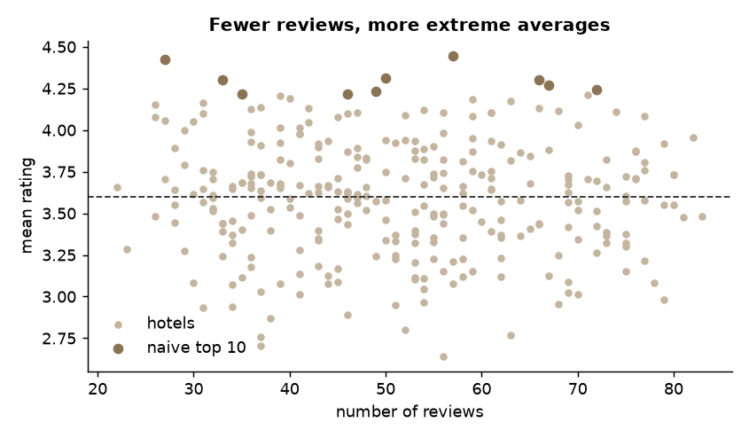
PITFALL
The Small-sample Trap in Rankings
Hotels with few reviews have extreme averages (a funnel shape)
Shrinkage pulls small samples toward the overall mean: (n·mean + m·C)/(n+m)
In a simulation with 3–60 reviews per hotel, shrinkage recovered 5.9 of the true top 10 versus 5.3 for the naive ranking
Source: Week 5 notebook, section 7
11

Slide 12
HONEST RANKING
Naive vs Shrinkage Ranking
Naive mean
Shrinkage (Bayesian) average
Fast and easy to explain.
Rewards lucky small samples.
In our data the top-10 hotels have a median of 49.5 reviews.
Evidence-aware: weak evidence moves toward the global mean.
Top-10 median reviews: 58.
Show n beside every score.
Rule: a ranking is only as good as the evidence behind it.
12

Slide 13
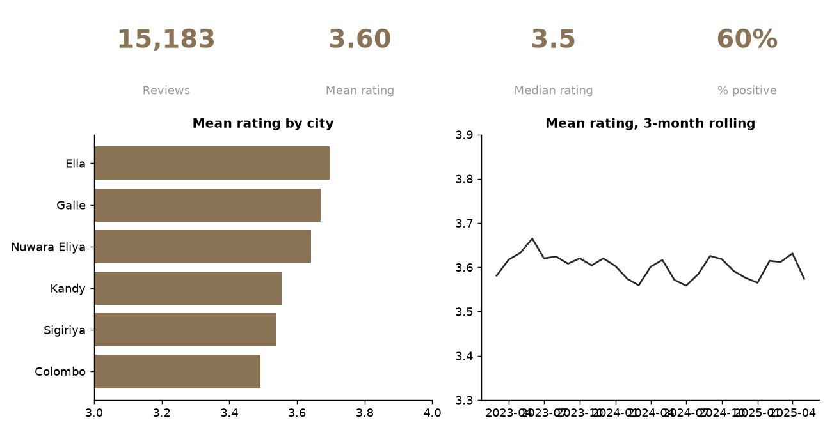
COMMUNICATION
A KPI Dashboard for Decision Makers
One screen, a few KPIs, each answering a stated question.
13

Slide 14
LO4 · SPARK
Descriptive Statistics at Scale
df.groupBy("city")
.agg(F.count("*").alias("n"),
F.avg("rating").alias("mean"))
.orderBy("mean")
# exact quantiles are expensive;
# approximate ones are cheap
df.approxQuantile("rating",
[0.25, 0.5, 0.75], 0.01)
groupBy + agg = a wide transformation (shuffle)
approxQuantile trades a little accuracy for large speed-ups
On our data Spark returns quartiles 3.0, 3.5, 4.5, matching pandas
14

Slide 15
IN-CLASS LAB · 30 MIN · UNGRADED PRACTICE
Lab: Describe the Travel Reviews
1
Open Week5_Descriptive_Analytics.ipynb and run sections 1–3
2
Find the city with the widest rating spread (use SD)
3
Rebuild the ranking with m = 5 and m = 50: how does the top 10 change?
4
Add a panel to the dashboard that answers a question you choose
15

Slide 16
WRAP-UP
Key Takeaways
1
Describe before you model: centre, spread, shape.
2
Group-bys and pivots answer most business questions.
3
Correlation is not causation, and small samples mislead.
4
Show n next to every score; shrink small samples.
5
Spark scales the same summaries with groupBy and approxQuantile.
Next week Predictive analytics: train, test and trust a model.
16

