Slide 1
SENG 42293 · BIG DATA ANALYTICS · WEEK 6
Predictive Analytics
Learning from history: models, honest evaluation, leakage and thresholds
LO3, LO4 | Level 4 · 3 credits

Slide 2
WHERE WE ARE
Recap and Today's Agenda
Week 5 recap
Today
Centre, spread, shape
Group-by, pivot, heatmap
Correlation is not causation
Rank with evidence (shrinkage)
1
Framing a prediction problem
2
Baselines and cross-validation
3
Evaluation metrics and thresholds
4
Overfitting
5
Data leakage
6
Feature importance and Spark MLlib
2

Slide 3
FRAMING
Frame the Problem Before Choosing a Model
Our task: will a review rate the stay 4 stars or more?
Target
Features
Forbidden
high = rating ≥ 4 (binary classification).
Stars, city, review length, helpful votes, tags, month: known when the review is posted.
Anything computed from the rating itself. That is leakage.
Rule Write down what is known at prediction time before touching any algorithm.
3

Slide 4
BASELINE
Always Beat the Baseline First
54.1%
0.986
accuracy from always predicting the majority class
RMSE from always predicting the mean rating
If a model cannot beat the baseline, it has learned nothing useful.
Accuracy alone can flatter: pair it with precision, recall and AUC.
4

Slide 5
MODEL COMPARISON
Three Models, Five-fold Cross-validation
Model | CV AUC | Reading
Logistic regression | 0.592 | Linear: limited here
Random forest | 0.686 | Captures interactions
Gradient boosting | 0.698 | Best of the three
Cross-validation averages over several splits, so one lucky split cannot fool you.
5

Slide 6
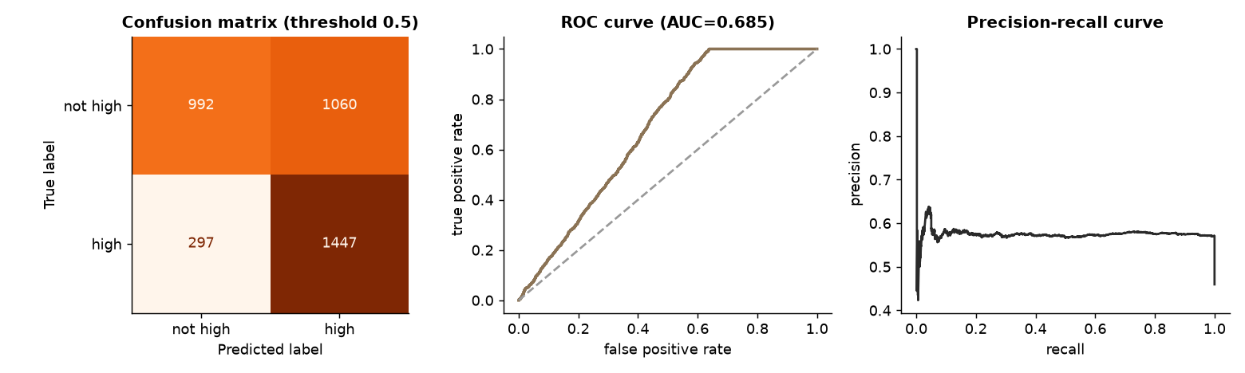
EVALUATION
Held-out Test Performance
Test accuracy 0.64, precision 0.58, recall 0.83, F1 0.68, AUC 0.69
The gain over the 54% baseline is real but modest
Metadata alone cannot predict happiness precisely
Source: Week 6 notebook, section 4
6

Slide 7
TOO GOOD TO BE TRUE
Adding the Review Text
AUC 0.59
AUC 0.999
Why
Hotel metadata only (logistic regression)
With text sentiment: suspiciously perfect
Our synthetic text is generated from the rating, so it leaks the answer by construction. Real text gives strong, but never perfect, signal.
Habit When a result looks magical, assume a bug or leakage and investigate before celebrating.
7

Slide 8
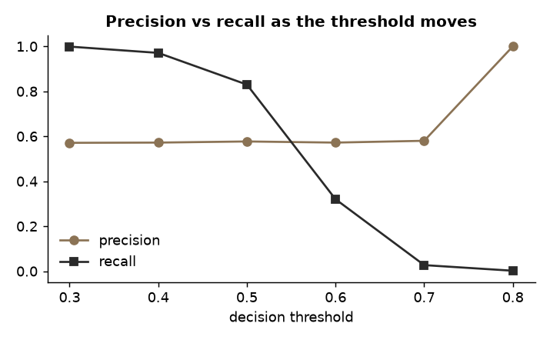
BUSINESS DECISION
The Threshold Is a Choice
Threshold 0.3 finds 99.9% of positives but flags 80% of reviews
Threshold 0.7 is picky: recall falls to 2.7%
Choose by the cost of a miss versus a false alarm, not by default 0.5
Source: Week 6 notebook, section 5
8

Slide 9
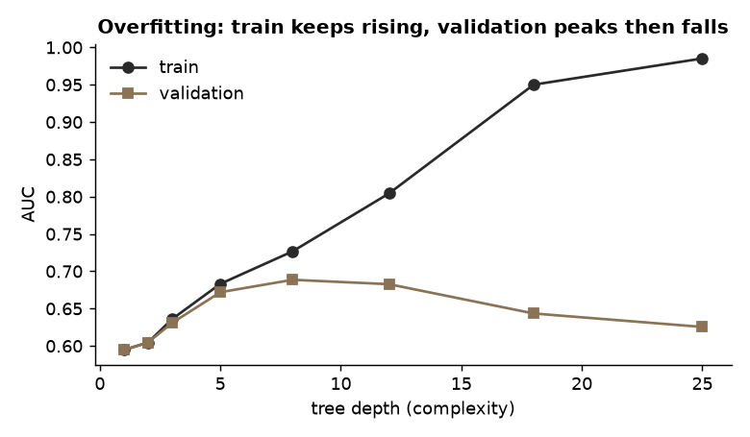
OVERFITTING
Training Score vs Real Score
A deep tree reaches train AUC 0.985 but validation AUC 0.625
The gap, not the training score, signals memorisation
Remedies: simpler models, more data, regularisation, early stopping
Source: Week 6 notebook, section 6
9

Slide 10
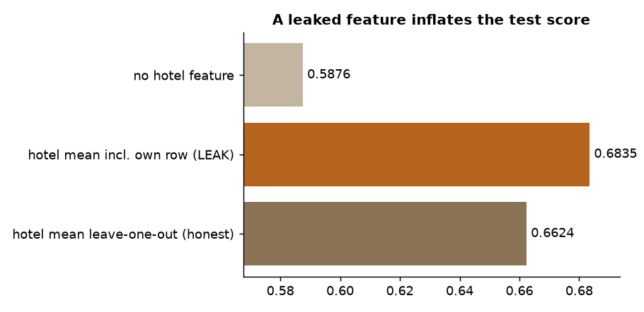
LEAKAGE
The Silent Killer
Hotel mean including the row being predicted: AUC 0.68 (inflated)
Leave-one-out hotel mean: AUC 0.66 (honest)
Never let target-derived information reach the training features
Source: Week 6 notebook, section 7
10

Slide 11
LEAKAGE, PART 2
Random vs Grouped Splits
Random split
Grouped split
Reviews of one hotel land in both train and test.
AUC 0.662: the model can partly recognise hotels.
Whole hotels are held out, as in production for new hotels.
AUC 0.646: the honest estimate.
Split the way the model will be used.
11

Slide 12
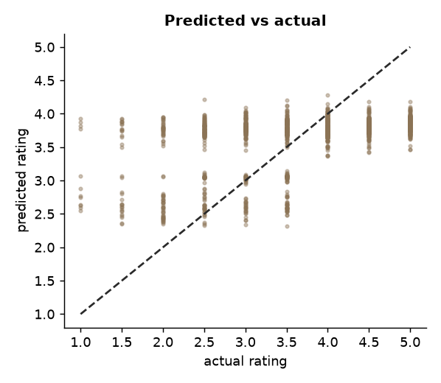
REGRESSION
Predicting the Rating Itself
Baseline RMSE 0.986 versus gradient boosting 0.875
The model explains part of the variation, not most of it
Predicted vs actual: a wide scatter around the diagonal shows how much is left unexplained
Source: Week 6 notebook, section 8
12

Slide 13
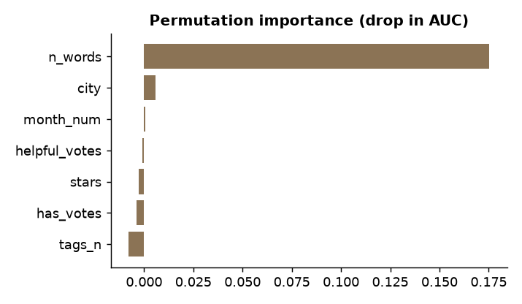
EXPLAINABILITY
What Drives the Predictions?
Permutation importance: shuffle one feature and measure the damage
Review length (n_words) is the top feature
Importance describes the model, not causes in the real world
Source: Week 6 notebook, section 9
13

Slide 14
LO4 · SPARK MLLIB
The Same Idea on a Cluster
from pyspark.ml import Pipeline
from pyspark.ml.feature import VectorAssembler
from pyspark.ml.classification import GBTClassifier
pipe = Pipeline(stages=[
VectorAssembler(inputCols=cols,
outputCol="features"),
GBTClassifier(labelCol="high")])
model = pipe.fit(train)
auc = evaluator.evaluate(
model.transform(test))
Pipelines package preprocessing and the model as one object
Our Spark GBT scored AUC 0.585 on metadata only, in line with the single-machine result
Scale changes the engine, not the discipline
14

Slide 15
IN-CLASS LAB · 35 MIN · UNGRADED PRACTICE
Lab: Break and Fix a Model
1
Run sections 1–4 of the notebook and note the CV scores
2
Reproduce the leakage in section 7 and explain the inflated AUC
3
Choose a threshold for a "flag unhappy guests" use case and defend it
4
Group-split by city instead of hotel: what happens?
15

Slide 16
WRAP-UP
Key Takeaways
1
Frame the target and the features before choosing algorithms.
2
Beat a baseline; evaluate with cross-validation and a held-out test set.
3
Treat the threshold as a business decision.
4
Overfitting and leakage create results that collapse in production.
5
Spark MLlib pipelines reuse the same discipline at scale.
Next week Prescriptive analytics: from prediction to the best decision.
16

