Slide 1
SENG 42293 · BIG DATA ANALYTICS · WEEK 7
Prescriptive Analytics
From prediction to the best decision: optimisation, what-if and robustness
LO3 | Level 4 · 3 credits

Slide 2
WHERE WE ARE
Recap and Today's Agenda
Week 6 recap
Today
Frame the target and the features
Beat a baseline, cross-validate
Thresholds are business decisions
Beware overfitting and leakage
1
Prediction versus prescription
2
Modelling a decision as optimisation
3
Naive, greedy and optimal plans
4
What-if: the value of budget
5
Robustness by simulation
6
Overbooking: a classic problem
2

Slide 3
CONCEPT
Predictive Tells You What; Prescriptive Tells You What To Do
Decision variables
Objective
Constraints
What we control: feature hotel i or not (x_i = 1 or 0).
What we maximise or minimise: expected extra bookings.
What limits us: total budget, at most 5 hotels per city.
Optimisation Choose the decisions that maximise the objective without breaking any constraint.
3

Slide 4
MODEL
The Campaign Problem: Which Hotels To Feature?
Element | Our model
Decision | x_i ∈ {0, 1} for each hotel i
Objective | maximise Σ u_i · x_i, with u_i = 0.1 · n_reviews · (avg_rating/5)³
Budget | Σ c_i · x_i ≤ B = 25 units
Costs c_i | 2★ = 1.0, 3★ = 1.5, 4★ = 2.5, 5★ = 4.0
Diversity | at most 5 hotels per city
These utility and cost formulas are assumptions; state yours explicitly.
4

Slide 5
THREE WAYS TO DECIDE
Naive vs Greedy vs Optimal
Plan | Hotels | Cost used | Expected extra bookings
Naive: top rated | 14 | 25.0 | 44.1
Greedy: uplift per cost | 21 | 24.5 | 69.9
Optimal (MILP) | 21 | 25.0 | 70.8
Optimal beats naive by 60.7%: picking the best-rated hotels is not the best plan.
5

Slide 6
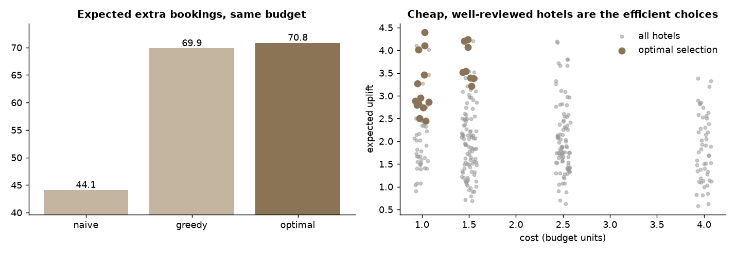
RESULT
The Chosen Plans Compared
The naive plan spends the budget on only 14 top-rated hotels
Greedy and optimal buy more, cheaper hotels with high uplift per unit cost
Greedy lands within about 1.4% of optimal: good heuristics are valuable but not guaranteed
Source: Week 7 notebook, section 2
6

Slide 7
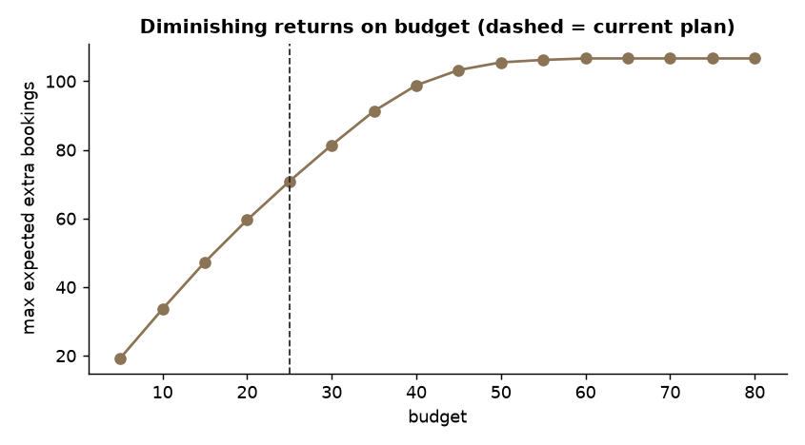
WHAT-IF
The Value of Budget
Extra bookings rise with budget, then flatten near 107
Beyond about B = 60 the extra budget buys nothing: the city caps bind
The shadow price at B = 25 is about 2.16 bookings per extra unit
Source: Week 7 notebook, section 3
7

Slide 8
SHADOW PRICE
What a Constraint Costs You
Reading the shadow price
Caution
Relax the budget by one unit and the LP bound improves by about 2.16 bookings.
It tells you which constraint is worth negotiating.
Valid for small changes only.
It comes from the LP relaxation; the integer plan can jump in steps.
Decision value: should we ask for more budget, or for a looser per-city cap?
8

Slide 9
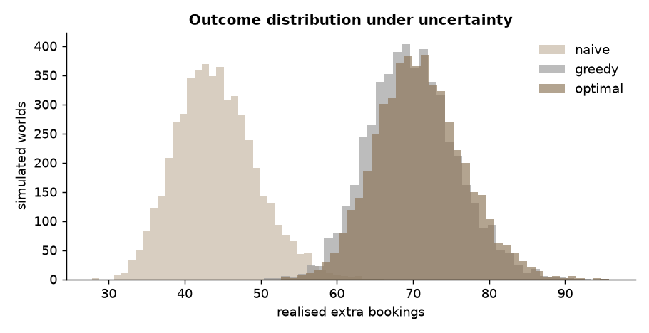
UNCERTAINTY
Robustness by Simulation
Utilities are estimates, so perturb them and re-score each plan 1,000s of times
Optimal: mean 70.9, 5th percentile 61.9; naive: mean 44.1, 5th percentile 36.1
The optimal plan dominates even in the bad cases
Source: Week 7 notebook, section 4
9

Slide 10
ROBUST PLAN
Is a "Robust" Plan Worth It?
Robust objective: maximise mean − 1 SD.
Optimal (mean)
Robust (mean − 1 SD)
Honest reading
Mean 70.9, 5th percentile 61.9.
Mean 70.8, 5th percentile 61.8.
In this problem the two plans are practically identical. Robustness pays only when risk differs between options.
10

Slide 11
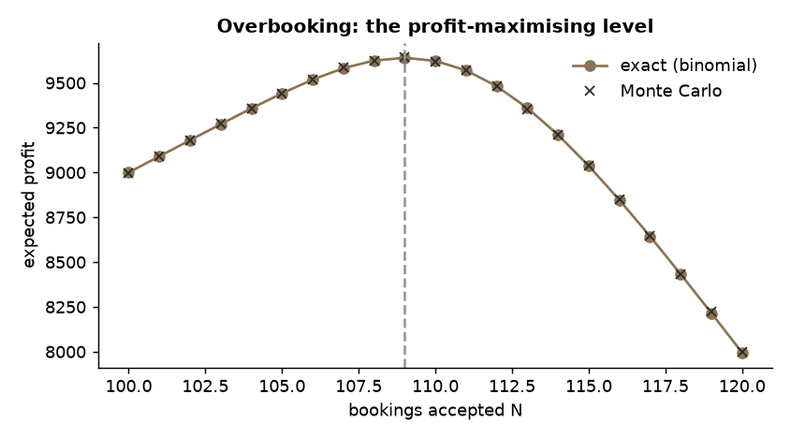
CLASSIC PROBLEM
Overbooking
100 rooms, each booking shows with probability 0.90
A room filled earns 100; a guest we cannot house costs 250
Best policy: accept 109 bookings, profit 9,640 versus 9,000 with no overbooking (+7.1%)
Source: Week 7 notebook, section 5
11

Slide 12
IMPLEMENTATION
Solving It With scipy `milp`
from scipy.optimize import milp, LinearConstraint, Bounds
res = milp(c=-u, # maximise -> minimise -u
constraints=[LinearConstraint(A, ub=b)],
integrality=np.ones(n), # x_i integer
bounds=Bounds(0, 1)) # 0 or 1
milp solves mixed-integer linear programs exactly
Write the model first, then code it
At cluster scale, solve per-region subproblems in parallel or use a specialised solver
12

Slide 13
IN-CLASS LAB · 35 MIN · UNGRADED PRACTICE
Lab: Plan a Campaign
1
Run the notebook and reproduce the three plans
2
Change the budget to 15 and 40: how do plan and shadow price change?
3
Add a rule: at least 2 five-star hotels. Does the optimum fall?
4
Change the show-up probability to 0.85: what is the new best N?
13

Slide 14
WRAP-UP
Key Takeaways
1
Prescriptive analytics chooses decisions, not just forecasts.
2
Model decision variables, an objective and constraints explicitly.
3
Compare optimal plans with naive and greedy baselines.
4
Use what-if and shadow prices to value constraints.
5
Test plans under uncertainty with simulation.
Next week Survival analysis: time-to-event and censoring.
14

