Slide 1
SENG 42293 · BIG DATA ANALYTICS · WEEK 8
Survival Analysis
Time-to-event modelling: censoring, Kaplan–Meier, hazards and Cox regression
LO3, LO4 | Level 4 · 3 credits

Slide 2
WHERE WE ARE
Recap and Today's Agenda
Week 7 recap
Today
Decision variables, objective, constraints
Naive vs greedy vs optimal
What-if analysis and shadow prices
Simulation for robustness
1
Time-to-event questions
2
Censoring
3
Kaplan–Meier by hand
4
Comparing groups: log-rank
5
Hazard and Cox regression
6
Life table in Spark
2

Slide 3
MOTIVATION
When "How Long?" Is the Question
Membership
Bookings
Operations
How long until a member cancels?
How long until a guest rebooks?
How long until equipment fails?
Our case 4,000 members tracked for up to 24 months; 1,711 cancelled, 57.2% were still members when observation ended.
3

Slide 4
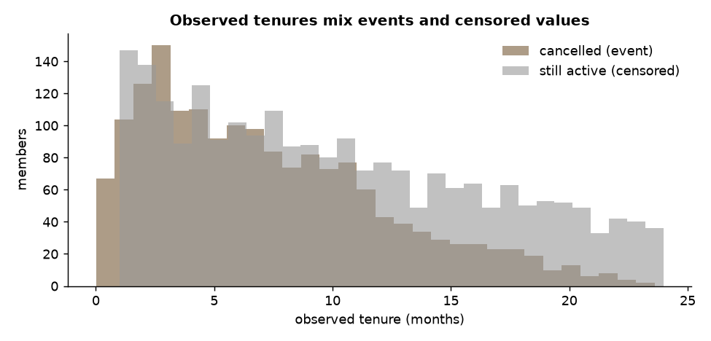
THE KEY PROBLEM
Censoring
Cancelled: we know the exact tenure
Censored: still a member, so we only know tenure ≥ observed time
Dropping or mishandling censored cases biases every average
Source: Week 8 notebook, section 1
4

Slide 5
WHY AVERAGES MISLEAD
Three Tempting but Wrong Summaries
Method | Estimate (months) | Problem
Mean tenure, everyone | 8.9 | Treats censored time as final
Mean tenure, cancelled only | 7.2 | Drops the long-stayers
Kaplan–Meier median | 13.6 | Uses all information correctly
The right answer is 13.6 months; both naive numbers badly understate it.
5

Slide 6
ESTIMATOR
Kaplan–Meier, Built by Hand
# at each event time t_i:
# d_i = events, n_i = still at risk
# S(t) = S(t-1) * (1 - d_i / n_i)
S = 1.0
for t in event_times:
n_i = (tenure >= t).sum()
d_i = ((tenure == t) & event).sum()
S *= 1 - d_i / n_i
S(t) is the probability of lasting beyond t
Censored members leave the risk set without causing a drop
Our hand-built curve matches the lifelines library
6

Slide 7
READING THE CURVE
Survival Probabilities
77%
54%
40%
27%
still members at 6 months
at 12 months
at 18 months
at 24 months
Median survival is 13.6 months: the time when S(t) crosses 0.5.
Always report the median together with S at planned horizons.
7

Slide 8
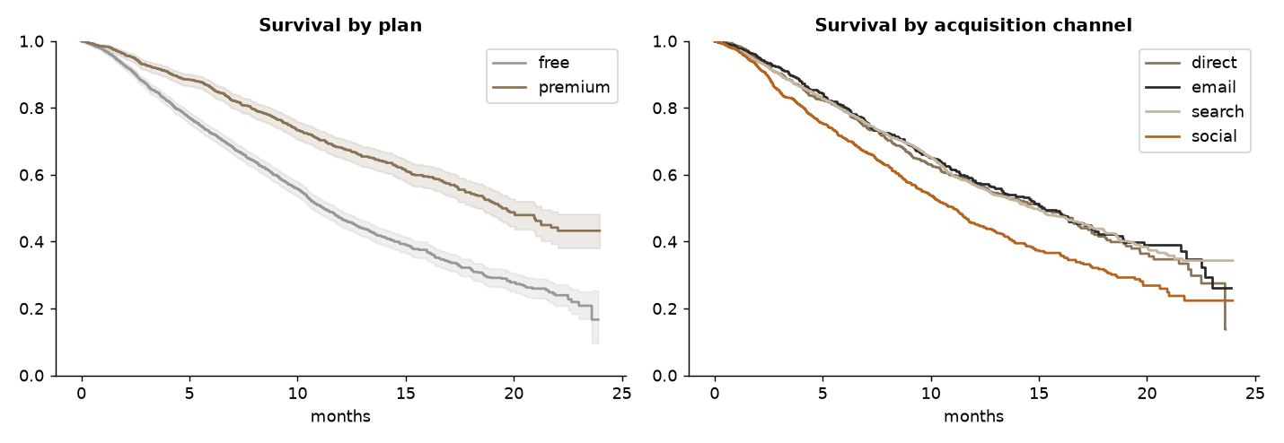
COMPARING GROUPS
Free vs Premium
Premium median 19.5 months versus free 11.2
12-month retention: premium 68%, free 47%
Log-rank test p < 0.001 for plan and for channel
Source: Week 8 notebook, section 3
8

Slide 9
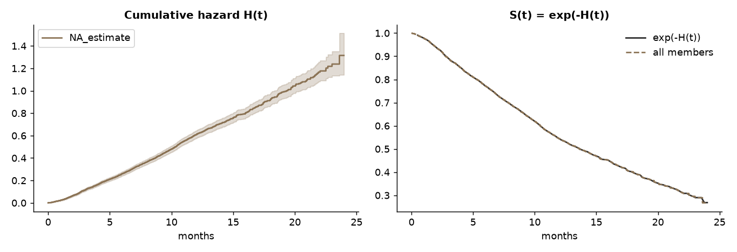
HAZARD
Hazard and Cumulative Hazard
Hazard h(t) is the risk of cancelling now, given you are still a member
Cumulative hazard H(t) bends upward, so risk rises with tenure (Weibull shape above 1)
S(t) = exp(−H(t)) links the two views
Source: Week 8 notebook, section 4
9

Slide 10
COX MODEL
Cox Proportional Hazards: Hazard Ratios
Variable | HR | 95% CI | Meaning
Premium | 0.57 | 0.51–0.64 | 43% lower cancellation risk
Social channel | 1.46 | 1.32–1.62 | 46% higher risk
Avg rating given (per star) | 0.62 | 0.59–0.66 | Happier members stay
Bookings in year 1 (each) | 0.93 | 0.91–0.96 | Engagement protects
Concordance index 0.64. The model recovers the effects built into the synthetic data.
10

Slide 11
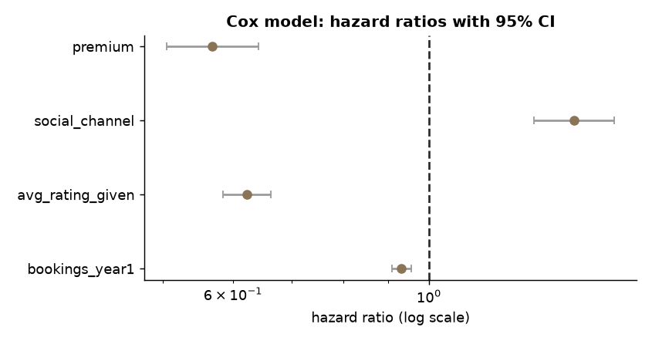
INTERPRETATION
Hazard Ratios at a Glance
HR < 1 reduces risk, HR > 1 raises it
Intervals that avoid 1 are statistically clear
HR is multiplicative and holds over time only if proportionality holds
Source: Week 8 notebook, section 5
11

Slide 12
CHECK THE MODEL
Proportional-hazards Assumption
What it means
Our check
The effect of a covariate is a constant multiple of risk at all times.
If curves cross, it is violated.
Schoenfeld-residual test: smallest p-value 0.66, so no evidence against the assumption.
When violated: stratify or add time interactions.
Always test assumptions before trusting hazard ratios.
12

Slide 13
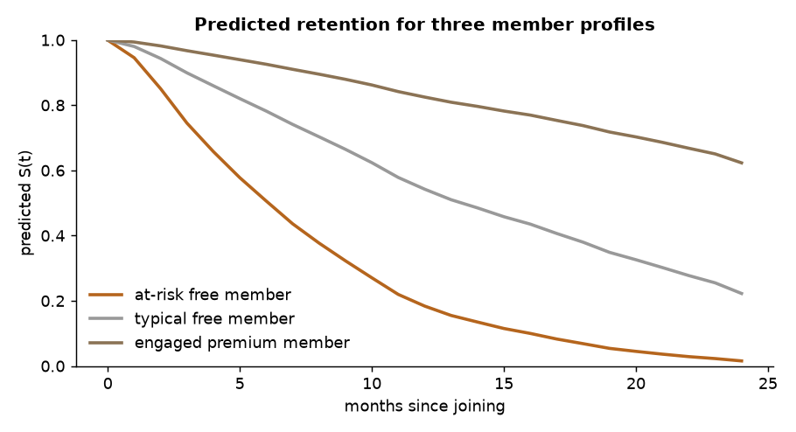
WHAT-IF
Predicting Retention for Profiles
12-month retention: at-risk free member 18%, typical free 54%, engaged premium 83%
Upgrading a typical member to premium lifts 12-month retention from 54% to 71%
Predictions are model-based and assume the effect is causal; an experiment would confirm
Source: Week 8 notebook, section 7
13

Slide 14
LO4 · SPARK
A Life Table in Spark
life = (df.groupBy("tenure_months")
.agg(F.sum("cancelled").alias("d"),
F.count("*").alias("c"))
.orderBy("tenure_months"))
# at-risk = total - cumulative leavers
# S(t) = cumulative product of (1 - d/n)
Counting at-risk and events is an aggregation, so it distributes well
Spark gives S(12) = 0.545 versus 0.544 from Kaplan–Meier (ties handled slightly differently)
Cox fitting is usually done on a sample or per segment
14

Slide 15
IN-CLASS LAB · 35 MIN · UNGRADED PRACTICE
Lab: Retention Analysis
1
Run sections 1–3 and reproduce the Kaplan–Meier curve
2
Compare curves by channel and report medians with the log-rank p
3
Fit the Cox model and explain one HR to a manager
4
Propose one retention action and the experiment to test it
15

Slide 16
WRAP-UP
Key Takeaways
1
Time-to-event data are censored; simple averages mislead.
2
Kaplan–Meier gives the survival curve; the log-rank test compares groups.
3
Hazard shows how risk changes with tenure; Cox HRs measure effects.
4
Test the proportional-hazards assumption.
5
Spark builds life tables; modelling happens on samples or segments.
Next week Text and sentiment analytics.
16

