Slide 1
SENG 42293 · BIG DATA ANALYTICS · WEEK 9
Sentiment & Text Analytics
Turning review text into features, sentiment scores and topics
LO3, LO4 | Level 4 · 3 credits

Slide 2
WHERE WE ARE
Recap and Today's Agenda
Week 8 recap
Today
Censoring and Kaplan–Meier
Log-rank comparison
Hazard and Cox ratios
Life table in Spark
1
Why text needs special treatment
2
Pre-processing and word frequencies
3
Bag of words and TF-IDF
4
Lexicon vs learned sentiment
5
Failure cases: negation
6
Topics, aspects and Spark ML
2

Slide 3
PART III · SPECIALISED
Text Is Unstructured Data
The challenge
The craft
The risk
Models need numbers; words are symbols with order, context and ambiguity.
Convert text into vectors, then reuse the models of Weeks 5–8.
Every conversion loses information; know what each step throws away.
Our data 15,183 rated reviews. The text is synthetic and templated, so accuracies are unrealistically high; the method and failure modes transfer.
3

Slide 4
PIPELINE
Text Pre-processing
1
2
3
4
Lower-case
Tokenise
Filter
Normalise
Same word, same token.
Split into words with a regular expression.
Remove stop words and punctuation, but keep "not".
Optional stemming or lemmatisation.
Each step discards information, so choose deliberately.
4

Slide 5
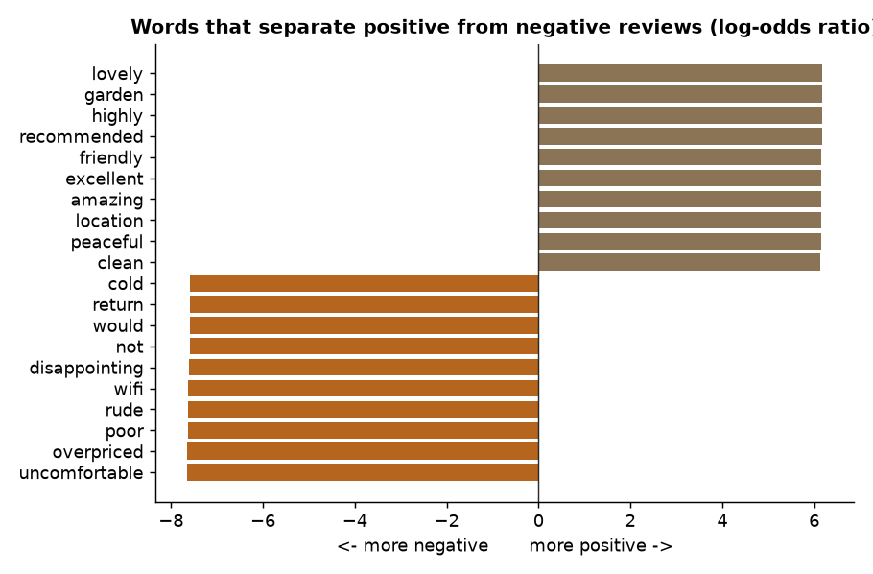
EXPLORATION
Words That Separate Positive From Negative
Log-odds ratio compares how often a word appears in each group
Most positive: lovely, garden, highly, recommended, friendly
Most negative: uncomfortable, overpriced, wifi, poor, rude
Source: Week 9 notebook, section 2
5

Slide 6
REPRESENTATION
Bag of Words and TF-IDF
tf-idf(t, d) = tf(t, d) x idf(t)
idf(t) = ln((1 + N) / (1 + df(t))) + 1
# 15,183 documents x 44 terms
# sparsity: 86.8% zeros here
# real corpora: > 99% zeros
Bag of words discards word order
TF-IDF down-weights words found in nearly every document
Sparse storage is essential at scale (Spark SparseVector)
N-grams (bigrams) recover some local context
6

Slide 7
METHOD 1
Lexicon-based Sentiment
How it works
Weakness
Count positive and negative dictionary words.
No training data, fully explainable.
Accuracy on pos/neg reviews: 100% here; Spearman with rating 0.82.
Negation: "not friendly" still scores positive.
No sarcasm, no context.
Quality depends on the dictionary.
On real text, lexicons are a transparent baseline, not a finish line.
7

Slide 8
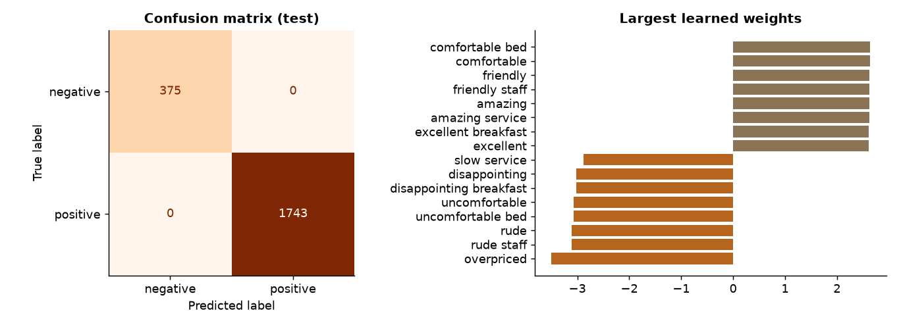
METHOD 2
A Machine-learned Classifier
TF-IDF unigrams + bigrams into logistic regression
Test accuracy and F1 are 1.00: a symptom of templated text, not a great model
Real review classifiers typically reach roughly 85–93%
Source: Week 9 notebook, section 6
8

Slide 9
STRESS TEST
Eight Hard Sentences
Method | Accuracy on 8 hard cases
Plain lexicon | 62.5%
Lexicon + negation window | 87.5%
ML (TF-IDF + logistic regression) | 62.5%
Test on hard cases, not only on a random split. Models inherit the limits of their data.
9

Slide 10
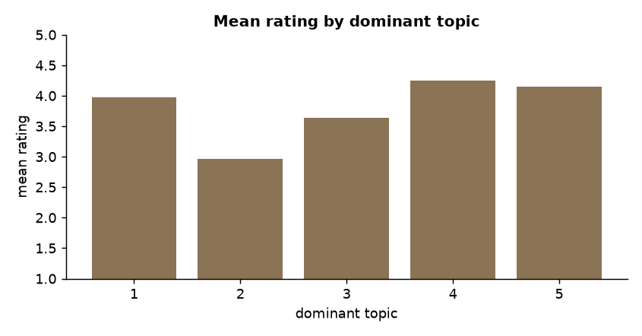
TOPICS
Topic Modelling With NMF
NMF factorises the TF-IDF matrix into topics and topic weights
Humans must name topics by reading the top words
Mean rating by dominant topic ranges from 2.96 to 4.25
Source: Week 9 notebook, section 8
10

Slide 11
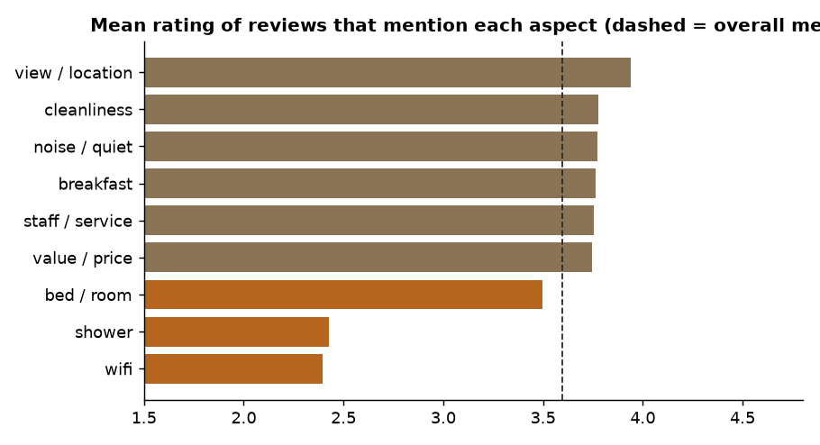
ACTIONABLE INSIGHT
Aspect-based Scorecard
Reviews mentioning wifi (2.40) or showers (2.43) rate lowest
Reviews mentioning views and location rate highest (3.94)
A single score hides why; aspects show what to fix
Source: Week 9 notebook, section 9
11

Slide 12
LO4 · SPARK ML
The Same Pipeline at Scale
Pipeline(stages=[
RegexTokenizer(inputCol="text",
outputCol="tokens"),
CountVectorizer(inputCol="tokens",
outputCol="tf", vocabSize=5000,
minDF=3),
IDF(inputCol="tf",
outputCol="features"),
LogisticRegression(maxIter=50)])
Every stage is distributed; sparse vectors stay on the cluster
Spark accuracy 1.00, matching scikit-learn on this data
Word count at scale reuses the Week 4 explode and groupBy pattern
12

Slide 13
RISKS
Pitfalls and Ethics
Risk | Example | Mitigation
Negation, sarcasm | "not bad", "great, another delay" | Negation handling, contextual models, audits
Domain shift | Hotel model used on restaurants | Re-train on the target domain
Language mixing | Sinhala, Tamil and English together | Language detection, multilingual models
Fake or copied reviews | Paid, duplicated text | De-duplication, anomaly checks
Privacy | Reviews can identify people | Anonymise, minimise, obtain consent
13

Slide 14
IN-CLASS LAB · 35 MIN · UNGRADED PRACTICE
Lab: Read the Reviews
1
Run the notebook through section 7 and list which hard sentences fail
2
Extend the lexicon negation window to 3 words: better or worse?
3
Change NMF to 3 and 8 topics and decide which is most interpretable
4
Build an aspect scorecard for one hotel and recommend an action
14

Slide 15
WRAP-UP
Key Takeaways
1
Text must become numbers; each conversion loses information.
2
TF-IDF weights distinctive words; sparse matrices are essential.
3
Lexicons are transparent but fail on negation; learned models need good data.
4
Test on hard cases and report realistic expectations.
5
Topics and aspects turn text into decisions; Spark ML scales the pipeline.
Next week Social network analytics.
15

