Slide 1
SENG 42293 · BIG DATA ANALYTICS · WEEK 10
Social Network Analytics
Who matters, who belongs together, and how information spreads
LO3, LO4 | Level 4 · 3 credits

Slide 2
WHERE WE ARE
Recap and Today's Agenda
Week 9 recap
Today
Pre-processing and TF-IDF
Lexicon vs learned sentiment
Negation and other failure modes
Topics and aspect scorecards
1
Graphs: nodes and edges
2
Degree and the long tail
3
Three centralities
4
Community detection (Louvain)
5
PageRank by hand and on Spark
6
Information diffusion
2

Slide 3
PART III · SPECIALISED
Relationships Are Data
Nodes
Edges
Questions
Travellers (600 in our network).
Directed "follows" links (3,167).
Who is influential? Which groups exist? How far would a recommendation spread?
Our data A synthetic follower network with four interest communities and a few hubs, so the right answer is known.
3

Slide 4
BASICS
The Network in Numbers
600
3,167
5.3
88
travellers
follow edges
mean followers
maximum followers
Median followers is 4: most people have few, a few have many (long tail).
The mean misleads on skewed data; hubs dominate how information moves.
4

Slide 5
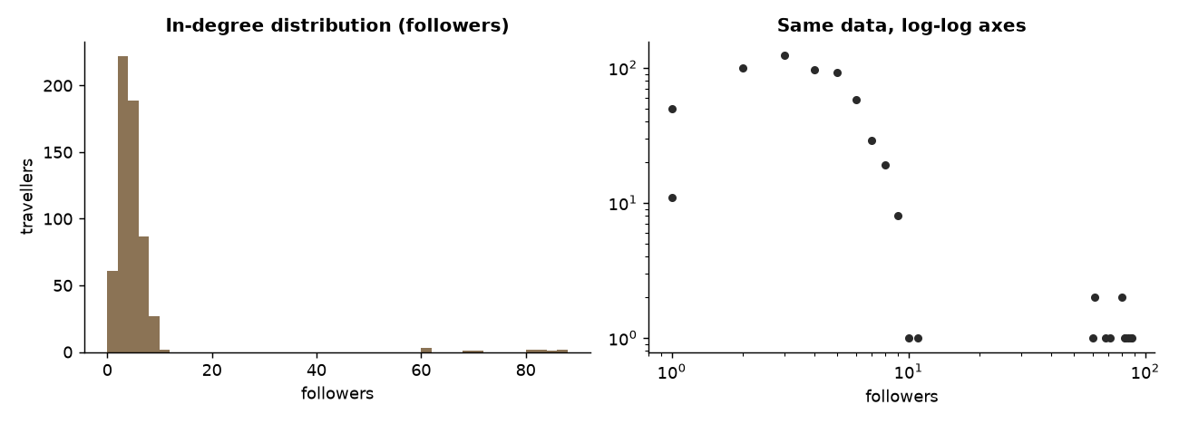
DEGREE
The Long Tail
In-degree = followers, out-degree = accounts followed
Heavy right tail: compare mean 5.3 with median 4 and maximum 88
Straight-ish line on log-log axes is the classic hub signature
Source: Week 10 notebook, section 1
5

Slide 6
CENTRALITY
Three Meanings of "Important"
Measure | Question it answers | Cost
Degree | Who has the most direct connections? | Cheap
Betweenness | Who bridges otherwise separate groups? | Expensive: sample it
PageRank | Who is followed by important people? | Iterative, scalable
Spearman correlation between followers and PageRank is 0.76: related, not identical. Top-20 overlap: 14 of 20.
6

Slide 7
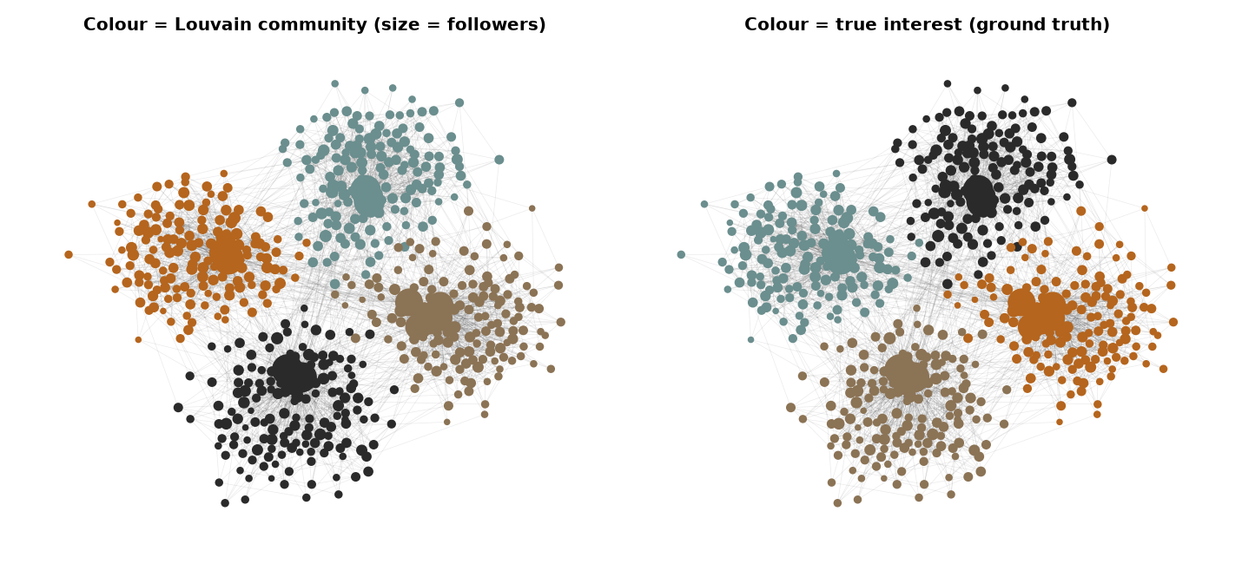
COMMUNITIES
Louvain Finds the Interest Groups
Louvain maximises modularity (0.62 here) without seeing interest labels
It recovered 4 communities of 150, with purity 1.00 against the true interests
Real networks are fuzzier: expect partial agreement
Source: Week 10 notebook, section 3
7

Slide 8
ALGORITHM
PageRank in One Formula
PR(v) = (1 - d)/N
+ d * sum( PR(u) / outdeg(u) )
over followers u of v
# d = 0.85 damping
# dangling nodes share their rank
# iterate until ranks stop changing
Rank flows along edges; important followers pass more
Manual NumPy and networkx agree to about 4e-5
The loop maps to join → flatMap → reduceByKey
8

Slide 9
LO4 · SPARK RDD
PageRank on a Cluster
for _ in range(15):
contribs = links.join(ranks).flatMap(
lambda kv: [(v, kv[1][1]/len(kv[1][0]))
for v in kv[1][0]])
summed = contribs.reduceByKey(add, 4)
ranks = allnodes.map(...) \
.leftOuterJoin(summed)...cache()
ranks.count() # materialise
Each iteration shuffles: iterative graph jobs are expensive
cache() the link table and materialise ranks each loop, or lineage grows
Spark and manual NumPy results differ by under 1e-4
GraphX, GraphFrames and Pregel exist for this reason
9

Slide 10
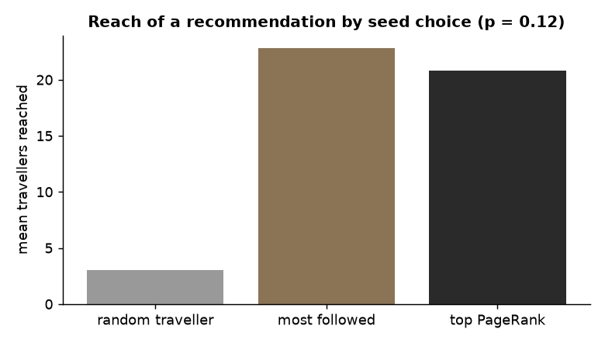
SPREAD
Information Diffusion
Independent cascade with adoption probability 0.12, 300 runs per seed
Random traveller reaches about 3 people; most-followed about 23; top PageRank about 21
Reach depends strongly on the seed and on p
Source: Week 10 notebook, section 5
10

Slide 11
LIMITS
Ethics and Limitations
Issue | Why it matters
Sampling bias | You rarely see the full network; metrics shift when edges are missing
Homophily | Friends are similar because of influence or because similar people connect
Privacy | Graph structure can re-identify "anonymous" users
Scale | All-pairs measures are expensive: sample or approximate
11

Slide 12
IN-CLASS LAB · 35 MIN · UNGRADED PRACTICE
Lab: Find the Influencers
1
Run sections 1–3 and list the top 5 travellers by PageRank
2
Run Louvain with a different seed and resolution; compare purity
3
Remove the top 5 PageRank travellers: how does the network break up?
4
Repeat diffusion with p = 0.05 and 0.25
12

Slide 13
WRAP-UP
Key Takeaways
1
Graphs add relationships to the analyst’s toolbox.
2
Real networks have long tails; averages mislead.
3
Pick centrality by question: reach, brokerage or endorsement.
4
Louvain finds structure without labels; verify it when you can.
5
Iterative graph algorithms shuffle heavily: cache and materialise.
Next week Web analytics: sessions, funnels and A/B tests.
13

