Slide 1
SENG 42293 · BIG DATA ANALYTICS · WEEK 11
Web Analytics
From raw clicks to sessions, funnels and trustworthy experiments
LO3, LO4 | Level 4 · 3 credits

Slide 2
WHERE WE ARE
Recap and Today's Agenda
Week 10 recap
Today
Graphs and long-tailed degrees
Degree, betweenness, PageRank
Louvain communities
PageRank on Spark RDDs
1
Event logs and sessionisation
2
Core metrics and segments
3
The conversion funnel
4
A/B testing and confidence intervals
5
Power and the peeking problem
6
Sessionisation on Spark
2

Slide 3
DATA
The Clickstream
44,276
6,000
10,084
1.68
events
visitors
sessions
sessions per visitor
Each row: user, timestamp, page, device, channel, A/B variant.
The log has no session column: we derive it.
Synthetic data with a built-in lift for variant B.
3

Slide 4
SESSIONISATION
The 30-minute Rule
df.sort(user, time)
gap = time - previous_time (per user)
new_session = gap is null or gap > 30 min
session_id = running sum of new_session
A convention, not a law: state the rule you used
In our synthetic log the count is identical at 10, 30 and 60 minutes because gaps are either tiny or hours long
Real logs are messier and move with the threshold
4

Slide 5
CORE METRICS
Sessions at a Glance
14.7%
12.5%
4.39
bounce rate (one-event sessions)
session conversion
pages per session
Desktop converts best (14.5%), mobile lowest (11.1%).
Channels barely differ (12.2%–12.6%).
Segments reveal where averages hide differences.
5

Slide 6
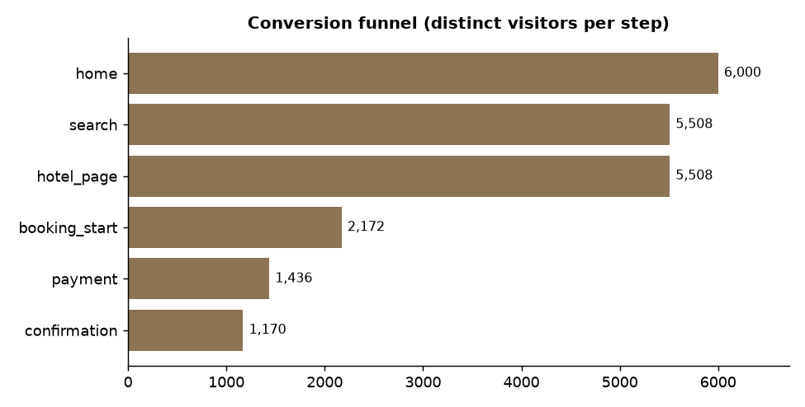
FUNNEL
The Conversion Funnel
6,000 visitors reach home; 1,170 reach confirmation
Biggest relative drop: only 39% of those on hotel pages start a booking
Count distinct visitors per step, not events
Source: Week 11 notebook, section 3
6

Slide 7
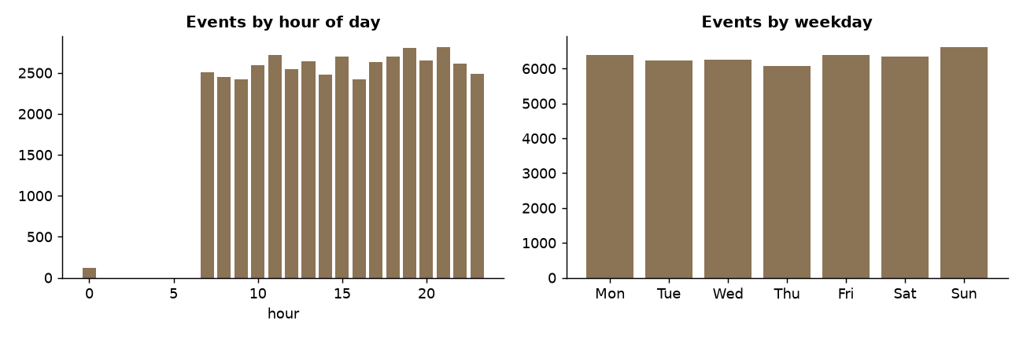
TIMING
When Do People Visit?
Peak hour is 21:00; busiest weekday is Sunday
Schedule campaigns and maintenance around the rhythm
Check time zones before drawing conclusions
Source: Week 11 notebook, section 4
7

Slide 8
A/B TEST
Two-proportion z-test
z = (p_B - p_A)
/ sqrt( p(1-p) (1/n_A + 1/n_B) )
# p = pooled conversion rate
# analyse by VISITOR, the
# randomisation unit
Never analyse by event or session when people appear many times
Report the confidence interval, not only the p-value
Significant does not mean valuable
8

Slide 9
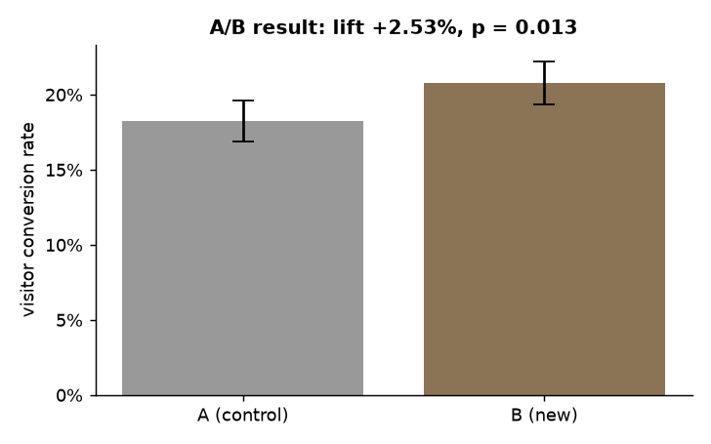
RESULT
Did Variant B Help?
A 18.2% versus B 20.8%: lift +2.5 points (+13.9% relative)
z = 2.48, p = 0.013; 95% CI for the lift: +0.5 to +4.5 points
The lift appears on every device; mobile gains most (+3.2 points)
Source: Week 11 notebook, sections 5 and 8
9

Slide 10
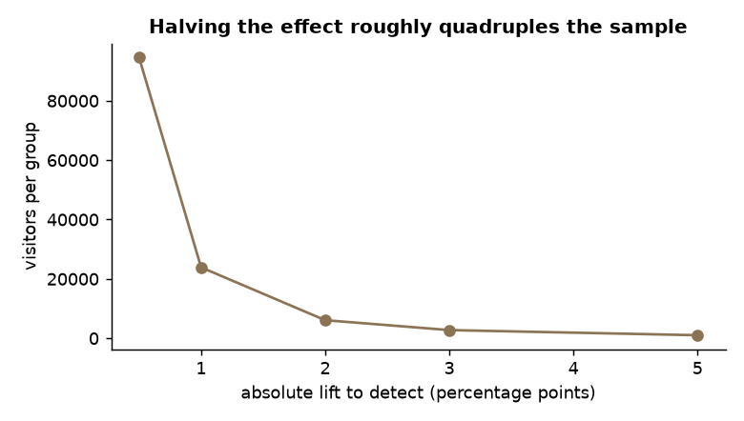
PLANNING
Power and Sample Size
3,000 visitors per group detect about a 3-point lift at 80% power
Detecting 1 point needs about 23,900 per group
Halving the effect roughly quadruples the sample
Source: Week 11 notebook, section 6
10

Slide 11
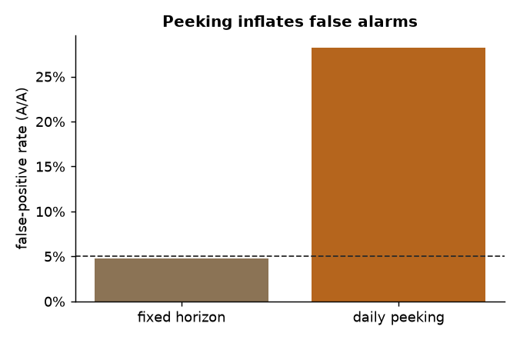
PITFALL
The Peeking Problem
A/A test: both groups identical, so every "win" is a false alarm
Testing once at the end: 4.7% false positives (nominal 5%)
Stopping at the first significant daily peek: 28.2%
Source: Week 11 notebook, section 7
11

Slide 12
LO4 · SPARK
Sessions With Window Functions
w = Window.partitionBy("user_id").orderBy("ts")
df = (df
.withColumn("gap_s", ts_long - F.lag("ts").over(w))
.withColumn("new", F.when(gap_s.isNull() | (gap_s > 1800), 1).otherwise(0))
.withColumn("session", F.sum("new").over(w.rowsBetween(
Window.unboundedPreceding, Window.currentRow))))
Shuffle by user_id so each visitor’s events sit together
Spark finds 10,084 sessions, identical to pandas
Production: incremental jobs over hourly Parquet partitions
12

Slide 13
CHECKLIST
Pitfalls in Web Analytics
Pitfall | Why it matters
Bots and crawlers | Inflate traffic, depress conversion
Wrong unit of analysis | Analyse by randomisation unit (visitor)
Peeking / early stopping | False positives
Novelty effect | New designs win early; run full weekly cycles
Sample-ratio mismatch | A 55/45 split in a 50/50 test means broken assignment
Privacy | Cookies and IDs are personal data
13

Slide 14
IN-CLASS LAB · 35 MIN · UNGRADED PRACTICE
Lab: Run an Experiment
1
Sessionise the log and reproduce the funnel
2
Reproduce the A/B z-test and compute the confidence interval
3
Plan a test for a 0.5-point lift: sample size and duration
4
Rerun the peeking simulation with a stricter threshold
14

Slide 15
WRAP-UP
Key Takeaways
1
Sessions are derived from events by a stated rule.
2
Funnels show where visitors drop; count distinct visitors.
3
A/B tests: randomise, pre-plan sample size, analyse once.
4
Confidence intervals and power matter as much as p-values.
5
Window functions sessionise at scale.
Next week Visualisation and the capstone pipeline.
15

