Slide 1
SENG 42293 · BIG DATA ANALYTICS · WEEK 12
Visualisation & Capstone
Communicating honestly and proving the pipeline is trustworthy
LO1–LO4 | Level 4 · 3 credits

Slide 2
WHERE WE ARE
Recap and Today's Agenda
Weeks 5–11 recap
Today
Descriptive, predictive, prescriptive
Survival analysis
Text and sentiment
Network and web analytics
1
Honest versus misleading charts
2
Choosing a chart for the question
3
Small multiples
4
A one-screen dashboard
5
Pipeline quality gates
6
Capstone report and assessment
2

Slide 3
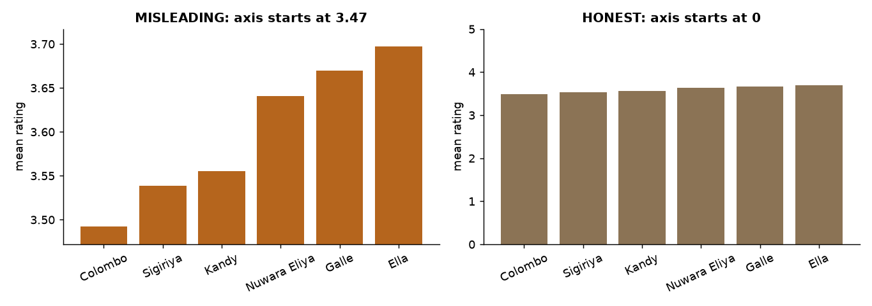
ETHICS
The Same Data, Two Stories
Same six city means, different axes
A truncated bar axis turns a 0.2-star gap (4% of the scale) into a dramatic difference
Bars should start at zero; show scale honestly
Source: Week 12 notebook, section 1
3

Slide 4
CHOOSING
Pick the Chart for the Question
Question | Good chart | Avoid
Compare categories | Sorted horizontal bar | Pie with many slices
Trend over time | Line | 3-D area
Distribution | Histogram, box plot | Bar of means only
Two numbers | Scatter plus trend | Dual-axis line
Many groups, one measure | Small multiples | One tangled multi-line chart
4

Slide 5
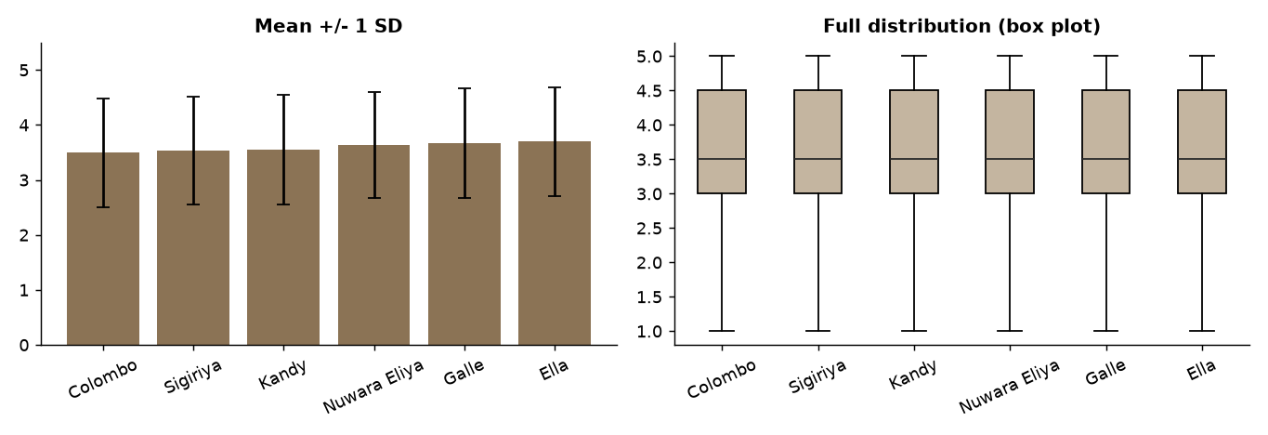
SHAPE
Means Hide Distributions
City means differ by only 0.2 stars
Spread (SD about 1 star) is five times larger than the gap
Show the distribution when the decision depends on it
Source: Week 12 notebook, section 2
5

Slide 6
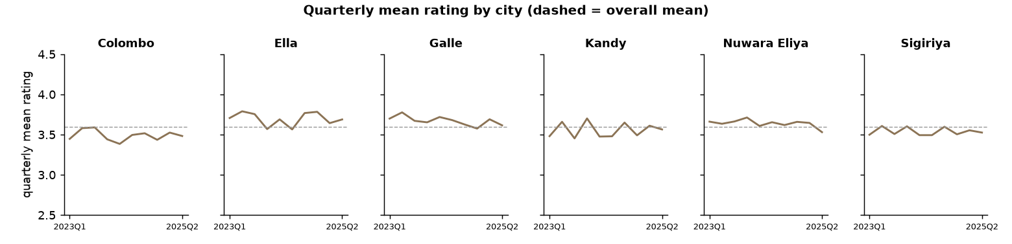
MANY GROUPS
Small Multiples
One panel per city, shared axes: the eye compares shape, not legends. Quarterly swings are 0.11–0.25 stars.
6

Slide 7
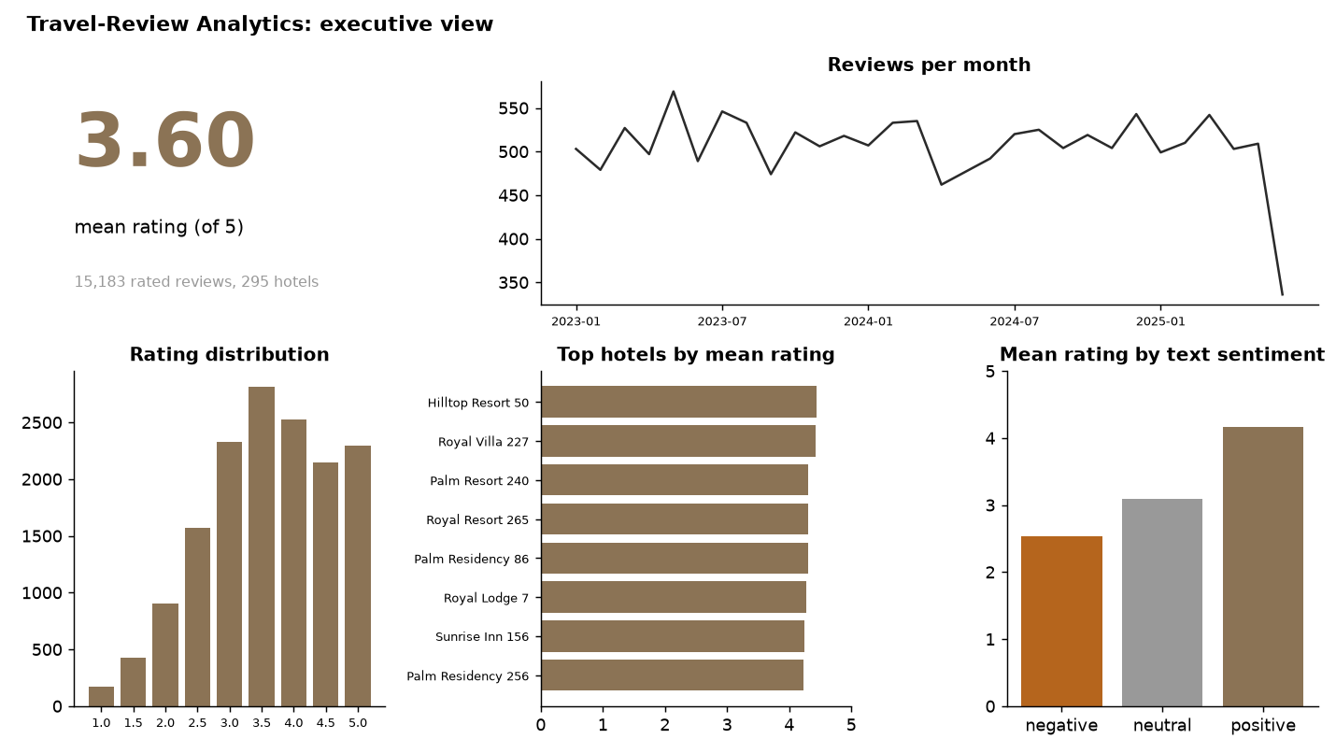
COMMUNICATION
A One-screen Dashboard
Headline KPI, volume, distribution, ranking, relationship: every panel answers a question.
7

Slide 8
TRUST
Quality Gates
What
Where
How
Automated checks that stop the pipeline when data looks wrong.
After ingest, after cleaning and before publishing the gold layer.
Compare statistics to thresholds; exit with a non-zero code on failure.
Principle A dashboard is only as trustworthy as the pipeline behind it.
8

Slide 9
OUR PIPELINE
Seven Gates, All Passed
Gate | Observed | Result
Corrupt-line rate below 5% | 1.7% | PASS
Duplicate rate below 5% | 1.1% | PASS
Missing/invalid rating below 20% | 12.1% | PASS
Unparsed dates = 0 | 0 | PASS
Mean rating within 1–5 | 3.60 | PASS
Quartiles ordered | 3.0 ≤ 3.5 ≤ 4.5 | PASS
Rating-sentiment correlation positive | 0.86 | PASS
Fed corrupted statistics, three of the gates fail as they should.
9

Slide 10
CAPSTONE
Report Structure (20% of the Grade)
Section | Content
1 Problem and users | Who decides what with these results?
2 Data | Source, volume, schema, 4 Vs, biases
3 Pipeline design | Bronze/silver/gold, tools, cluster configuration
4 Data quality | Findings, rules, before/after counts, gates
5 Analysis | At least two techniques from Weeks 5–11
6 Visualisation | Dashboard with stated questions
7 Ethics and privacy | Consent, bias, fairness
8–9 Limits, reproducibility | Next steps; one command to rerun
10

Slide 11
ASSESSMENT
How the Course Is Graded
Component | Weight | What it measures
End-of-semester examination | 70% | Concepts across Weeks 1–12
Travel-Review Analytics Pipeline | 20% | End-to-end implementation and analysis
Concepts quiz | 10% | Core vocabulary and reasoning
Weekly labs are ungraded practice for all three.
11

Slide 12
WRAP-UP
Key Takeaways
1
Charts are arguments: choose and scale them honestly.
2
Small multiples and dashboards communicate comparisons clearly.
3
Quality gates make pipelines trustworthy and failures visible.
4
The capstone integrates ingestion, cleaning, analytics, visualisation and ethics.
5
Big data analytics is craft plus judgement; show your assumptions.
12

