Slide 1
Causal Representation Learning from Temporal Sequences
Advanced Research Topics in Causal Machine Learning
Seminar SS2026
Luis Roberto Bustos Vargas (7084008)
Tirso Gustavo Ordaz Garcia (7082527)

Slide 2
Background & Motivation
DL relies mainly on correlations
Real world data is highly entangled
We want to predict true high level causal variables from raw images, not just predict next frame

Slide 3
Why temporal sequences?
Time + interventions are the keys for identifiability
Changes are governed by physics and causal laws: temporal dynamics
By observing how high dimensional observations transition over time under specific actions, we can guarantee the isolation and identification of the true causal variables.

Slide 4
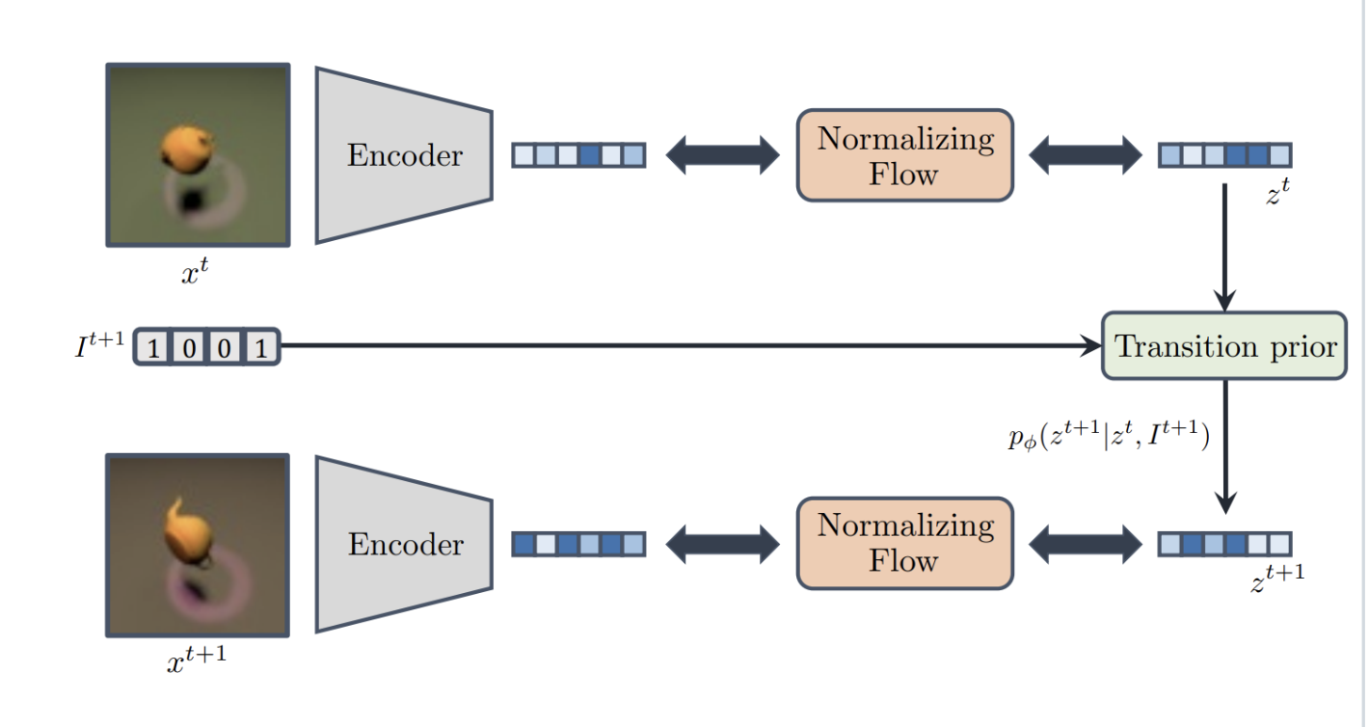
CITRIS: Causal Identifiability from (Instantaneous) Temporal Intervened Sequences
Encoder
Normalizing Flow
Transition Prior
https://github.com/phlippe/CITRIS

Slide 5
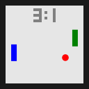
Interventional Pong environment
Paddles move towards the ball
Ball has slight random movements
Causal Variables:
Paddles
Ball position
Ball velocity
Score
https://github.com/phlippe/CITRIS

Slide 6
Limitations of CITRIS
Requires known targets for interventions
Explicitly say which causal variable is in action at time step t.
Works only for controlled simulators
Longer dependencies may be lost, e.g. is the ball accelerating?

Slide 7
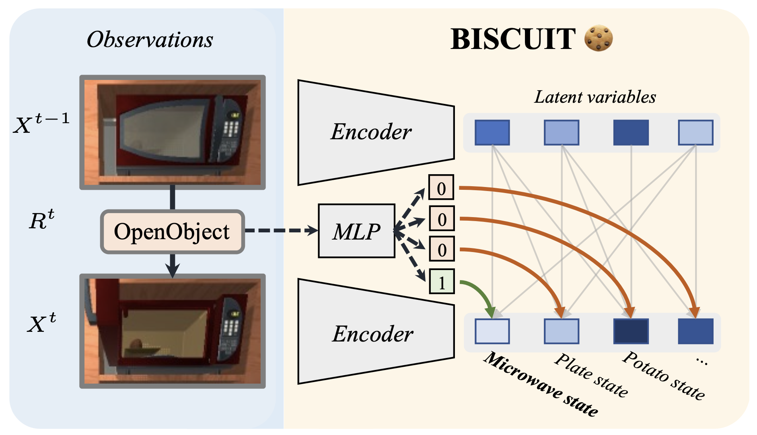
BISCUIT: Causal Representation Learning from Binary Interactions
Can we identify causal variables without knowing the intervention targets?
https://phlippe.github.io/BISCUIT/

Slide 8
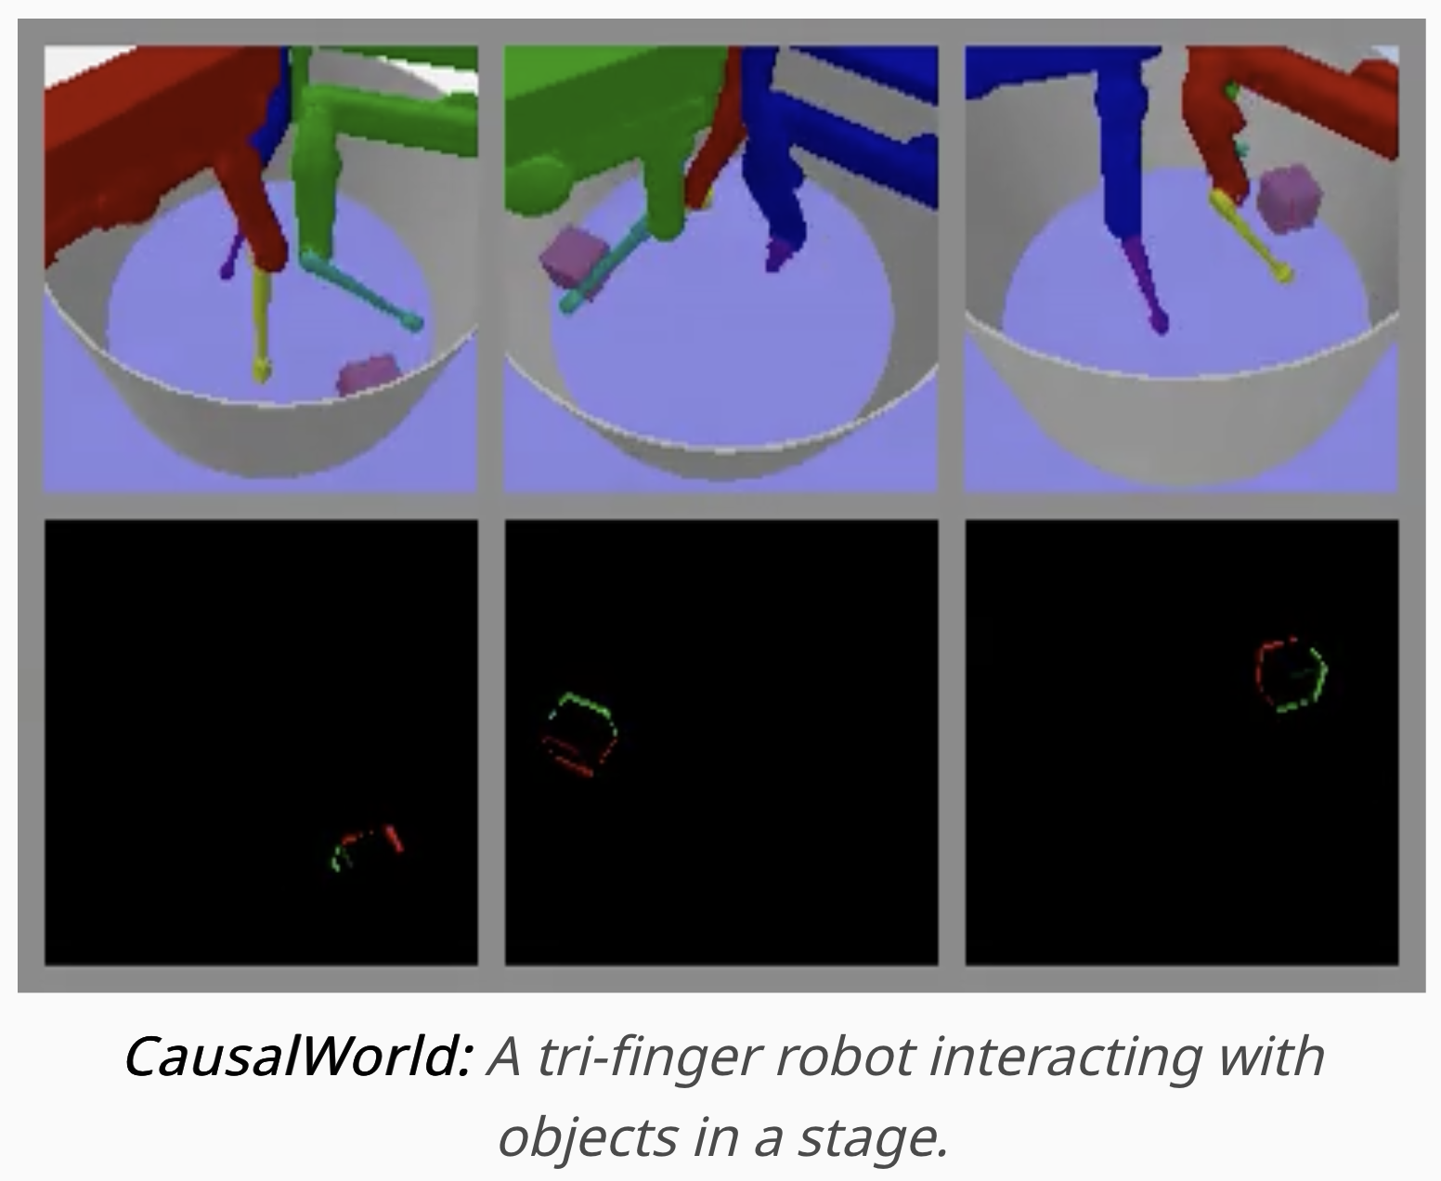
CausalWorld Setup
Causal Factors:
Cube position
Cube velocity
Cube rotation
Robot arms
Friction
In the original setup, information on velocity is encoded in the dataset (difference in frames).
https://phlippe.github.io/BISCUIT/

Slide 9
BISCUIT Replication
Using the CausalWorld dataset:
Setup the environment with respective packages and versions.
Download data for CausalWorld experiment as well as trained autoencoder
Pass the original data through the autoencoder and then train the normalizing flow.
Achieved average diagonal R^2 score of 0.9678
Corroborating the original papers baseline R^2 = 0.97.

Slide 10
Proposed Extension
Standard framework for CITRIS and BISCUIT assumes that the previous frame contains everything needed to predict and understand the second frame:
X^{t-1} → X^{t}
If we concatenate more than one historical latent, does the model remain robust? Can the model intrinsically learn temporal dynamics?
…, X^{t-2}, X^{t-1} → X^{t}

Slide 11
CITRIS Experiment
We want to go from:
p(z^{t}|z^{t-1}, I^{t})
to:
p(z^{t}|z^{t-1}, z^{t-2},...,z^{t-k}, I^{t})

Slide 12
CITRIS Experiment - Setup
Working on CITRIS-VAE.
Interventional Pong Dataset.
Added configurable history length parameter.

Slide 13
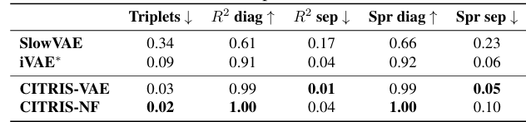
CITRIS Experiment - Evaluation metrics
Metrics from the CITRIS paper:

Slide 14
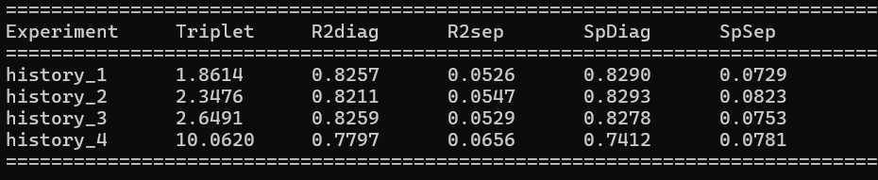
CITRIS Experiment - Results

Slide 15
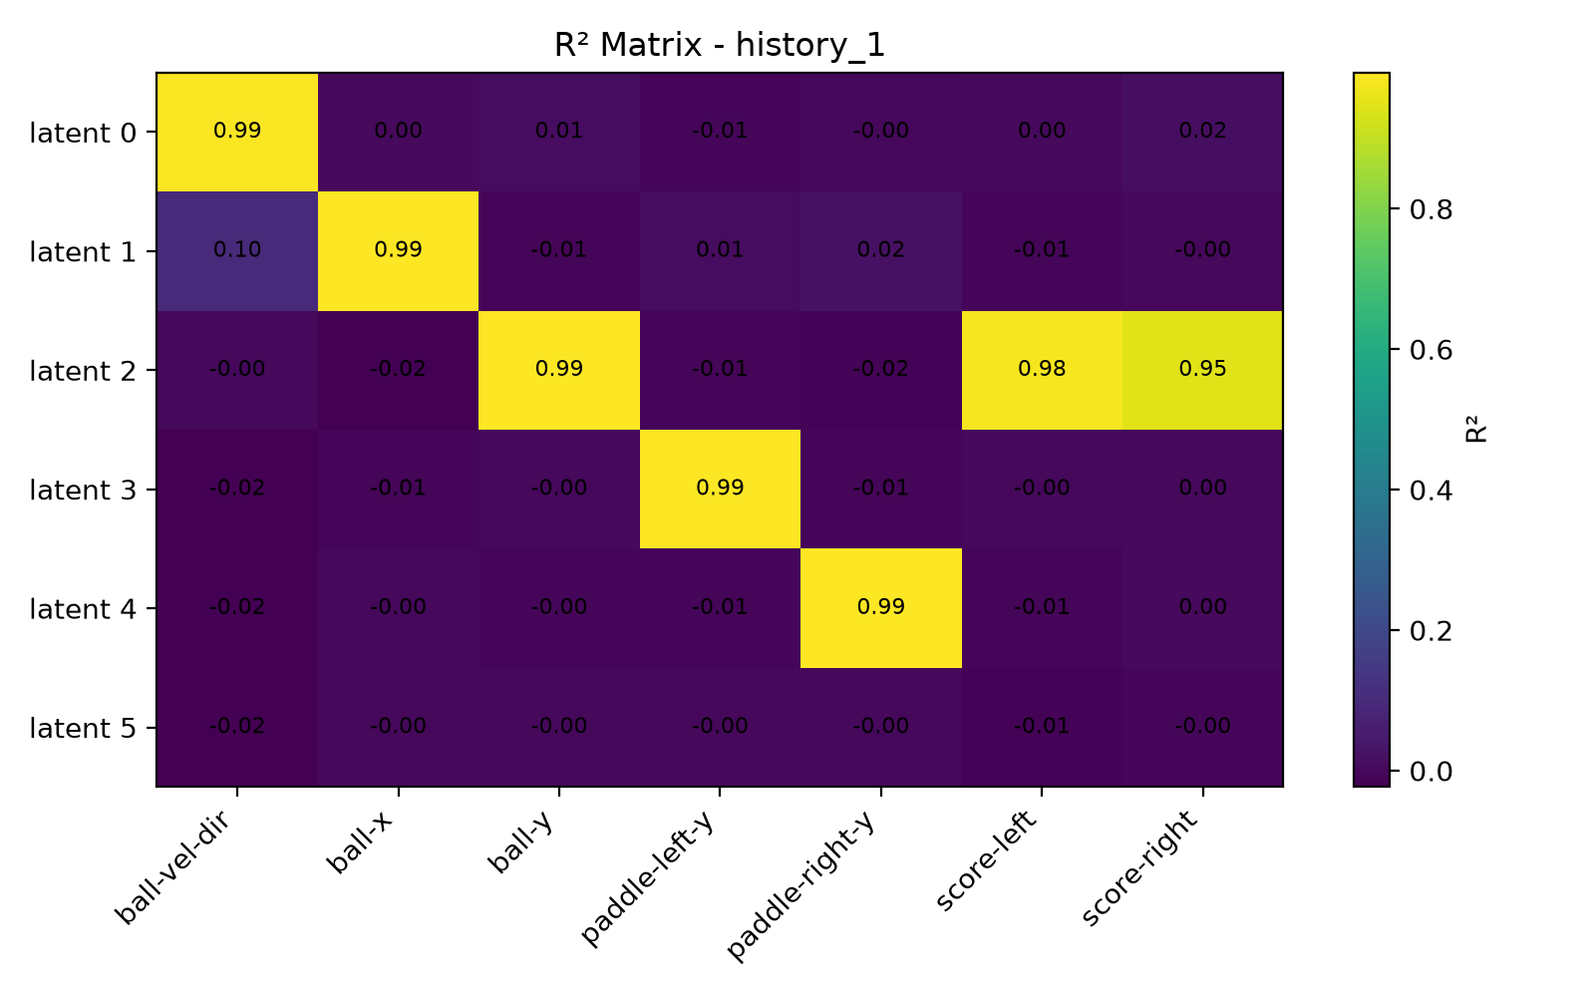
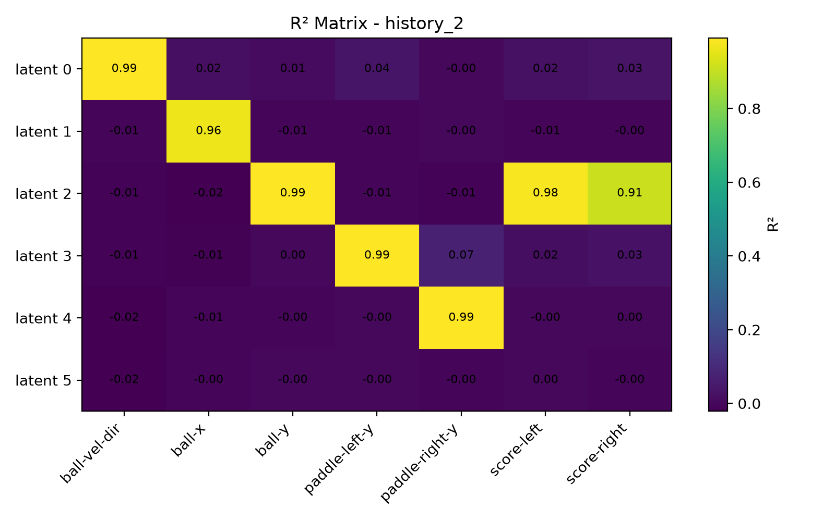
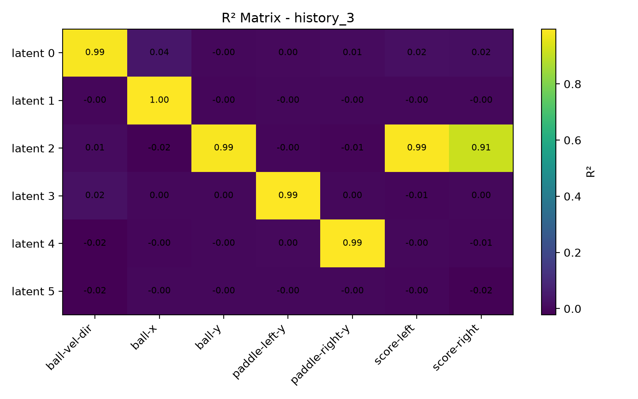
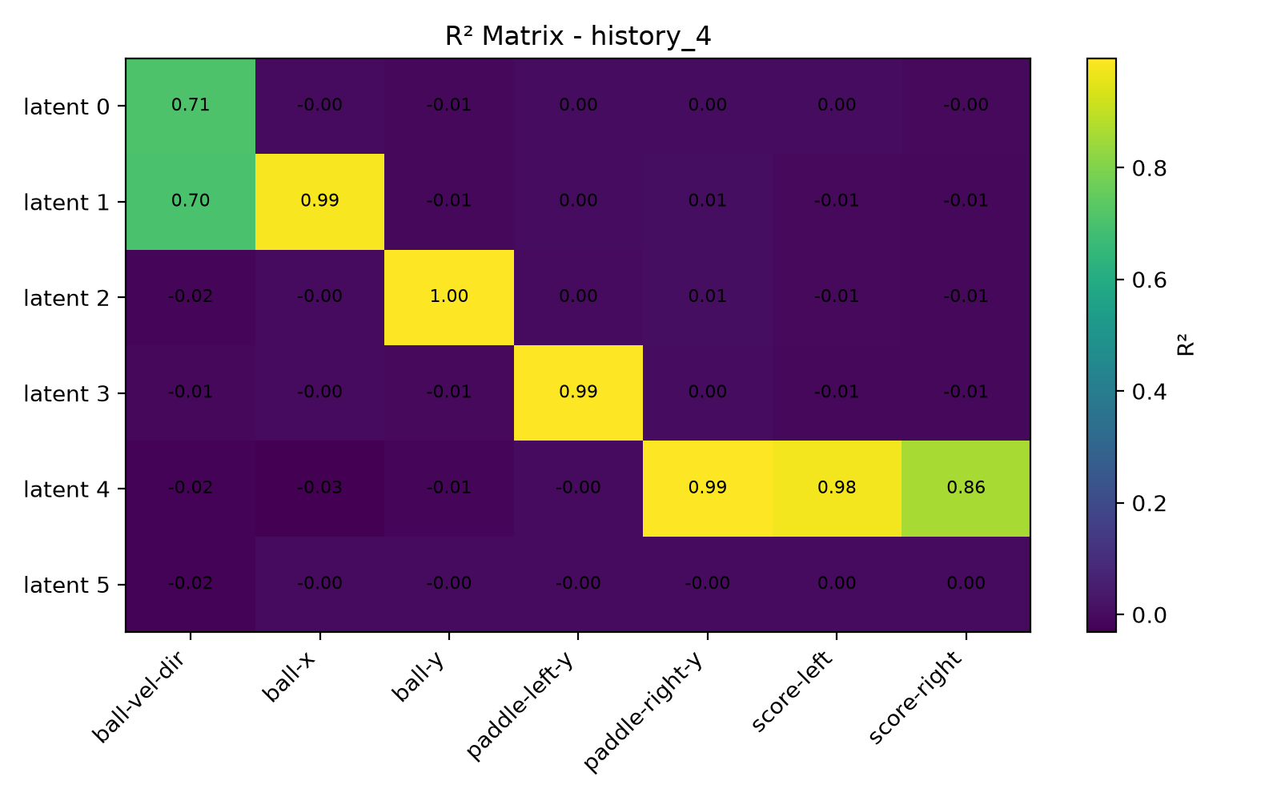
CITRIS Experiment - Results

Slide 16
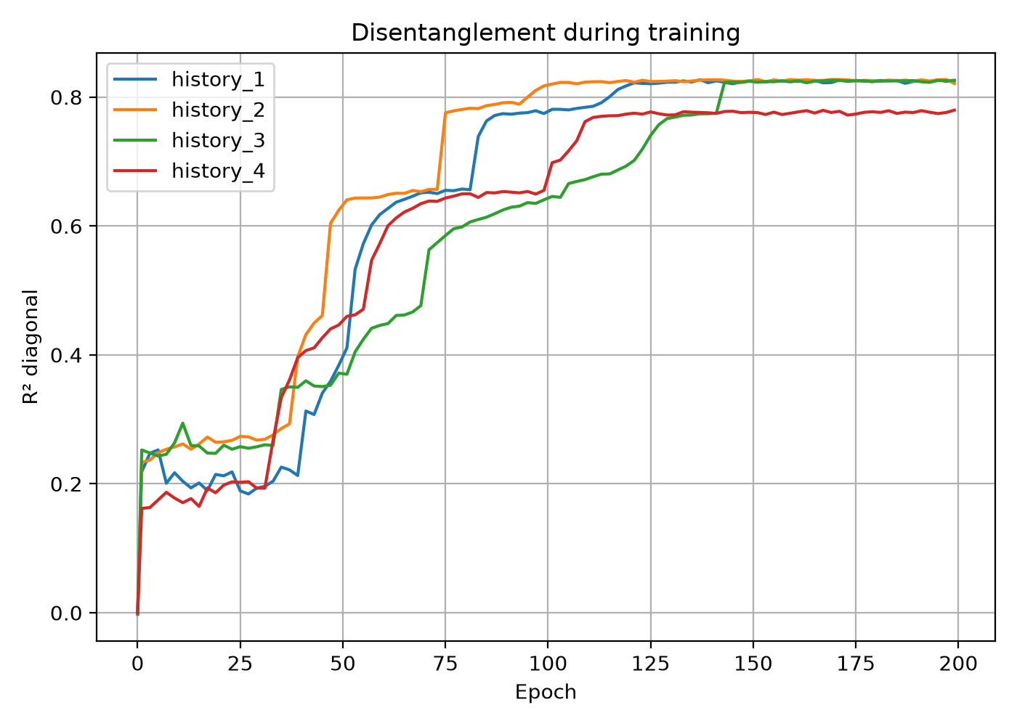

Slide 17
BISCUIT Experiment
Adding a concatenated input to the BISCUIT model and adjusting it so it can process it and train using the same architecture.
Extending the temporal horizon does not cause the Normalizing Flow to entangle the representations. It preserved the true causal isolation. However temporal dynamics data is still embedded in the input.
Model | Baseline x^{t}, x^{t-1}, I^{t} | Proposed x^{t}, x^{t-1},x^{t-2}, I^{t}
R^2 | 0.9678 | 0.9652

Slide 18
Conclusion and Future Work
The proposed temporal extension did not improve upon the original CITRIS-VAE temporal formulation for the Interventional Pong benchmark. However, it did work technically with similar results.
Results suggest that the optimal amount of temporal information depends on the characteristics of the environment and the complexity of its dynamics.
Perhaps the temporal windows become more beneficial in a more complex environment.
For BISCUIT the temporal extension did not improve the Baseline benchmark, however it remained high despite the added temporal sequence. It would be interesting to see if it is affected when removing the embedded temporal dynamics from input vector in Causal World.

Slide 19
Future Work
Only small history windows have been tested.
Intervention handling was unchanged (CITRIS).
Computational cost increase.

