Slide 1
StockFlow
An inventory app, shipped the DevOps way
Tests → Docker → CI/CD + Trivy → GHCR → Terraform (AWS EKS) → Helm → Prometheus + Grafana
github.com/tirth-alt/stockflow-devops
Notes:
StockFlow is a small inventory app for a hardware store's stock room. The app is intentionally small: the project is about taking it from a laptop to a monitored Kubernetes cluster.

Slide 2
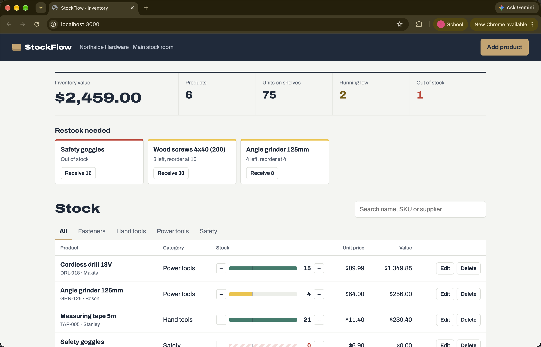
The app: a stock room that flags what to reorder
1
Products CRUD
Name, SKU, category, quantity, reorder level, price, supplier
2
Restock queue
Low stock (qty ≤ reorder level) and out of stock, at the top of the page
3
Inventory value
Totals from /api/products/stats
React → Nginx → FastAPI → PostgreSQL
Notes:
Staff add and edit products, adjust stock with one click, and see the restock queue. Nginx proxies /api, so the browser never needs the backend hostname.

Slide 3
Architecture: git push to a monitored cluster
git push
Developer
Test
pytest + build
Build
2 images, SHA tag
Scan
Trivy gate
Push
GHCR
Deploy
helm upgrade
Kubernetes · namespace stockflow · installed with Helm
Terraform → AWS
VPC (2 public + 2 private subnets, NAT) + EKS 1.36 + managed node group
Observability
Prometheus scrapes /metrics via a ServiceMonitor; Grafana shows the StockFlow API dashboard
Ingress (nginx)
stockflow.local
frontend ×2
Nginx + React · /
backend 2–6
FastAPI · /api · HPA 60% CPU
postgres
PostgreSQL 16 + PVC
Notes:
Every push to main runs test, build, scan, push, deploy. If tests or the Trivy scan fail, nothing is pushed or deployed. Images are tagged with the commit SHA, never latest.

Slide 4
Tech stack
Frontend
React 19 + Vite, served by non-root Nginx
Backend
FastAPI, SQLAlchemy 2, Pydantic
Database
PostgreSQL 16, Alembic migrations
Tests
pytest, in-memory SQLite (11 passing)
Containers
Dockerfiles + Docker Compose
CI/CD
GitHub Actions
Security
Trivy, HIGH/CRITICAL gate
Registry
GHCR, commit-SHA tags
Infrastructure
Terraform: AWS VPC + EKS
Deployment
Helm chart, Ingress, HPA
Monitoring
kube-prometheus-stack
Troubleshooting
Deliberately broken manifests

Slide 5
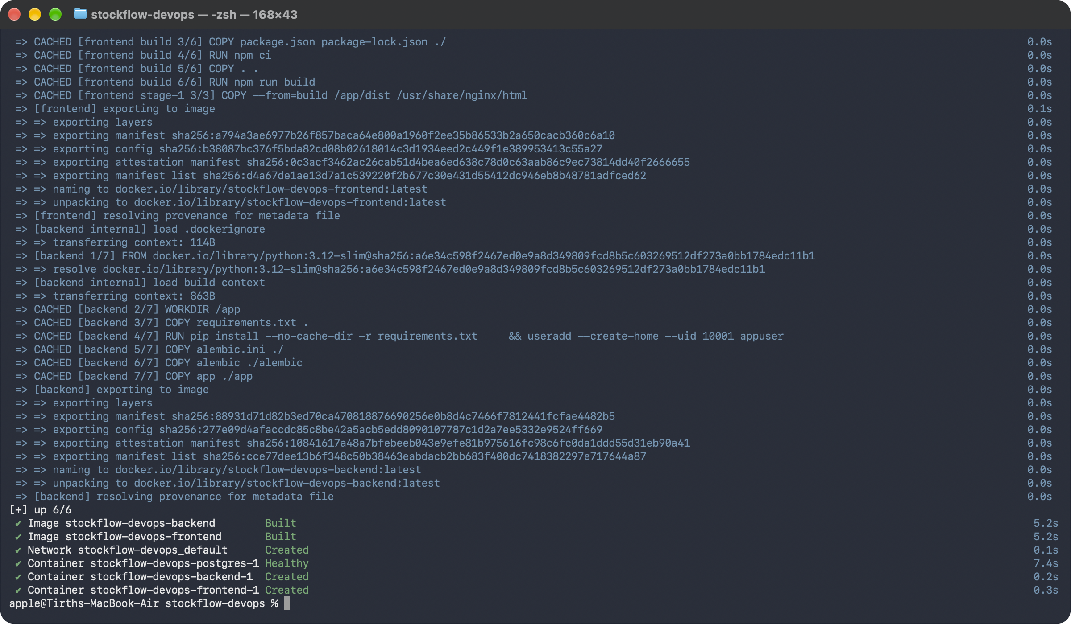
Containers: small, non-root, reproducible
1
Non-root by default
Backend runs as UID 10001; frontend uses nginx-unprivileged (UID 101, port 8080)
2
Multi-stage frontend
Node build stage → Nginx runtime stage, about 80 MB
3
Safe migrations
Alembic runs at start behind a Postgres advisory lock, so replicas don't race
Notes:
docker compose up --build runs the whole stack locally. The backend waits for PostgreSQL to be healthy, runs alembic upgrade head, then starts Uvicorn.

Slide 6
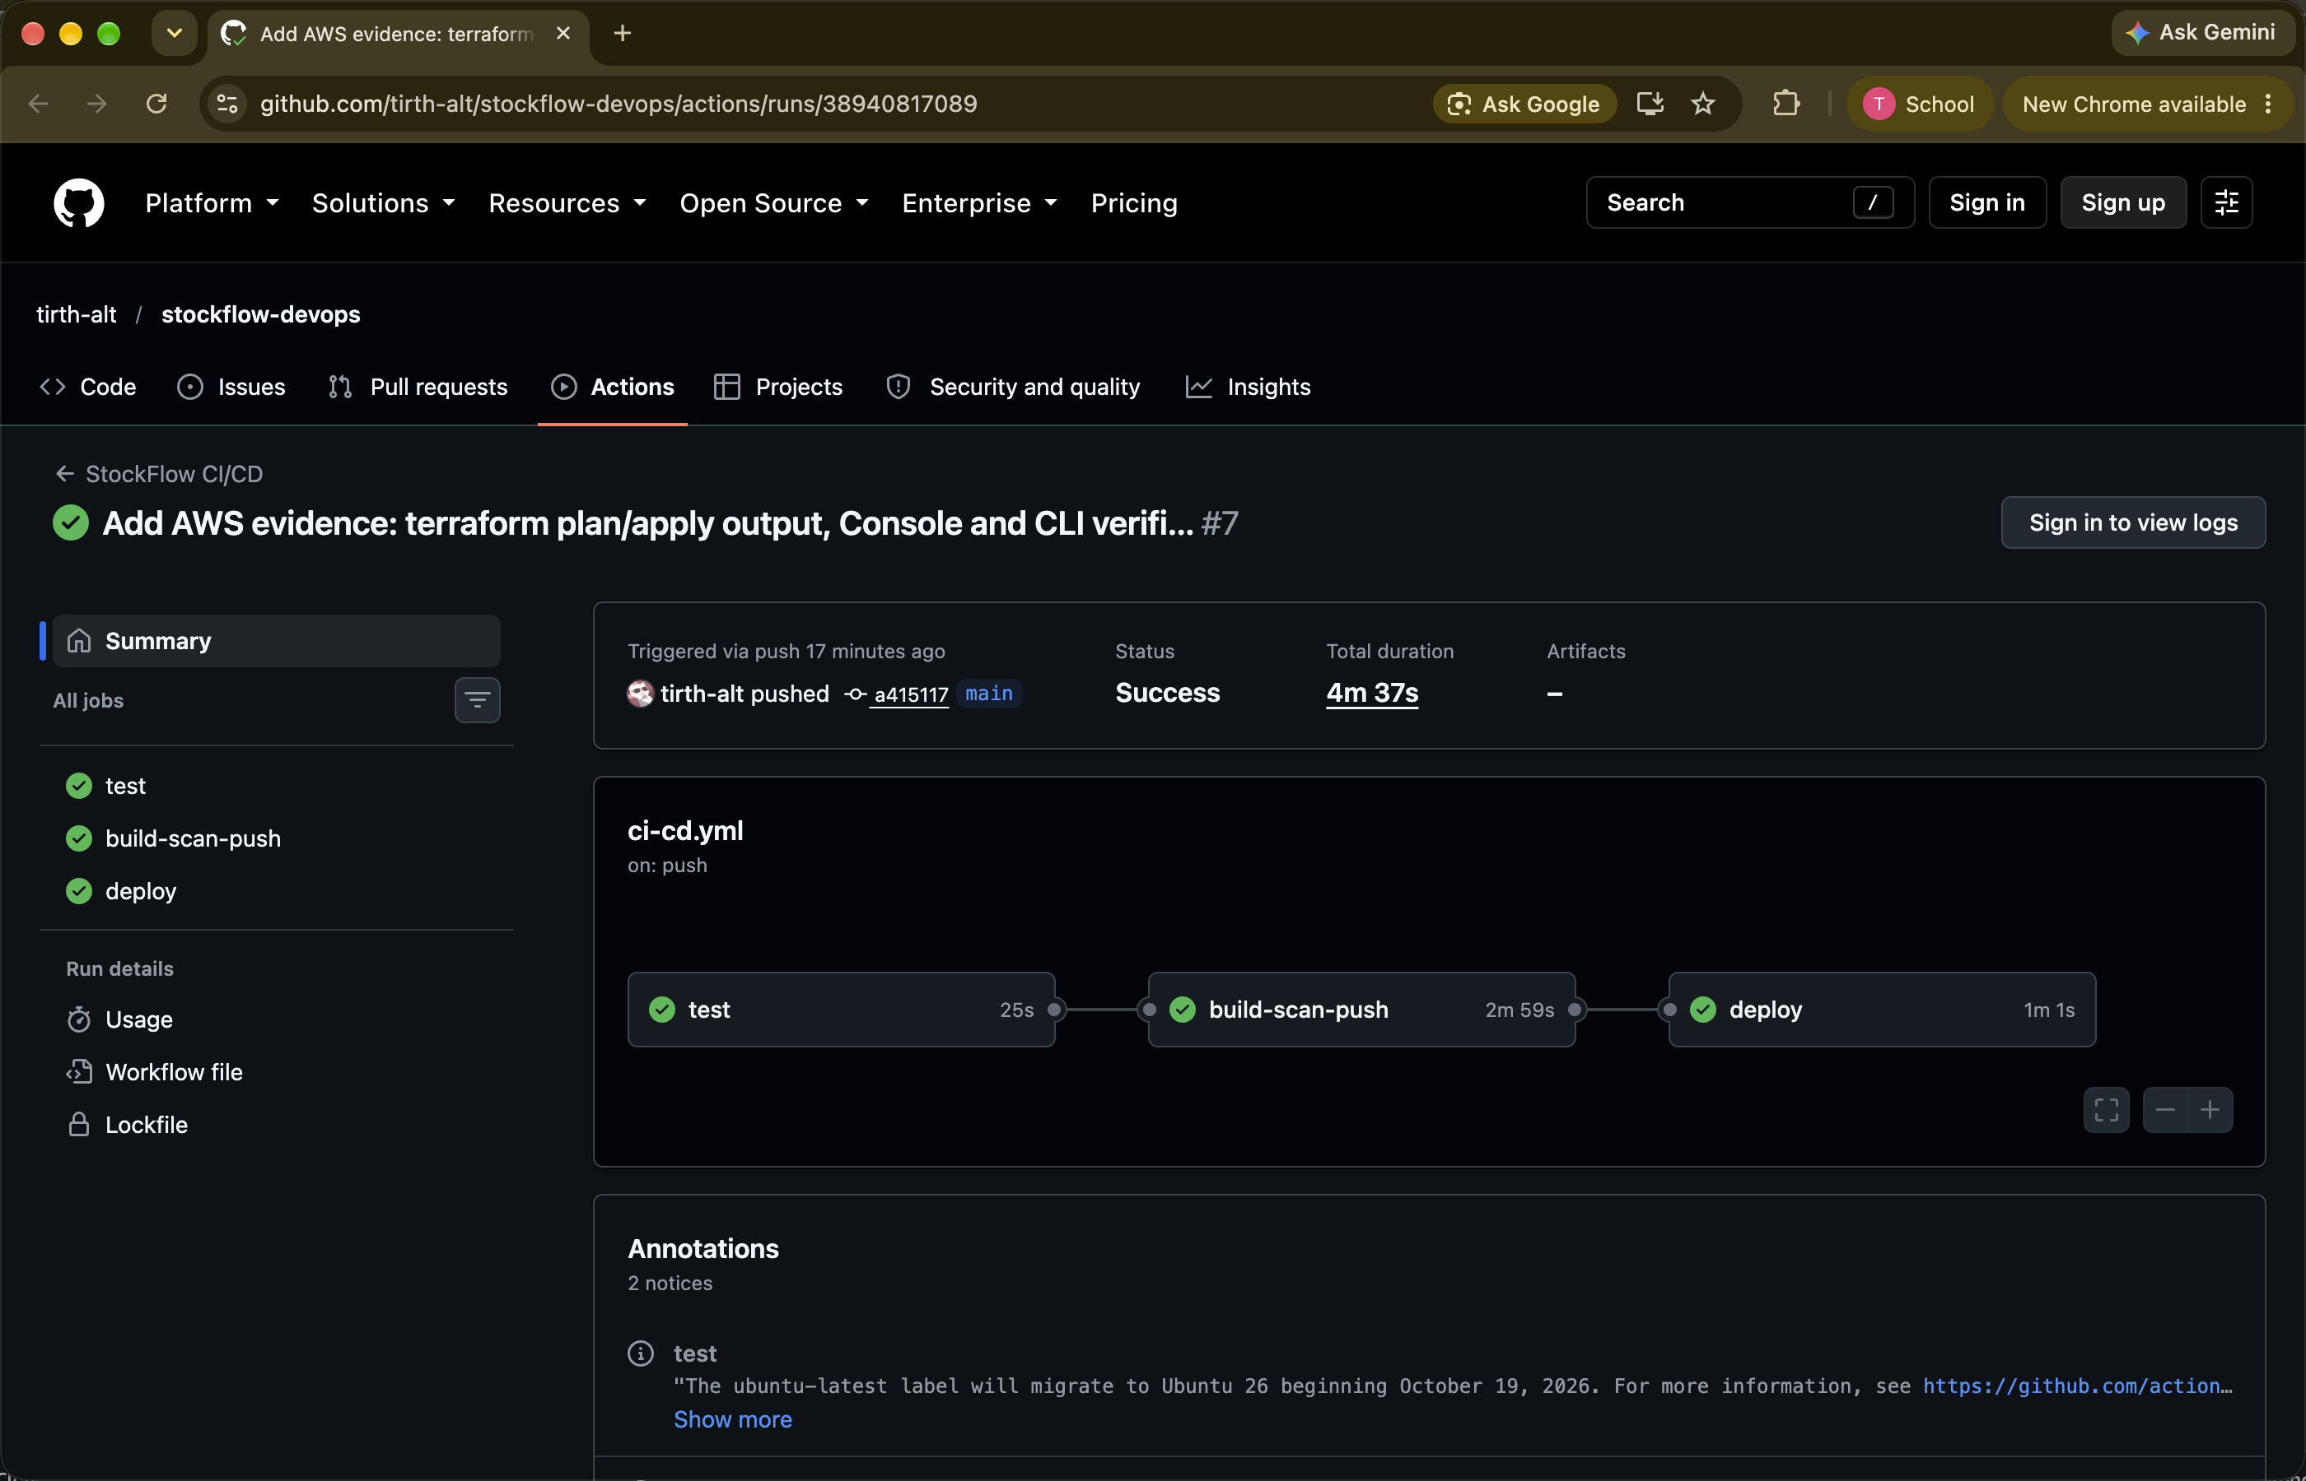
CI/CD: every push to main ships itself
test pytest + frontend build; a failure stops everything
build-scan-push Docker build, Trivy, push to GHCR
deploy helm upgrade --install on a self-hosted runner
Images tagged with the commit SHA, never latest
Notes:
The image tag is the commit SHA, so the cluster always runs exactly the code that was tested and scanned. The demo video shows a header change going through this pipeline.

Slide 7
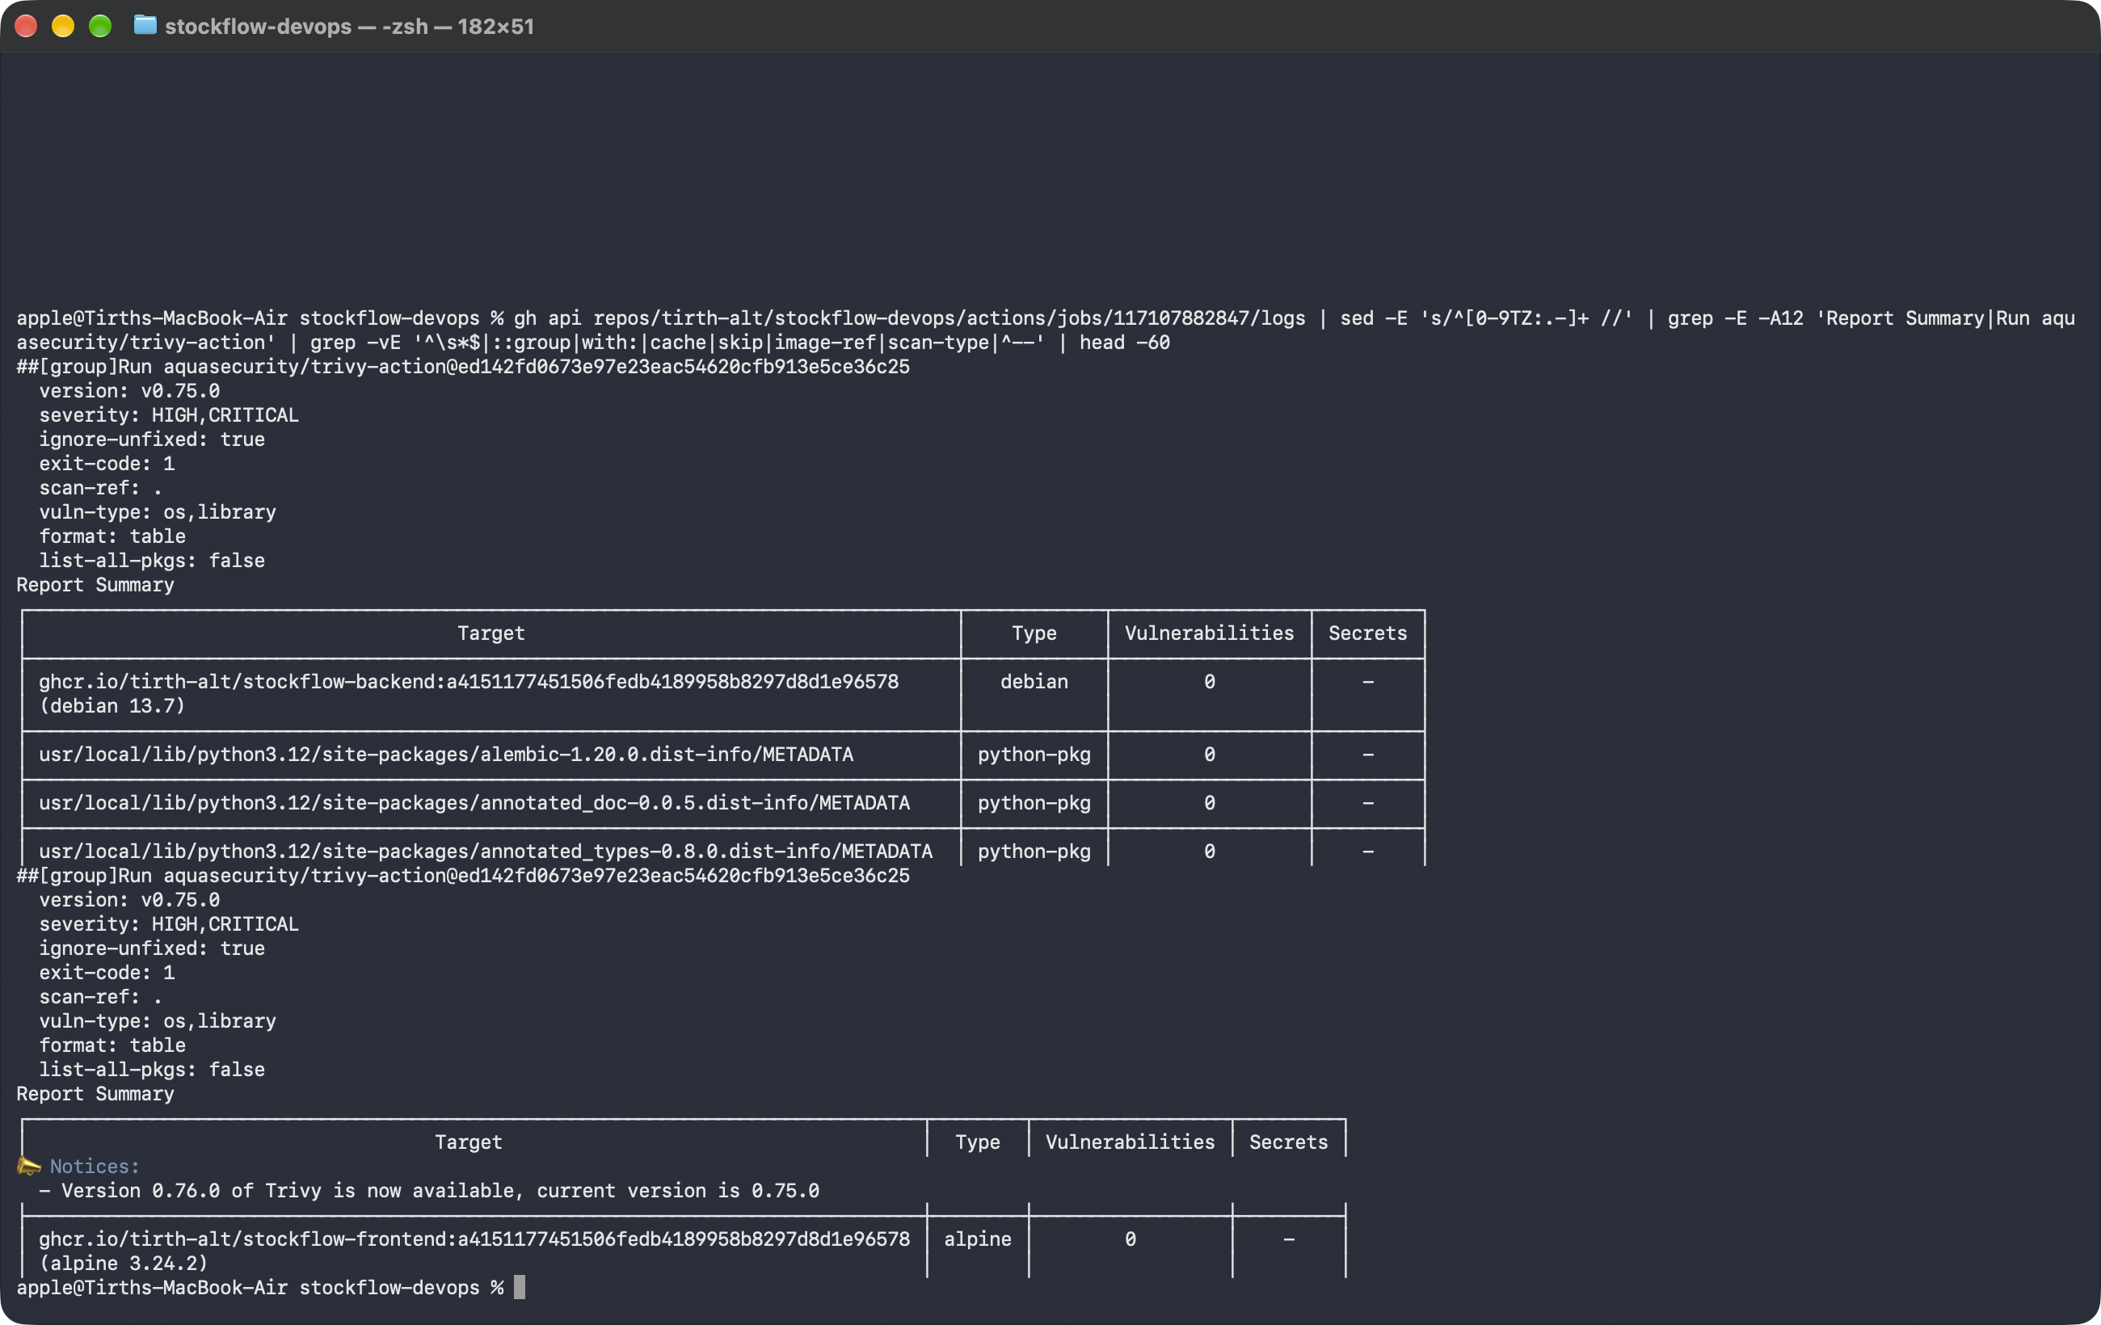
Security gate: Trivy blocks known CVEs
0
HIGH/CRITICAL fixable CVEs in both images today
The gate caught a real one
The first scan failed the frontend: the nginx 1.29 base shipped a vulnerable pcre2 and libtiff. Moving to nginx 1.30 brought patched packages and the gate turned green.
A clean scan is not proof of safety: it doesn't cover our own code, leaked secrets or future CVEs
Notes:
severity HIGH,CRITICAL with exit-code 1: if a fixable HIGH or CRITICAL CVE is found the job fails before the push step, so a vulnerable image never reaches the registry.

Slide 8
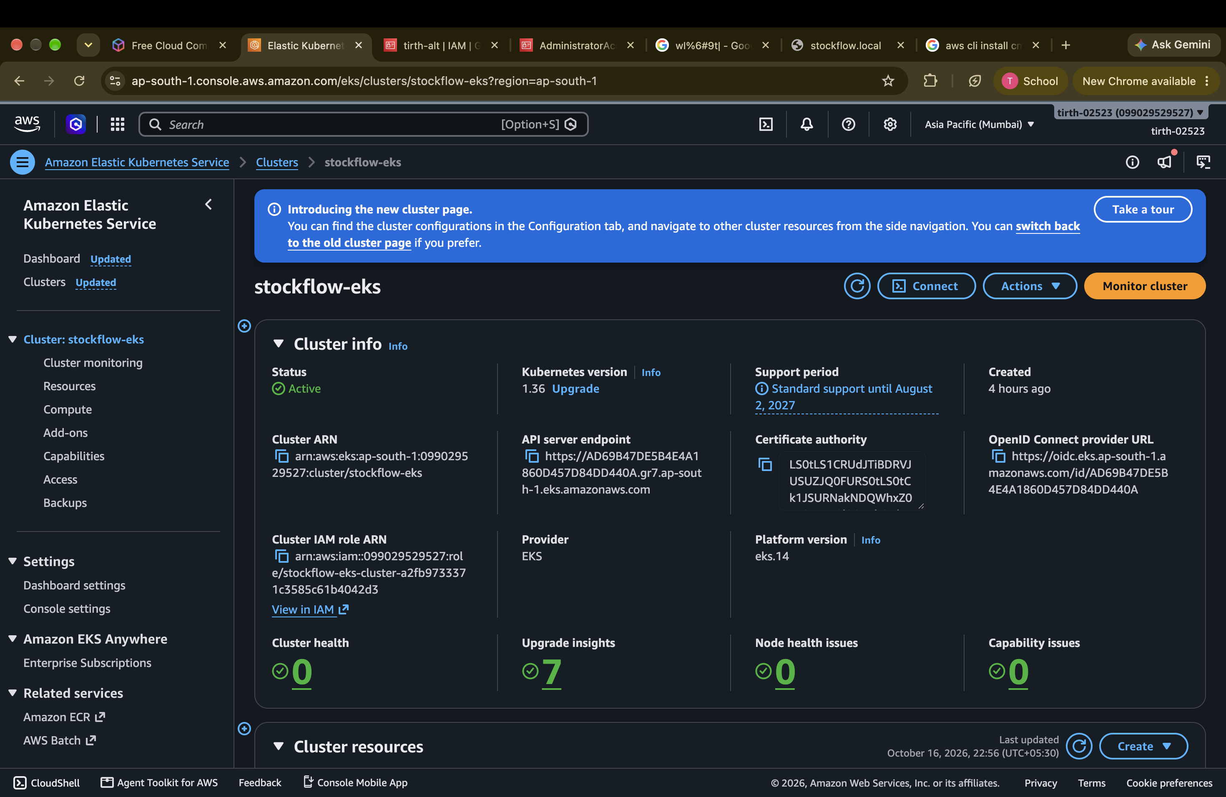
Terraform: AWS VPC + EKS as code
1.36
EKS version, in standard support ($0.10/h control plane, not $0.60)
$0.25/h
for the whole stack, so terraform destroy runs at the end
2 public + 2 private subnets across 2 AZs, NAT, c7i-flex.large nodes (free-tier eligible)
Notes:
terraform init, plan -out tfplan, apply tfplan, then configure kubectl from the output. Evidence for plan, apply, Console, CLI and destroy is in docs/evidence.

Slide 9
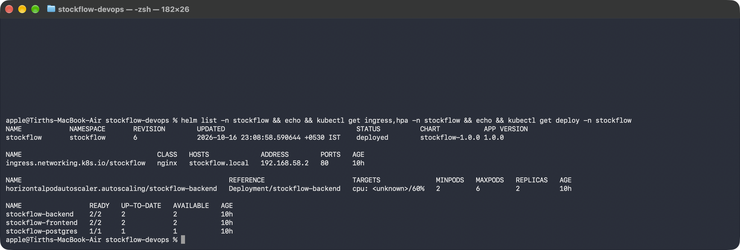
Kubernetes with Helm
1
Ingress
One hostname; / → frontend, /api → backend
2
Probes
/health = alive (no DB); /ready = DB answers
3
No latest
The chart refuses to render without an image tag
Notes:
If liveness checked the database, a DB blip would restart every healthy backend pod. Readiness checks the DB, so pods only get traffic when they can serve it.

Slide 10
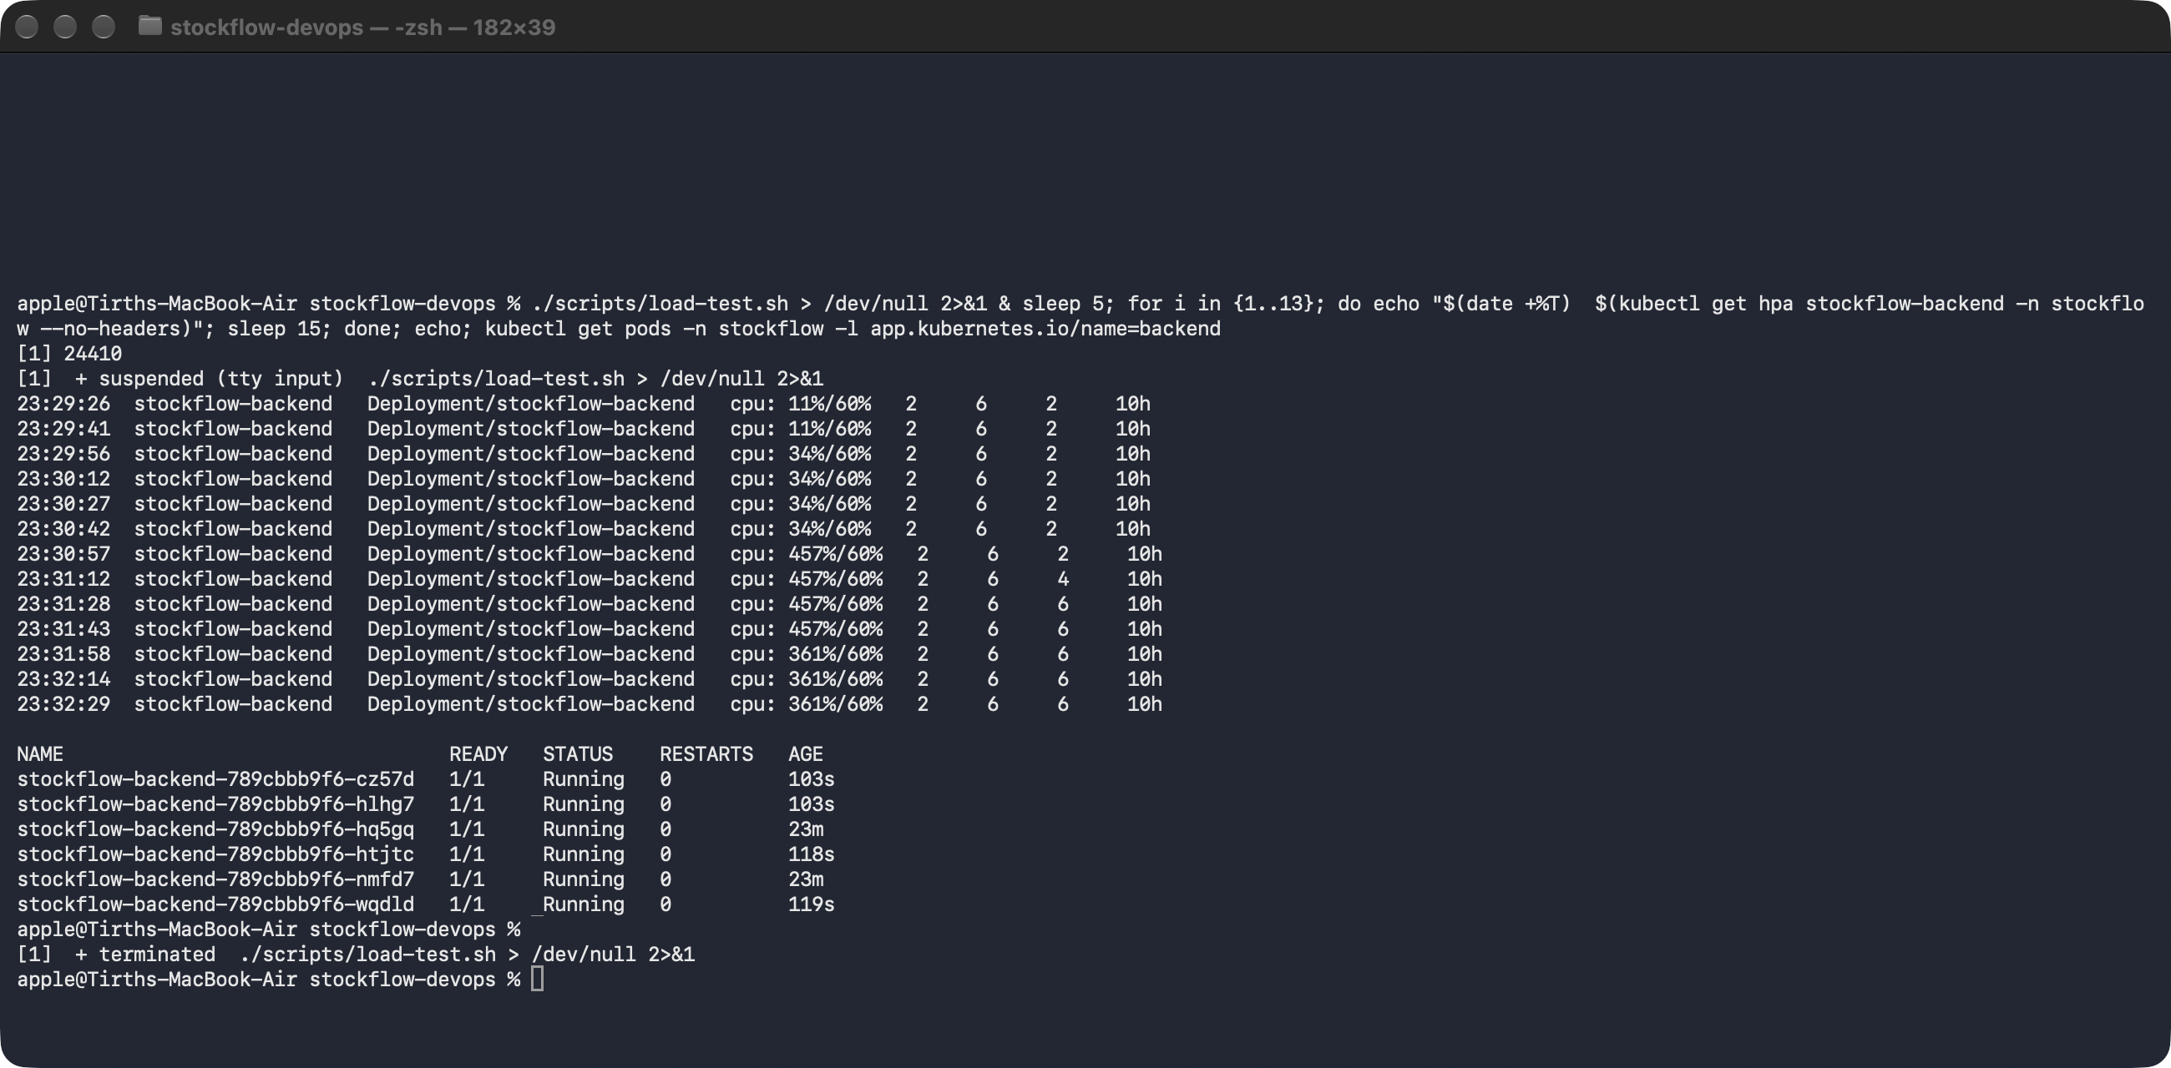
Autoscaling under load
11% → 457%
backend CPU against a 60% target during scripts/load-test.sh
2 → 6 pods
HPA scaled the backend 2 → 4 → 6, then back down
Notes:
The HPA reads CPU from metrics-server. Requests and limits are set on the backend so the percentage means something.

Slide 11
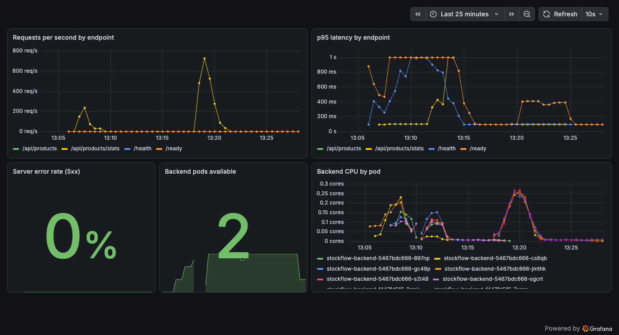
Observability: Prometheus + Grafana
Requests per second
p95 latency
5xx error rate
Running pods and CPU
The dashboard ships inside the Helm chart, and a ServiceMonitor tells Prometheus to scrape /metrics

Slide 12
Troubleshooting labs: break it, then fix it
ImagePullBackOff
Service with no endpoints
Cause
Tag v9.9.9-does-not-exist was never pushed
How I found it
kubectl describe pod → Events: manifest unknown
Fix
Point the Deployment at a real commit-SHA tag
Cause
Selector says backnd, pods say backend
How I found it
kubectl get endpoints → <none>
Fix
Patch the selector; endpoints list pod IPs again

Slide 13
Thank you
Code, docs and evidence: github.com/tirth-alt/stockflow-devops
Demo video: demo/stockflow-demo.mp4

