Slide 1

TEAM FRONTIERS
R.E.A.C.T.
Resilient Engine for Adaptive Cargo & Transport
An AI-powered supply-chain disruption assistant and fleet-utilisation optimizer for India cargo operations
Supply Chain Disruption Assistant & Fleet Utilisation Optimizer — Team Submission
September 2026

Slide 2



THE PROBLEM
When Disruption Hits, Chaos Cascades
A canal blockage, a dock strike, a storm off the coast — and suddenly hundreds of active shipments are affected in ways no ops team can track by hand. While that happens, fleet assets sit idle on quiet lanes and temperature-sensitive cargo drifts out of range with nobody watching.
Cascading Disruptions
Weather events, port strikes, and geopolitical crises ripple across a fleet faster than any spreadsheet can follow — leaving no clear view of who is actually affected.
Idle & Overloaded Fleet
Trucks, containers, and vessels sit empty on quiet lanes while other routes buckle under pressure, with no live signal telling dispatch where to redeploy.
Cold-Chain Blind Spots
A single temperature excursion can spoil $500K+ of vaccines or perishables — and today it is usually discovered only at delivery, when it is already too late.
R.E.A.C.T. — FRONTIERS
2

Slide 3
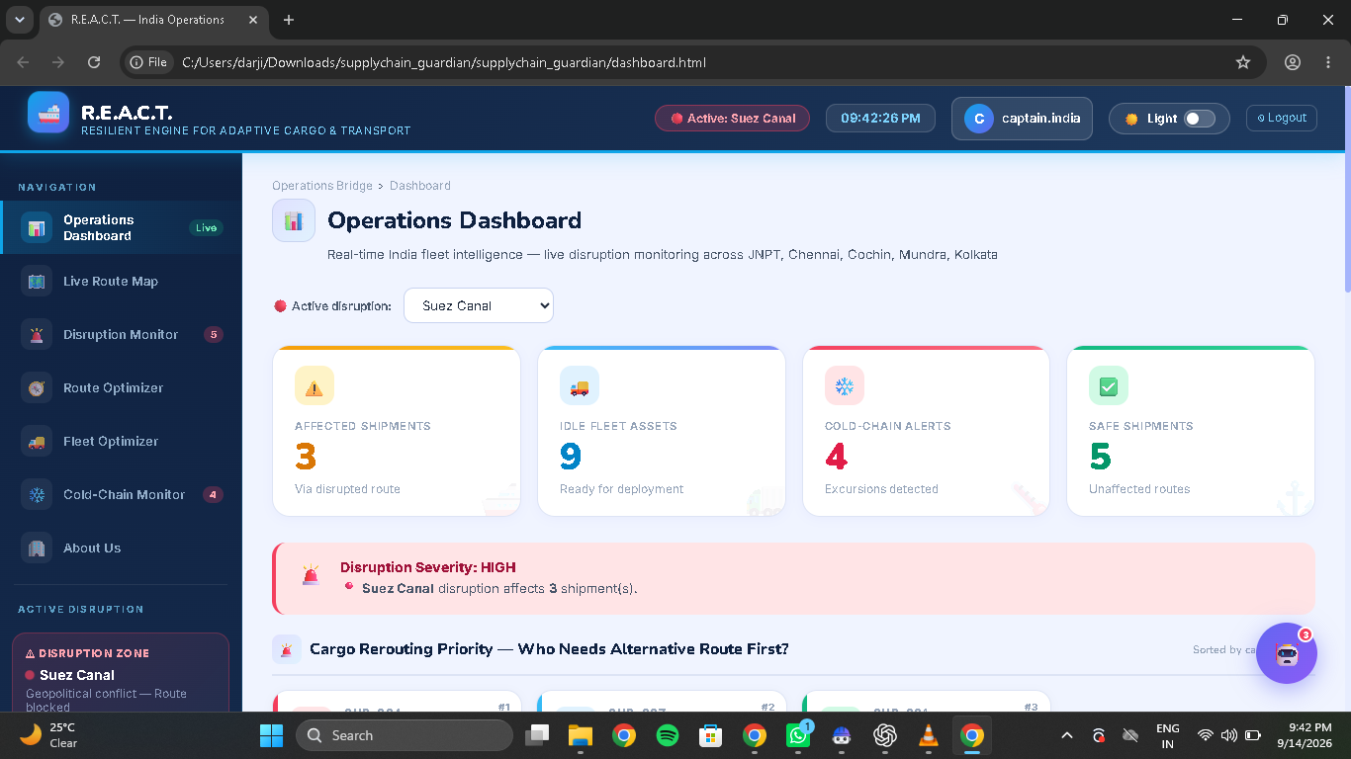



THE SOLUTION
One Command Bridge for Global Cargo Ops
Detects exactly which shipments are affected the instant a disruption strikes
Recommends re-routing and alternative-carrier options in seconds, not hours
Surfaces idle fleet assets so dispatch can redeploy them immediately
Live Operations Dashboard — JNPT · Chennai · Cochin · Mundra · Kolkata
Flags cold-chain excursions in transit — before spoiled cargo ever reaches the dock
R.E.A.C.T. — FRONTIERS
3

Slide 4



HOW IT WORKS
Three Layers, One Decision Loop
DATA INPUTS
REASONING ENGINE
OPERATIONS BRIDGE
Disruption feeds
Disruption matcher
Live dashboard & map
weather, strikes, geopolitics
who is affected, how badly
fleet + routes, one screen
Fleet telemetry
Route & fleet optimizer
Guardian AI assistant
GPS position & idle status
best alternative + idle assets
plain-language Q&A
Cold-chain IoT
Excursion classifier
Real-time alerts
sensor temperature logs
severity scoring, pre-delivery
severity-ranked action list
R.E.A.C.T. — FRONTIERS
4

Slide 5
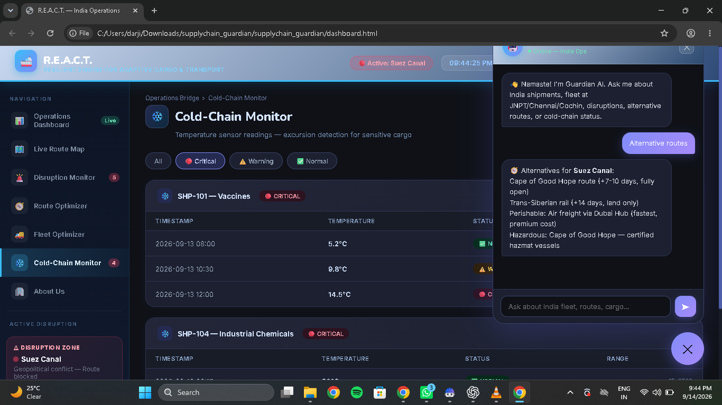
IN ACTION
Guardian AI — Ask, Don’t Search
Ask in plain English
Type "alternative routes?" and Guardian AI instantly returns Cape of Good Hope (+7-10 days, fully open), Trans-Siberian rail (+14 days, land only), Dubai-hub air freight for perishables, and certified hazmat vessels for dangerous cargo.
Catch excursions before delivery
Vaccine shipment SHP-101 drifted 5.2°C → 9.8°C → 14.5°C across three sensor reads. The system flags it Critical while it is still in transit — not after it has already arrived spoiled.
Cold-Chain Monitor + Guardian AI chat, live in the Ops Bridge
R.E.A.C.T. — FRONTIERS
5

Slide 6




UNDER THE HOOD
Technology Stack
Operations Bridge
Guardian AI
A responsive HTML/CSS/JS dashboard delivering live maps, fleet status, and cold-chain views in one console.
A conversational reasoning layer that turns raw disruption data into instant route and fleet guidance.
Unified Data Layer
Cloud-Ready Architecture
Disruption feeds, GPS fleet telemetry, and cold-chain IoT sensor logs, normalised in real time.
Built to deploy on enterprise cloud & AI platforms — including IBM watsonx and IBM Cloud — as the engine scales.
R.E.A.C.T. — FRONTIERS
6

Slide 7

IMPACT
One Screen Replaces a Dozen Phone Calls
3
9
4
5
Affected Shipments
Idle Fleet Assets
Cold-Chain Alerts
Safe Shipments
rerouted around the Suez blockage
surfaced and ready for redeployment
caught before delivery, not after
confirmed clear on unaffected routes
From alarm to action in one view
The Suez Canal disruption is triaged from a HIGH-severity alert straight to a ranked rerouting priority list — no manual cross-checking required.
Hours of research, seconds of chat
Alternative-route research that used to mean emails and phone calls now returns a ranked, cost-aware answer the moment it is asked.
R.E.A.C.T. — FRONTIERS
7

Slide 8
MEET THE BUILDERS
Team FRONTIERS
TM
01
JK
02
Tirth Makavana
Jaini Khandhar
LEAD DEVELOPER & SYSTEMS ARCHITECT
UI/UX DESIGNER & FRONTEND LEAD
KP
03
MR
04
Kunj Patel
Mihir Rana
SUPPLY CHAIN ANALYST & AI ENGINEER
COLD-CHAIN & IOT SPECIALIST
R.E.A.C.T. — FRONTIERS
8

