Slide 1
MACHINE LEARNING
RECS Energy Intelligence Studio
Residential Electricity Demand Prediction & What-If Retrofit Simulator
Tirth • Nirmit • Divy • Ayush
Detached
Attached
Apartment
Mobile
Other
Academic Machine Learning Project

Slide 2
OVERVIEW
What This Project Does
The System in One View
⚡ Energy Predictor
Dwelling questionnaire → forecast kWh & bill (₹).
▪ Predicts annual residential electricity consumption (kWh) and utility cost in Indian Rupees (₹).
▪ Trained on 39,833 U.S. household records across 4 EIA RECS survey cycles (2005, 2009, 2015, 2020).
▪ Tuned XGBoost model evaluated on held-out 2020 cycle — zero data leakage across survey waves.
▪ Live “What-If” retrofit simulator with sliders for appliances, LED adoption, thermostat settings.
▪ SHAP explainability ranks the top factors driving electricity demand per household.
▪ Data harmonization crosswalk maps 17 core features across 15 years of survey instruments.
🎛️ What-If Simulator
Real-time sliders → instant savings delta in ₹.
📊 Model Evaluation
MAE / RMSE / R² / MAPE across 4 architectures.
🔍 SHAP Explainability
Feature attribution for every prediction.
RECS Energy Intelligence Studio • Machine Learning Project
2

Slide 3
PROBLEM STATEMENT
Why Residential Energy Prediction Matters
The Challenge
Impact If Solved
▪ Households lack visibility into their annual electricity consumption and cost.
▪ Retrofit decisions (LED, appliances, insulation) are made without data-backed savings estimates.
▪ Electricity demand varies widely by home size, occupancy, climate, and appliance mix.
▪ Utilities and planners need aggregate demand forecasts for grid and tariff planning.
▪ Existing tools are generic — not trained on real, harmonized household microdata.
800–1,200 kWh/yr
saved by retiring a secondary refrigerator (~₹6,400–₹9,600/year).
~28%
lower consumption achievable with high-efficiency benchmark home.
100% LED
adoption significantly drops continuous baseload draw.
±1,729 kWh/yr
variation driven by heating fuel type (electric vs gas/oil).
RECS Energy Intelligence Studio • Machine Learning Project
3

Slide 4
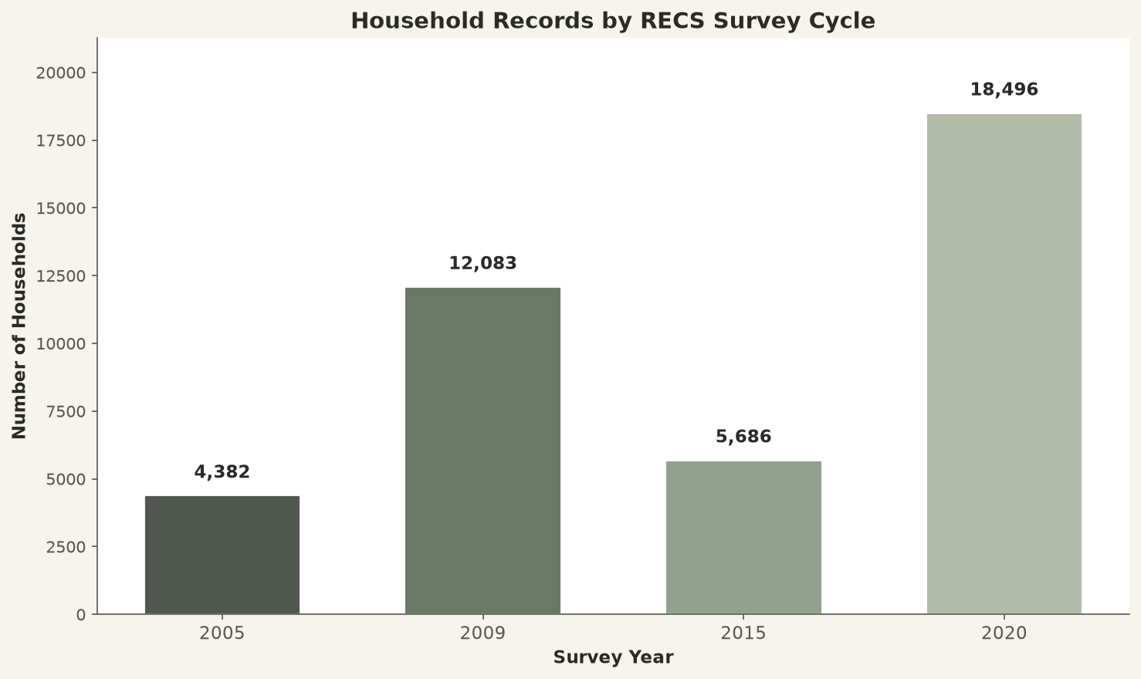
DATASET
EIA RECS Survey Microdata
Dataset at a Glance
Source
U.S. Energy Information Administration (EIA) RECS
Records
39,833 households across 4 survey cycles
Cycles
2005 • 2009 • 2015 • 2020
Train
21,678 households (2005–2015 cycles)
Test
18,155 households (held-out 2020 cycle)
Target
Annual electricity consumption (kWh)
Currency
Indian Rupees (₹) @ ₹8.00/kWh
Features
30 harmonized input features
RECS Energy Intelligence Studio • Machine Learning Project
4

Slide 5
DATA PIPELINE
Harmonization → Preprocessing → Modeling
1
Load & Harmonize
2
Preprocess & Cap
3
Feature Engineering
Standardize 17 core features across 4 survey years; map missing codes (−2, −8, −9, −99) to NaN.
1st–99th percentile outlier trimming; categorical label encoding fitted on train only.
sqft/person, rooms/person, LED ratio, HDD×heat, CDD×region interactions.
4
Time-Aware Split
5
Tune & Train
6
Explain & Deploy
Train: 2005–2015 | Test: held-out 2020 cycle — zero leakage.
XGBoost with RandomizedSearchCV (20 iters × 3-fold CV).
SHAP attribution + FastAPI backend + academic dashboard UI.
RECS Energy Intelligence Studio • Machine Learning Project
5

Slide 6
FEATURES
30 Harmonized Input Features
Structural
Rooms • Bedrooms • Sqft • Housing Type
Target Variable
Occupancy
Occupants • Survey Year
kWh
Annual Electricity Consumption (kWh)
Appliances
Refrigerators • Washer • Dryer • Freezer • AC
Derived from: EIA RECS KWH field across all 4 survey cycles
Converted to cost: kWh × ₹8.00 domestic tariff
Outlier-trimmed: 1st–99th percentile bounds
Lighting
Total Lights • LED Bulbs • CFL Bulbs • LED Ratio
Heating / Cooling
Heat Fuel • Heat Equipment • AC Type • HDD65 • CDD65
Climate / Geography
Region • Climate Region • Division
Engineered
sqft/person • rooms/person • LED ratio • HDD×heat • CDD×region
RECS Energy Intelligence Studio • Machine Learning Project
6

Slide 7
MODEL USED
Tuned XGBoost — Champion Architecture
Why XGBoost?
Tuned Hyperparameters
▪ Gradient-boosted decision trees — captures non-linear appliance × climate interactions.
▪ Handles mixed categorical + numeric features natively after label encoding.
▪ Tree-based structure is fully SHAP-explainable — every prediction attributable.
▪ Hist-based tree method with n_jobs=-1 — fast training on 21,678 households.
▪ Hyperparameter-tuned via RandomizedSearchCV (20 iterations × 3-fold CV).
n_estimators
300 / 500 / 700
max_depth
4 / 6 / 8
learning_rate
0.03 / 0.05 / 0.1
subsample
0.7 / 0.85 / 1.0
colsample_bytree
0.7 / 0.85 / 1.0
min_child_weight
1 / 3 / 5
reg_alpha
0 / 0.1 / 1
tree_method
hist
objective
reg:squarederror
RECS Energy Intelligence Studio • Machine Learning Project
7

Slide 8
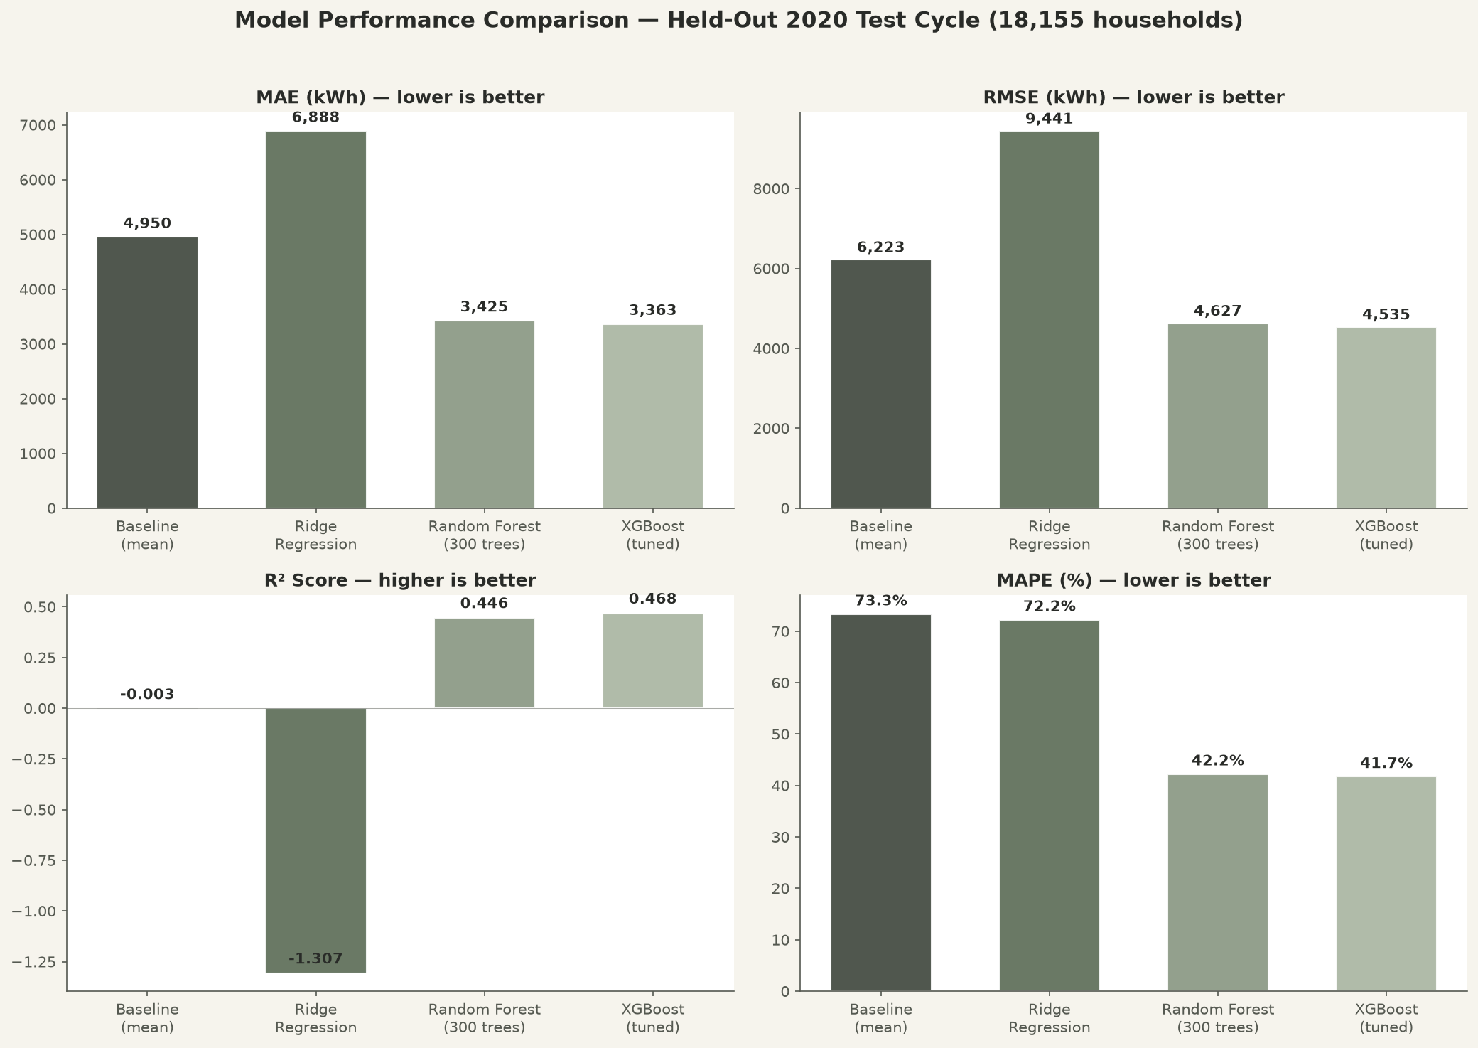
MODEL COMPARISON
XGBoost Wins — Here's Why the Others Lost
Why Other Models Were Rejected
Baseline (mean)
R² ≈ −0.003 — no better than guessing the average. MAPE 73.3%.
Ridge Regression
R² = −1.307 — worse than baseline; linear assumption can't capture appliance×climate non-linearities.
Random Forest
R² = 0.446 — strong, but 3.2% higher MAE and 5% higher MAPE than XGBoost.
RECS Energy Intelligence Studio • Machine Learning Project
8

Slide 9
RESULTS
Benchmark Performance on Held-Out 2020 Test Cycle
Model | MAE (kWh) | RMSE (kWh) | R² Score | MAPE (%) | Status
Baseline (mean) | 4,950 | 6,223 | −0.003 | 73.3% | Reference
Ridge Regression | 6,888 | 9,441 | −1.307 | 72.2% | Linear Baseline
Random Forest | 3,425 | 4,627 | 0.446 | 42.2% | Non-linear Ensemble
XGBoost (tuned) | 3,363 | 4,535 | 0.468 | 41.7% | Champion
Key Takeaways
▪ XGBoost reduces MAE by 32% vs baseline and 2% vs Random Forest — best overall accuracy.
▪ R² = 0.468 means the model explains ~47% of variance in annual household electricity demand.
▪ Time-aware validation (2020 held-out) guarantees no data leakage across survey waves.
RECS Energy Intelligence Studio • Machine Learning Project
9

Slide 10
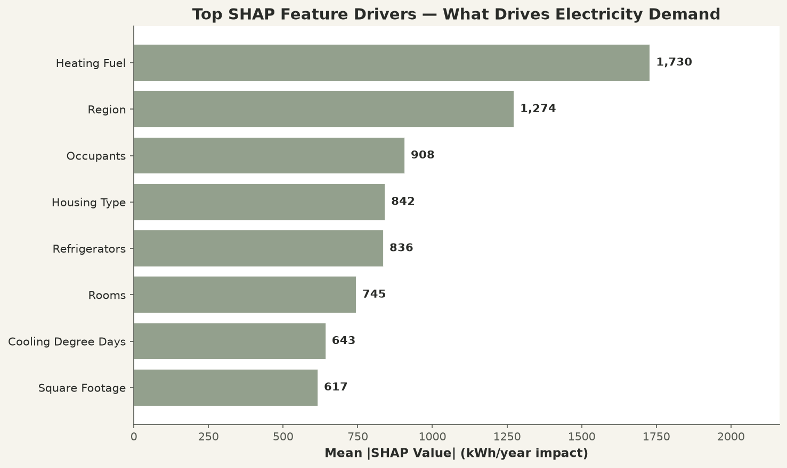
EXPLAINABILITY
SHAP — What Drives Electricity Demand
Key SHAP Findings
Heating Fuel (#1)
±1,729 kWh/yr — electric resistance vs gas/oil is the single biggest driver.
Region
1,274 kWh/yr — census region shapes baseline cooling/heating needs.
Occupants
908 kWh/yr — more people = more appliances, lights, hot water.
Housing Type
842 kWh/yr — detached homes consume more than apartments.
Refrigerators
836 kWh/yr — each additional fridge adds ~800–1,200 kWh/yr.
RECS Energy Intelligence Studio • Machine Learning Project
10

Slide 11
WHAT-IF SIMULATOR
Live Retrofit & Appliance Simulation
How It Works
Example Savings Scenarios
▪ Sliders adjust refrigerator count, LED adoption %, occupancy, AC thermostat intensity.
▪ Toggles for washer, dryer, freezer, AC, electric space heat.
▪ Instant re-prediction via /api/whatif endpoint — savings delta in ₹ shown live.
▪ Comparison bar chart: your forecast vs national / regional / high-efficiency benchmarks.
▪ Built on FastAPI + XGBoost with real-time SHAP driver attribution.
Retire 2nd fridge
−800 to −1,200 kWh/yr
≈ −₹6,400 to −₹9,600/yr
100% LED lighting
Drop baseload draw
Measurable annual savings
Eco AC thermostat (−15%)
Lower summer CDD load
Reduced cooling cost
Gas vs electric heat
Up to 3× difference
Cold-climate impact
RECS Energy Intelligence Studio • Machine Learning Project
11

Slide 12
USEFULNESS
Real-World Applications & Benefits
Homeowners
Retrofit Planning
Know your expected annual kWh and bill (₹) before moving in or retrofitting.
Test LED, appliance, and thermostat changes — see savings before spending.
Utilities & Planners
Energy Auditors
Aggregate demand forecasts for grid capacity and tariff design.
SHAP drivers pinpoint where efficiency upgrades will have the most impact.
Policy Makers
Researchers
Evidence for efficiency standards, appliance rebates, and building codes.
Open harmonization crosswalk across 15 years of EIA RECS instruments.
RECS Energy Intelligence Studio • Machine Learning Project
12

Slide 13
LIMITATIONS
Methodological Notes & Constraints
Known Limitations
Mitigation Strategy
▪ Non-panel cross-sectional data — RECS surveys independent samples, not the same households over time.
▪ survey_year captures structural shifts (efficiency standards, LED adoption), not time-series trends.
▪ Missing codes (−2, −8, −9, −99) mapped to NaN and median-imputed — may introduce bias.
▪ Survey replicate weights (BRRWT1–96) dropped to avoid overfitting on sampling artifacts.
▪ R² = 0.468 — model explains ~47% of variance; 53% remains unexplained.
▪ Trained on U.S. microdata; cost converted to ₹ using flat ₹8.00/kWh tariff.
Hold out full 2020 cycle
Zero leakage across survey waves.
1st–99th percentile trim
Removes erroneous consumption extremes.
Label encoders fit on train only
No target or category leakage.
SHAP explainability
Transparent per-prediction attribution.
Harmonization crosswalk
17 features mapped across 15 years.
RECS Energy Intelligence Studio • Machine Learning Project
13

Slide 14
CONCLUSION
RECS Energy Intelligence Studio
Predicts residential electricity demand with tuned XGBoost — and shows how to cut it.
39,833
0.468
41.7%
SHAP
₹8.00/kWh
Live
households, 4 RECS cycles
R² — champion XGBoost model
MAPE — best-in-class accuracy
explainable per-prediction drivers
cost in Indian Rupees
what-if retrofit simulator
Next steps: regional tariff integration • appliance-level modeling • deployment at scale
Thank you — RECS Energy Intelligence Studio

