Slide 1

Aim: Case study of Deep Learning Operations (DLOPs)
Created By : Tirth Shah Enroll : 20012531031

Slide 2

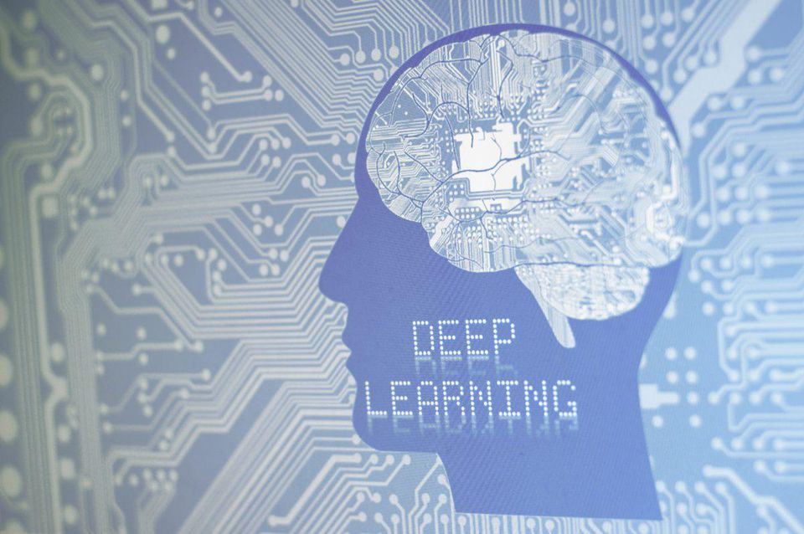
Introduction to DLOPs
Deep Learning Operations (DLOPs) is a specialized field dedicated to the management and optimization of data pipelines and workflows for deep learning operations. As organizations continue to rely on deep learning for critical business functions, the significance of DLOPs cannot be overstated. Effective DLOPs play a pivotal role in enabling organizations to enhance their deep learning performance, reduce costs, and increase overall efficiency.

Slide 3

Challenges
Data Management: Handling large volumes of data efficiently for training and inference.
Infrastructure Scalability: Scaling computational infrastructure to meet the demands of deep learning models.
Model Deployment and Monitoring: Ensuring reliable and performant deployment and monitoring of deep learning models in production.
Resource Optimization: Efficiently utilizing computational resources while minimizing costs.
Versioning and Reproducibility: Managing model, dataset, and experiment versions and ensuring reproducibility across environments.
Pipeline Orchestration: Orchestrating complex data pipelines for training, evaluation, and inference with reliability and fault tolerance.

Slide 4

DataOps Implementation
Data Management: Utilizes secure and compliant data storage and processing systems to manage medical images while ensuring patient privacy and regulatory compliance.
Infrastructure Scalability: Implements scalable GPU clusters and cloud-based solutions for efficient processing of medical images and deep learning model training.
Model Deployment and Monitoring: Develops a robust deployment pipeline for deploying and monitoring deep learning models in a healthcare environment, integrating with existing clinical workflows.
Resource Optimization: Optimizes neural network architectures and inference algorithms to ensure efficient use of computational resources while maintaining high accuracy in medical image analysis.
Versioning and Reproducibility: Adopts version control systems and data management practices to ensure reproducibility and consistency in medical image analysis, facilitating collaboration and research.
Pipeline Orchestration: Implements automated pipeline orchestration for continuous model training, validation, and deployment, integrating with healthcare information systems.

Slide 5
Results
By effectively managing and optimizing deep learning operations, the healthcare organization achieves the following outcomes:
Improved accuracy and efficiency in medical image analysis, leading to more accurate diagnoses and treatment planning.
Reduced processing time for medical image analysis, enabling faster clinical decision-making.
Enhanced compliance with data privacy and regulatory requirements in healthcare imaging analysis.
Streamlined deployment and integration of deep learning models into clinical workflows, improving the overall quality of patient care.
This case study demonstrates how Deep Learning Operations (DLOPs) can be applied to address the complex challenges of managing and optimizing deep learning in real-world healthcare applications, leading to significant improvements in diagnostic accuracy, operational efficiency, and patient care.

Slide 6
Tools and Technique
Tools
Techniques
TensorFlow and Keras: These deep learning frameworks are used for building and training neural network models tailored for medical image analysis tasks. Their flexibility and extensive community support make them ideal for developing custom deep learning solutions in healthcare imaging.
Docker: Docker is employed for containerizing the deep learning applications, ensuring consistent deployment across different environments and facilitating reproducibility in healthcare imaging analysis.
Git and GitLab: Version control systems such as Git and GitLab are utilized for managing code, models, and datasets, enabling versioning, collaboration, and reproducibility in the development and deployment of deep learning models for medical image analysis.
Transfer Learning: The technique of transfer learning is applied to leverage pre-trained deep learning models and adapt them for medical image analysis, enabling the efficient utilization of existing model architectures and learned features for specific healthcare imaging tasks.
Continuous Integration/Continuous Deployment (CI/CD): Automated CI/CD pipelines are implemented for model training, validation, and deployment, ensuring rapid and reliable updates to deep learning models in clinical settings, thereby streamlining the deployment process and ensuring model reliability.

Slide 7
Benefits of DLOPS
Improved Model Performance: DLOPs lead to enhanced model performance and accuracy in applications such as image recognition and predictive analytics.
Cost Reduction: DLOPs optimize resource utilization, resulting in reduced operational costs for infrastructure and computational resources.
Enhanced Efficiency: DLOPs streamline workflows, leading to increased operational efficiency and faster insights.
Scalability: DLOPs enable organizations to handle large volumes of data and adapt to changing business needs.
Reproducibility and Collaboration: DLOPs promote reproducibility and collaboration through version control and standardized workflows.
Optimized Resource Utilization: DLOPs techniques optimize computational resources, improving performance and reducing wastage.
Compliance and Security: DLOPs ensure compliance with data privacy regulations and provide secure processes for managing sensitive data.

Slide 8

Conclusion
In summary, Deep Learning Operations (DLOPs) are crucial for organizations leveraging deep learning technologies. DLOPs offer benefits such as improved model performance, cost reduction, enhanced efficiency, scalability, reproducibility, optimized resource utilization, and compliance with data privacy regulations. These advantages highlight the significance of DLOPs in maximizing the potential of deep learning, leading to enhanced performance, reduced operational costs, and streamlined workflows. As deep learning continues to be integral to various industries, robust DLOPs strategies are essential for organizations aiming to drive innovation and derive maximum value from their deep learning initiatives.

Slide 9

Q & A
We welcome your questions, thoughts, and discussions on today's topic. This is an opportunity to engage, share insights, and explore new perspectives. Let's open the floor!

