Slide 1
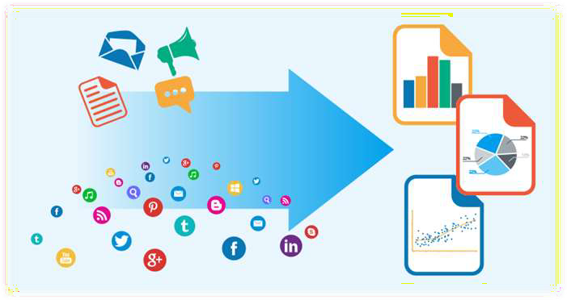
Sentiment Analysis
Using machines to analyze big data and produce incites for business decisions.

Slide 2
Team Members:
Tirth Patel (170020107041)
Ravi Sahani (170020107049)

Slide 3
Project:
Team ID : 125083
Project Name : Sentiment Analysis
Project Type : UDP
Keywords : Sentiment, Streamlit, Python, Jupyter Notebook, Twitter, API,
Anaconda, Heroku

Slide 4
Abstract:
In the age of artificial intelligence and machine learning, competition is between best and best. So inorder to gain control over market, it is essential to understand market condition especially during covid-19 situation.
For that sentiment of market is very important and sentiment of market is what consumer think of certain product. Sentiment analysis is the interpretation and classification of emotions (positive, negative and neutral) within text data using text analysis techniques. Sentiment analysis tools allow businesses to identify customer sentiment toward products, brands or services in online feedback.

Slide 5


Sentiment Analysis: What is it?
“The practice of applying
Natural Language Processing and Text Analysis techniques to identify and extract
subjective information from a piece of text”

Slide 6
Sentiment Analysis: What is it?
The process of analyzing unstructured text to extract relevant information
and transforming it into useful business intelligence
It determines if an expression is positive, negative, or neutral, and to what degree
It is an emerging field that attempts to analyze and measure human emotions and convert it into hard facts

Slide 7
Sentiment Analysis: What is it?
Also called opinion mining since it includes identifying attitudes, emotions, and opinions of a company’s product, brand, or service
It is text analytics that looks at the face value of the words to give them meaning
Gives insight into the emotion behind the words
Helps businesses monitor news articles, online forums and social networking sites for trends in opinions about their products and services

Slide 8
Sentiment Analysis: What is it?
Businesses have realized that not all opinions are equally important- Some
opinions carry more weight than others
A negative tweet by Lady Gaga will have a much greater impact than a tweet by an ordinary person
It is a tool to allow users to generate ‘influence scores’ to identify people, blogs, forums etc. that are important

Slide 9







Sentiment Analysis: How it Works-
Collect Data
Analyze Data
Indexing
Delivery
Social Media, Blogs, Twitter, News, Product Reviews
Algorithms process the data and performs sentence splitting
Algorithms tag sentences based on polarity and intensity sentiments
Provides an output reporting the outcome of the analysis

Slide 10
Sentiment Analysis: How it Works-
Data Collection
Public sentiments from consumers expressed on public forums and on social network are collected
Opinions and feelings are expressed in different way, with different vocabulary, context of writing, usage of short forms and slang, makes data huge and disorganized

Slide 11
Sentiment Analysis: How it Works-
Analyze Data
Text Preparation
Data is extracted and filtered before analysis
Non-textual content and content is identified and eliminated if it is irrelevant
Sentiment Detection
Each sentence and opinion is examined for subjectivity
Sentences with subjective expressions are retained and ones that convey objective expressions are discarded

Slide 12
Sentiment Analysis: How it Works-
Indexing (Sentiment Classification)
Sentiments can be broadly classified into two groups, positive and negative
Each subjective sentence is classified into positive, negative, good, bad, like, dislike
Delivery (Presentation of Output)
The result of converted unstructured text into meaningful information
Usually displayed as graphs for easy interpretation

Slide 13

Sentiment Analysis: How it Works-
In the Simplest Terms:
Algorithms scan keywords to categorize a statement as negative or positive based on a simple binary analysis
Ex: “enjoyed” = good, “miserable” = bad

Slide 14

Sentiment Analysis: Machine Learning-
In order for computers to identify the meaning of words code need to be
written- Algorithms
Algorithms learn to classify a sentence or phrase as positive or negative through training

Slide 15
Sentiment Analysis: Machine Learning- Types
Supervised Machine Learning
Unsupervised Machine Learning

Slide 16


Sentiment Analysis:
Language-Independent Analysis
Twitter receives over 400 Million tweets a day
Less than 40% of tweets are in English
One method is to use language independent indicators to create positive or
negative classifiers
Ex: Emoticons

Slide 17



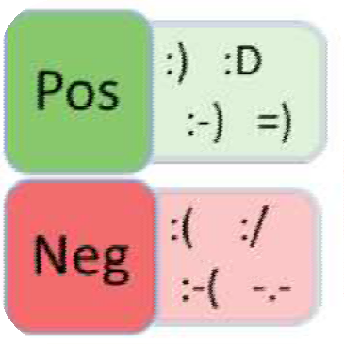
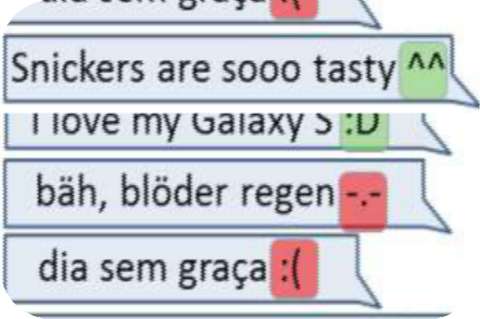
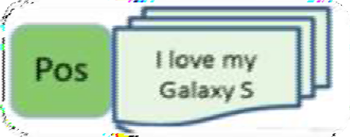

Process Flow Diagram:
Sentiment indicators are assigned to emoticons
Tweets with emoticons are read by the algorithm
Tweets get labeled as positive or negative

Slide 18


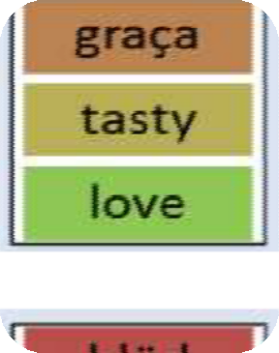
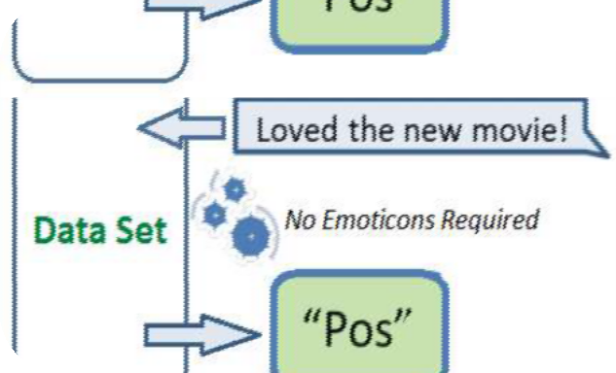

Process Flow Diagram
Based on the label, machines can learn the sentiment of words and phrases of different languages creating a data base for positive and negative sentiments
Once created, Emoticons are no long needed to determine the sentiment of phrases in different languages

Slide 19
Tools and Technology
Frontend : HTML, CSS, Streamlit
Backend : Python, Jupyter Notebook
Libraries : Numpy, Pandas, Scikitlearn, Matplotlib, Seaborn, tweepy

Slide 20

Sentiment Analysis: Why Use It?
Over 30 billion pieces of content are shared every month on Facebook
Millions of blogs and forums being read by billions of people
Personal opinions in reviews, ratings, and recommendations about products
are posted across websites and platforms every day

Slide 21

Sentiment Analysis:
What Can it do for Brands?
Can provide a competitive advantage- A trove of business opportunities and
product possibilities
Gives insight on how you measure up to competition
Gives predictions of consumer trends so companies can develop strategies to gain an advantage
Gives an insight on what customers are looking for, what they like or what they want to see

Slide 22
Usability:
Sentiment Analysis can help
answer these questions:
How do the company’s policies or external events or its employees impact customers’ perception of the brand?
What do customers think of the products and brand?
Are customers happy with the services the y receive?
What do customers like about the brand’s competitors?

Slide 23

Sentiment Analysis: Problems-
Many find analysis lacking and search for better ways to measure and apply it to business problems
There is a clear consensus that Sentiment Analysis is problematic and inaccurate when left solely to machines
Human language is too complex to reduce it just to algorithms
Humans are needed to verify and correct algorithms models used to support machine learning

Slide 24
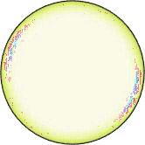

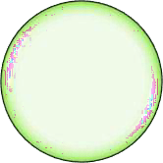


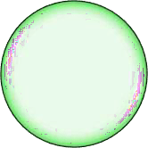




Sentiment Analysis Problems
Emerging
Terms
Topic Categories Differences
Negation
Sentence Completeness
Issues
Undermining
Accuracy:
Sarcasm
Lack of Context
Word Roots (Stemming)
Semantic Ambiguity
Term Frequency

Slide 25



Current Top Software:
Returns the sentiment of Tweets
Two APIs analyze new Tweets and Tweets already received, one Tweet at a time
Tweet Sentiments
A WebKnox text processing API processes (natural) language texts
Can detect the language, the quality of the writing, find entity mentions, tag parts of speech, extract dates, extract locations, or determine the sentiment of the text
Text Processing
API designed to turn any text into meaningful expressions, entities, and sentiment terms
Supports English, Spanish, French, German, Chinese, Swedish, Greek, Czech, Italian and Russian
Tweepy

Slide 26
Data Dictionary
Field Name | Datatype | Data Format | Character Length | Contraint | Description
Username | varchar | - | 20 | Primary key | Username of twitter user
Tweet | varchar | - | 280 | Not null | Tweet of user
Time | integer | dd/mm/yyy | - | Not null | Time of tweet
Twitter Handle | varchar | - | 15 | Not null | @twitter_handle

Slide 27
Data Dictionary
Field Name | Datatype | Data Format | Character Length | Contraint | Description
Retweet | varchar | - | - |  | Retweeted content
Location | varchar | - | 280 | Not null | Location of user
Verified | - |  | - | Not null | Verified User

Slide 28
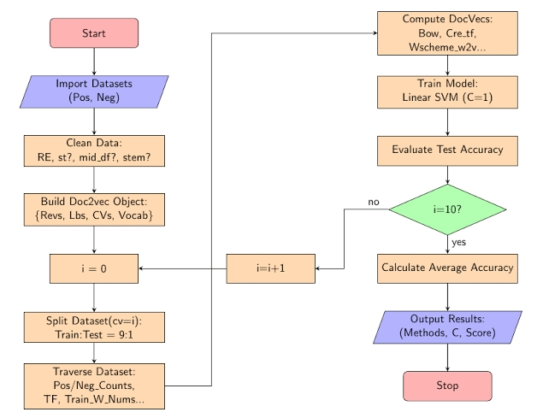
Data Flowchart:

Slide 29
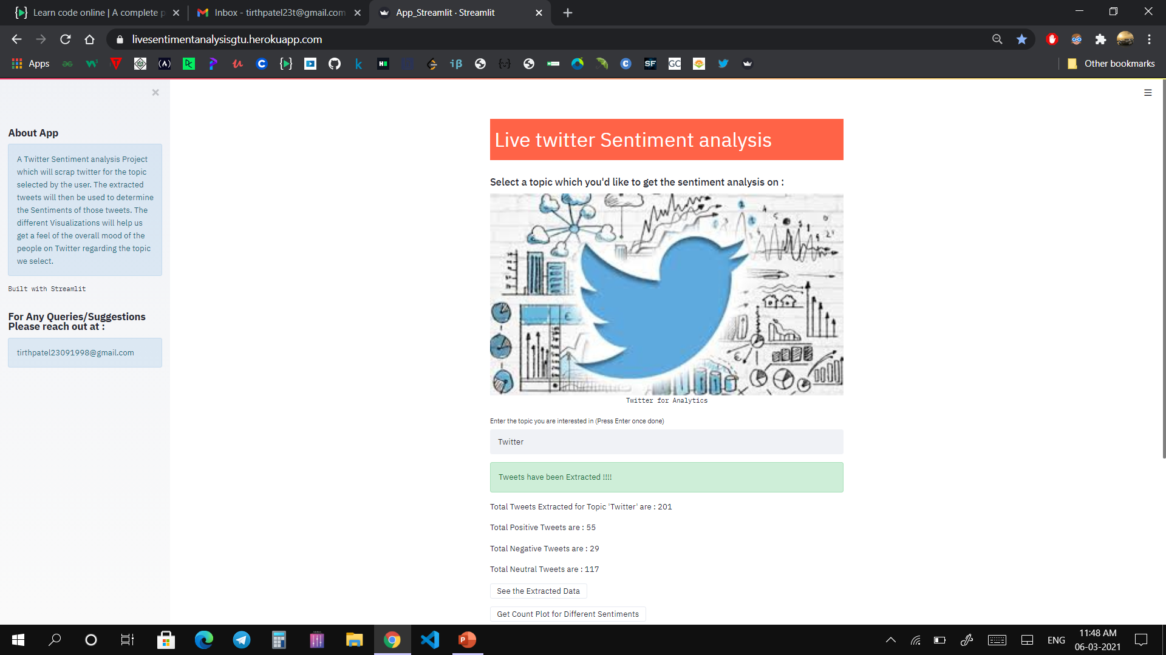
GUI

Slide 30
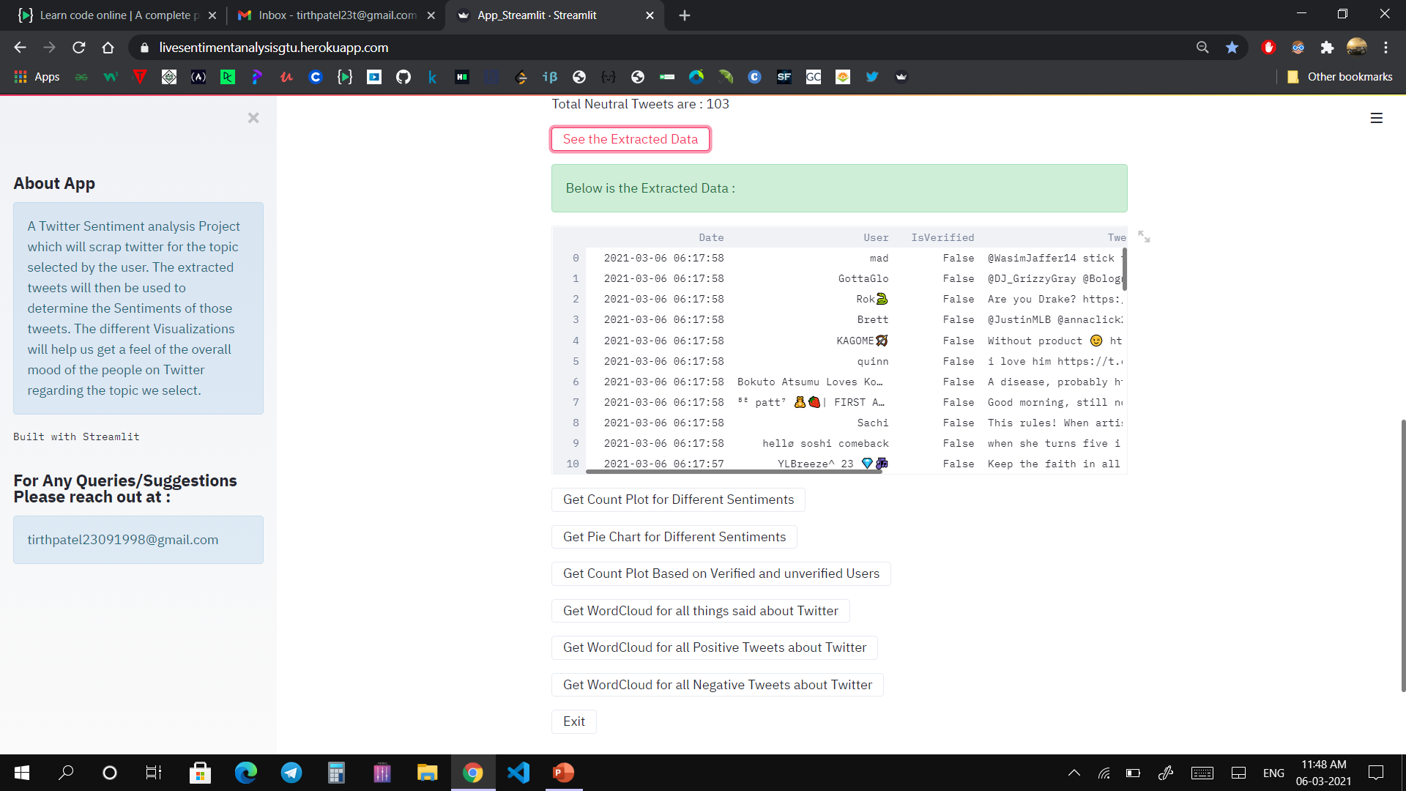
GUI

Slide 31
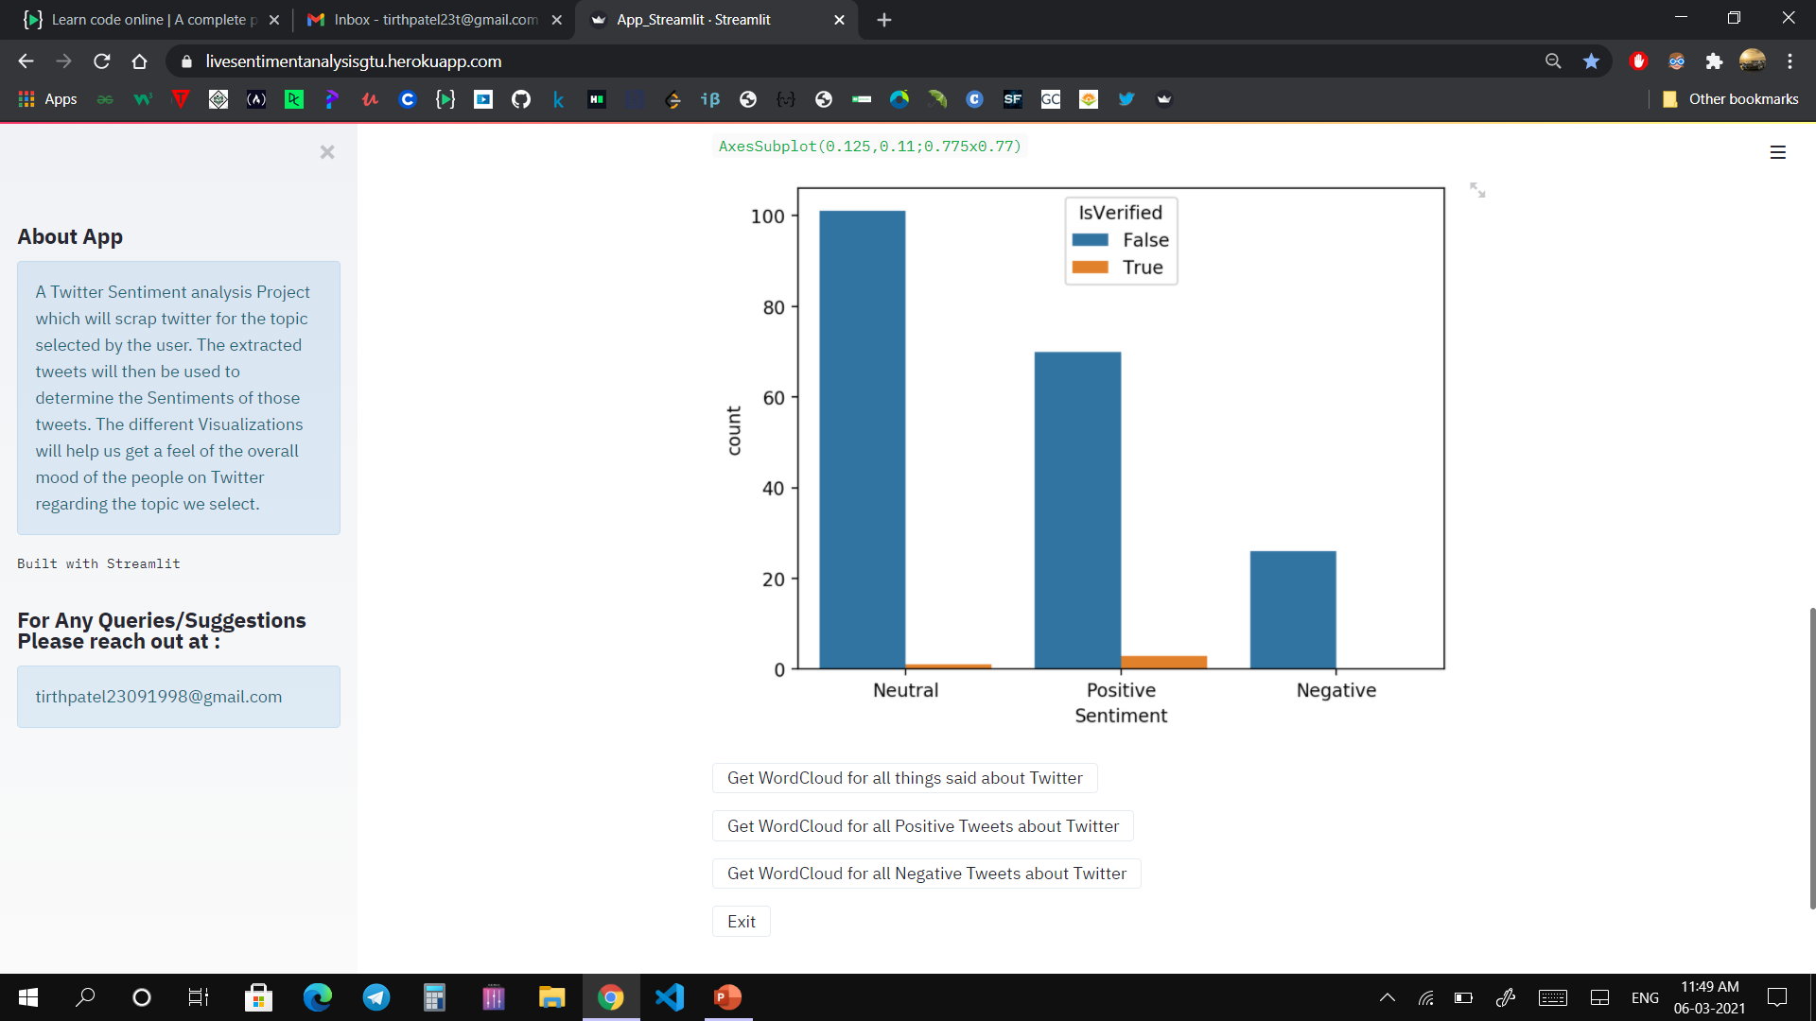
GUI

Slide 32
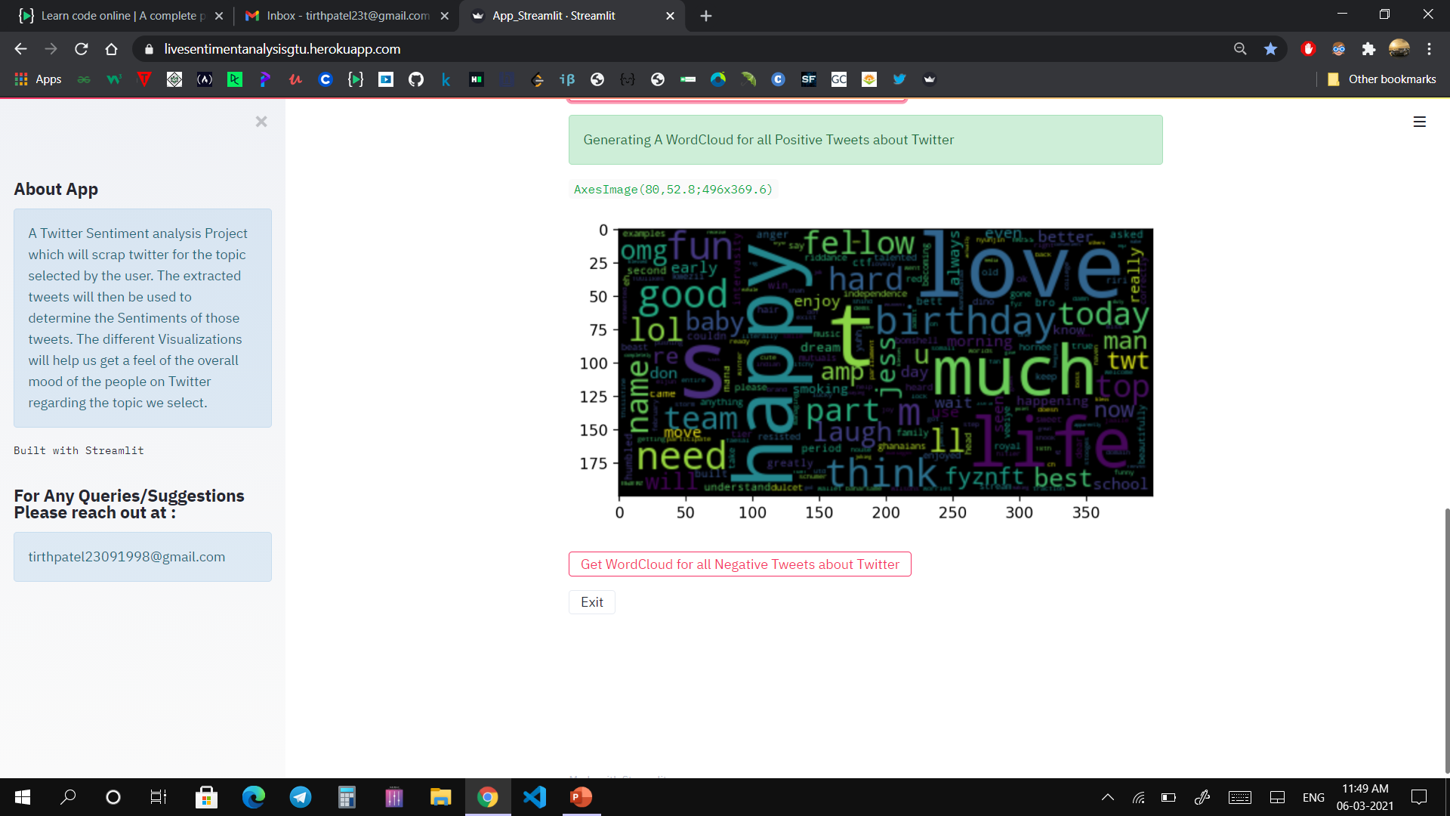
GUI

Slide 33
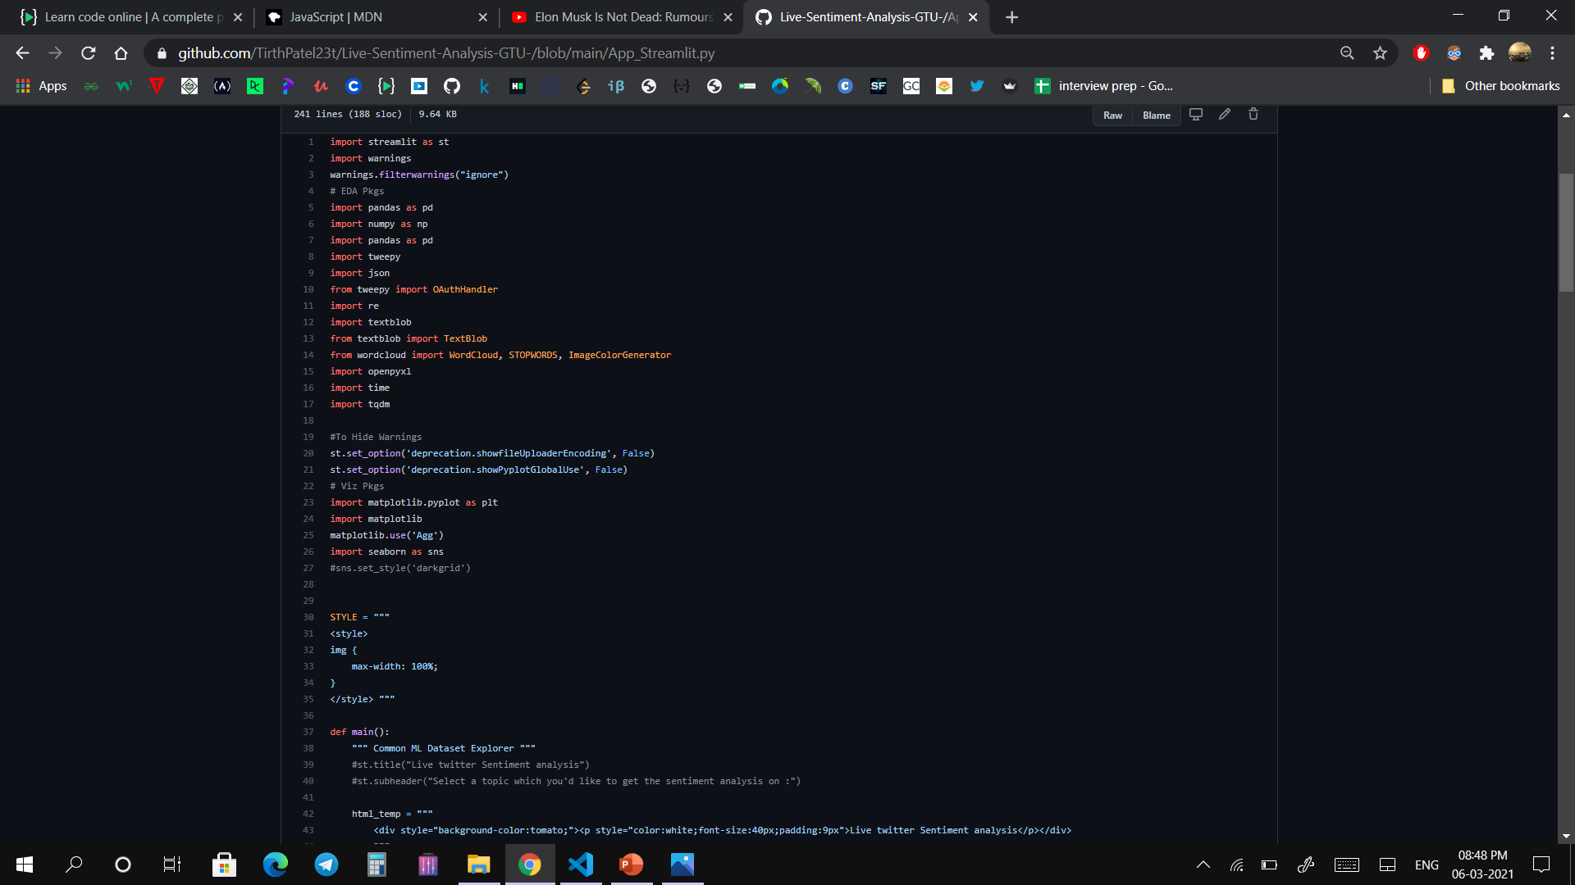
Code

Slide 34
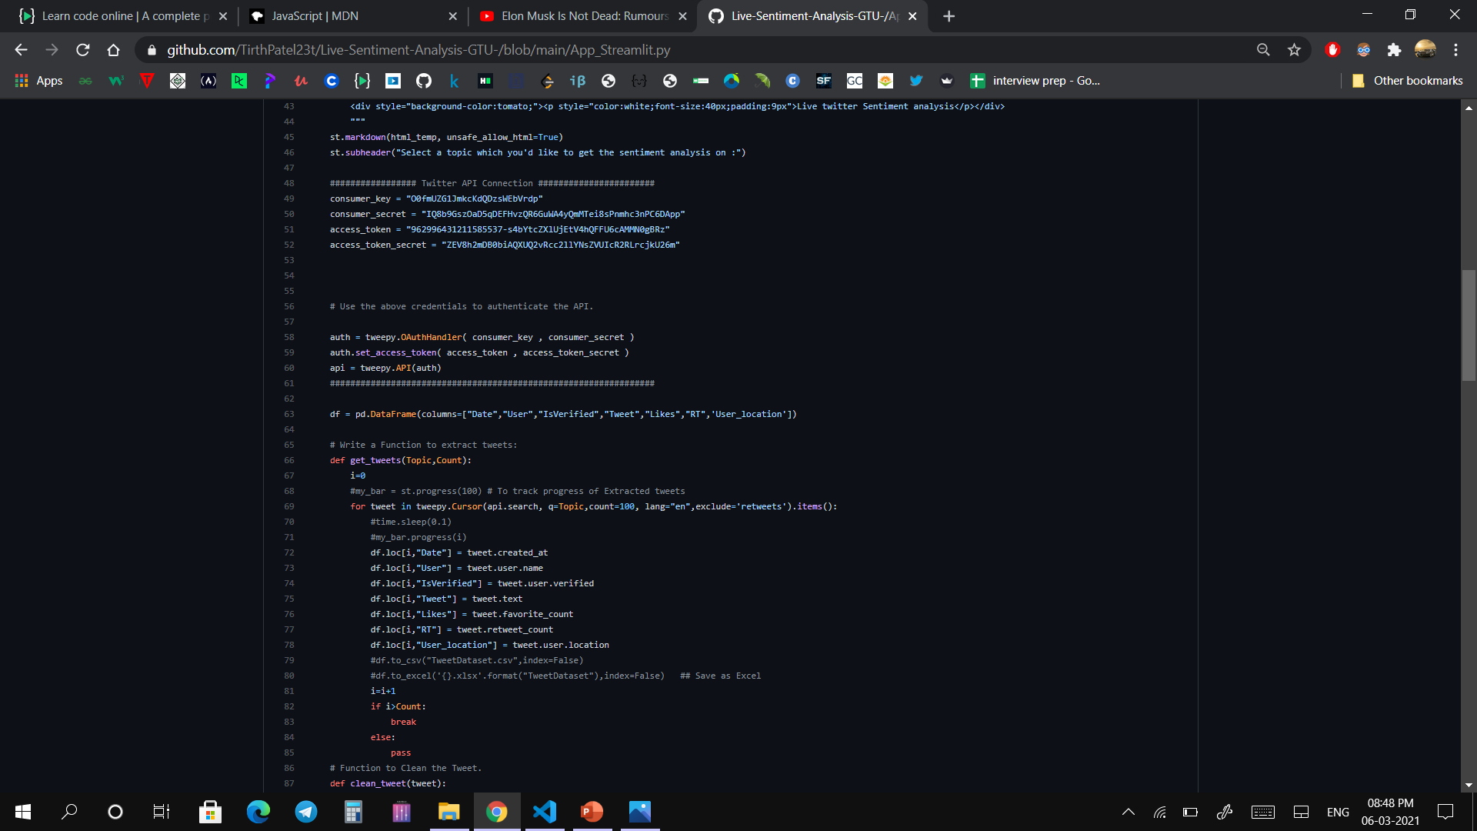
Code

Slide 35
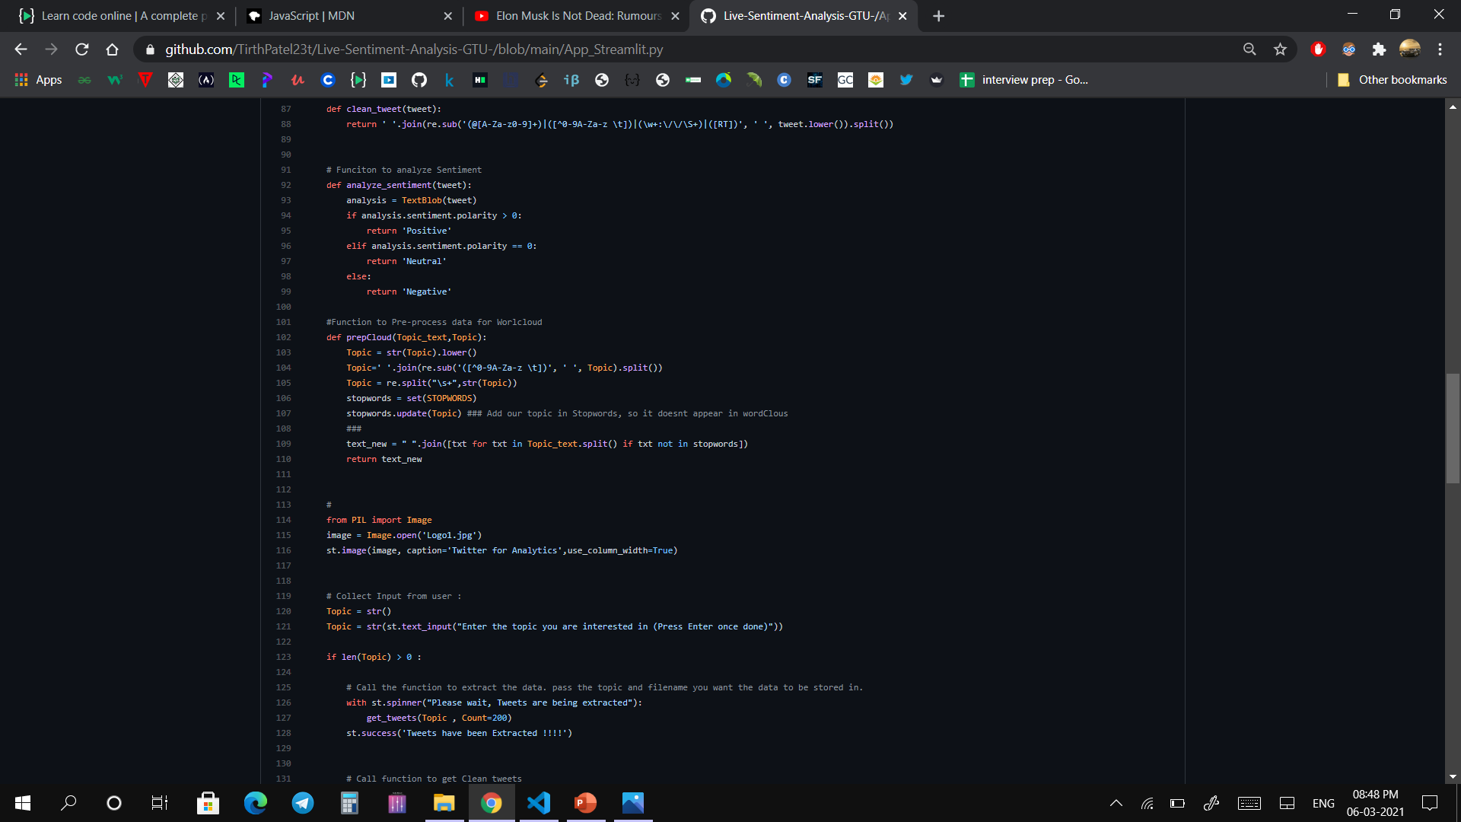
Code

Slide 36
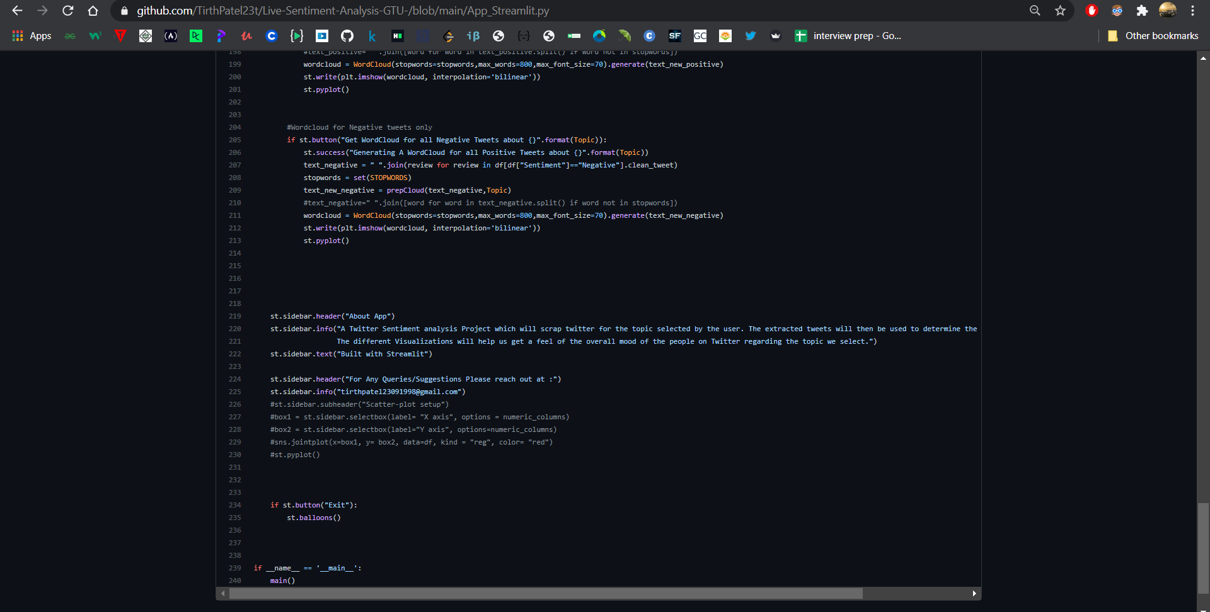
Code

Slide 37
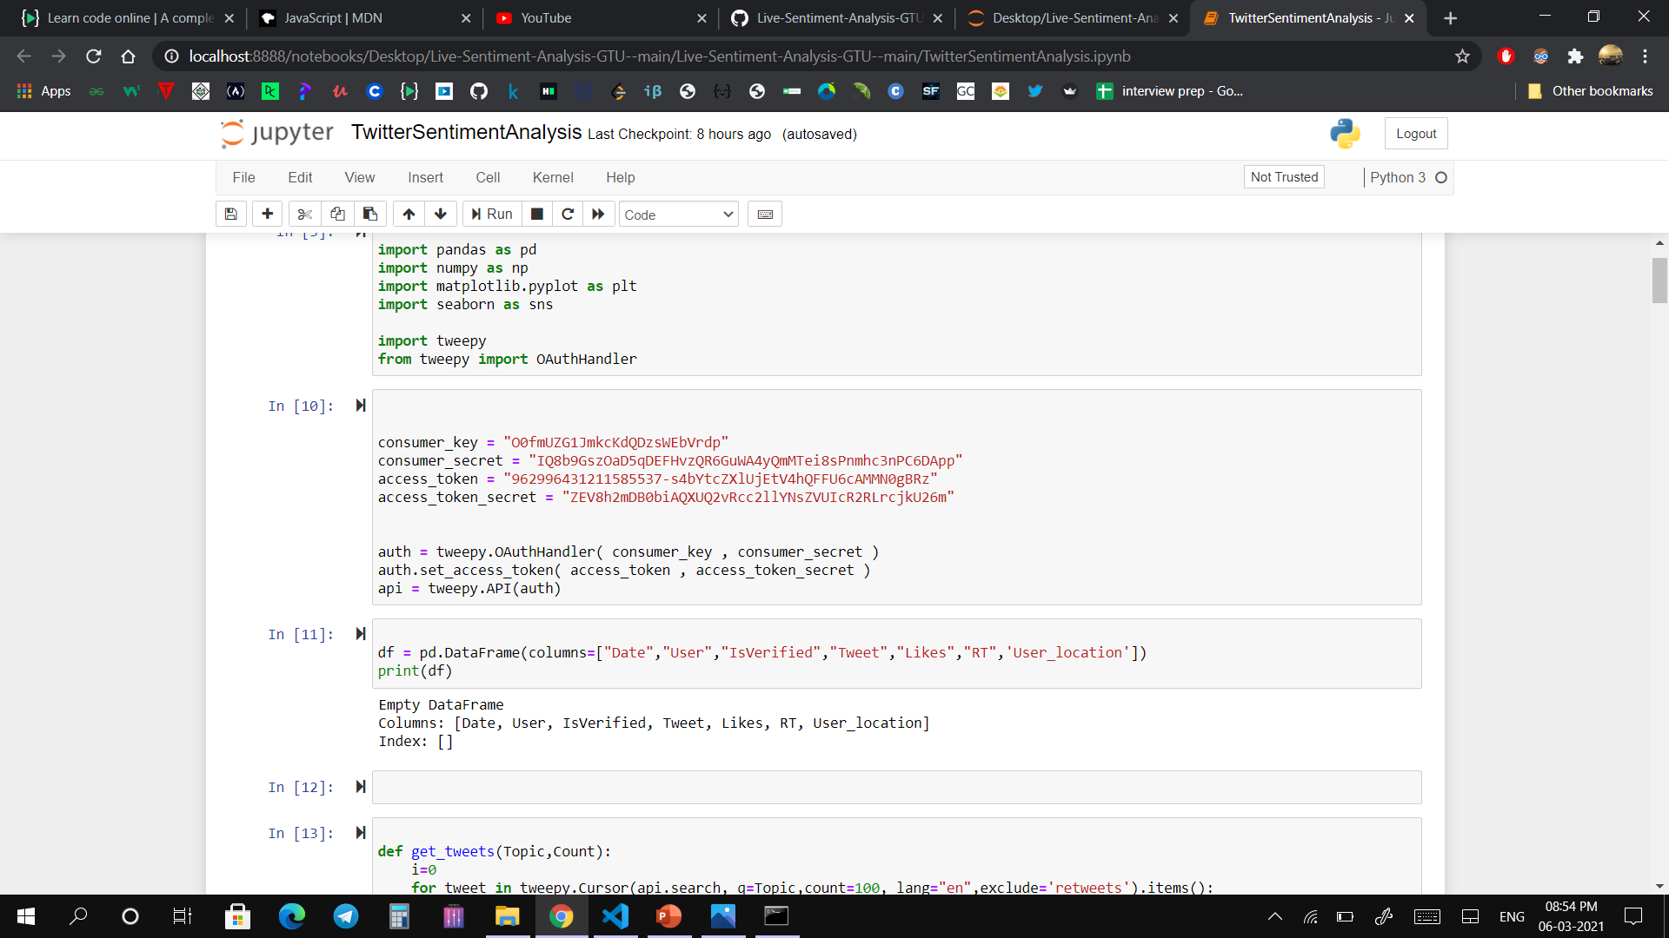
Code

Slide 38
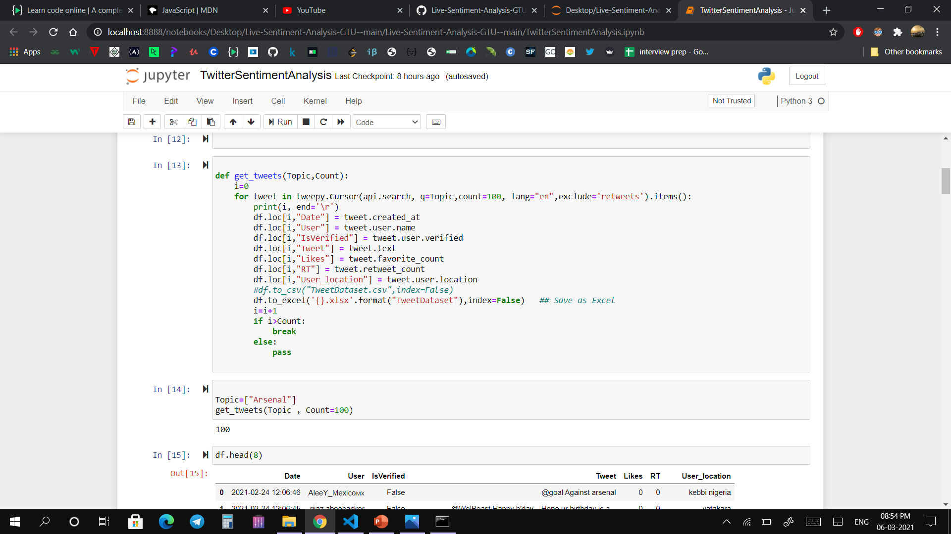
Code

Slide 39
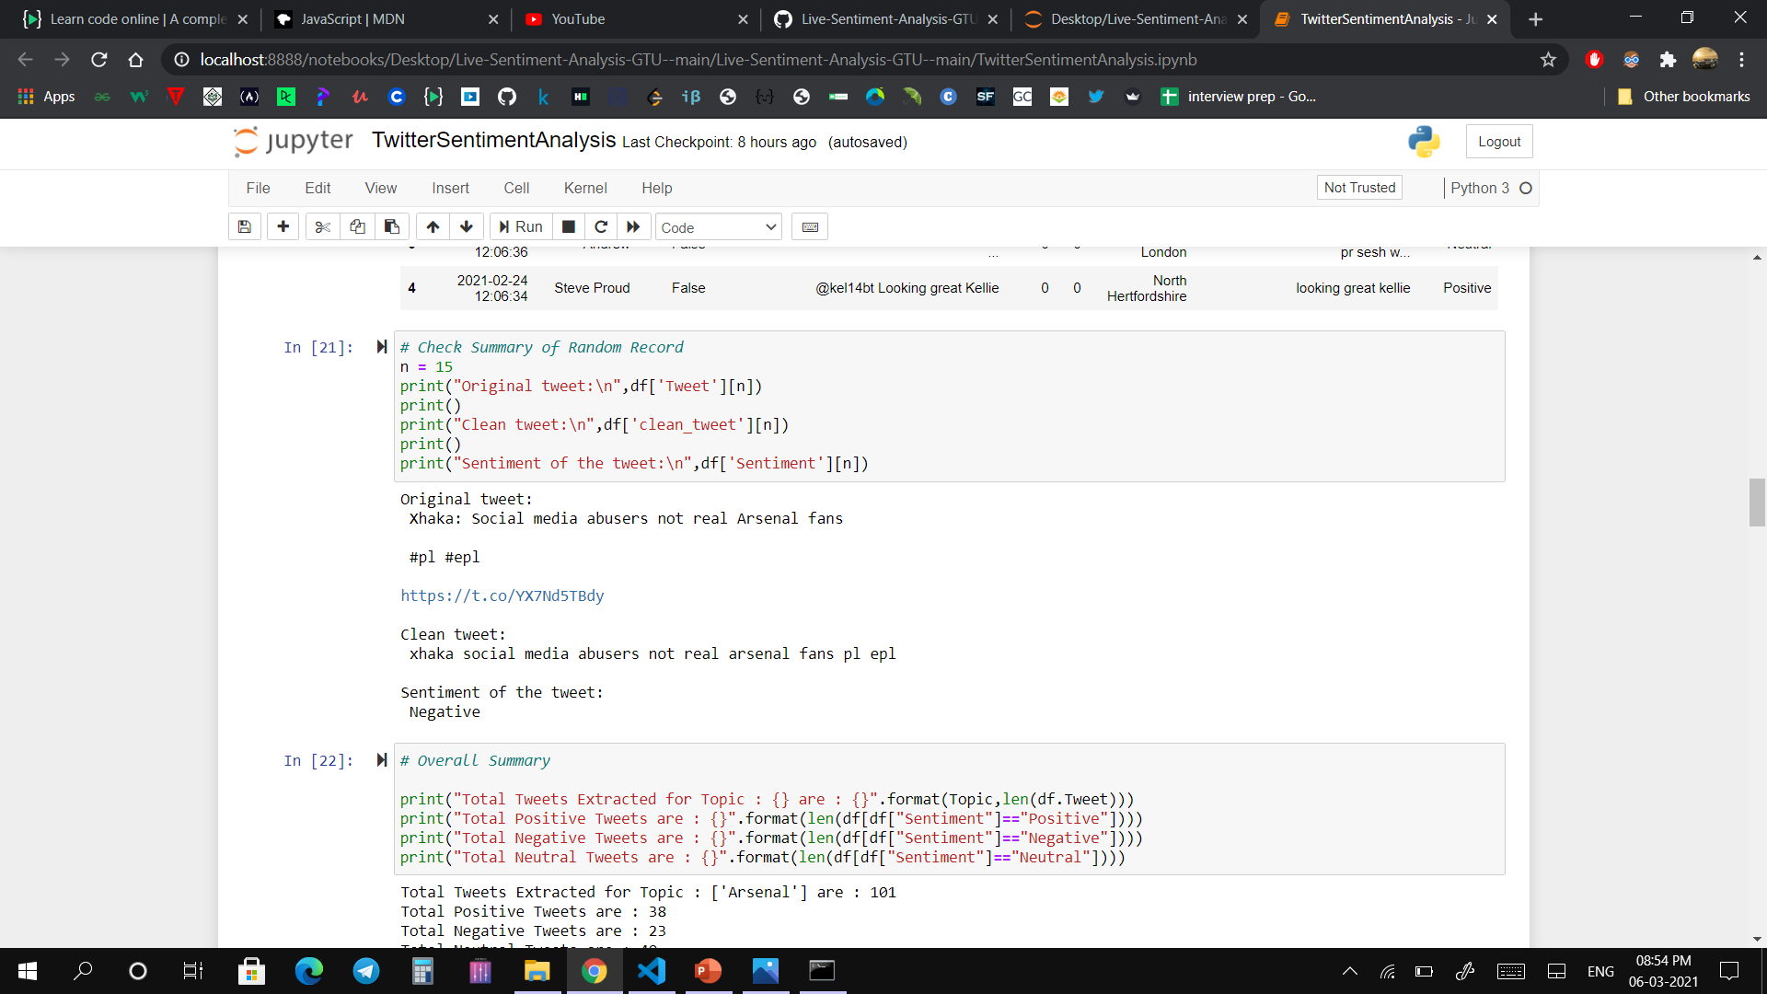
Code

