Slide 1
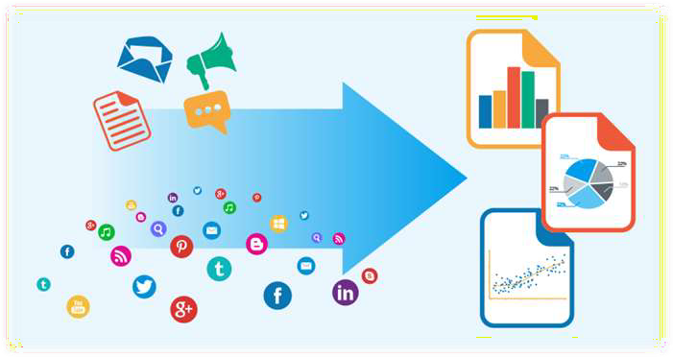

Sentiment Analysis
Using machines to analyze big data and produce incites for business decisions.
Image Source: Google Images

Slide 2

What is Sentiment Analysis?
A look at what Sentiment Analysis is and what it does.

Slide 3


Sentiment Analysis: What is it?
“The practice of applying
Natural Language Processing and Text Analysis techniques to identify and extract
subjective information from a piece of text”

Slide 4
Sentiment Analysis: What is it?
The process of analyzing unstructured text to extract relevant information
and transforming it into useful business intelligence
It determines if an expression is positive, negative, or neutral, and to what degree
It is an emerging field that attempts to analyze and measure human emotions and convert it into hard facts

Slide 5
Sentiment Analysis: What is it?
Also called opinion mining since it includes identifying attitudes, emotions, and opinions of a company’s product, brand, or service
It is text analytics that looks at the face value of the words to give them meaning
Gives insight into the emotion behind the words
Helps businesses monitor news articles, online forums and social networking sites for trends in opinions about their products and services

Slide 6
Sentiment Analysis: What is it?
Businesses have realized that not all opinions are equally important- Some
opinions carry more weight than others
A negative tweet by Lady Gaga will have a much greater impact than a tweet by an ordinary person
It is a tool to allow users to generate ‘influence scores’ to identify people, blogs, forums etc. that are important

Slide 7









Sentiment Analysis: What is it?
Review Mining
Opinion Mining
Subjective Analysis
Appraisal Extraction
Synonymous & Interchangeable
Names
Compiled by author form sources: SlideShare by Kavita Ganesan

Slide 8
How does it Work?
A look at the different processes involved with Sentiment Analysis.

Slide 9







Sentiment Analysis: How it Works-
Collect Data
Analyze Data
Indexing
Delivery
Social Media, Blogs, Twitter, News, Product Reviews
Algorithms process the data and performs sentence splitting
Algorithms tag sentences based on polarity and intensity sentiments
Provides an output reporting the outcome of the analysis
Compiled by author form sources: researchgate.net

Slide 10
Sentiment Analysis: How it Works-
Data Collection
Public sentiments from consumers expressed on public forums and on social network are collected
Opinions and feelings are expressed in different way, with different vocabulary, context of writing, usage of short forms and slang, makes data huge and disorganized

Slide 11
Sentiment Analysis: How it Works-
Analyze Data
Text Preparation
Data is extracted and filtered before analysis
Non-textual content and content is identified and eliminated if it is irrelevant
Sentiment Detection
Each sentence and opinion is examined for subjectivity
Sentences with subjective expressions are retained and ones that convey objective expressions are discarded

Slide 12
Sentiment Analysis: How it Works-
Indexing (Sentiment Classification)
Sentiments can be broadly classified into two groups, positive and negative
Each subjective sentence is classified into positive, negative, good, bad, like, dislike
Delivery (Presentation of Output)
The result of converted unstructured text into meaningful information
Usually displayed as graphs for easy interpretation

Slide 13

Sentiment Analysis: How it Works-
In the Simplest Terms:
Algorithms scan keywords to categorize a statement as negative or positive based on a simple binary analysis
Ex: “enjoyed” = good, “miserable” = bad
Compiled by Author from Sources: analyticstraining.com

Slide 14

Machine Learning
A look at how machine learning plays a role in Sentiment Analysis.

Slide 15

Sentiment Analysis: Machine Learning-
In order for computers to identify the meaning of words code need to be
written- Algorithms
The field of “teaching” computers is call deep learning
Algorithms learn to classify a sentence or phrase as positive or negative through training

Slide 16




Sentiment Analysis:
Machine Learning- How Machines Learn
It is a structural process where every stage builds a better version
Data as Input
Text files, Spreadsheets, SQL Databases
Abstracting the Data
Representation of the data in a structural format through the algorithm chosen
Elementary Learning
Generalization
Practical Application
Where the learning from the previous step is used to develop an insight
Compiled by Author from Sources: analyticsvidhya.com

Slide 17











Sentiment Analysis: Machine Learning- Types
Different types use different strategies and techniques to identify the
sentiments contained in a particular text
Subjectivity/Objectivity Identification
Feature/Aspect-based Identification
Two Main Types
Compiled by Author from Sources: kdnuggets.com

Slide 18
Sentiment Analysis: Machine Learning- Types
Subjectivity/Objectivity Identification
Entails classification of a sentence or a text fragment into subjective or objective status
The challenge when conducting this type of analysis is that the meaning of the word or a phrase is often contingent on its context
Feature/Aspect-Based Identification
Allows for the determination of different opinions or sentiments in relation to different aspects
Allows for a much more nuanced overview of opinions and feelings

Slide 19

















Sentiment Analysis: Machine Learning- Types
Two Main Types of Algorithms Used
Supervised Learning
Subjectivity/Objectivity Identification
Unsupervised Learning
Feature/Aspect-based Identification
Compiled by Author from Sources: astro.caltech.edu

Slide 20

Sentiment Analysis:
Machine Learning- Supervised Learning
The algorithm is provided with both the input data and the desired results
For some input data the correct result is already known
Algorithms generalize data into preset outcomes
For predicting something specific
Can directly measure how well the algorithm is learning

Slide 21
Sentiment Analysis:
Machine Learning- Supervised Learning
Generalization
The ability to produce reasonable outputs for data not used during learning
Algorithms do not learn underlying functions of phrases and sentences
Supervised algorithms do well with training data but poor with new data

Slide 22



Sentiment Analysis:
Machine Learning- Unsupervised Learning
The algorithm is not provided with predetermined results during the training
Used to cluster and label input data into classes or groups based on statistical properties
Labels can be given to clusters even if there is only a small number of representatives in the group

Slide 23
Sentiment Analysis:
Machine Learning- Unsupervised Learning
Not trying to predict something specific
Not exactly sure what you are looking for- Can not give a prediction of outcome
Rather trying to “learn” about the data- like patterns

Slide 24


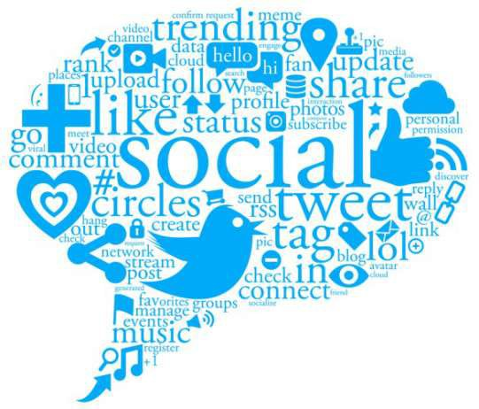
Sentiment Analysis:
Language-Independent Analysis
What happens when you have data in multiple languages?
Image Source: Google Images

Slide 25
Sentiment Analysis:
Language-Independent Analysis
Twitter receives over 400 Million tweets a day
Less than 40% of tweets are in English
One method is to use language independent indicators to create positive or
negative classifiers
Ex: Emoticons

Slide 26



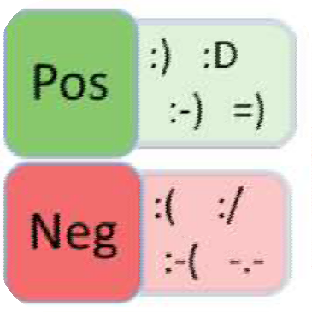
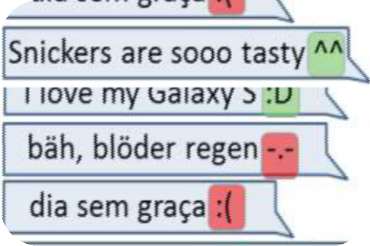
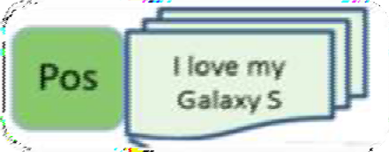

Sentiment Analysis:
Language-Independent Analysis
Sentiment indicators are assigned to emoticons
Tweets with emoticons are read by the algorithm
Tweets get labeled as positive or negative
Compiled by author form sources: irml.dailab.de
Image Source: irml.dailab.de

Slide 27


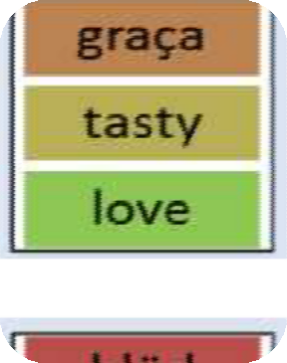
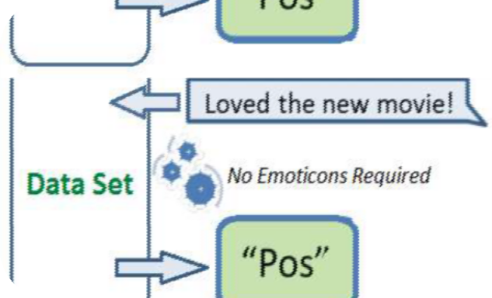

Sentiment Analysis:
Language-Independent Analysis
Based on the label, machines can learn the sentiment of words and phrases of different languages creating a data base for positive and negative sentiments
Once created, Emoticons are no long needed to determine the sentiment of phrases in different languages
Compiled by author form sources: irml.dailab.de
Image Source: irml.dailab.de

Slide 28

How can Sentiment Analysis be Useful?
A look at the significance of Sentiment Analysis in business decision making.

Slide 29

Sentiment Analysis: Why Use It?
Over 30 billion pieces of content are shared every month on Facebook
Millions of blogs and forums being read by billions of people
Personal opinions in reviews, ratings, and recommendations about products
are posted across websites and platforms every day

Slide 30






Sentiment Analysis:
What Can it do for Brands?
Increase Customer Retention
Resolve Customer Experience Pain Points
Optimize Customer Service
Optimize Pricing
Measure Social Media ROI
Compiled by author form sources: relevantinsights.com

Slide 31
Sentiment Analysis:
What Can it do for Brands?
Through comprehensive analysis, businesses gain valuable insights towards
their customers
It can help enhance customer experience towards brands and business
Insights on what is being done right from positive sentiment analytic reports and what needs improvement

Slide 32
Sentiment Analysis:
What Can it do for Brands?
It can help revitalize a business’ brand
Companies can quantify people’s perception about their products or services, marketing strategies and their customer experience
When used right, it can help companies develop engaging marketing strategies to improve people’s perception about their brands

Slide 33
Sentiment Analysis:
What Can it do for Brands?
Can provide a competitive advantage- A trove of business opportunities and
product possibilities
Gives insight on how you measure up to competition
Gives predictions of consumer trends so companies can develop strategies to gain an advantage
Gives an insight on what customers are looking for, what they like or what they want to see

Slide 34
Sentiment Analysis:
What Can it do for Brands?
Sentiment Analysis can help
answer these questions:
How do the company’s policies or external events or its employees impact customers’ perception of the brand?
What do customers think of the products and brand?
Are customers happy with the services the y receive?
What do customers like about the brand’s competitors?
Compiled by author from sources: analyticstraining.com

Slide 35

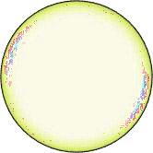

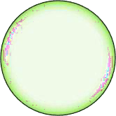







Sentiment Analysis: Problems-
Emerging
Terms
Topic Categories Differences
Negation
Sentence Completeness
Issues
Undermining
Accuracy:
Sarcasm
Lack of Context
Word Roots (Stemming)
Semantic Ambiguity
Term Frequency
Compiled by author form sources: relevantinsights.com

Slide 36
Sentiment Analysis: Problems-
Many find analysis lacking and search for better ways to measure and apply it to business problems
There is a clear consensus that Sentiment Analysis is problematic and inaccurate when left solely to machines
Human language is too complex to reduce it just to algorithms
Humans are needed to verify and correct algorithms models used to support machine learning

Slide 37

Sentiment Analysis: Top Software-
Performs sentiment analysis, stemming and lemmatization, parts of speech tagging and chunking, phrase extraction and named entity recognition
Text-Processing
Preforms text classification, article summarization, sentiment analysis, extracts stock symbol, extracts person names, language detection, and extracts locations
ML Analyzer
Compiled by author form sources: blog.mashape.com

Slide 38









Sentiment Analysis: Top Software-
Returns the sentiment of Tweets
Two APIs analyze new Tweets and Tweets already received, one Tweet at a time
TweetSentiments
A WebKnox text processing API processes (natural) language texts
Can detect the language, the quality of the writing, find entity mentions, tag parts of speech, extract dates, extract locations, or determine the sentiment of the text
Text Processing
API designed to turn any text into meaningful expressions, entities, and sentiment terms
Supports English, Spanish, French, German, Chinese, Swedish, Greek, Czech, Italian and Russian
Skyttle
Compiled by author form sources: blog.mashape.com

Slide 39



Contact Us for the Full Presentation:
Mediacontact USA Inc.
13575 58TH Street North #160
Clearwater, Fl. 33760
T: 727 538 4112
E: contact@mcusa.co
www.mediacontactusa.com

Slide 40

Works Cited
Donalek, Ciro. "Supervised and Unsupervised Learning." (n.d.): n. pag. Apr. 2011. Web. 20 June 2016.
<http://www.astro.caltech.edu/~george/aybi199/Donalek_Classif.pdf>.
Ganesan, Kavita. "Opinion Mining Tutorial (Sentiment Analysis)." Opinion Mining Tutorial (Sentiment Analysis). SlideShare, 7 Apr. 2011. Web. 20 June 2016.
<http://www.slideshare.net/KavitaGanesan/opinion-mining-kavitahyunduk00>.
Infinit Datum. "Sentiment Analysis: Everything You Need to Know." Infinit Datum. Infinit Datum, 26 Mar. 2015. Web. 20 June 2016.
<http://www.infinitdatum.com/blog/sentiment-analysis-everything-you-need-to-know/>.
Ismael, Chris. "List of 20+ Sentiment Analysis APIs." Mashape Blog. Mashape, 24 Apr. 2013. Web. 20 June 2016. <http://blog.mashape.com/list-of-20-sentiment-analysis- apis/>.
JAIN, KUNAL. "Machine Learning Basics for a Newbie." Analytics Vidhya. Analytics Vidhya, 11 June 2015. Web. 20 June 2016.
<http://www.analyticsvidhya.com/blog/2015/06/machine-learning-basics/>.
Kabadjov, M., Balahur, A. And Boldrini, E. 2009. Sentiment Intensity: Is It a Good Summary Indicator?. Proceedings of the 4th Language Technology Conference LTC, pp.380-
384. Poznan, Poland, 6-8.11.2009.
Kiser, Matt. "The Algorithmia Guide to Sentiment Analysis." Algorithmia Developer Center Atom. Algorithmia, 28 Jan. 2016. Web. 20 June 2016.
<http://developers.algorithmia.com/guides/sentiment-analysis/>.
Mora, Michaela. "The State of Sentiment Analysis." The State of Sentiment Analysis. Relevant Insights, 3 May 2015. Web. 20 June 2016.
<http://www.relevantinsights.com/the-state-of-sentiment-analysis#sthash.pNOCPkrX.CRcKaILs.dpbs>.
Narr, Sascha, Michael Hülfenhaus, and Ing. Sahin Albayrak, Dr. "Language-Independent Twitter Sentiment Analysis." Language-Independent Twitter Sentiment Analysis (2012): n. pag. CC IRML. Impressum, 20 Sept. 2012. Web. 20 June 2016. <http://irml.dailab.de/wp-content/uploads/2012/09/narr-LWA2012- TwitterSentiment_Poster.pdf>.
Shankhdhar, Gaurav. "Sentiment Analysis Methodology." Edureka Blog RSS. Edureka, 23 Jan. 2014. Web. 20 June 2016. <http://www.edureka.co/blog/sentiment-analysis-
methodology/>.
Sigler, Lisa. "Text Analytics vs. Sentiment Analysis." Clarabridge. Clarabridge, 27 July 2015. Web. 20 June 2016. <http://www.clarabridge.com/text-analytics-vs-sentiment- analysis/>.
Sims, Scott. "Sentiment Analysis 101." KDnuggets. KDnuggets, Dec. 2015. Web. 20 June 2016. <http://www.kdnuggets.com/2015/12/sentiment-analysis- 101.html#.VmBg3Ci8OSM.facebook>.
Victorlavrenko. "IAML2.20: Supervised vs Unsupervised Learning." YouTube. YouTube, 10 Sept. 2015. Web. 20 June 2016.
<https://www.youtube.com/watch?v=xtp8AJ2Yd1E>.
Vohra, Gaurav. "What’s the Sentiment on “sentiment Analysis”?" Analytics Training Blog. N.p., 03 Jan. 2011. Web. 20 June 2016.
<http://analyticstraining.com/2011/sentiment-analysis/>.
◆
◆
◆
◆
◆
◆
◆
◆
◆
◆
◆
◆
◆

