Slide 1
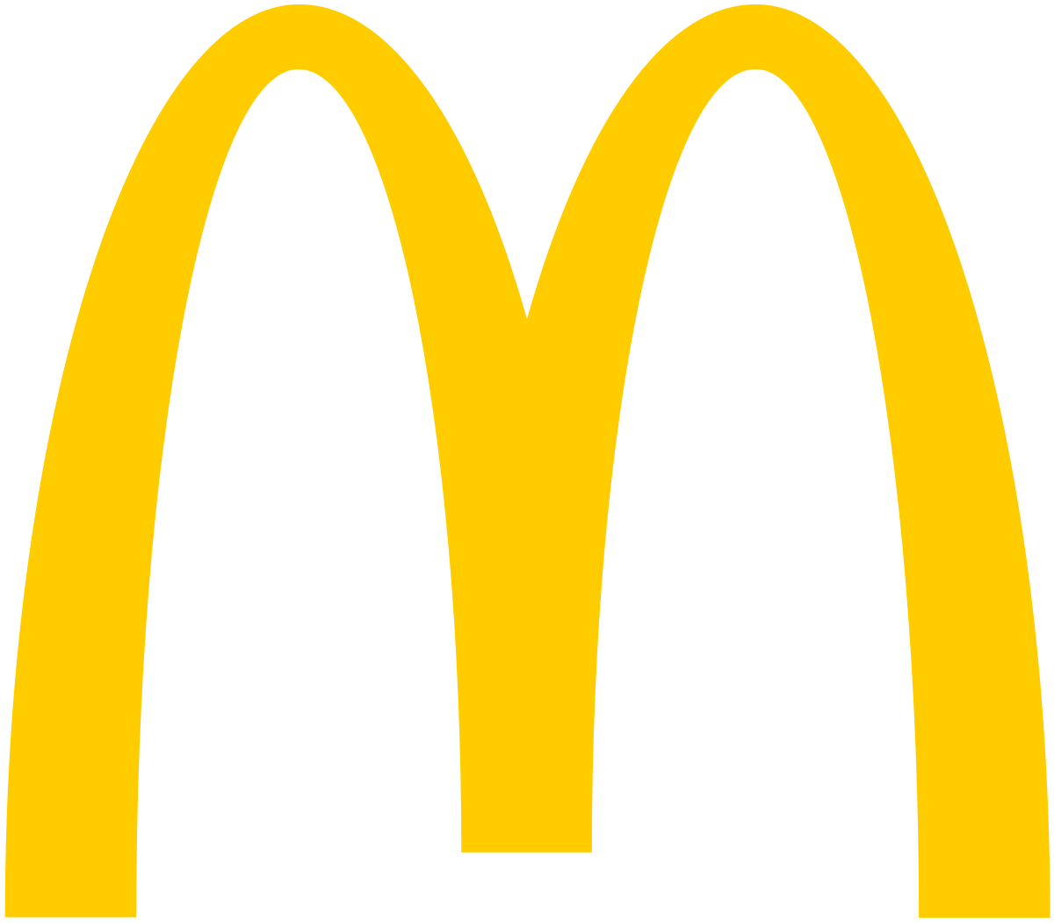


MCDONALD’S BILLING SYSTEM
Name : PATEL TIRTH R.
Roll No : 124
Enrolment No : 2021002170110119
Batch : A-4 Branch : CE
This Photo by Unknown Author is licensed under CC BY-SA

Slide 2
INTRODUCTION
McDonald's is one of the largest fast-food chains in the world, serving millions of customers every day. To efficiently manage customer orders and payments, McDonald's has implemented an advanced billing system. This system streamlines the ordering and payment process, improving customer experience and reducing wait times.

Slide 3
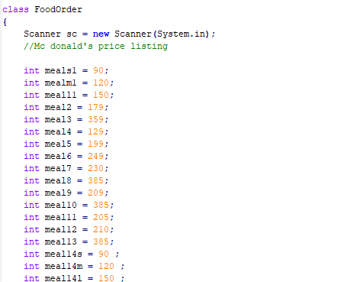
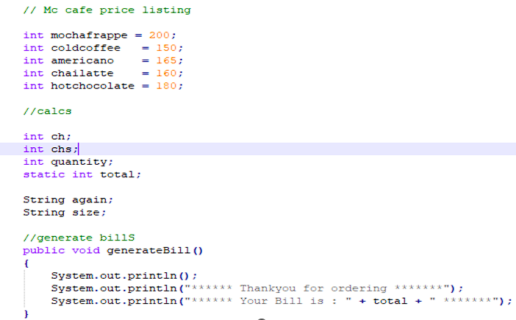
FUNCTIONALITY
Class FoodOrder is a class containing common methods between McD and McCafe.
Like generateBill method , it also contains items price list.
Total amount and gobal variables.

Slide 4
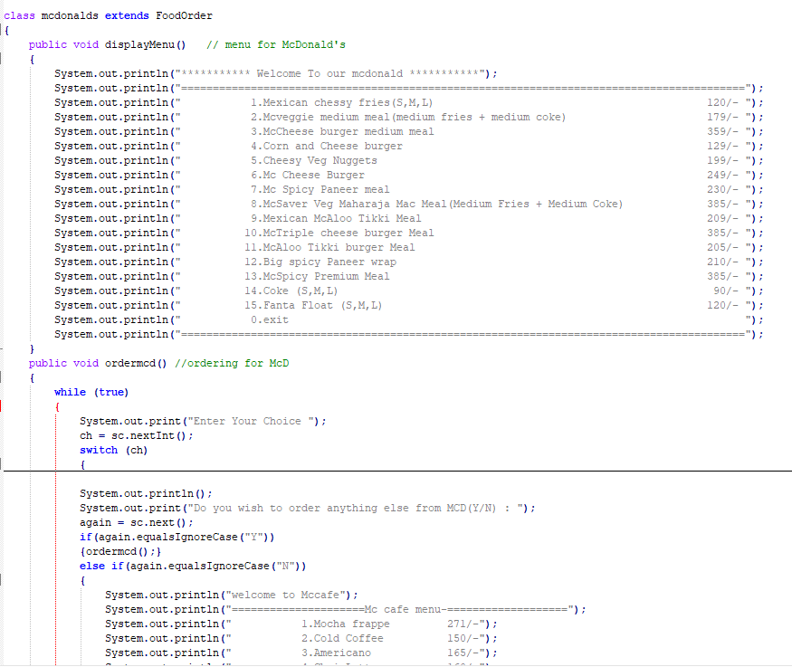
FUNCTIONALITY
ClassMcDonalds inherits class foodorder means child class has access to generate bill method and price list
Display menu then ordermcd methods are listed.
The items and desired quantity selected add up to the total amount.

Slide 5
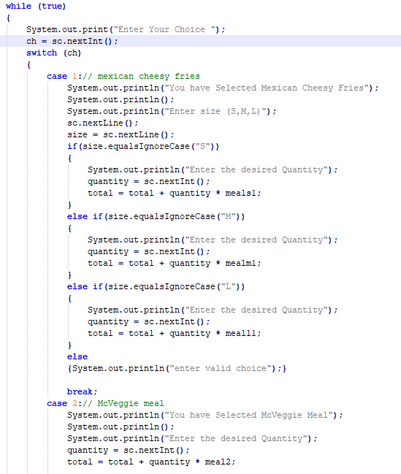
FUNCTIONALITY
Switch case are used to get choice of items from the menu.
Some items are costumisable with size options
Small , medium ,large these are listed by if , else logic.
With equalsIgnoreCase for easy input user experience for user.

Slide 6
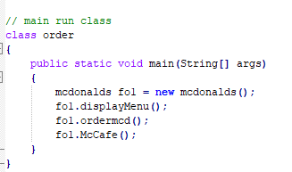
FUNCTIONALITY
Main driver class or run class has child class as object as it has parents access also.
All the methods as per priorities are listed.
We have used inheritance to increase code reusablity

Slide 7
FLOW-CHART
Start
DISPLAY
MAIN MENU
DISPLAY
CAFÉ MENU
ENTER YOUR CHOICE
ENTER YOUR CHOICE
ENTER QUANTITY
DO YOU WISH TO ORDER ANYTHING ELSE ?
ENTER QUANTITY
DO YOU WISH TO ORDER ANYTHING ELSE ?
GENERATE BILL
End

Slide 8
MERITS
It reduces human labour.
Saves extra operational cost.
Bills are always accurate.
Require only weekly maintanances.
It eliminates the manual data entry and calculation process.
You can easily calculate total bill of the customer.

Slide 9
DEMERITS
It is not effective all the time.
Technology illiteracy.
Security concerns.

Slide 10
CONCLUSION
Overall, the billing system at McDonald's is an essential component of the company's operations, enabling faster and more accurate order processing and payment. While there are some disadvantages associated with the system, the advantages far outweigh them, making it an essential tool for businesses in the fast-food industry.

Slide 11
THANK YOU...

