Slide 1

Intelligent Network Monitoring & Automated Alert System
Computer Networking Lab
CSE 318· Summer 2026_241_D2
TIRTHA BABU SARKAR ·
ID: 241002058
Submitted To: Mahbubur Rahman
Green University of Bangladesh ·
Department of CSE

Slide 2

Why Network Monitoring Is Critical
The Challenge
Manual monitoring is reactive, error-prone, and unscalable. Network failures cause downtime, data loss, and degraded service — often detected too late.
Core Objectives
Continuously monitor host availability and TCP port status
Measure and log network latency in real time
Trigger automated alerts on threshold breaches
Generate structured CSV reports for audit and analysis

Slide 3
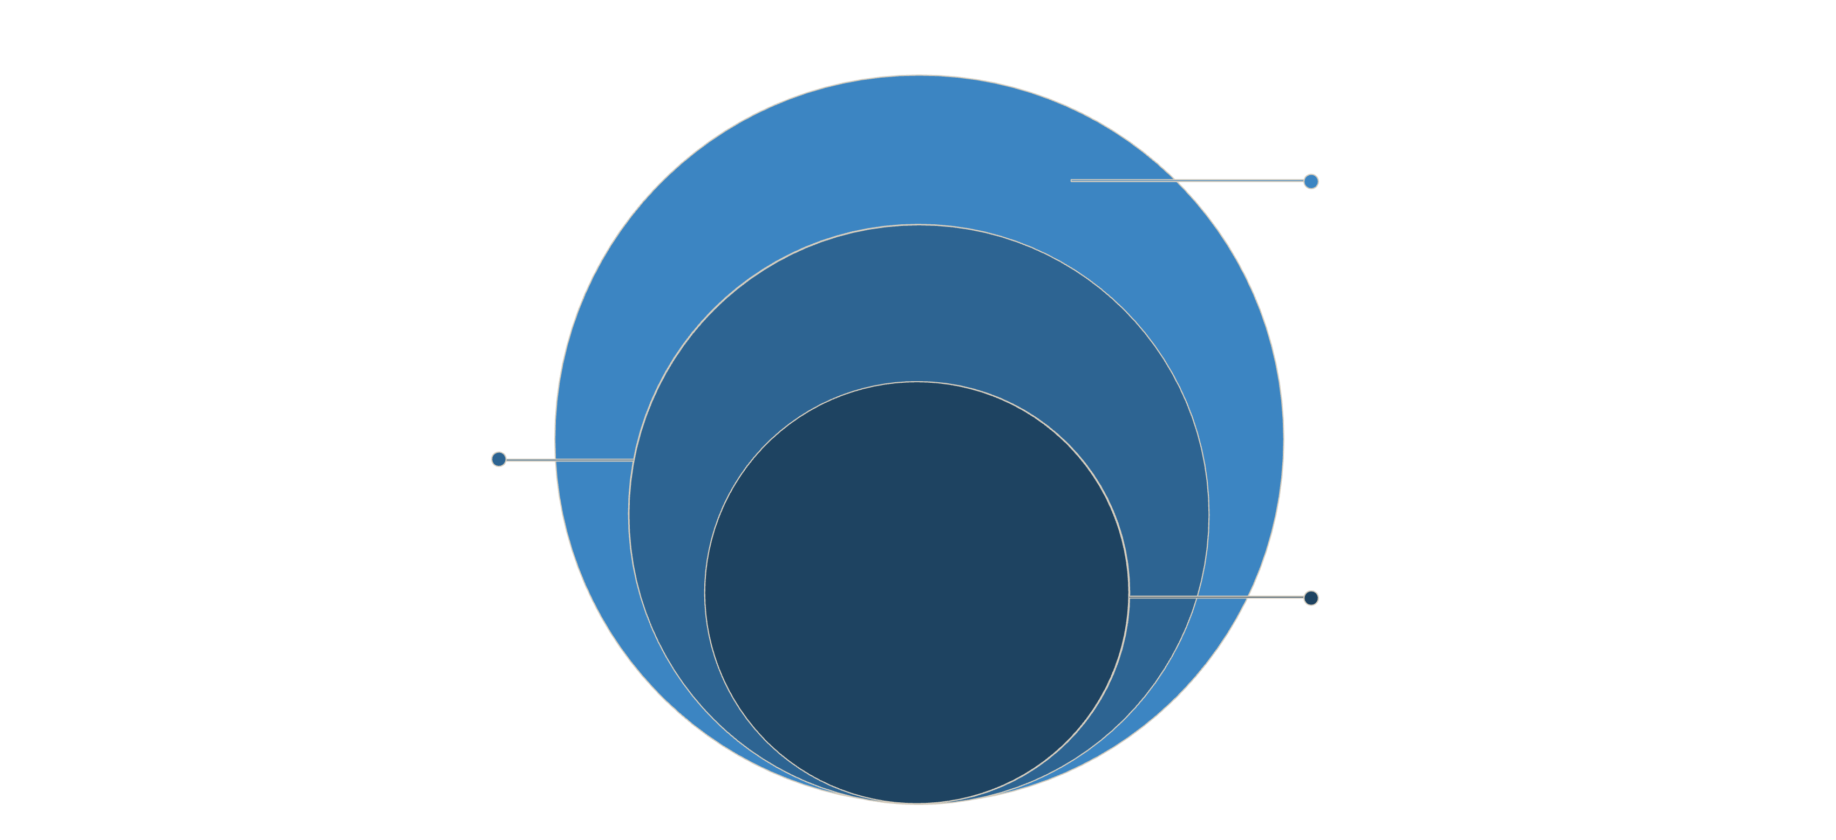
System Architecture
Alert & Reporting
Thresholds, notifications, CSV export
Monitoring Engine
Ping, TCP checks, latency measurement
GUI Layer
User interface, dashboard, controls

Slide 4
Features & Functionalities
Real-Time Monitoring
TCP Port Checking
Continuous host status checks with live visual feedback on the dashboard.
Validates service availability on specified ports (HTTP, SSH, FTP, etc.).
Automated Alerts
Latency Measurement
Instant on-screen alerts triggered when latency or availability thresholds are breached.
Round-trip time measurement logged per host for performance trending.
CSV Report Export
Dashboard Visualization
Structured export of monitoring logs for offline
analysis and auditing.
Unified GUI with status indicators, alert history,
and host summaries.

Slide 5
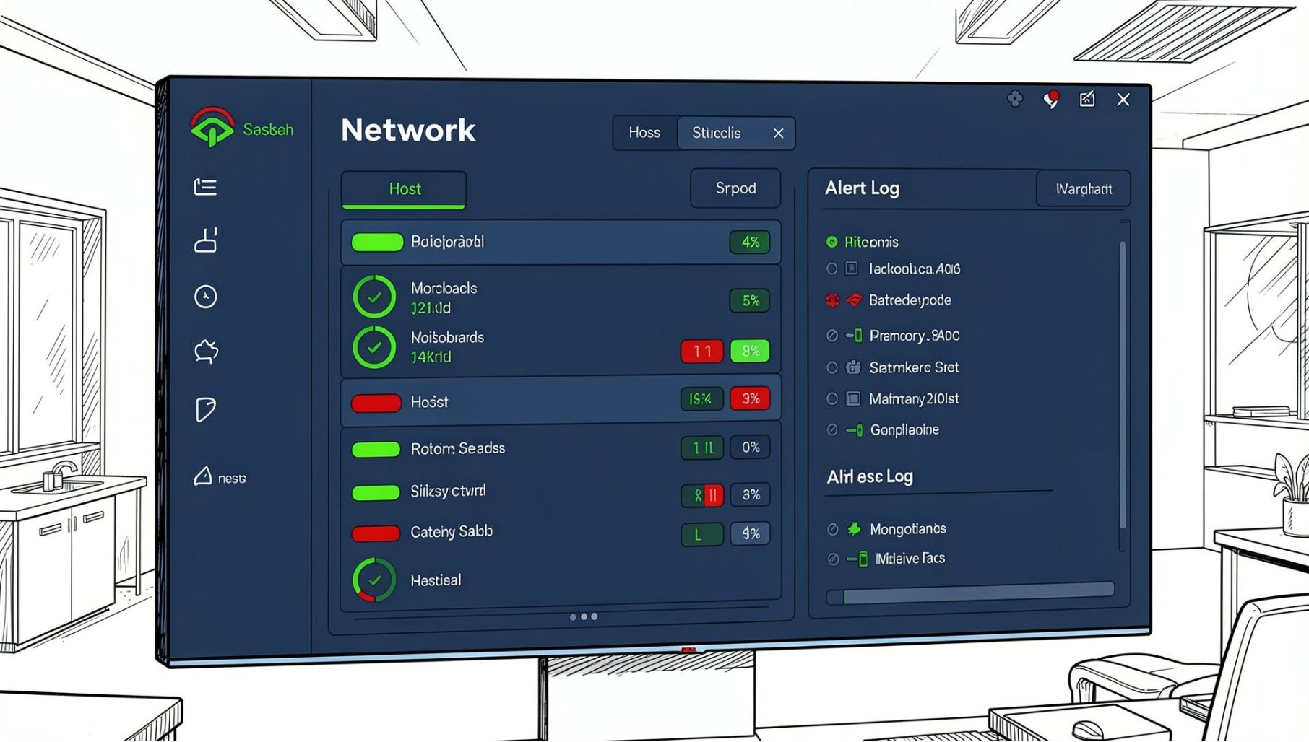
Dashboard Walkthrough
1
2
Dashboard Overview
Alert Log Panel
Timestamped alert history with severity levels and host details.
Host list with live status icons, latency values, and port indicators.
3
4
Monitoring Status
Project Info Page
Color-coded states: Online (green), Warning (yellow), Down (red).
Student details, course info, and system version displayed in-app.

Slide 6
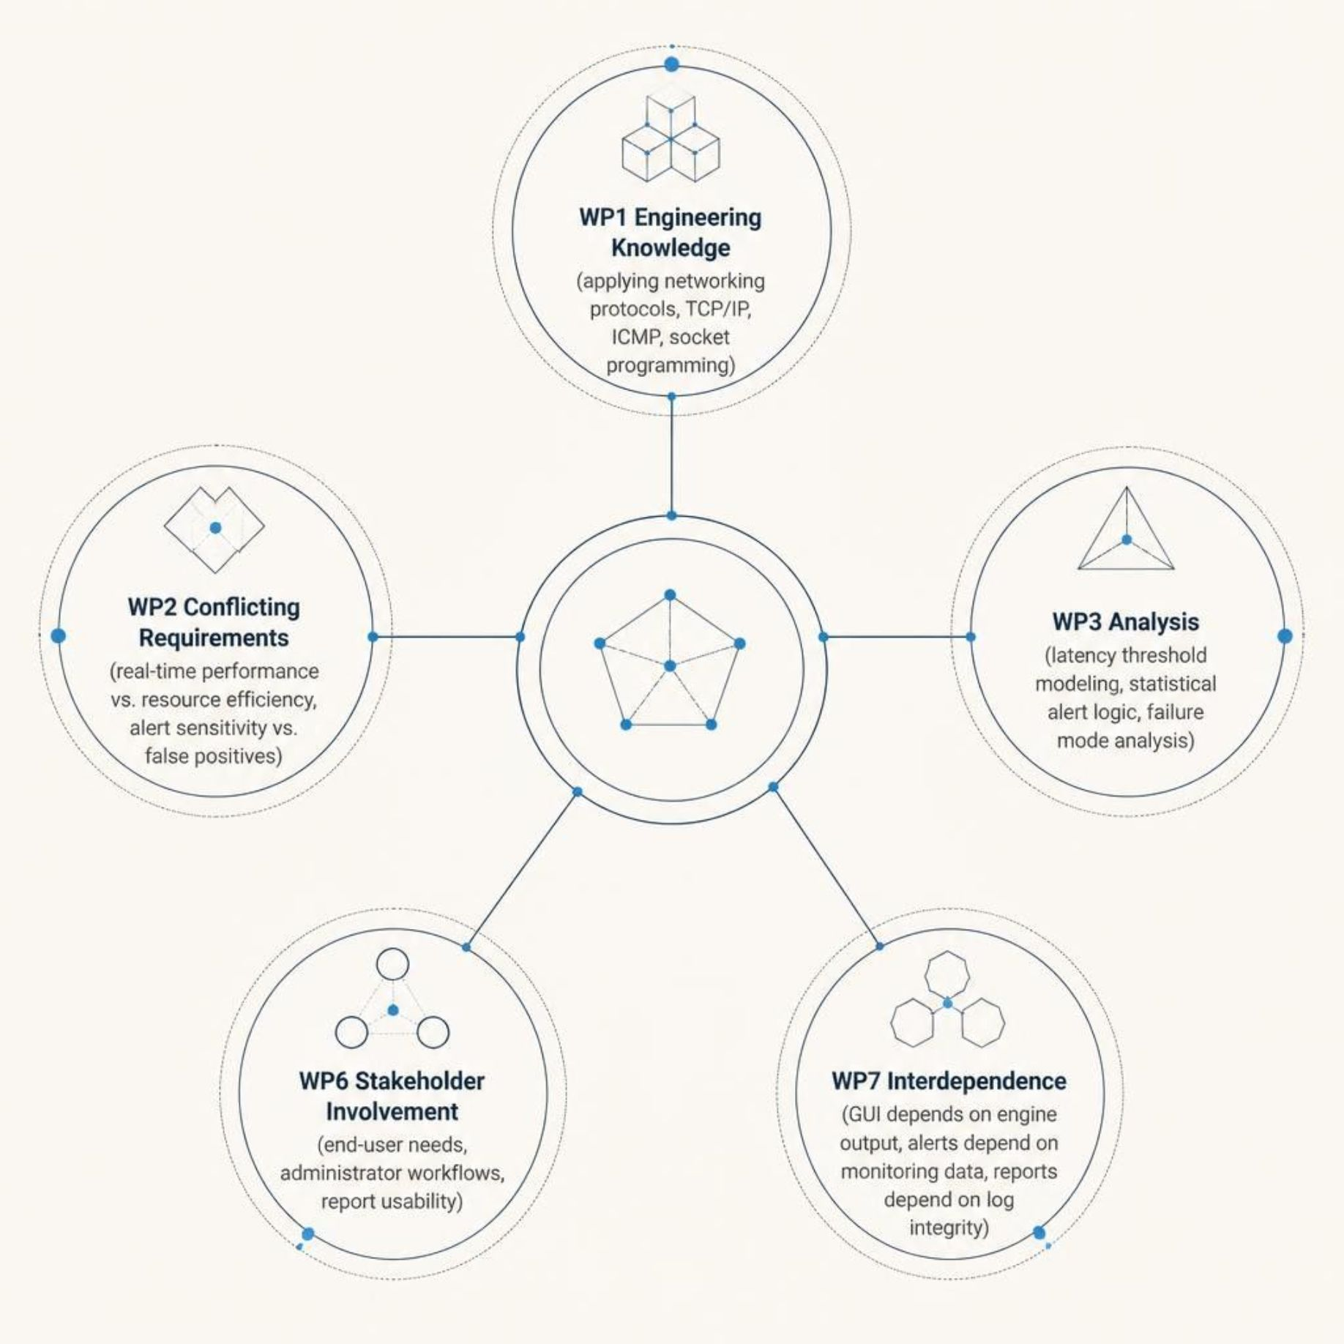
Engineering Problem Analysis

Slide 7

Achievements
✅ Delivered
Fully functional GUI-based monitoring system
Real-time TCP port and latency checks
Automated alert engine with threshold logic
CSV report export and alert logging

Slide 8

Future Scope
🔮 Future Enhancements
AI-based anomaly detection using ML models
Email and SMS alert integration
Cloud-based distributed monitoring
Historical trend analysis and visualization

Slide 9

Thank You

