Slide 1
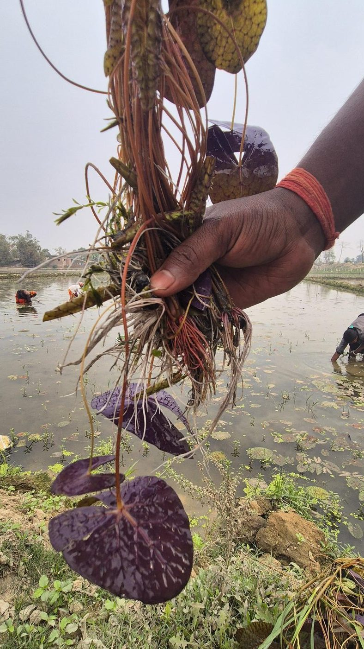


ISB CGMO COHORT II · BUSINESS LEADERSHIP CHALLENGE
DeHaat Honest Farms:
Category Creation & Scale Acceleration
Verified in the fields. Honest on the shelves.
TEAM 1
Sabika Mirza · Sharon Batliwalla · Syed Kashif Ali · Sonu Adarsh · Abhishek Nandan

Slide 2
THE MANDATE
Scale DHF from ₹53 Cr (FY26) to ₹300+ Cr in three years.
Not by outspending organic, but by creating and owning a category that does not yet formally exist.
PHASE 1
PHASE 2
PHASE 3
PHASE 4
DIAGNOSE & DECODE
CATEGORY & BRAND STRATEGY
GROWTH ENGINE DESIGN
SCALE BLUEPRINT
Build a shared, fact-based understanding of category, competition & consumer
Define what DHF must own in the mind of the consumers
Decide where to play and how to win – the moat
Build a sustainable, funded path to growth
Category & consumer insight base
Trust tension map + segmentation
Imitation risk heatmap
Internal diagnosis snapshot
Category creation framework
Positioning & Brand Architecture
Proof hierarchy
Codified Pesticide-Free standard
Top growth drivers
Hero SKU list (10–15 SKUs)
Channel role matrix
Competitive defense playbook
5-year growth ambition
Investment & capital roadmap
Category Rulebook & governance
Operating model + KPI framework
THE EVIDENCE BASE
305
31+
₹90.9 Cr
4
Respondents for Quantitative survey. 5 metros · Fielded 28–29 May 2026, by 1Lattice
Qualitative respondents
6 cities · intercepts, IDIs, ethnography
Internal revenue audited
4,365 MT · 8 half-years · 8 channels
Competitors benchmarked
11 DHF advantages stress-tested
THE MANDATE
01

Slide 3
THE CATEGORY
A ₹48,000 Cr Category with No Definition, No Standard, and No Owner.
The whitespace is regulatory and semantic, not just commercial.
84%
35.9%
2.8%
$8.6B → $22B
Indian consumers are extremely or very concerned about food safety (PwC Voice of the Consumer 2025)
Share of monitored samples with detectable residues, up from 22.6% in 2018–19
Of 86,401 FSSAI samples tested 2022–25 breached maximum residue limits
India organic food, 2024 → 2033 (CAGR ~11%)
SIZING THE PESTICIDE-FREE OPPORTUNITY
WHY THE CATEGORY HAS NOT FORMED YET
TAM
₹48,000 Cr
Pesticide-free food across the top 300 cities. Anchored to Technopak's 5–6% organic-of-packaged-food potential (₹35,000 Cr), uplifted 1.3–1.5× because pesticide-free prices below organic.
01
No standard definition, "pesticide-free" is not a regulated term in India
02
Harder to prove than to claim; proof lives in back-end systems, not on pack
SAM
₹13,500 Cr
A 28% serviceability factor: staples, pulses, rice, spices and select value-added, sold through quick commerce, e-commerce and modern trade to ~25 Mn health-conscious households.
03
Awkward economics; trust-led cost structure at a mass-premium price
04
No player has codified or defended it; the term commoditizes before standards exist
SOM
₹300–350 Cr
The three-year ambition — 2.2–2.6% of SAM, 0.6–0.7% of TAM. Five-year aspiration ₹700–800 Cr.
DEMAND IS REAL. BELIEF IS THE BOTTLENECK.
Indian shoppers will pay ~20% more for low-impact products — the highest of 11 countries surveyed; yet ~60% fear greenwashing and only ~29% trust corporate environmental claims.
THE CATEGORY
Source: *Technopak Report 2022-23
02

Slide 4
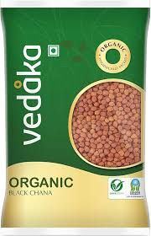
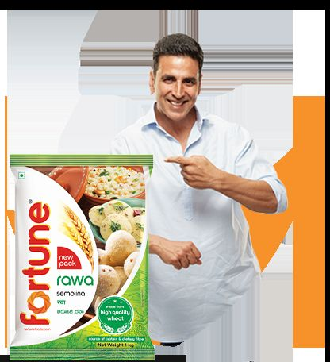
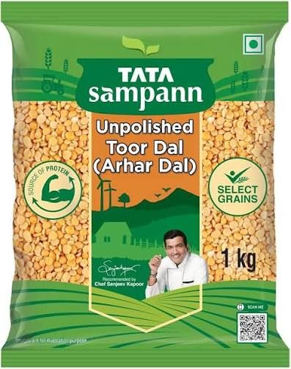
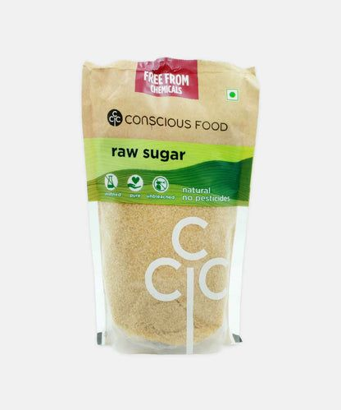
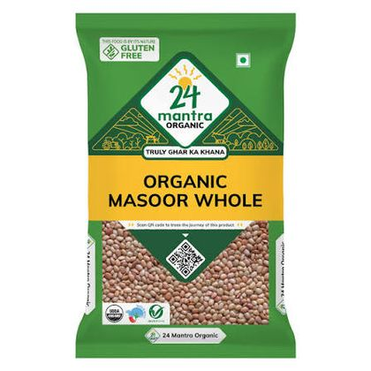
THE SHELF
Category Structure: Laddering on pricing & claims
RETAILER & REGIONAL PRIVATE LABEL
CONVENTIONAL NATIONAL PACKAGED
NATURAL OR NUTRITION-LED
CLEAN-LABEL / PROVENANCE CHALLENGERS
CERTIFIED ORGANIC SPECIALISTS
Retailer QA and lab testing.
Factory & FSSAI process credibility.
Process + Nutrition + Brand Legacy.
Sourcing stories.
NPOP/NOP certification + traceability.
No Ownable Narrative
Trust Story shallow, easily copied.
Natural reads wholesome, Not Safer.
Premium, fragmented, No Mass Trust Code.
Structurally higher price ladder; Scale Friction.
THE PRICE LADDER: TOOR DAL, ₹ / KG
₹306
ACCESSIBLE-PREMIUM · ₹150–250 / KG
₹255
₹257
₹136
₹145
₹156
₹157
Vedaka
(private label)
Fortune
Tata Sampann
BB Royal
Organic
Organic Tattva
Tata Sampann
Organic
24 Mantra
Organic
THE CATEGORY
03

Slide 5
THE PROOF BENCHMARK
Proof & Claims Benchmarking
WHO CAN ACTUALLY SHOW THEIR WORK
Organic Tattva
24 Mantra (ITC)
Tata Sampann
Organic India (Tata)
DeHaat Honest Farms
QR: YES
QR: NO
QR: NO
QR: NO
QR: GAP
250-parameter farm-level residue test, QR on every pack to the batch report. The category benchmark.
EU + USDA + NPOP certification, 1.4 lakh acres, 27,500 farmers. Logos are the proof — no consumer-facing test report.
Brand trust plus an "unpolished" visual cue and a celebrity anchor. No public batch-level residue disclosure.
Certification-heavy — USDA, EU, NPOP, Kosher — across 35+ export markets. Logos, not data.
230+ pesticide checks, batch-level testing, failing lots rejected. All of it invisible to the shopper.
IMITATION RISK: MONTHS TO COPY
MESSAGING CONSISTENCY, SCORED*
Pesticide-Free label claim
already copied
Tata Sampann
9/10
200+ SKU breadth
3–6 months
Organic Tattva
8/10
Quick-commerce presence
6–12 months
230+ quality checkpoints
12–18 months
Organic India
7/10
QR batch traceability
12–18 months
24 Mantra
6/10
Farm-level residue testing
18–24 months
Curated 5,000-farmer cohort
24–36 months
24 Mantra 6/10 — expected to reach 9/10 within 12 to 18 months of ITC integration.
Farmer margin model
3–5 years
DeHaat agritech input control
5+ years
THE CATEGORY
Source: *Technopak Report 2022-23
04

Slide 6
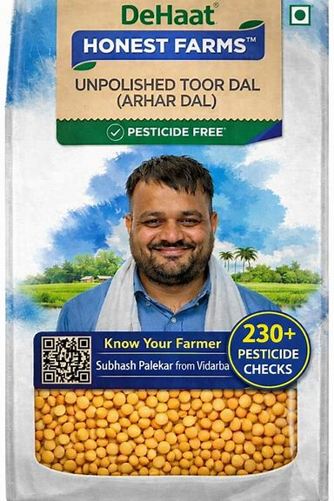
UNTAPPED OPPORTUNITY
DeHaat Honest Farms: A Pesticide-free, System-led Challenger.
UNTAPPED OPPORTUNITY FOR DEHAAT HONEST FARMS.
01
AgriTech-embedded input control
We prevent pesticide use at source, rather than testing for it afterward
CURRENT UTILIZATION IN BRAND COMMUNICATION: NEAR ZERO
02
Continuous quality intelligence across 2M farms
Quality trajectory is known before harvest, not after rejection
CURRENT UTILIZATION IN BRAND COMMUNICATION: ZERO
03
Farmer economic ecosystem
Priced as Accessible - Premium @ ₹150 – ₹250 / kg (Tur Daal for instance)
Supply exclusivity earned through 30 to 50% better farmer returns
Value and mainstream brands sit at ₹136/- to 157/-; certified organic sits at ₹255/- to 306/-.
The corridor between them is empty of trust codes and is already being squeezed from below by BB Royal Organic at ₹157/-.
CURRENT UTILIZATION IN BRAND COMMUNICATION: MINIMAL
Proof comes from controlling procurement and processing, not from holding a certificate. No brand occupies it today, and DHF's own Shelf Price is inconsistent across platforms.
THE CATEGORY
05

Slide 7
QUALITATIVE RESEARCH BY THE TEAM · 31 RESPONDENTS ACROSS 6 CITIES
Scope for education on the Pesticide-Free Category
70%
100%
0%
of in-market shoppers could not distinguish "organic" from "pesticide-free"
cited health of self & family as their primary food purchase driver
connected the word "pure" to pesticide residue — a language gap, not an interest gap
FOUR TENSIONS BENEATH THE CATEGORY
IN THEIR OWN WORDS
01 Conceptual fog, not an information gap
“Pesticides are sometimes put in soil, not on fruits. This makes them pesticide-free.”
Consumers do not merely lack information — they hold incorrect information that feels correct
In-market intercept, Bengaluru
02 Adulteration fatalism
“There is no such thing as Pesticide-Free. We have done enough research.”
73% agree some adulteration is unavoidable. The risk is known and quietly accepted – example highest in chilli
In-market intercept, Bengaluru
03 Bodily proof beats label proof
“Pesticide-free means no use of pesticides at any stage of the lifecycle of the produce.”
Confidence comes from energy, weight, blood work of self and family members
Organic farmer, Hyderabad — the most accurate definition in the sample
04 Assumed safety in Makhana
“Testing information plays a very important role. Knowing the source and certifications matters most in rice and dal — they are staples.”
Believed to be "grown from lotus stems" and "processed like popcorn". Neither is accurate, and it is the only category with no residue conversation
Benifer Lewis, 45, Mumbai
THE CONSUMER
06

Slide 8
QUANTITATIVE RESEARCH BY 1LATTICE – COMMISSIONED BY DHF
How the survey was built, and who answered it
RESEARCH METHODOLOGY
CONSUMER PROFILES
~18 min
4 screens
78%
82%
63%
58%
50 questions across 10 topics and 4 food categories
Decision-maker role, purchase frequency, ≥2 of 4 categories, income — SEC D/E and sub-monthly buyers terminated
have a child under 12 and / or an elderly member at home
do the household grocery shopping entirely themselves
earn ₹1–2.5 Lakh per month
shop for groceries three or more times a week
15-item battery
2 trust grids
WHERE THEY SHOP (% USING, MULTI-SELECT)
Five-point Likert attitude statements, written for post-survey factor extraction
Six claims tested twice — once bare, once with an independent certificate attached
Blinkit
53%
Swiggy Instamart
43%
Kirana
41%
FIELDWORK & GOVERNANCE
BigBasket
34%
Online panel, fielded by 1Lattice, 28–29 May 2026. n=305 after quality screening. Report dated 12 June 2026.
Five metros: Delhi NCR 31% · Bengaluru 21% · Mumbai 17% · Ahmedabad 15% · Pune 15%.
Category bases: rice n=253 · tur dal n=241 · red chilli n=164 · makhana n=58.
Makhana is reported as directional only. Every segment claim in this deck rests on the full n=305 base, not on a category sub-base.
Amazon / JioMart
30%
Zepto
29%
Supermarkets
10%
A quick-commerce-first, metro sample: The exact cohort DHF already sells to, and the cohort that will decide whether the category forms and how it will shape.
THE CONSUMER
07

Slide 9
THE ANALYTICAL PIPELINE
Factor Analysis and K – Means on 15 Attitude Statements
1
2
3
4
5
305 × 15 matrix
Exploratory factor analysis
3 latent factors retained
K-means clustering (k=4)
4 archetypes
Every respondent scored on 15 five-point attitude statements
Principal-axis factoring with Varimax rotation
Eigenvalues 5.55 · 1.50 · 1.03 — cumulative variance 42.6%
Run on standardised factor scores, n_init = 20
Named, sized, and profiled on trigger, barrier and channel
ADEQUACY — BOTH TESTS PASSED BEFORE EXTRACTION
KMO
BARTLETT
SILHOUETTE
0.886
"meritorious"
p < 0.001
sphericity rejected
0.347
highest at k=4
THE THREE FACTORS — AND THEIR DEFINING STATEMENTS
F1 — SOCIAL & EXPERIENTIAL TRUST
F2 — SYSTEM DISTRUST & PREMIUM INTENT
F3 — PROOF-DEMANDING VIGILANCE
Trust is earned through people and events, not systems and symbols.
The system is corrupt, and I will pay to exit it. This is the financial engine of premium food brands.
I will check it myself. Show me the evidence.
Stopped buying after a news story
0.68
Factories cannot be genuinely clean
0.65
I will pay only if a test is shown
0.64
A doctor beats any pack logo
0.62
Some adulteration is unavoidable
0.50
I need to verify proof myself
0.60
I trust a farmer I know by name
0.59
I would pay 20–30% more
0.48
I can spot a genuine claim
0.55
I prefer smaller brands
0.53
The problem is proof, not cost
0.47
Cost blocks me from safer food
0.48
The statistics didn’t create these groups; they revealed groups already in the data. At k=3, Guardians and Trusters merge into one unusable segment.
THE CONSUMER
08

Slide 10
SEGMENTATION OUTPUT
Four Customer Segments emerged from Research
SEGMENT
N (%)
F1 SOCIAL
F2 DISTRUST
F3 VIGILANCE
TRUST IN CERT. CLAIM
WOULD PAY 11%+
Proof-Hungry Guardians
109 (36%)
+0.46
+0.47
+0.69
4.4 / 5
54%
Social Trusters
62 (20%)
+0.65
+0.17
−0.89
3.6 / 5
34%
Passive Defaulters
80 (26%)
−0.39
−1.05
−0.34
3.5 / 5
6%
System Fatalists
54 (18%)
−1.09
+0.41
+0.13
3.6 / 5
22%
Factor scores are standardized — 0 is the sample mean. Guardians are the only cluster positive on all three factors simultaneously.
PERCENTAGE OF SEGMENT WILLING TO PAY 11%+
THE TRUST WALL, NOT THE WALLET WALL
Roughly half of every category’s buyers say they would pay nothing extra — and give the reason: they do not trust the claims
44% sit inside a +10–20% corridor; only 5% accept 21–30%
Yet 60% say they would pay 20–30% more if someone they trusted had independently verified it. Stated willingness to pay under distrust is a floor, not a ceiling
54%
34%
22%
6%
PREMIUM WILLINGNESS DOES NOT TRACK INCOME.
Guardians
Trusters
Fatalists
Defaulters
It peaks in the ₹60K–1L band (71%) and falls to 32% in ₹1–1.5L. Geographically, it runs from Delhi NCR at 64% down to Ahmedabad at 33% — which makes Delhi NCR the launch market on belief, not on affluence.
THE CONSUMER
09

Slide 11
THE BUYER PERSONAS
The Buyer Personas
V
Vandana Iyer
M
Meera Nair
K
Karan Mehta
S
Sanjay Deshpande
THE VERIFIER · 36%
THE BELIEVER · 20%
THE CRUISE-CONTROLLER · 26%
THE SCEPTIC · 18%
PROOF-HUNGRY GUARDIAN
SOCIAL TRUSTER
PASSIVE DEFAULTER
SYSTEM FATALIST
“The word organic on a label means nothing to me anymore. Show me the actual test report for this batch and I'll happily pay more.”
“If my doctor and my sister both say it's good for the family, that's all the proof I need. I'm not going to scan codes and read reports.”
“Honestly, I just buy whatever brand I know that looks decent and isn't overpriced. Food safety isn't something I lose sleep over.”
“Every brand says it's pure. Adulteration is everywhere, and no factory is truly clean. Prove me wrong — but don't insult me with marketing.”
PROFILE
PROFILE
PROFILE
PROFILE
34–45 · postgraduate · senior professional · nuclear family with young children · ₹1.5–2.5L+/month · Tier-1 metro
30–50 · graduate · homemaker or teacher · joint or extended family · ₹1–1.5L/month · Tier-1 and Tier-2
26–38 · graduate · IT / sales / ops professional · DINK or small family · ₹80K–1.5L/month · heavy quick-commerce user
38–55 · graduate to postgraduate · senior professional or business owner · established family · Tier-1 and Tier-2
WHAT CONVERTS HER / HIM
WHAT CONVERTS HER / HIM
WHAT CONVERTS HER / HIM
WHAT CONVERTS HER / HIM
Batch-specific lab report by QR; "below detectable limits"; a specialist who has personally reviewed it
Doctor and dietitian endorsement; a trusted person already using it; warm, relatable word of mouth
Visible on the app he already uses; price parity with his usual brand; taste he notices
Unscripted farmer proof; independent, non-brand-paid verification; being shown what is imperfect
WHAT BLOCKS THE SALE
WHAT BLOCKS THE SALE
WHAT BLOCKS THE SALE
WHAT BLOCKS THE SALE
No way to verify independently; greenwashing fatigue; a scan, not a research project
Clinical, jargon-heavy messaging; conflicting opinions in her circle; nobody she trusts has vouched
Not stocked where he shops; a premium with no obvious reason; anything requiring effort to switch
Polished claims like everyone else's; certification with no visible teeth; anything that reads like a script
Guardians convert fast on facts. Trusters need a voice of assurance. Defaulters need shelf presence and price parity. Fatalists need to be shown the imperfections to win their trust.
THE CONSUMER
10

Slide 12
THE TARGETING DECISION
The targeting decision: Where to play first ?
PRIMARY
SECONDARY
DEFER
SEQUENCE LAST
36%
20%
26%
18%
Proof-Hungry Guardians
Social Trusters
Passive Defaulters
System Fatalists
Largest segment, highest willingness to pay, and the only one that responds to the proof DHF already generates.
Activated by the Guardians' verification becoming social proof. Doctor endorsement bridges both segments at once.
Proof-heavy messaging misfires. Capture cheaply in phase two, once the category feels default.
Smallest and hardest. Needs a separate radical-transparency, farmer / founder-direct playbook.
WHAT WOULD MAKE YOU TRY A NEW BRAND? (% NAMING IT THE SINGLE TOP DRIVER)
Doctor / child-specialist endorsement
44%
THE UNCOMFORTABLE FINDING
"Below detectable limits" + QR to lab report
27%
DHF leads with the claim only 6% find convincing and barely uses the endorsement 44% name first. Doctor endorsement wins in every segment. 55% of Trusters, 56% of Defaulters, 50% of Fatalists. Only Guardians rank the QR lab report first.
Farmer's name and village on pack
12%
Government certificate as the lead message
8%
"Tested for 200+ chemicals"
6%
THE LARGEST SEGMENT IS THE MOST VALUABLE
Farm-visit invitations
3%
Guardians are 36% of decision-makers but hold roughly 60% of all stated premium-rupee intent. They also do their own diligence, which means they generate the reviews, the doctor conversations and the proof trail that the next segment follows.
Side-by-side residue comparison vs rivals
1%
THE PLAY
Win Guardians with proof → convert their advocacy into the social proof that activates Trusters → ride the combined 56% into default category leadership.
THE CONSUMER
11

Slide 13
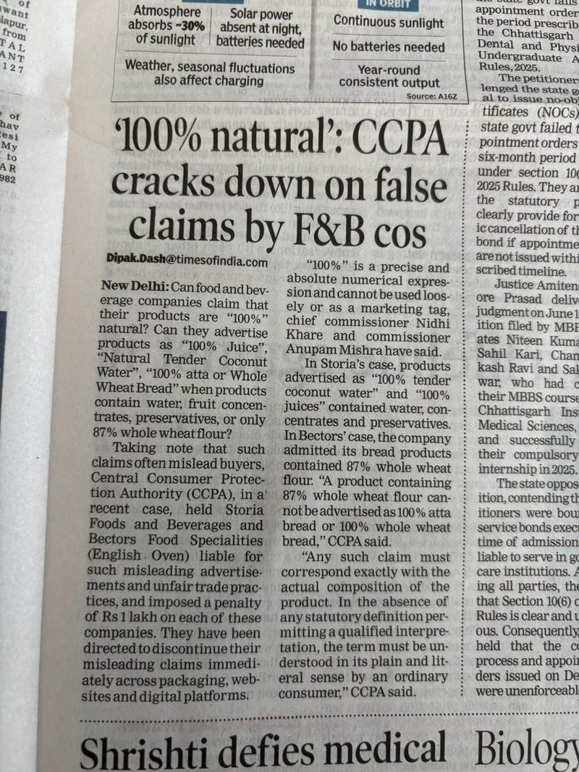
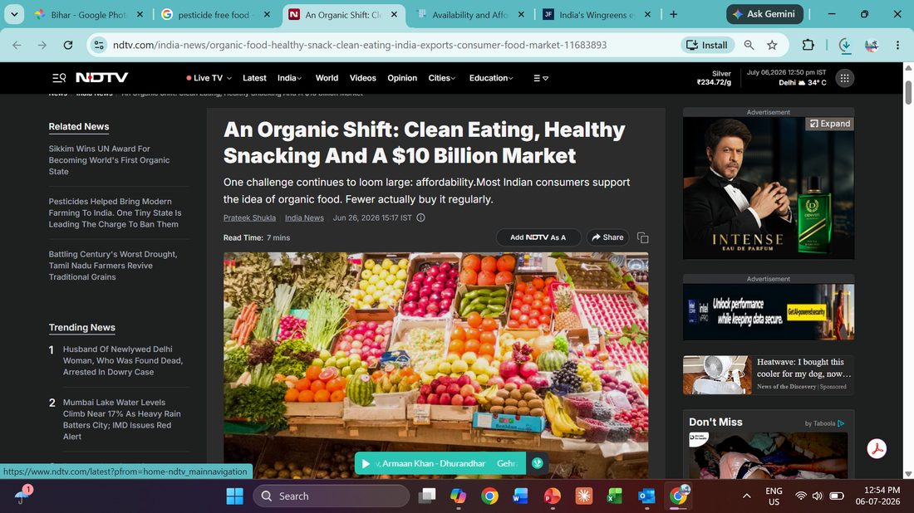
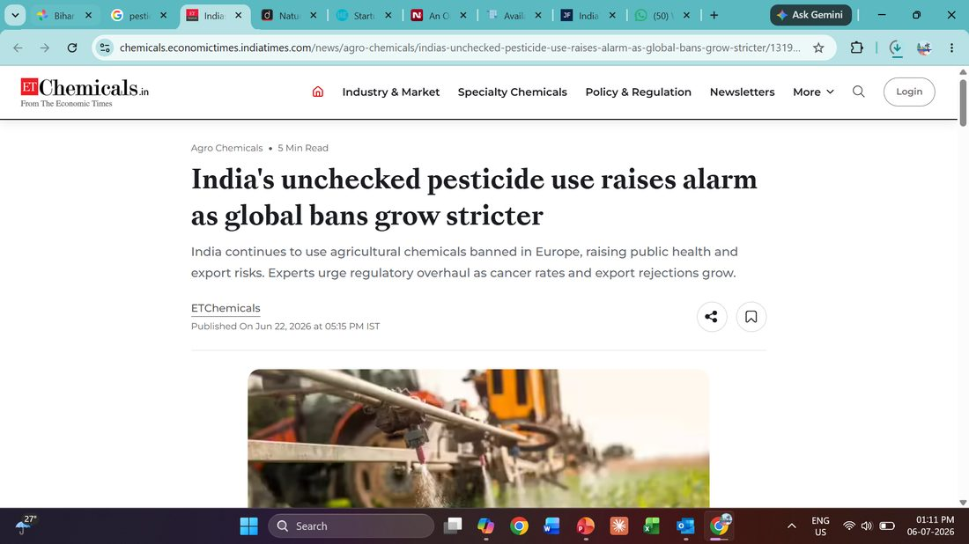
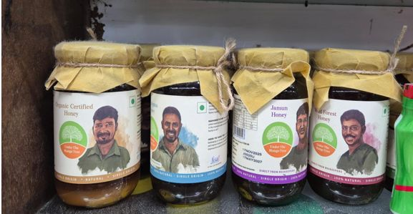
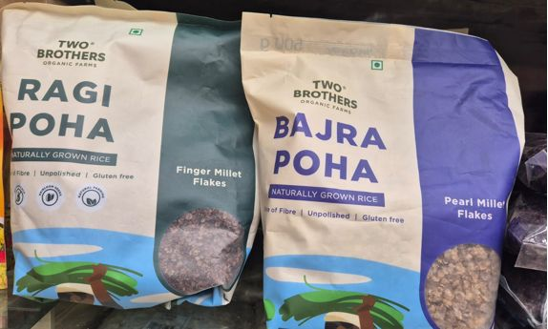
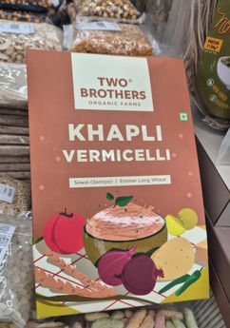
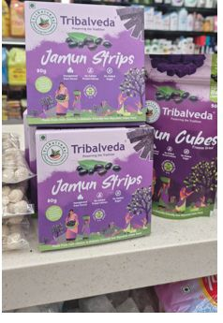
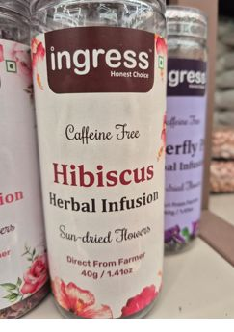
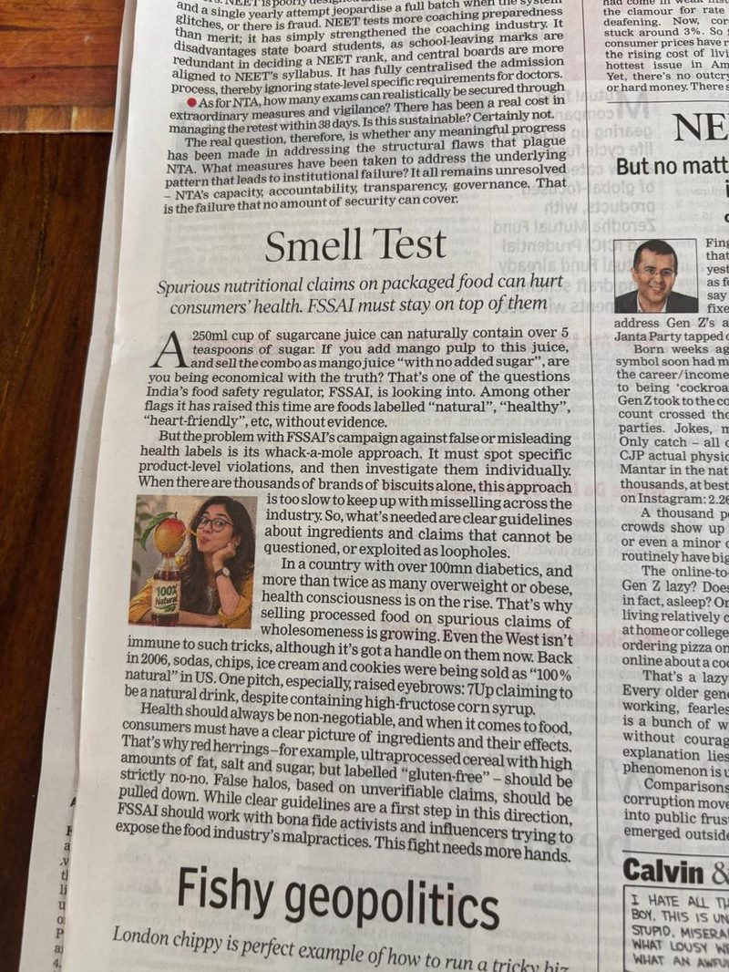
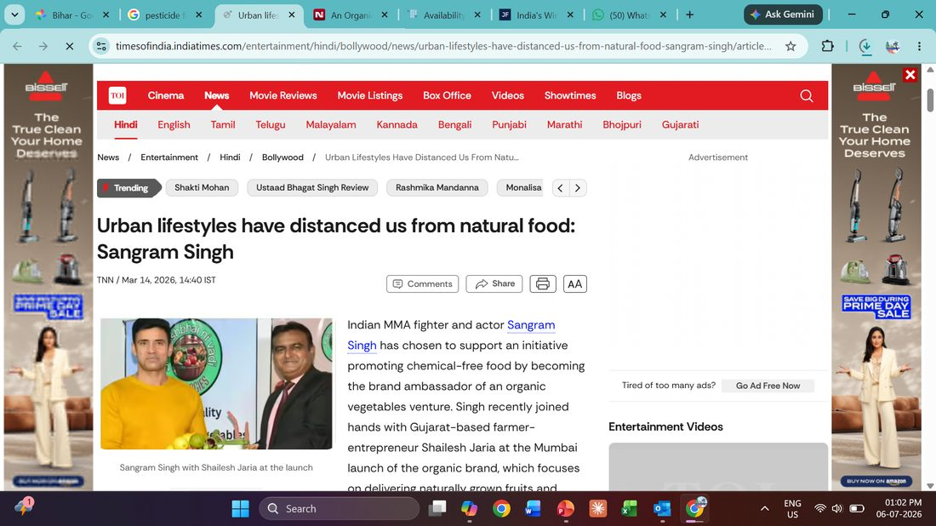
THE SHELF TODAY
With every shelf using a different, often unverifiable claim, generic language adds to the noise.
GT & MT SHELVES ARE FLOODED WITH CLAIMS, SENDING DIVERSE TRUST SIGNALS TO CONSUMERS
MEDIA IS BUILDING THE CASE FOR VERIFIED PROOF
Farmer-face labelling - personal provenance
‘Naturally grown’, ‘unpolished’
Certification seal on label
‘Direct from farmer’
100% Natural
Regulatory crackdown
Market growth, affordability gap
Celebrity & consumer validation
DHF’s edge is a specific: Verifiable Proof Mechanism (QR + Test Data), not another claim in the pile.
Policy & certification landscape
Pesticide safety alarm
BRAND & PROOF
12

Slide 14
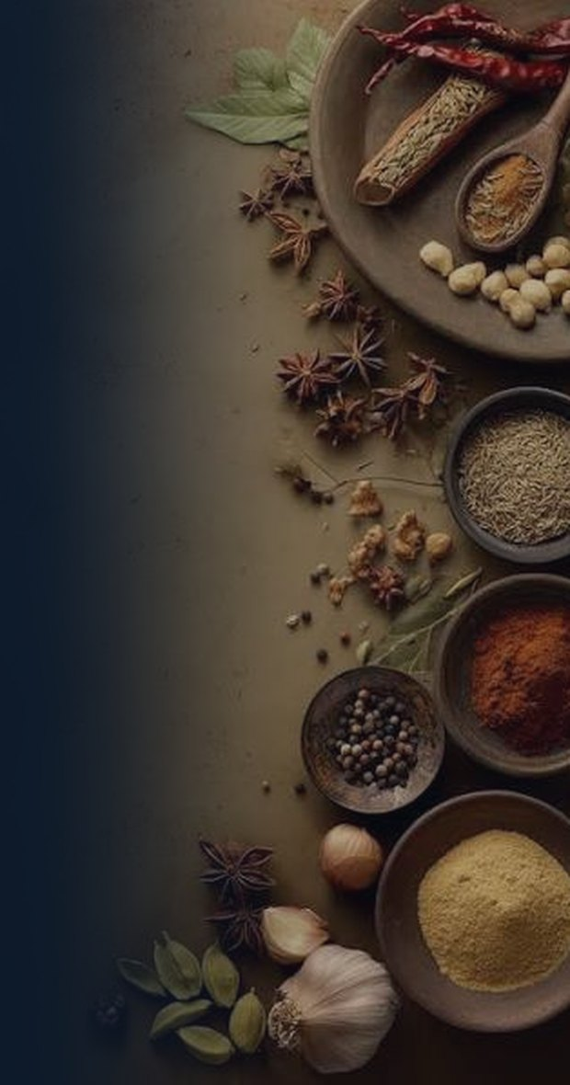
BRAND MANIFESTO
We believe
The future of food isn’t claimed on a label; it’s proven in the field. Every seed we recommend, every practice we track, and every farmer we name is how we turn honesty into something you can verify, not just believe.
WE STAND FOR
Resilience
Integrity
We meet uncertainty with patience and grit, learning from the land and adapting so farmers can thrive through seasons and shocks.
Transparency is a mechanism, not a promise to be broken. You can check batch data, farmer names, and practices. They are not the claims you’re asked to believe.
Simplicity
Progress
We turn complex agri-data into one clear signal, so our farmers can take confident actions, and consumers can trust what they see instantly.
Not progress for its own sake, but progress powered by DeHaat’s own agri-tech, in service of tradition, not instead of it.
Education and empowerment
Connection
We bridge Krishi wisdom and modern methods, so farming becomes more productive, profitable, and sustainable; inspiring young people to see agriculture as a modern opportunity.
The farmer isn’t a sourcing story we tell; they’re the name on the batch, accountable and credited. When farmers prosper, supply is reliable; when consumers can trace what they buy back to a real farm, honesty becomes provable, not just promised.
We are Honest Farms. Verified in the fields, Honest on the shelves.
BRAND & PROOF
13

Slide 15

BRAND PURPOSE
To nurture soil and skills, to do business honestly, and to prove it batch by batch, farmer by farmer.
BRAND & PROOF
14
Notes:
It’s a promise about the value you deliver to your customers.

Slide 16
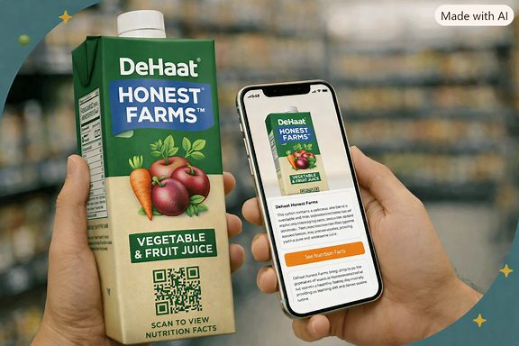
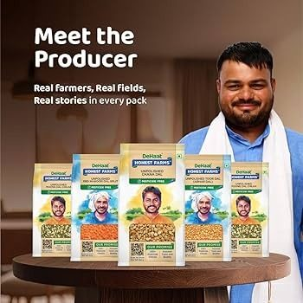
MAKING BACKEND AGRI-TECH RIGOR VISIBLE TO THE CONSUMERS
Flip the Script on QR Traceability: Farmers in the Spotlight
QR to farmer
Village / Farm clusters on pack
Scan the pack and land on a unique microsite of that farmer - know his village, harvest date, daily life, growth, consumer connects & download the Pesticide-Free Certificate.
Like most wine brands across the world, Bordeaux, Nice, Nashik, Napa Valley - Prove provenance.
Farmers as content creators
Hand-written Farmer Letters in pack
They play the lead role with unscripted reels, voice notes, and live harvest streams. Rougher, less polished than a typical ad, which is exactly what signals "real" to a sceptical buyer.
Rotating, handwritten-style notes from the actual farmer of that batch.
Farmers send audit invitation
Farmer-Led sampling
No need to give advance notice. Wins the prove me wrong archetype.
The farmers, not agency promoters, make demos at flea markets or housing societies to drive trials.
Consumer-to-farmer feedback loop
Get consumers to review the farmers and their fields’ produce, instead of the product purchased.
BRAND & PROOF
15
Notes:
4% → 22% full trust when the pesticide-free claim carries an independent certificate — a 5× uplift, the largest of any claim tested. The three layers together address the cognitive, institutional and "I can check it" needs at once.

Slide 17
POSITIONING
The only food brand in India that consumers verify, not just trust.
ROLE
WHAT THE PROMISE MEANS TO EACH STAKEHOLDER
An honest guide that leads with transparency, answers with proof, and never preaches.
FARMERS/FPO
Q-COMM, E-COMM & MTS
Dehaat trains Farmers for productivity, profitability and sustainability with simplified agri-tech data to give clear signals to consumers. Winning trust with no hidden stories, no shortcuts.
Made to win Honest Farms' brand trust by showing superiority in backend agri-tech, not just another category claim on apps/shelves.
BELIEF
Progress moves from seed to plate, and every hand that touches it is named, not hidden.
FUNCTIONAL BENEFIT:
EMOTIONAL BENEFIT:
EXPERIENTIAL BENEFIT:
Verified safety.
Relief.
Honest Progress with every basket,
CONSUMERS
EMPLOYEES
No detectable residue.
You're no longer the only one keeping watch.
from seed to plate.
Empowered to verify every batch, farmer, and agri practice before they add to cart and put food on the table.
Hire and train to demonstrate the spirit of progress - bringing Krishi wisdom and modern methods to make farming more productive, profitable, and sustainable.
PROMISE:
Verified in the fields, Honest on the shelves.
BRAND & PROOF
16

Slide 18
THE NORTH STAR
Be the only food brand in India that consumers verify, not just trust.
HOW DO WE MEASURE SUCCESS?
Verified Purchase Rate — the % of purchases where a consumer engages a real proof point (batch QR scan, farmer profile, lab report) before or after buying the product.
V
M
K
S
Vandana - The Verifier
Meera - The Believer
Karan - The Cruise Controller
Sanjay - The Sceptic
Scans the batch QR; visits the microsite to engage with farmers
Confirms it with her doctor or her circle of influence
Notices it’s on his app already; repeat-buys anyway
Watches unscripted farm content; takes up an audit invite from the farmer
Revenue and share are outcomes. Verified Purchase Rate is the lever that sales, product, and marketing teams continuously optimize.
BRAND & PROOF
17
Notes:
It is the only metric that goes down if the proof mechanism breaks — brand awareness would not. It is measurable from day one, without a tracker study: scans, microsite sessions, report downloads, audit sign-ups. It is the one number a professor, a retailer and a farmer would all read the same way. Karan counts as verified without ever scanning — someone else’s verification is what put the product in front of him. That is how a category becomes the default.

Slide 19
PROOF ARCHITECTURE
One standard, four communication deliveries
Vandana — The Verifier
Meera — The Believer
Karan — The Cruise-Controller
Sanjay — The Sceptic
PROOF-HUNGRY GUARDIANS · 36%
SOCIAL TRUSTERS · 20%
PASSIVE DEFAULTERS · 26%
SYSTEM FATALISTS · 18%
“Scan the pack. See exactly what's inside.”
“Ask your doctor. Then ask your sister. They've approved us.”
“Same taste. Same price. Honestly, better choice.”
“We'll show you the parts no brand talks about.”
THE MECHANISM
THE MECHANISM
THE MECHANISM
THE MECHANISM
QR to the batch-level lab report and the farmer
Doctor or dietitian citation on pack, beside the farmer's view
Certification carrying a live verification link
Doctor and dietitian partnership programme
Referral incentive for existing customers
Testimonials from families she recognises
Priority placement in quick-commerce search
Price parity with the brand he already buys
Taste-forward sampling, never health-forward
Unscripted farmer and founder video content
Open invitations to audit or visit the farm
Independent verification nobody paid for
CHANNEL
CHANNEL
CHANNEL
CHANNEL
QR code · D2C · Modern trade
Clinic tie-ups · Community WhatsApp · WOM
Quick commerce · Modern trade endcaps
Farmer-direct platforms · Founder-led content
CONVERSION SPEED
CONVERSION SPEED
CONVERSION SPEED
CONVERSION SPEED
Fast, once proof is visible. She does her own diligence.
Medium. Needs one or two trusted validators, then sticks.
Fast to trial, low loyalty. Needs habitual reinforcement.
Slowest — but becomes a vocal advocate once earned.
TRUST IS MULTI-DIMENSIONAL FOR EACH ARCHETYPE
Vandana
Meera
Karan
Sanjay
Trust lever
Verified data (QR + lab)
Human endorsement
Familiarity, shelf presence
Radical transparency
Price perception
Premium OK, with proof
Modest premium if endorsed
Expects price parity
Suspicious of any premium
Key to win
Batch proof + doctor review
Get her circle to vouch
Be visible and taste-led
Show the imperfect parts
BRAND & PROOF
18

Slide 20
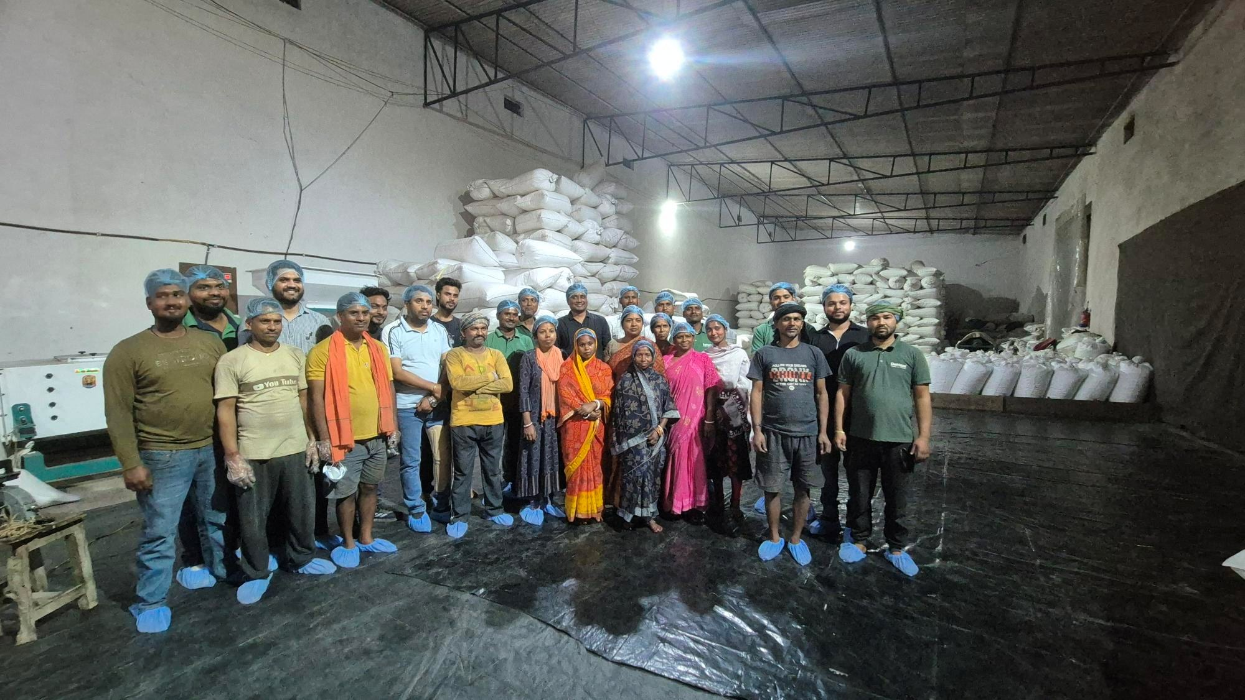
WAREHOUSE
Laying the Foundation For Growth over the next 5 years

Slide 21
INTERNAL DIAGNOSIS
DHFs Strategy says accessible - premium food brand. Portfolio says commodities.
₹90.9 Cr
+219%
24%
~33%
Cumulative revenue audited across eight half-years; FY26 ≈ ₹53 Cr, up ~30% YoY
Growth of the value-added block (makhana, jaggery, honey) = 29% of revenue, the real engine
Of revenue from a single account, Zepto — and one rupee in four is at platform mercy
Of revenue (≈₹30 Cr) has no channel attribution at all
PORTFOLIO MIX VS PORTFOLIO GROWTH (CUMULATIVE ₹ CR, GROWTH %)
THREE TENSION POINTS THAT DECIDE THE STRATEGY
Pulses · 56% of revenue
₹50.4 Cr · +113%
01 Revenue is anchored in the slowest-growing, lowest-margin block.
Pulses are 56% of revenue and grow below the portfolio average.
Value-Added · 29%
₹26.0 Cr · +219%
02 Realization is falling while volume rises.
Spices · 12%
₹10.9 Cr · +185%
Revenue per MT fell 4.3% in FY26-H2; a margin warning masked by tonnage.
Oil & Ghee · 1%
₹0.8 Cr · NPD
03 Proof is asserted, not demonstrated.
Seven simultaneous taglines, no hierarchy, and "230+ quality checks" stated but never explained.
THE GROWTH ENGINE
20

Slide 22
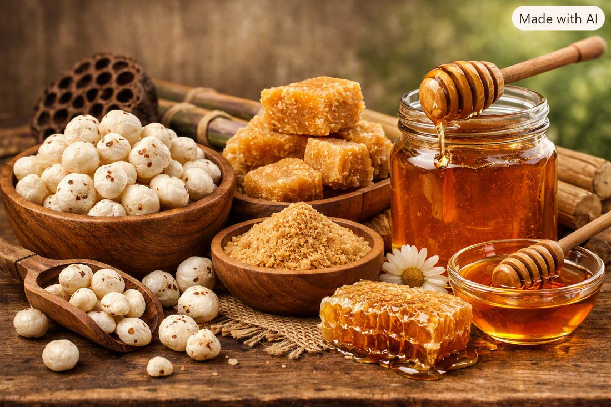
THE GROWTH AMBITION
₹53 Cr today. ₹748 Cr by FY31.
Where to sell it. What to sell. What it costs.
NET REVENUE, ₹ CR
14.1×
On the FY26 base of ₹53 cr
₹748
64%
Net revenue CAGR, FY27 to FY31
₹450
+5.8pp
₹274
Gross margin, 37.5% → 43.3%
₹168
₹104
₹53
FY26
FY27
FY28
FY29
FY30
FY31
THE GROWTH ENGINE
21

Slide 23
PORTFOLIO DESIGN
Spices carry the margin.
REVENUE BY CATEGORY, ₹ CR — FY27 VS FY31
11.2×
₹228
Spices, FY27 → FY31. Mix moves from 17% to 27% of revenue, at 51–58% gross margin.
₹202
₹169
₹99.9 Cr
Makhana — the single largest SKU in the FY31 plan, and a realisation play, not a tonnage play.
₹120
₹95.5 Cr
From four ground spice powders that do not exist today. Pure NPD, from a zero base.
₹43
₹32
₹30
₹18
₹9
₹2
Pulses hold the volume base. Spices deliver the entire +5.8pp of margin expansion. So, a slipped spice launch is a slipped P&L.
Pulses
Spices
Value-Added
Oil & Ghee
Processed
FY27
FY31
THE GROWTH ENGINE
22

Slide 24
THE DISTRIBUTION ROADMAP
Earn the shelf. Then densify it.
22,628
110
40%
selling points by FY31, from 1,672 today
offline cities, from 22 today
the ceiling on any single channel's share of revenue
CHANNEL MIX AT FY31, ₹ CR
THE SEQUENCE
1
Earn the metro shelf
E-commerce & quick commerce
₹304 Cr
Regional & premium offline
₹263 Cr
2
Ride quick commerce into Tier 2 & 3
National modern trade
₹129 Cr
Convert regional chains, state by state
3
Exports
₹54 Cr
4
Densify what is already open
No single channel above 40% — the ceiling is what stops the plan becoming a bet on one platform.
13.5× the selling points at 5× the revenue. The plan does not need better stores, it needs more of them, faster than the dilution.
THE GROWTH ENGINE
23

Slide 25

COMPETITIVE DEFENCE
What DHF controls, and how defensible it is.
10 Mn+
8
230+
THE MOAT HAS TO BE VISIBLE BY FY29
L4
Farmer-direct transparency
STRUCTURAL
Farmers on the
Dehaat network
Sourcing clusters
owned end to end
Pesticide checks
On every batch
L3
DeHaat input control
5.5 YRS TO COPY
We don't test the harvest. We control the input.
THE FIVE STEPS BEHIND THE CLAIM
L2
NPOP certification
PARITY
1
2
3
4
5
L1
QR to the batch lab report
1.2 YRS TO COPY
Clean
cultivation
Direct
sourcing
230+
checks
Controlled
processing
Traceable
to source
L0
A label claim
0.3 YRS TO COPY
BIHAR MAKHANA · UTTARAKHAND JAGGERY · GUJARAT JAVA PEANUT · AND FIVE MORE, OWNED END-TO-END
DHF sits at L1. Only L3 and L4 survive imitation.
The only asset that cannot be bought inside five years. ITC bought 24 Mantra; Wingreens bought Safe Harvest — DHF has roughly two years to build, certify and make this moat consumer-visible before ₹274 Cr makes it worth attacking.
THE MOAT & THE ASK
24

Slide 26
THE SCALE BLUEPRINT
₹105 Cr buys breakeven by FY29
FY27
FY28
FY29
THE FUNDING ASK
₹105 Cr
REVENUE
104
168
274
INVESTABLE MARGIN
27.6
50.2
86.6
Operating losses
20.3
Capex
29.5
EBITDA
−12.4
−7.9
+4.7
Working capital
37.3
Investment intensity falls from 38% to 30% of revenue. Breakeven is not efficiency — it is the same rupees over more revenue.
Contingency
17.4
Below every comparable in the set.
DHF clears breakeven at ₹274 Cr only because a 43.1% gross margin buys ₹38 Cr that Farmley's 29% does not.
No Indian clean-label brand between ₹75 and ₹400 Cr is EBITDA-positive today.
22 → 98
People, FY26 to FY29, across six functions. Revenue per head reaches ₹2.80 cr.
THE MOAT & THE ASK
25

Slide 27



CATEGORY LEADERSHIP
Open the category to make it a Proprietary Eponym
A category only becomes large if others are allowed in. DeHaat Honest Farms wins not by owning the words, but by owning the standard, the proof, and the relevance in consumers’ lives.
01
02
03
EDUCATE WHAT PESTICIDE-FREE MEANS
OUT-PROOF EVERYONE: CERTIFICATION VISIBLE
VERTICAL SOURCING CONTROL: FARM TO FORK
Pesticide-free call-out with QR to the farmer, carrying the Jaivik Bharat logo, on the front of pack
Invite parents, teachers and children to the farm to see the process and meet the farmers
Bring the 56% core audience into cook-off sessions after the visit; give the 18% sceptics firsthand access
Webinars and podcasts led by the farmers and doctors — the two voices the research says are believed
On-ground activation in schools and colleges, and with GPs, gastro specialists and nutritionists. Catch them young
Quick-commerce platforms like Zepto, Amazon — showcase the Pesticide-Free certificate for every product, on the app (Like Nykaa)
The copycat test: when an incumbent prints "Pesticide-free", DeHaat Honest Farms asks publicly ” Where is the batch certificate?”
Own the input decision, not just the output test. Control at sowing is what a competitor cannot contract for
Embed the brand in Indian routine until the habit forms: Think Pesticide-free, Think Honest Farms
GUARDRAILS FOR COMMUNICATION IN LINE WITH INDUSTRY BODIES
WHAT WE SAY
WHAT WE NEVER SAY
“Tested for 230+ pesticides. None Detected.”
“No detectable pesticide residue, verified batch by batch.”
“Independently lab-tested. Scan to see this batch’s report.”
“Stronger residue testing than the organic standard requires.”
“100% pesticide-free” — or any absolute.
“Chemical-free”, “toxin-free”, “100% pure”.
“Healthier than organic.”
Anything implying the product prevents disease.
Never win by attacking organic or conventional.
THE MOAT & THE ASK
26

Slide 28
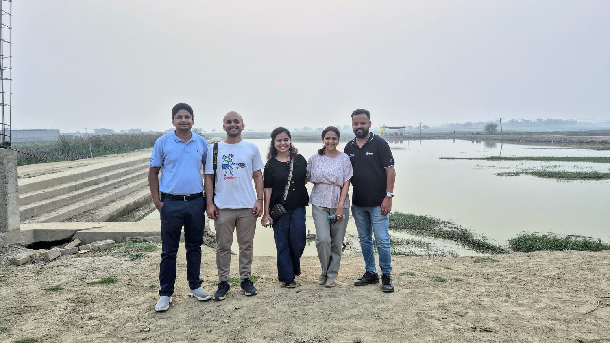


धन्यवाद
Verified in the fields. Honest on the shelves.

