Slide 1


TEAM CHANDRA
Urban Heat Island
Mitigation Simulation
GIET University,
Gunupur, Odisha
UHIMS
AI-Driven Urban Heat Island Mitigation Simulator
Presented By
TIRTHAPADA PANDA
ASHRITA BEHERA
SWAGATAM PRADHAN
RR HIMANSHU SEKHAR DAS

Slide 2
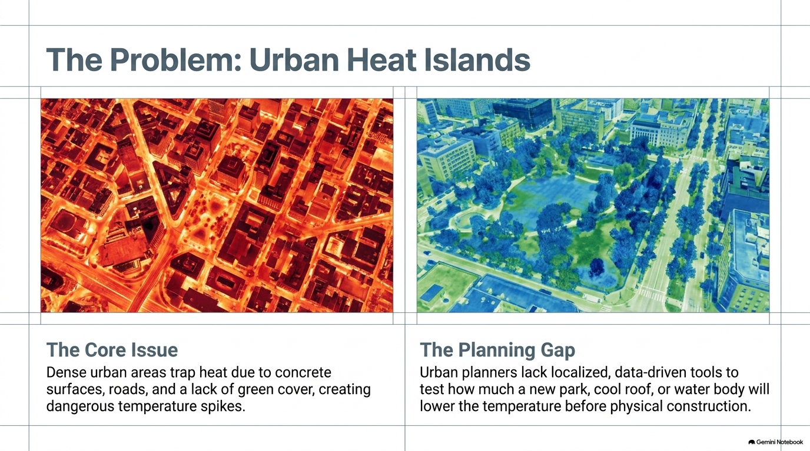
THE PROBLEM: URBAN HEAT ISLANDS
The Core Issue
Dense urban areas trap heat due to concreate surface, roads, and a lake of green cover, creating dangerous temperature spikes.
The Planning Gap
Urban planners lack localized, data –driven tools to test how much a new park, cool roof, or water body will lower the temperature before physical construction.
Urban Heat Island Mitigation Simulation | Team Chandra

Slide 3

THE IDEA
THE PROBLEM
OUR PROPOSED SOLUTION
High temperatures from buildings, roads & low vegetation.
Dense urban areas trap more heat.
Need localized, data-driven heat analysis.
Need to test mitigation strategies before implementation.
UHIMS
AI-Driven Urban Heat Island Mitigation Simulator
AI + Computer Vision + Geospatial Analysis + Simulation
CORE PIPELINE
Satellite Image
Urban feature extraction
Heat Prediction
Mitigation
Recommendation
Simulation &
Optimization
THE INNOVATION
Detects heat sources and urban patterns.
Recommends targeted cooling measures.
Simulates potential cooling before implementation.
Urban Heat Island Mitigation Simulation | Team Chandra
2

Slide 4
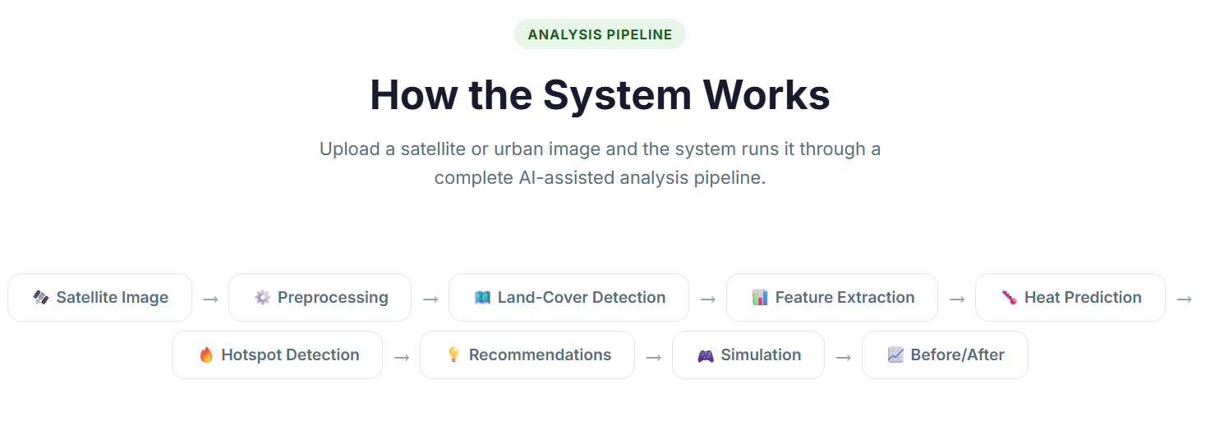
SYSTEM ARCHITECTURE
Urban Heat Island Mitigation Simulation | Team Chandra

Slide 5
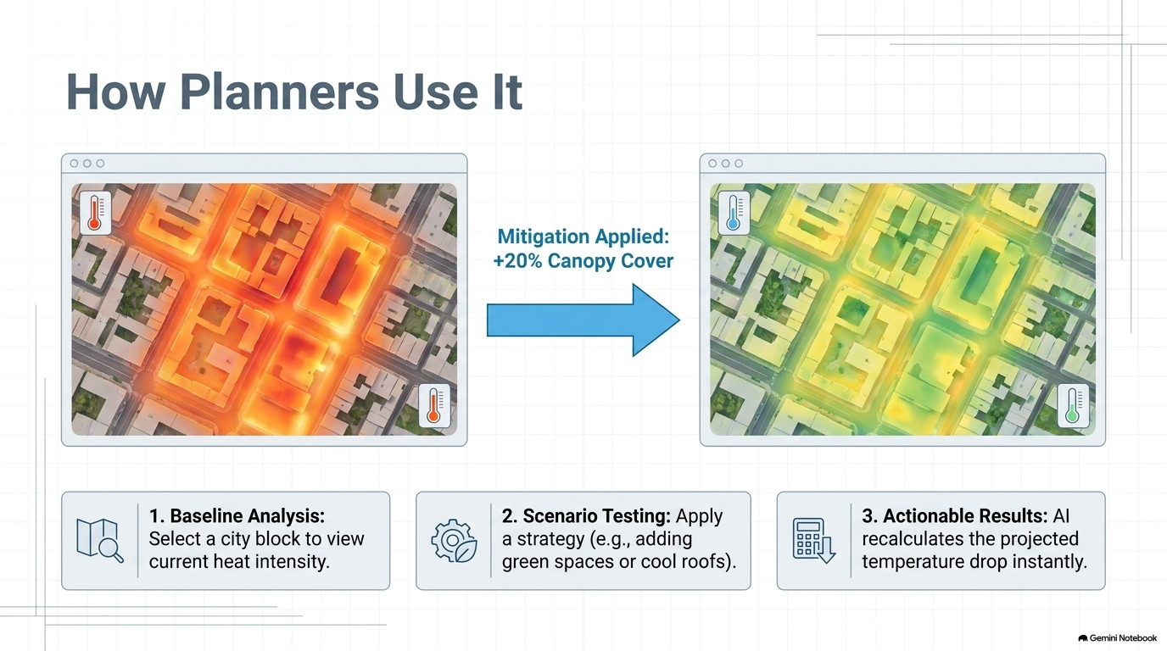


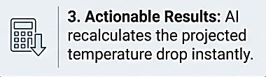
Mitigation applied:
+20% Canopy Cover
Urban Heat Island Mitigation Simulation | Team Chandra

Slide 6





TECHNICAL STACK
FRONTEND
BACKEND
HTML • CSS • JavaScript • Bootstrap
Python • Flask
COMPUTER VISION
MACHINE LEARNING
OpenCV + Segmentation Model
(candidates: SegFormer / U-Net / DeepLabV3)
Heat prediction (candidates: Random Forest / XGBoost / LightGBM)
VISUALIZATION
MAPPING / GIS
Chart.js dashboards
Leaflet • GIS layers
Urban Heat Island Mitigation Simulation | Team Chandra

Slide 7
ANALYSIS
TECHNICAL FEASIBILITY
CHALLENGES
Satellite & environmental data → urban analysis
Computer vision → land-cover detection
ML models → heat prediction
Simulation → compare mitigation strategies
Web dashboard → visualize results for planners
Localized temperature data
Image quality & resolution
Urban variation
Model accuracy & validation
Computational complexity
MITIGATION STRATEGIES
SCALABILITY
Combine geospatial & environmental data
Start with city-block analysis
Validate using temperature/LST data
Use modular AI/ML architecture
Scale from blocks to cities
City Block
Campus / Local Area
Neighbour-
hood
Urban Zone
›
›
›
›
City
Urban Heat Island Mitigation Simulation | Team Chandra

Slide 8



FROM DETECTION TO ACTION
AI Analysis
›
Hotspot
Identification
›
Targeted
Intervention
›
›
Data-Driven
Planning
Simulation
Targeted Green
Infrastructure
Planning
Optimized Water-
Based Cooling Interventions
High-Albedo / Cool-
Roof Area
Identification
Potential Reduction
Of Heat Stress
Potential Reduction in
Cooling-Energy
Demand
Scalable, Data-Driven
Urban Planning
Urban Heat Island Mitigation Simulation | Team Chandra
5

Slide 9
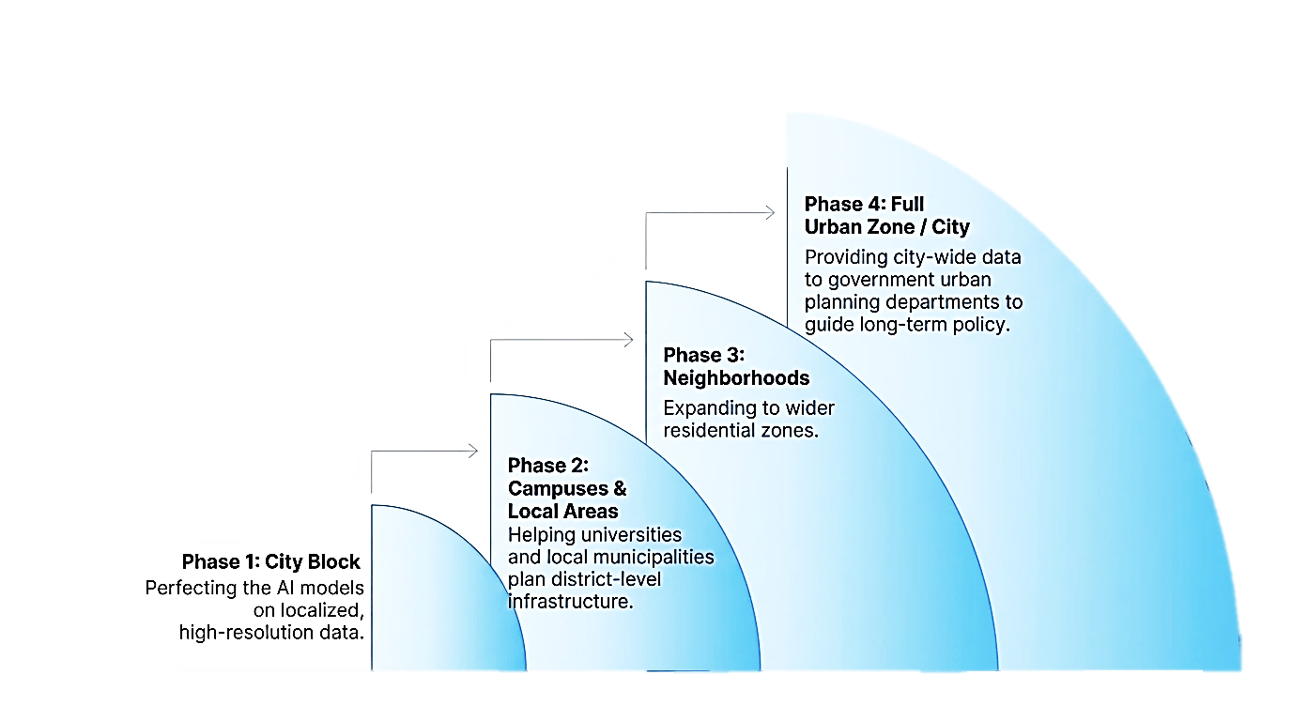
DEPLOYMENT & SCALABILITY
Designed to scale progressively, requiring minimal structural changes as we expand the analysis area.
Urban Heat Island Mitigation Simulation | Team Chandra

Slide 10
THANK YOU
Urban Heat Island Mitigation Simulation | Team Chandra

