Slide 1

Project name: An unstructured MRI compression technique using a convolutional approach
Project guide: Prof. Debkumar Chowdhury
Department of Computer Science
University of Engineering & Management, Kolkata
Tirtharaj Sinha | 3I(CSE) | 74 | 12019009001134
Anurag Unnikannan | 3J(CST) | 09 | 12019009001281
Susmit De | 3J(CST) | 72 | 12019009022078
Siddhartha Bose | 3I(CST) | 58 | 12019009022034
Arnobrata Ghosh | 3C(CSE) | 13 | 12019009001398
Devesh Raj | 3C(CST) | 21 | 12019009022196

Slide 2
Contents
Introduction
1.1. Background and motivation
1.2. Objective
Literature survey
Built-in architecture
Algorithms
Experimental result
5.1. Result analysis
5.2. Image reading
5.3. Image segmentation
Post training findings
5.1. performance parameters
5.2. performance parameter outcomes
Comparative study
Conclusion, Novelty, Future Scope & Application
Reference

Slide 3
1. Introduction
1.1 Background and Motivation
Medical images are one of the most important sources for medical practitioners and doctors to study various types of health problems and to achieve a better solution for that problem in the future.
Hence, it is considered a serious issue to store this collection of images in a dataset using a digital method to compress, store and recover it efficiently for further usage. This method will help medical practitioners and doctors to work on the improvement in the field.
1.2 Objective
To develop an Autoencoder algorithm that works on unstructured data such as medical images (MRI scans, ultrasound scans, etc.) and check the resemblance between the encoded and decoded images.

Slide 4
2. Literature Survey
Table. 1. Existing Methodology Analysis Table

Slide 5
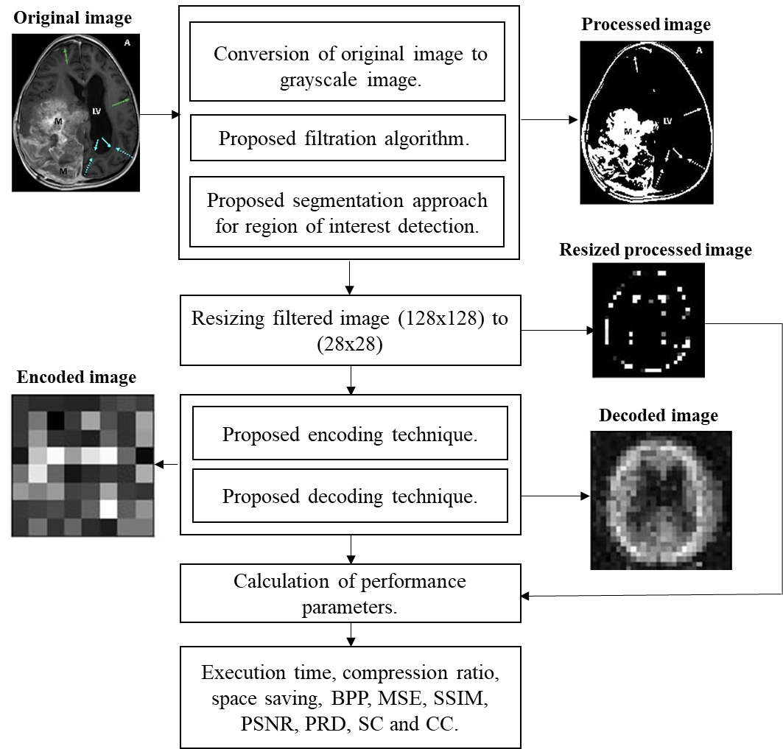
3. Built-in Architecture
Fig. 1. The built-in architecture of MRI compression technique using a convolutional approach

Slide 6
4. Algorithms

Slide 9
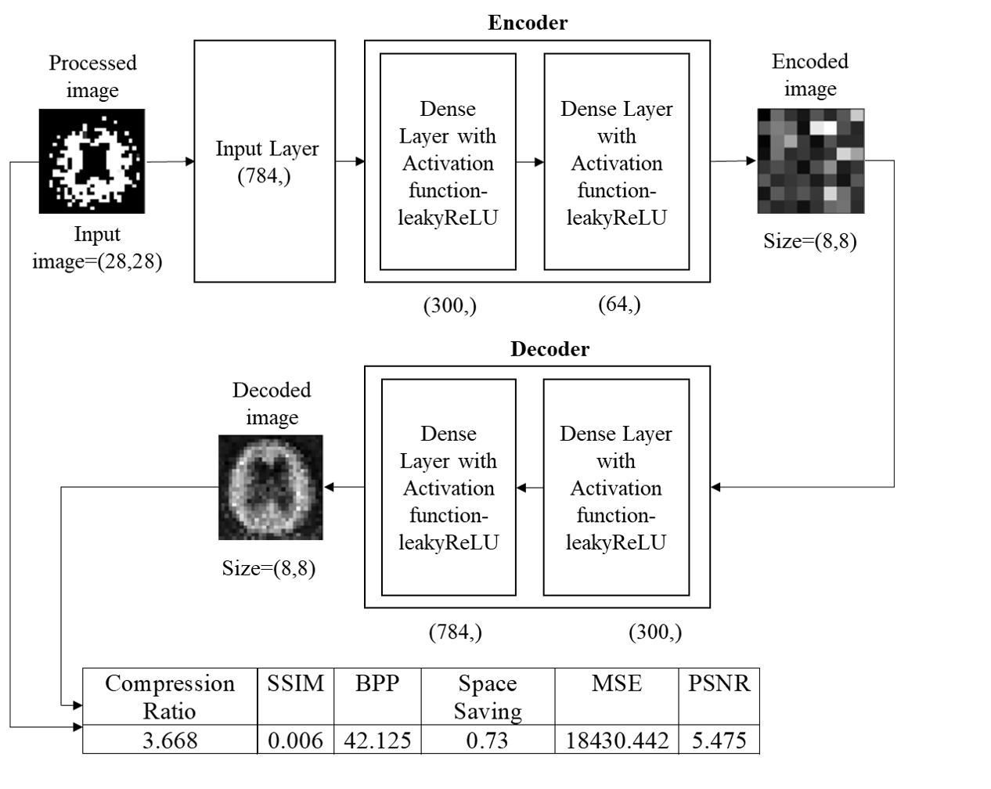
Fig.2. Training and testing phase using proposed model architecture

Slide 10
5. Experimental Results
5.1 Result Analysis
5.1.1 Dataset
We consider the custom hydrocephalus dataset, which consists of 132 images. The size, colour, and format of images in the dataset are similar in nature, whereas the resolutions of the images are different. The format of the images are ‘.jpg’ by nature.
5.1.2 Machine Configuration
We have applied our algorithm in the python environment, version 3.8, with the hardware configuration of the Intel Core i3 5th Generation processor,4GB DDR3 primary memory (RAM), and an integrated graphics card. Anaconda as a distributor of Python version 3.8 is used. jupyter notebook version 6.3.0 as an open web interface is used as a programming platform for the implementation of our algorithm.

Slide 11
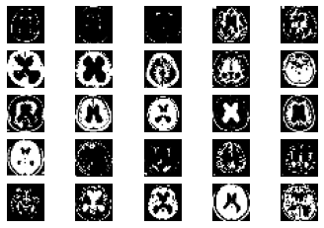
5.2 Image Reading
Fig. 3. Samples of hydrocephalus dataset

Slide 12
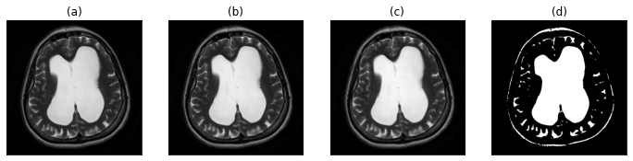
5.3 Image Segmentation
Fig. 4. (a) original image (b) gray-scale image (c) image after applying proposed filtration method (d) proposed segmentation approach for the region of interest detection

Slide 13
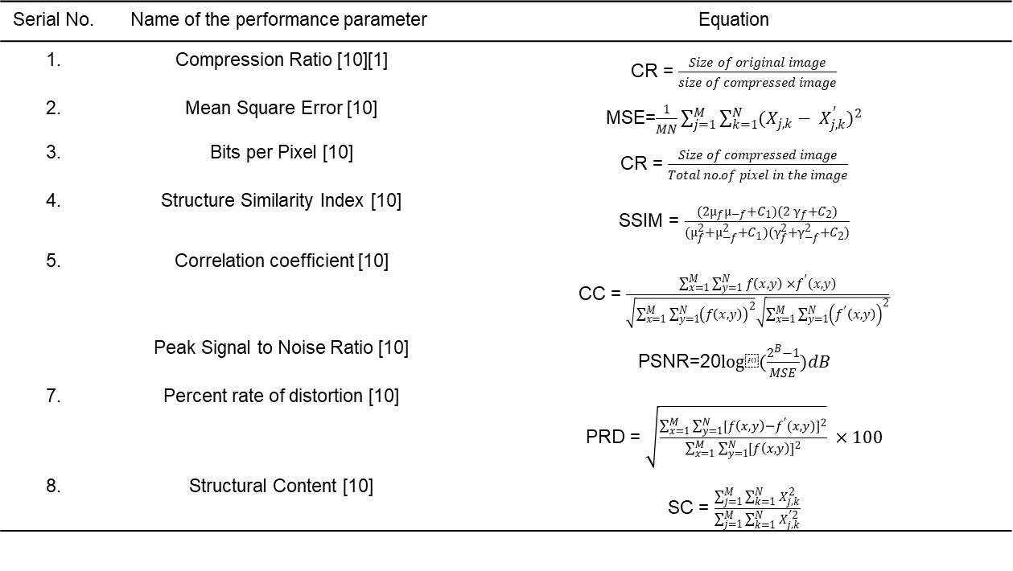
6. Post Training Findings
6.1 Performance parameters
Serial No. | Name of the performance parameter | Equation
1. | Compression Ratio [10][1] | CR = $\frac{Size of original image}{size of compressed image}$
2. | Mean Square Error [10] | MSE=$\frac{1}{MN}\sum_{j=1}^{M}{\sum_{k=1}^{N}{{(X_{j,k}− X_{j,k}^{′})}^{2}}}$
3. | Bits per Pixel [10] | CR = $\frac{Size of compressed image}{Total no. of pixel in the image}$
4. | Structure Similarity Index [10] | SSIM = $\frac{({2µ}_{f}µ_{−f}+C_{1})({2 γ}_{f}+C_{2})}{(µ_{f}^{2}+µ_{−f}^{2}+C_{1})(γ_{f}^{2}+γ_{−f}^{2}+C_{2})}$
5. | Correlation coefficient [10] | CC = $\frac{\sum_{x=1}^{M}{\sum_{y=1}^{N}{f\left(x, y\right) ×f^{′}\left(x, y\right)}}}{\sqrt{\sum_{x=1}^{M}{\sum_{y=1}^{N}{{\left(f\left(x, y\right)\right)}^{2}}}}\sqrt{\sum_{x=1}^{M}{\sum_{y=1}^{N}{{\left(f^{′}\left(x, y\right)\right)}^{2}}}}}$
 | Peak Signal to Noise Ratio [10] | PSNR=20$log⁡(\frac{2^{B}−1}{MSE})dB$
7. | Percent rate of distortion [10] | PRD = $\sqrt{\frac{\sum_{x=1}^{M}{\sum_{y=1}^{N}{{[f\left(x, y\right)−f^{′}(x, y)]}^{2}}}}{\sum_{x=1}^{M}{\sum_{y=1}^{N}{{[f\left(x,y\right)]}^{2}}}}} ×100$
8. | Structural Content [10] | SC = $\frac{\sum_{j=1}^{M}{\sum_{k=1}^{N}{X_{j, k}^{2}}}}{\sum_{j=1}^{M}{\sum_{k=1}^{N}{X_{j, k}^{′2}}}}$
Table 2: Various performance parameters

Slide 14
6.2 Performance parameters outcomes
Table 3: Calculation of performance parameters for each image

Slide 15
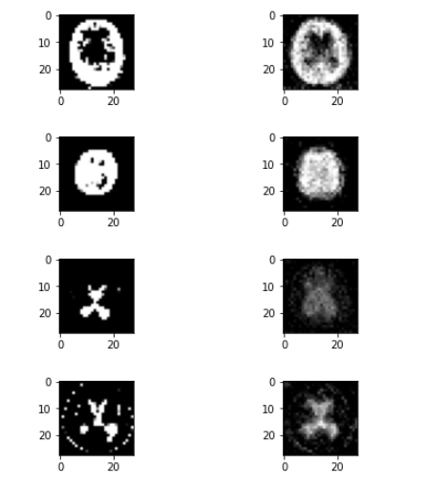
Processed image
Decoded image
Fig. 5. processed image versus decoded image

Slide 16
7. Comparative Study
Serial No. | Name of the compression algorithm | Compression ratio
1. | LZW [1] | 2.319%
2. | Huffman coding [1] | 2.203 %
3. | EZW [2] | 1.6647%
4. | RLE [3] | 1.5766%
5. | Shannon–Fano [3] | 1.9825%
6. | Arithmetic coding [3][5] | 2.2059%
7. | Proposed methodology | 2.4593%
Table 6: Comparison chart

Slide 17
8. Conclusion, Novelty, Application & Future scope
8.1 Conclusion
This algorithm is capable of compressing and storing generated images from medical equipment contained in the Custom hydrocephalus dataset, collected from the web resource.
It also generates an Compression ratio through which we compare our proposed method with existing methods.
The experiment result shows that after applying the proposed method and existing method on the Custom hydrocephalus dataset, our technique is producing a Compression ratio of approximately 2.4593%
This result is considered satisfactory and based on this result we can say that the proposed method is efficient.
5.1 Conclusion
This algorithm is capable of preprocessing unstructured breast mammogram images from the BUSI dataset , collected from the web resource.
It is responsible for the prediction of malignant and non-malignant breast mammogram images in terms of yes (malignant sample) and no (non-malignant sample) values.
It also generates an accuracy score through which we compare our proposed method with existing methods.
The experiment result shows that after applying the proposed method and existing method on the BUSI dataset, our technique is producing approximately 98.5% accuracy and 0.98 F1 scores on average.
This result is considered satisfactory and based on this result we can say that the proposed method is efficient.

Slide 18
8.2 Novelty
Novel compression and storage steps and modification in the proposed architecture using an Autoencoder algorithm make the proposed methodology unique.
8.3 Application
Due to high performance, novelty, ease of use, our proposed method is useful to develop any mobile or web applications in the future.
8.4 Future scope
Our method can be tested on various medical equipment generated images to identify its generic performance in the future. The performance of our proposed methodology may be increased by needed modifications.

Slide 19
9. References
Gajendra Sharma, “Analysis of Huffman Coding and Lempel–Ziv–Welch (LZW) Coding as Data Compression Techniques,” International Journal of Scientific Research in Computer Science and Engineering, Vol.8, Issue.1, pp.37-44, 2020.
A.M.Raid, W.M.Khedr, M. A. El-dosuky and Wesam Ahmed, “Image compression using embedded zerotree wavelet” Signal & Image Processing : An International Journal (SIPIJ) Vol.5, No.6, December 2014, pp. 33-39, doi : 10.5121/sipij.2014.5603
Rahman, Md. A., and Mohamed Hamada. 2019. "Lossless Image Compression Techniques: A State-of-the-Art Survey" Symmetry 11, no. 10: 1274. doi : 10.3390/sym11101274
S. S. Yu, M. N. Wernick and N. P. Galatsanos, "Lossless compression of multi-dimensional medical image data using binary-decomposed high-order entropy coding," Proceedings of 1st International Conference on Image Processing, 1994, pp. 351-355 vol.2, doi: 10.1109/ICIP.1994.413590.
G. Langdon and J. Rissanen, "Compression of Black-White Images with Arithmetic Coding," in IEEE Transactions on Communications, vol. 29, no. 6, pp. 858-867, June 1981, doi: 10.1109/TCOM.1981.1095052.
A. K. Jain, "Image data compression: A review," in Proceedings of the IEEE, vol. 69, no. 3, pp. 349-389, March 1981, doi: 10.1109/PROC.1981.11971.
P. Roos, M. A. Viergever, M. C. A. van Dijke and J. H. Peters, "Reversible intraframe compression of medical images," in IEEE Transactions on Medical Imaging, vol. 7, no. 4, pp. 328-336, Dec. 1988, doi: 10.1109/42.14516.
Z. Xiao and C. Zheng, "Medical Image Fusion Based on the Structure Similarity Match Measure," 2009 International Conference on Measuring Technology and Mechatronics Automation, 2009, pp. 491-494, doi: 10.1109/ICMTMA.2009.558.
Amin Mubarak Alamin Ibrahim* et al. ,(IJITR) INTERNATIONAL JOURNAL OF INNOVATIVE TECHNOLOGY AND RESEARCH, Volume No.3, Issue No.1, December – January 2015, 1808 – 1812.
Pardeep Kumar, Ashish Parmar, Versatile Approaches for Medical Image Compression: A Review, Procedia Computer Science, Volume 167, 2020, Pages 1380-1389, ISSN 1877-0509, doi : 10.1016/j.procs.2020.03.349

Slide 20
THANK YOU

