Slide 1

Project name: Unstructured breast mammogram data analysis using convolutional approach for effective classification and detection
Project guide: Prof. Debkumar Chowdhury
Department of Computer Science
University of Engineering & Management, Kolkata
Tirtharaj Sinha | 3I(CSE) | 74 | 12019009001134
Anurag Unnikannan | 3J(CST) | 09 | 12019009001281
Susmit De | 3J(CST) | 72 | 12019009022078
Siddhartha Bose | 3I(CST) | 58 | 12019009022034
Arnobrata Ghosh | 3C(CSE) | 13 | 12019009001398
Devesh Raj | 3C(CST) | 21 | 12019009022196

Slide 2
Introduction
Background
Medical images are one of the most important sources for medical practitioners and doctors to study various types of health problems and to achieve a better solution for that problem in the future.
Hence, it is considered a serious issue to store this collection of images in a dataset using a digital method to compress, store and recover it efficiently for further usage. This method will help medical practitioners and doctors to work on the improvement in the field.
Objective
To develop an Autoencoder algorithm that works on unstructured data such as medical images (MRI scans, ultrasound scans, etc.) and check the resemblance between the encoded and decoded images.

Slide 3
Literature Survey
Survey Table
Comparative Study

Slide 4
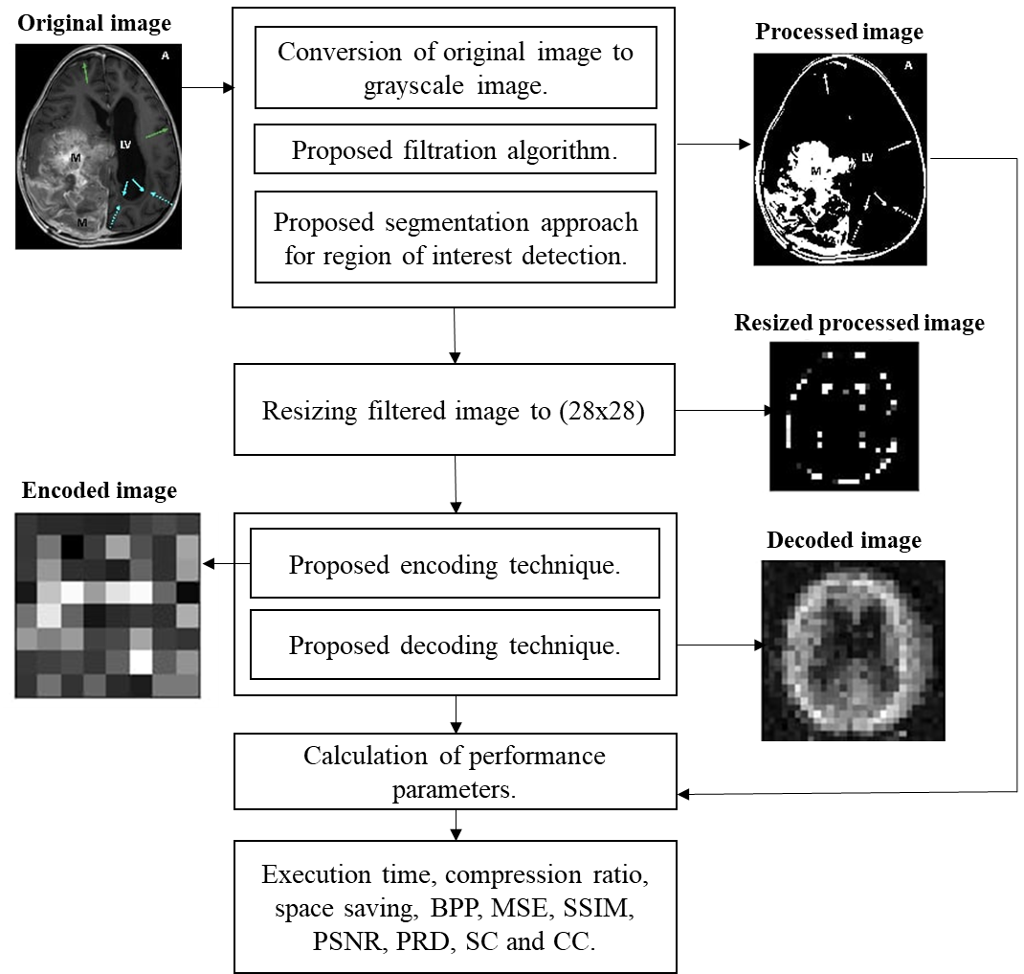
Built-in Architecture
Fig. 1. The built-in architecture of MRI compression technique using a convolutional approach

Slide 5
Algorithms

Slide 8
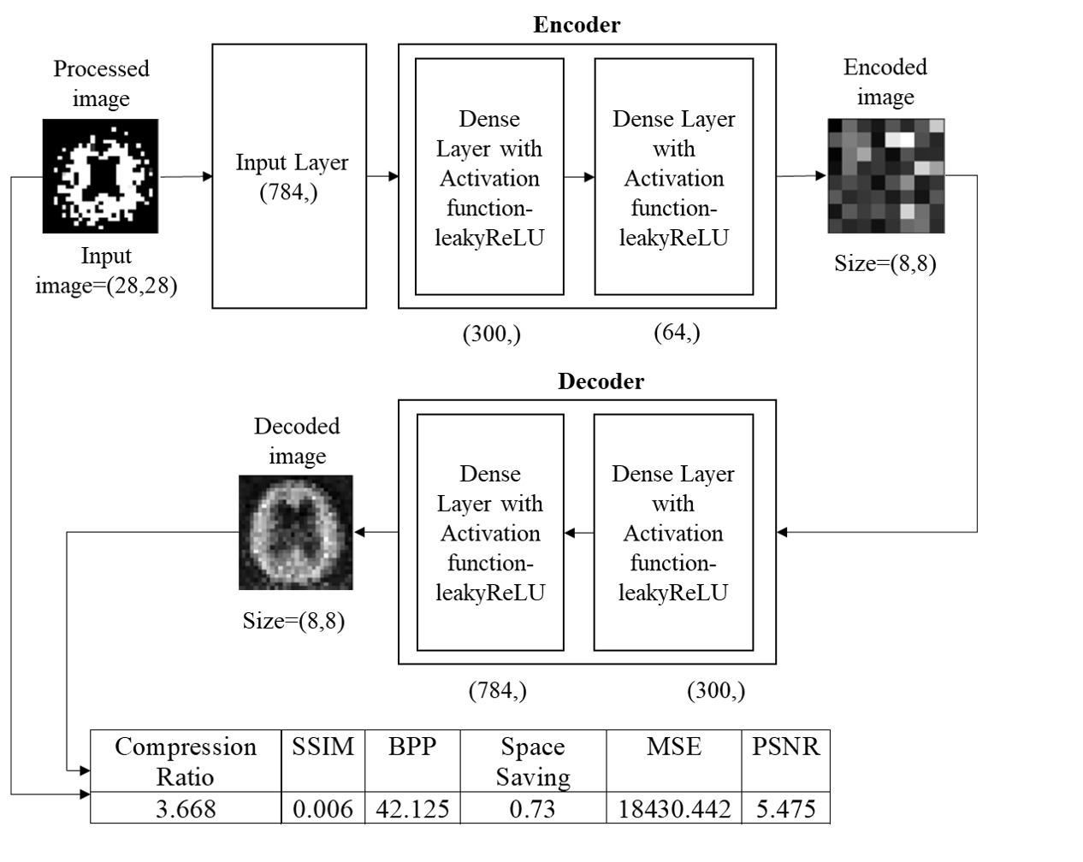
Fig.2. Training and testing phase using proposed model architecture

Slide 9
Experimental Results
Result Analysis
Dataset
We consider the brain MRIs as a dataset, which consists of 132 images. The size, colour, and format of images in the dataset are similar in nature, whereas the resolutions of the images are different. The format of the images are ‘.jpg’ by nature.
Machine Configuration
We have applied our algorithm in the python environment, version 3.8, with the hardware configuration of the Intel Core i3 5th Generation processor,4GB DDR3 primary memory (RAM), and an integrated graphics card. Anaconda as a distributor of Python version 3.8 is used. jupyter notebook version 6.3.0 as an open web interface is used as a programming platform for the implementation of our algorithm.

Slide 10
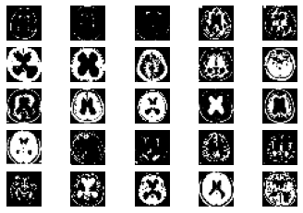
Image Reading
Fig. 3. Samples of hydrocephalus dataset

Slide 11
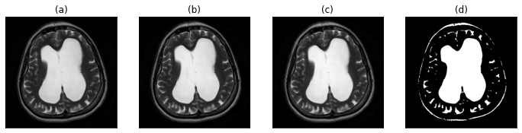
Image Segmentation
Fig. 4. (a) original image (b) gray-scale image (c) image after applying proposed filtration method (d) proposed segmentation approach for the region of interest detection

Slide 12
Post Training Findings
Table 1: Calculation of performance parameters for each image

Slide 13
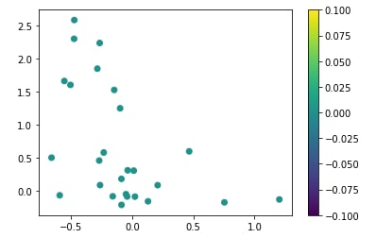
Post Training Findings
Fig. 5. Performance Parameter graph

Slide 14
Application Results

Slide 15
Conclusion & Future Scope

Slide 16
References

