Slide 1
Emerging Applications of Information Technology (EAIT 2022)
Paper name: Unstructured breast mammogram data analysis using convolutional approach for effective classification and detection
Paper id: 21
Session no. : 05
Session name: IoT in Healthcare.

Slide 2
1. Literature Survey
Methodology | Advantages | Disadvantages
Decision Tree [1] | Decision trees require less effort for data preparation during pre-processing. | A small change in the data can cause a large change in the structure. According to our problem, it causes instability.
K-Nearest Neighbor [2] | No assumption about data. | KNN needs a huge amount of memory.
Random Forest Classifier [3] | Random forest minimizes the overfitting issue and tries to increase the accuracy score. | This method needs high computational power and resources.
Support Vector Machine [4] | It is effective in high-dimensional spaces. | Due to a huge time consumption issue, the performance of this method is not satisfactory when we apply this strategy in a large dataset.
Gaussian Naïve Bayes [5] | Naive Bayes is more appropriate for categorical input variables than numerical variables. In the context of our problem, this property is suitable. | It presumes that every feature of the dataset is independent. This property limits the application of this technique in real-world cases.
Multi-Scale Fusion U-Net [6] | It solves the problem of multi-scale variation in breast lesions and boundary pixel blurring. | For the different modes of images, segmentation effects will be reduced.

Slide 3
2. Objective
To develop a novel breast mammogram classification and detection algorithm using a convolutional approach that works on unstructured data such as mammogram images [10] and displays the classified output using convolutional model architecture along with the satisfactory accuracy rate.

Slide 4
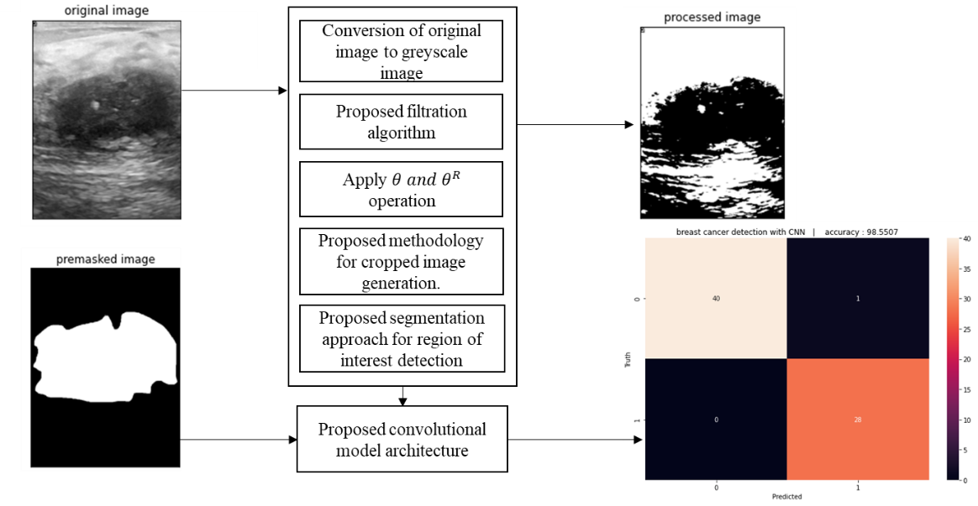
3. Built-in Architecture
Original image
Processed Image
Premasked image
Fig. 1. The built-in architecture of mammogram classification and detection algorithm using a convolutional approach

Slide 5
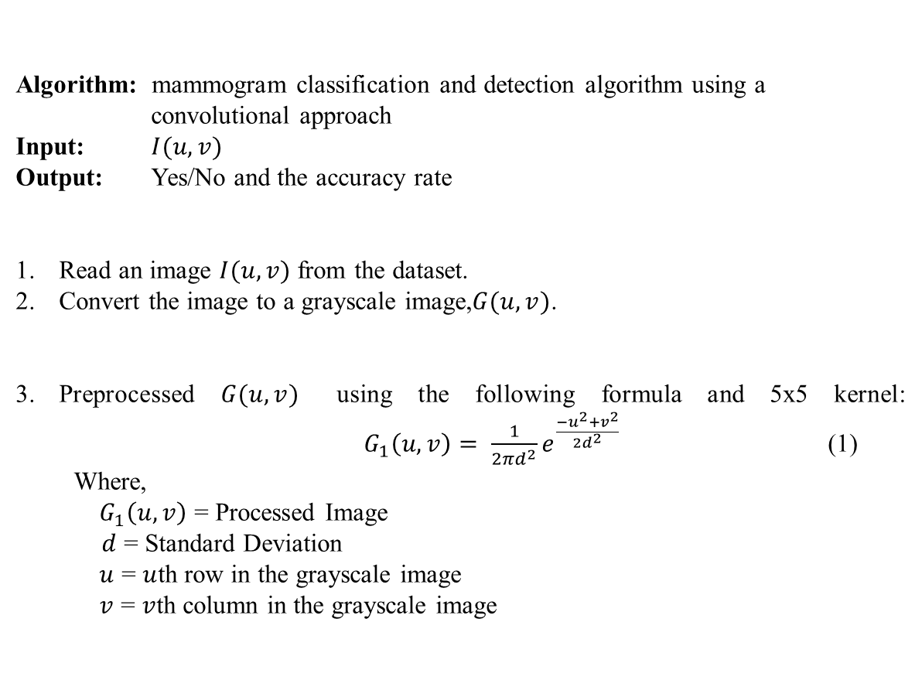
4. Algorithm
Algorithm: mammogram classification and detection algorithm using a convolutional approach
Input: $I(u,v)$
Output: Yes/No and the accuracy rate
Read an image $I(u,v)$ from the dataset.
Convert the image to a grayscale image,$G(u,v)$.
Preprocessed $G(u,v)$ using the following formula and 5x5 kernel: $G_{1}\left(u,v\right)= \frac{1}{2πd^{2}}e^{\frac{−u^{2}+v^{2}}{2d^{2}}}$ (1)
Where,
$G_{1}\left(u,v\right)$ = Processed Image
$d$ = Standard Deviation
$u$ = $u$th row in the grayscale image
$v$ = $v$th column in the grayscale image

Slide 6
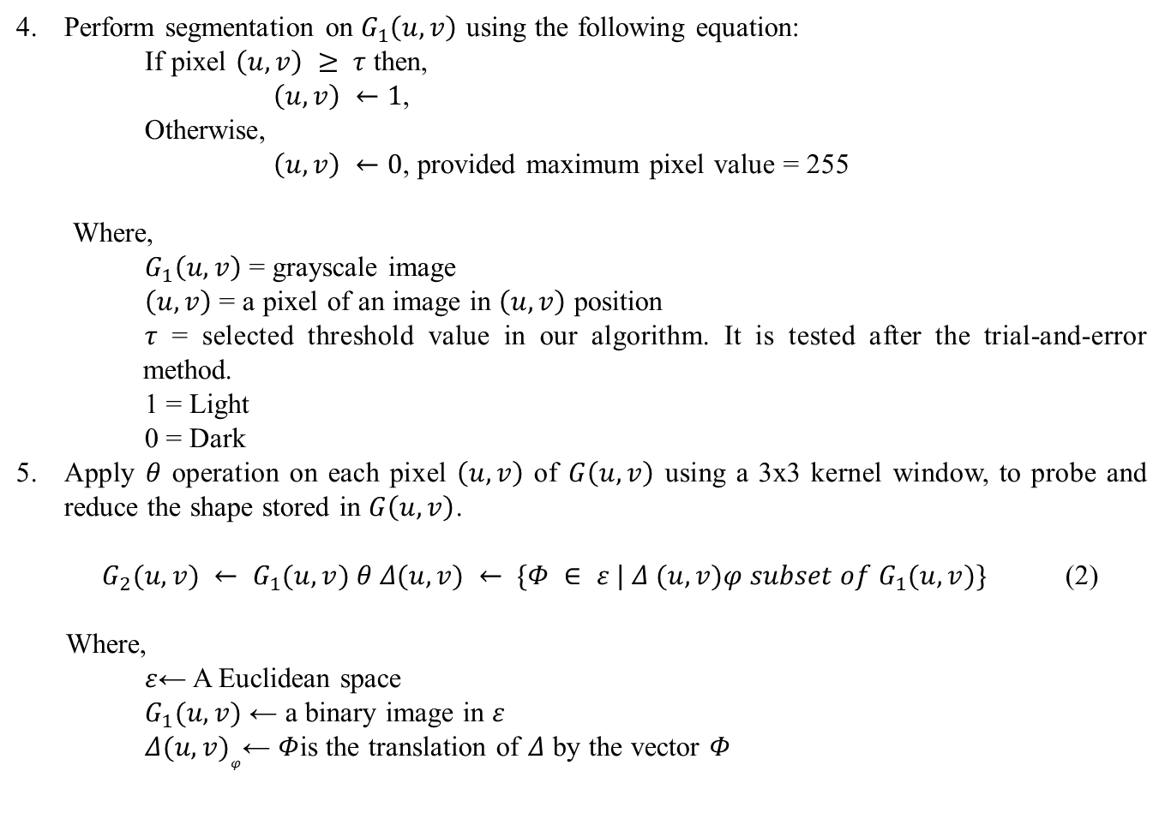
Perform segmentation on $G_{1}\left(u,v\right)$ using the following equation:
If pixel $\left(u,v\right) ≥ τ$ then,
$\left(u,v\right) ←1$,
Otherwise,
$\left(u,v\right) ←0$, provided maximum pixel value = 255
Where,
$G_{1}\left(u,v\right)$ = grayscale image
$\left(u,v\right)$ = a pixel of an image in $\left(u,v\right)$ position
$τ$ = selected threshold value in our algorithm. It is tested after the trial-and-error method.
1 = Light
0 = Dark
Apply $θ$ operation on each pixel $\left(u,v\right)$ of $G\left(u,v\right)$ using a 3x3 kernel window, to probe and reduce the shape stored in $G\left(u,v\right)$.
$G_{2}(u,v) ← G_{1}(u,v) θ Δ(u,v) ← \{Φ ∈ ε | Δ (u,v)φ subset of G_{1}(u,v)\}$ (2)
Where,
$ε$← A Euclidean space
$G_{1}(u,v)$ ← a binary image in $ε$
$Δ{(u,v)}_{φ}$← $Φ$is the translation of $Δ$ by the vector $Φ$

Slide 7
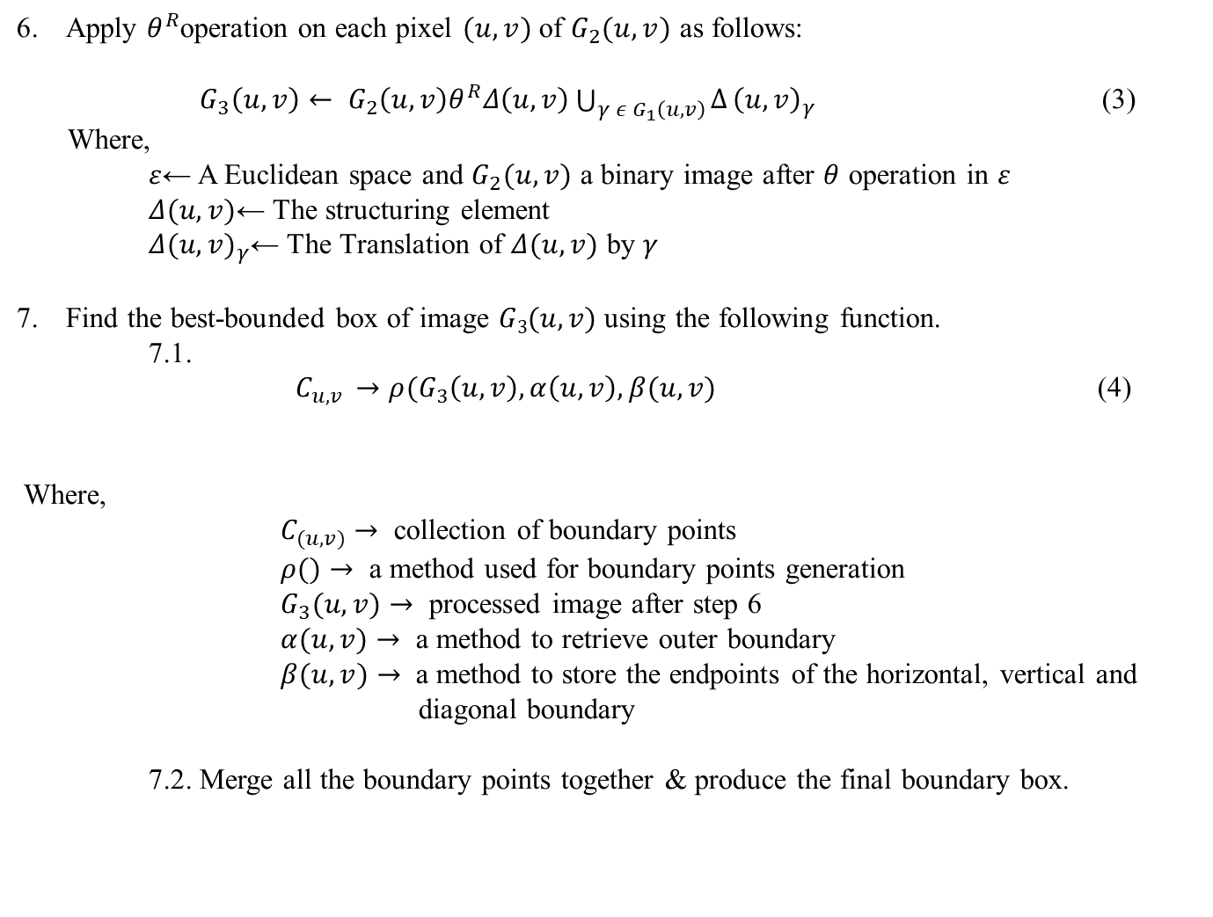
Apply $θ^{R}$operation on each pixel $(u,v)$ of $G_{2}(u,v)$ as follows:
$G_{3}\left(u,v\right)← G_{2}\left(u,v\right)θ^{R}Δ\left(u,v\right)\bigcup_{γ ε G_{1}\left(u,v\right)}{∆}{\left(u,v\right)}_{γ}$ (3)
Where,
$ε$← A Euclidean space and $G_{2}(u,v)$ a binary image after $θ$ operation in $ε$
$Δ(u,v)$← The structuring element
$Δ{(u,v)}_{γ}$← The Translation of $Δ(u,v)$ by $γ$
Find the best-bounded box of image $G3(u,v)$ using the following function.
7.1.
$C_{u,v }→{ρ(G}_{3}\left(u,v\right),α\left(u,v\right),β(u,v)$ (4)
Where,
$C_{(u,v)}→$ collection of boundary points
$ρ()→$ a method used for boundary points generation
$G_{3}(u,v)→$ processed image after step 6
$α(u,v)→$ a method to retrieve outer boundary
$β(u,v)→$ a method to store the endpoints of the horizontal, vertical and diagonal boundary
7.2. Merge all the boundary points together & produce the final boundary box.

Slide 8
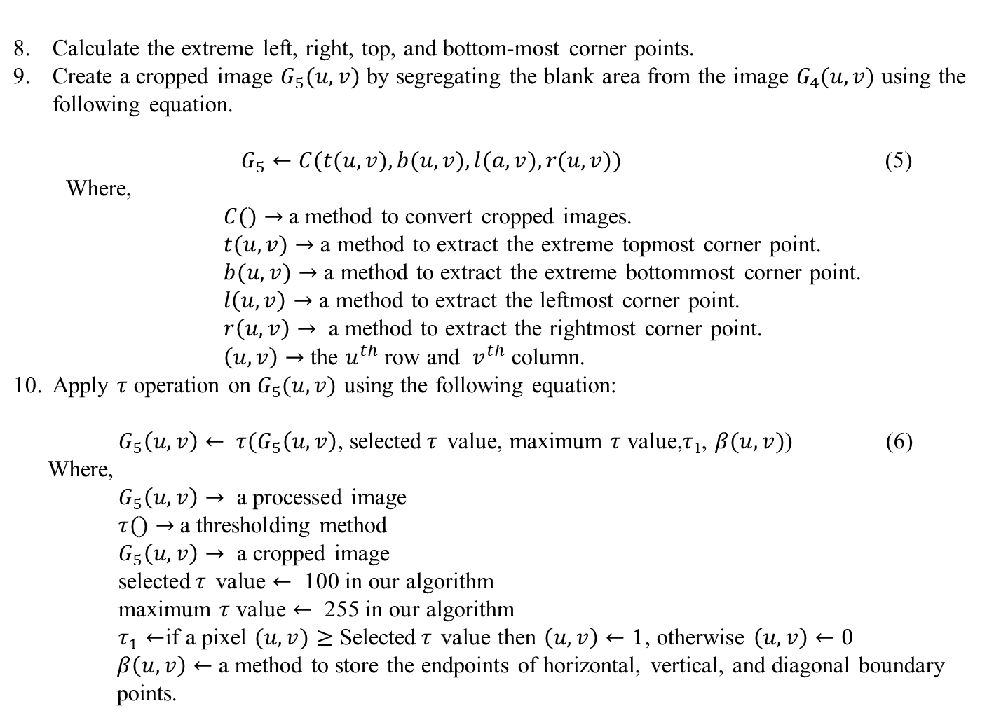
Calculate the extreme left, right, top, and bottom-most corner points.
Create a cropped image $G_{5}(u,v)$ by segregating the blank area from the image $G_{4}(u,v)$ using the following equation.
$G_{5}←C(t(u,v), b(u,v), l(a,v), r(u,v))$ (5)
Where,
$C()→$a method to convert cropped images.
$t(u,v)→$ a method to extract the extreme topmost corner point.
$b(u,v)→$ a method to extract the extreme bottommost corner point.
$l\left(u,v\right)→$ a method to extract the leftmost corner point.
$r\left(u,v\right)→$ a method to extract the rightmost corner point.
$\left(u,v\right)→$ the $u^{th}$ row and $v^{th}$ column.
Apply $τ$ operation on $G_{5}(u,v)$ using the following equation:
$G_{5}\left(u,v\right)← τ{(G}_{5}\left(u,v\right)$, selected$τ$ value, maximum $τ$ value,$τ$₁, $β(u,v)$) (6)
Where,
$G_{5}\left(u,v\right)→$ a processed image
$τ()→$a thresholding method
$G_{5}\left(u,v\right)→$ a cropped image
selected$τ$ value $←$ 100 in our algorithm
maximum $τ$ value $←$ 255 in our algorithm
$τ_{1}←$if a pixel $(u,v)≥$ Selected$τ$ value then $\left(u,v\right)←1$, otherwise $\left(u,v\right)←0$
$β\left(u,v\right)←$a method to store the endpoints of horizontal, vertical, and diagonal boundary points.

Slide 9
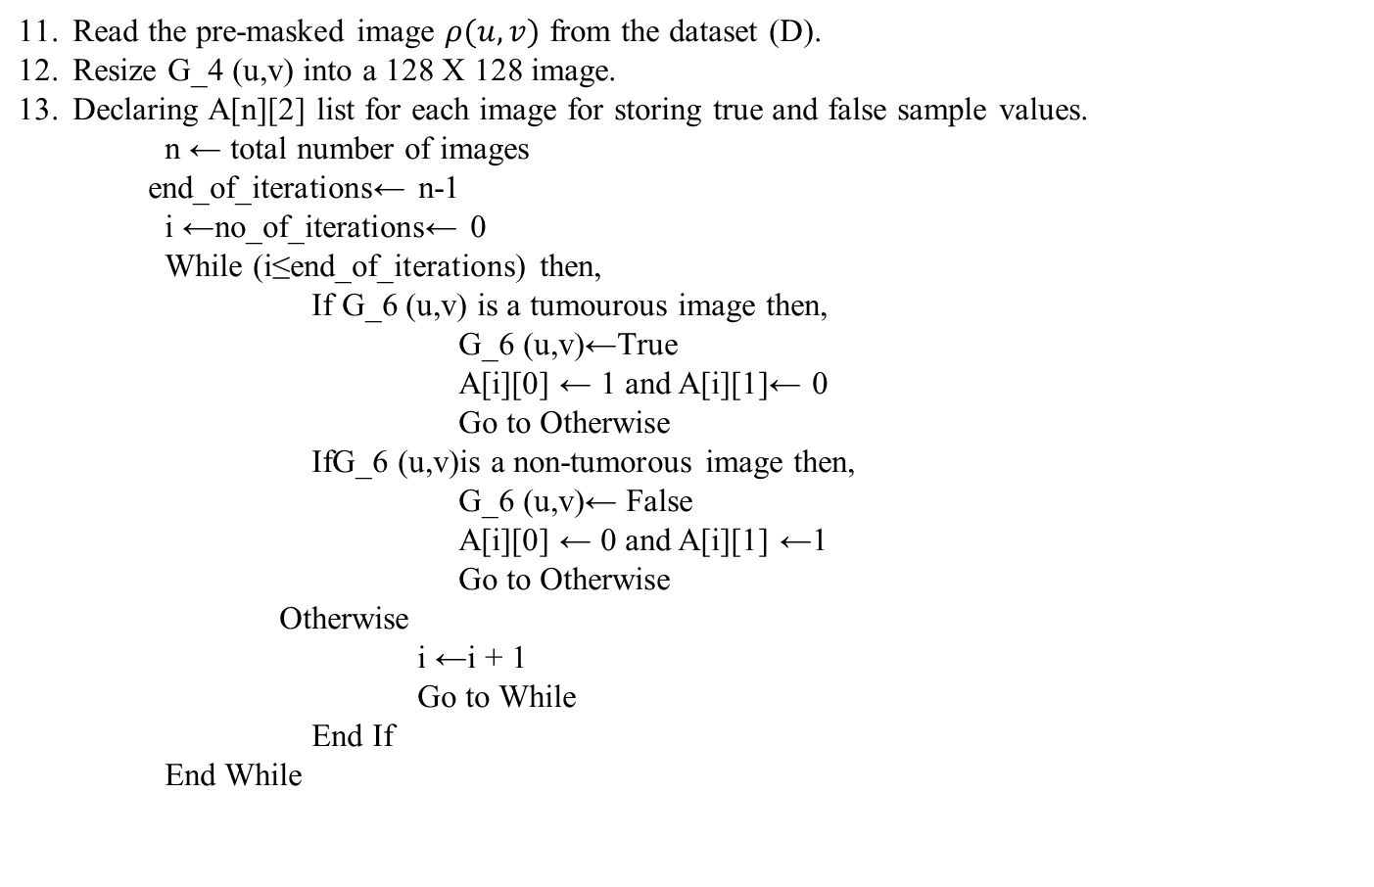
Read the pre-masked image $ρ(u,v)$ from the dataset (D).
Resize G_4 (u,v) into a 128 X 128 image.
Declaring A[n][2] list for each image for storing true and false sample values.
n ← total number of images
end_of_iterations← n-1
i ←no_of_iterations← 0
While (i≤end_of_iterations) then,
If G_6 (u,v) is a tumourous image then,
G_6 (u,v)←True
A[i][0] ← 1 and A[i][1]← 0
Go to Otherwise
IfG_6 (u,v)is a non-tumorous image then,
G_6 (u,v)← False
A[i][0] ← 0 and A[i][1] ←1
Go to Otherwise
Otherwise
i ←i + 1
Go to While
End If
End While

Slide 10
14. The proposed convolutional architecture is shown in Fig. 2. Each input x of size 128x128x3 is used to feed into the convolutional architecture. In the convolutional architecture following layers are observed:
a. One 2-dimensional convolution layer with kernel size 2x2
b. One 2-dimensional convolution layer with kernel size 2x2 and a rectified linear activation function.
c. One batch normalization layer
d. One 2-dimensional max pooling layer with pool size 2x2
e. One dropout layer
f. One 2-dimensional convolution layer of 64-bit input and a rectified linear activation function
g. One 2-dimensional convolution layer of 64-bit input and a rectified linear activation function
h. One batch normalization layer to calculate the mean output (close to 0) and the standard deviation output (close to 1)
i. One 2-dimensional max pooling layer with pool size 2x2
j. One dropout layer
k. One flatten layer
l. One dense layer and activation layer
m. One dropout layer
n. One dense layer with an activation softmax function.

Slide 11
Segregate the whole dataset [10] into two sections. We select 80% mammogram images from the dataset (BUSI) [10] for training purposes and 20% mammogram images from the dataset (BUSI) [10] for testing purposes.
We feed the training and testing data into the designed convolutional model architecture to generate result.
We feed the training and testing data in designed convolutional model architecture to generate result.

Slide 12
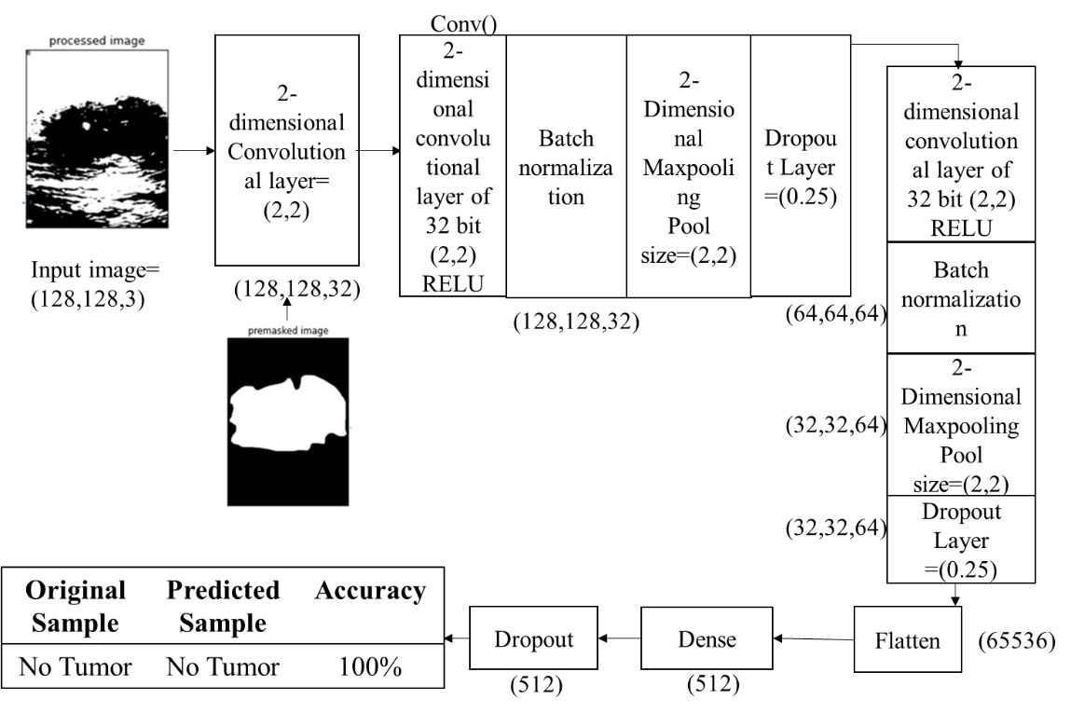
Processed Image
Premasked Image
Fig.2. Mammogram training and testing phase using proposed model architecture

Slide 13
4. Experimental results
4.1. Result analysis:
4.1.1 Dataset
We consider the mammogram image dataset (BUSI) [10], which consists of 410 malignant and 130 non-malignant images collected from the dataset [10] and 209 malignant and 133 non-malignant pre-masked images to calculate the performance of mammogram classification and detection algorithm using a convolutional approach. The size, colour, and format of breast tumor images in the dataset [10] are similar in nature, whereas the resolutions of the images are different. The format of the mammogram images are ‘.png’ by nature.
4.1.2 Machine Configuration
We have applied our algorithm in the python environment, version 3.8, with the hardware configuration of the Intel Core i3 5th Generation processor,4GB DDR3 primary memory (RAM), and an integrated graphics card. Anaconda as a distributor of Python version 3.8 is used. jupyter notebook version 6.3.0 as an open web interface is used as a programming platform for the implementation of our algorithm.

Slide 14
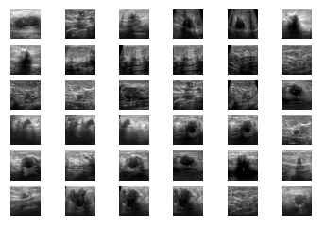
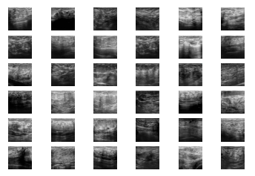
4.1.3. Image Reading
Fig. 3. Malignant images
Fig. 4. Non-malignant images

Slide 15
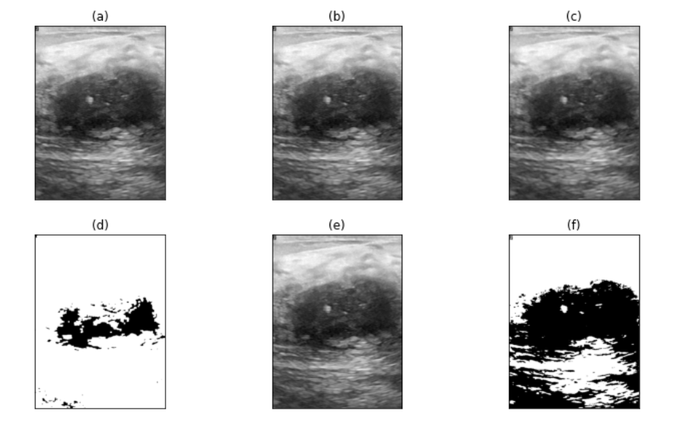
4.1.3. Image Segmentation
Fig. 5. (a) original image (b) grayscale image (c) image after applying proposed filtration method (d) image after applying θ and θ^{R} operation (e) cropped image after applying proposed image cropping methodology (f) proposed segmentation approach for the region of interest detection

Slide 16
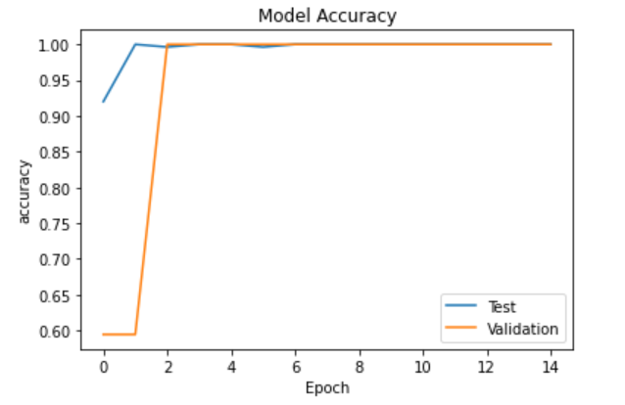
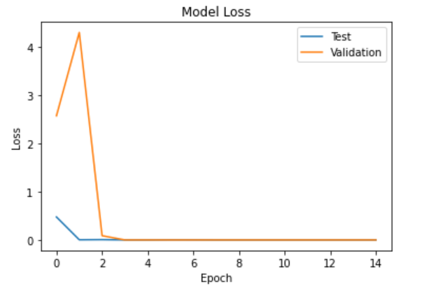
4.1.4. Post Training Findings
Fig. 6: Accuracy Graph
Fig. 7: Loss Graph

Slide 17
4.1.5. Comparative Study
Serial No. | Name of the classification algorithm | Accuracy Score | F1 Score
1. | Decision Tree [1] | 97% | 0.97
2. | K-Nearest Neighbor [2] | 94.2% | 0.94
3. | Gaussian Naïve Bayes [3] | 97% | 0.97
4. | Random Forest [4] | 97% | 0.95
5. | Support Vector Machine [5] | 96% | 0.96
6. | Multi-Scale Fusion U-Net [6] | 94% | 0.93
7. | Proposed Method | 98.5% | 0.98

Slide 18
5. Conclusion, Novelty, Application & Future scope
5.1 Conclusion
This algorithm is capable of preprocessing unstructured breast mammogram images from the BUSI dataset , collected from the web resource.
It is responsible for the prediction of malignant and non-malignant breast mammogram images in terms of yes (malignant sample) and no (non-malignant sample) values.
It also generates an accuracy score through which we compare our proposed method with existing methods.
The experiment result shows that after applying the proposed method and existing method on the BUSI dataset, our technique is producing approximately 98.5% accuracy and 0.98 F1 scores on average.
This result is considered satisfactory and based on this result we can say that the proposed method is efficient.

Slide 19
5.2 Novelty
Novel preprocessing steps and modification in the convolutional architecture using multiple layers make the proposed methodology unique.
5.3 Application
Due to high performance, novelty, ease of use, our proposed method is useful to develop any mobile or web applications in the future.
5.4 Future scope
Our method can be tested on various breast mammogram images to identify its generic performance in the future. The performance of our proposed methodology may be increased by needed modifications.

Slide 20
6. Reference
Hadidi, moh'd & Alarabeyyat, Abdulsalam & Alhanahnah, Mohannad. (2016). Breast Cancer Detection Using K-Nearest Neighbor Machine Learning Algorithm. 35-39. 10.1109/DeSE.2016.8.
B. Bılgıç, "Comparison of Breast Cancer and Skin Cancer Diagnoses Using Deep Learning Method," 2021 29th Signal Processing and Communications Applications Conference (SIU), 2021, pp. 1-4, doi: 10.1109/SIU53274.2021.9477992.
Al-Dhabyani W, Gomaa M, Khaled H, Fahmy A. Dataset of breast ultrasound images. Data in Brief. 2020 Feb;28:104863. DOI: 10.1016/j.dib.2019.104863
L. Yi and W. Yi, "Decision Tree Model in the Diagnosis of Breast Cancer," 2017 International Conference on Computer Technology, Electronics and Communication (ICCTEC), 2017, pp. 176-179, doi: 10.1109/ICCTEC.2017.00046.
S. Ara, A. Das and A. Dey, "Malignant and Benign Breast Cancer Classification using Machine Learning Algorithms," 2021 International Conference on Artificial Intelligence (ICAI), 2021, pp. 97-101, doi: 10.1109/ICAI52203.2021.9445249.

Slide 21
Thank You

