Slide 1
Asymptotic Notations and their meanings
1)Big-O notation : Represents asymptotic upper bound
Ex: The running time T(n) = 2n² + 4n + 5 can be expressed as O(n²) or O(n³) or O(n⁴).
2)Big-Ω notation : Represents asymptotic lower bound
Ex: The running time T(n) = 2n² + 4n + 5 can be expressed as Ω(n²) or Ω(n) or Ω(1).
3)Θ notation : Represents asymptotic tight bound
Ex: The running time T(n) = 2n² + 4n + 5 can be expressed as Θ(n²).
4)Little-o notation : Represents upper bound that is not asymptotically tight (strict upper bound)
Ex: The running time T(n) = 2n² + 4n + 5 can be expressed as o(n³) or o(n^{2.1}), but not as o(n²).
5)Little-ѡ notation : Represents lower bound that is not asymptotically tight (strict lower bound)
Ex: The running time T(n) = 2n² + 4n + 5 can be expressed as ѡ(n) or ѡ(n^{1.99}), but not as ѡ(n²).

Slide 2
Methods of proving Asymptotic Notations
1) Proof by definition : In this method, we apply the formal definition of the
asymptotic notation, and find out the values of constants
c > 0 and n₀ > 0, such that the required notation is proved.
2) Proof by Limit Rules : In this method, we apply certain rules of limit, and then
prove the required notation.

Slide 3
Proof by definition
Prove the following statements :
1) n² + n = O(n²)
According to the formal definition, let f(n) = n² + n and g(n) = n²
Find the values of constants c > 0 and n₀ > 0, such that
0 ≤ f(n) ≤ c g(n), for all n ≥ n₀ (condition for Big-O notation)
2) n² + n = O(n³)
According to the formal definition, let f(n) = n² + n and g(n) = n²
Find the values of constants c > 0 and n₀ > 0, such that
0 ≤ f(n) ≤ c g(n), for all n ≥ n₀ (condition for Big-O notation)

Slide 4
Proof by definition (cont.)
Prove the following statements :
1) n³ + 4n² = Ω(n²)
According to the formal definition, let f(n) = n³ + 4n² and g(n) = n²
Find the values of constants c > 0 and n₀ > 0, such that
0 ≤ c g(n) ≤ f(n), for all n ≥ n₀ (condition for Big-Ω notation)
2) n² + n = Ω(n²)
According to the formal definition, let f(n) = n² + n and g(n) = n²
Find the values of constants c > 0 and n₀ > 0, such that
0 ≤ c g(n) ≤ f(n), for all n ≥ n₀ (condition for Big-Ω notation)

Slide 5
Proof by definition (cont.)
Prove the following statements :
1) n² + n = Θ(n²)
According to the formal definition, let f(n) = n² + n and g(n) = n²
Find the values of constants c₁ > 0, c₂ > 0, and n₀ > 0, such that
0 ≤ c₁ g(n) ≤ f(n) ≤ c₂ g(n), for all n ≥ n₀ (condition for Θ notation)
2) n² + 5n + 7 = Θ(n²)
According to the formal definition, let f(n) = n² + 5n + 7 and g(n) = n²
Find the values of constants c₁ > 0, c₂ > 0, and n₀ > 0, such that
0 ≤ c₁ g(n) ≤ f(n) ≤ c₂ g(n), for all n ≥ n₀ (condition for Θ notation)

Slide 6
Proof by definition (cont.)
Prove the following statements :
(1/2)n² + 3n = Θ(n²)
(nlogn – 2n + 13) = Ω(nlogn)
(1/2)n² – 3n = Θ(n²)

Slide 7
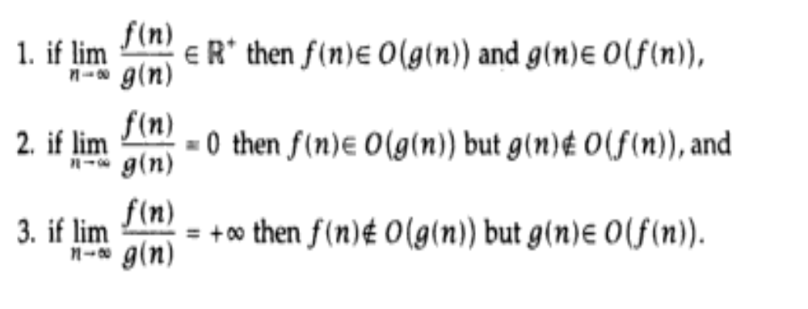
Proof by Limit Rules
If f(n) and g(n) are asymptotically increasing functions, then the following three rules hold true:

Slide 8
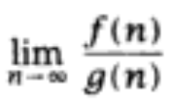
Proof by Limit Rules (Example)
Prove that : √n grows asymptotically faster than log n.
Proof: Let us consider f(n) = √n and g(n) = log n
We compute , a and then based on the result, the specific
“Limit Rule” proves the desired result.
OR
We can consider f(n) = log n and g(n) = √n, and still prove the desired result.

