Slide 1

School of Technology, Design and Computer Application
Bachelor of Technology
Department of Computer Engineering (04)
SUBJECT: Innovation and Design Thinking
Healthcare and Wellness
Group Members :-
Rensi(207)
Bansi(204)
Hitaxi(215)
Kokay(217)
Kinjal(218)
Internal Faculty Guide
Prof. Bhumika Sindhav

Slide 2
Table of Content
Abstract
Introduction
Literature Survey/Research
Proposed Work
AEIOU Canvas
Ideation Canvas
Product Canvas
Mind map
Prototype Screenshot
Problem
Solution
Novelty of definition
Worked carried out till date(Table format)
Future Work & Conclusion
References

Slide 3
Abstract
The project “Healthcare and Wellness” focuses on improving hospital and patient management using online technology.
It helps patients easily check bed availability, doctor timing, and appointment status from their mobile phones.
The system gives real-time updates to avoid long waiting hours and make hospital operations more efficient.

Slide 4
Introduction
In today’s world, managing healthcare efficiently is very important.
Many hospitals still use manual systems for patient entry and updates.
This causes problems like waiting in lines, lack of communication, and delayed updates.
Our system focuses on digitalizing healthcare services to improve patient convenience and hospital management.

Slide 5
Literature Survey/Research
Sr. No. | Title / Research Work | Technology Used | Key Findings / Outcome
1. | IoT-Based Smart Healthcare System | IoT, Cloud | Real-time health data collection using sensors and remote monitoring of patients.
2. | Online Hospital Management System | Web, Database | Simplifies hospital operations like appointments, billing, and bed management.
3. | Doctor Appointment & Scheduling Portal | Android, PHP, MySQL | Helps patients book and track doctor appointments online, reducing waiting time.

Slide 6
Proposed Work
Develop an online system to show live bed availability, doctor timings, and patient queue status.
Patients can check updates easily on their mobile phones.
Hospital staff can update information instantly through an admin panel.
Helps reduce waiting time, manage crowds, and improve hospital communication.

Slide 7
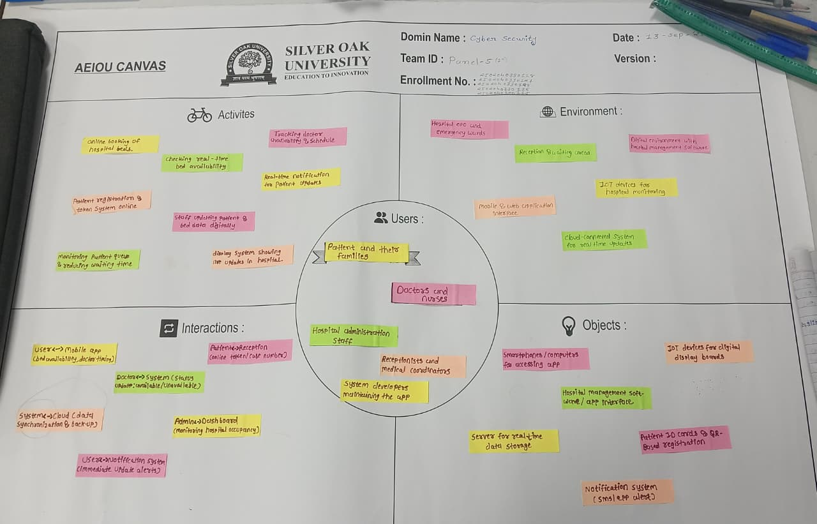
AEIOU Canvas

Slide 8
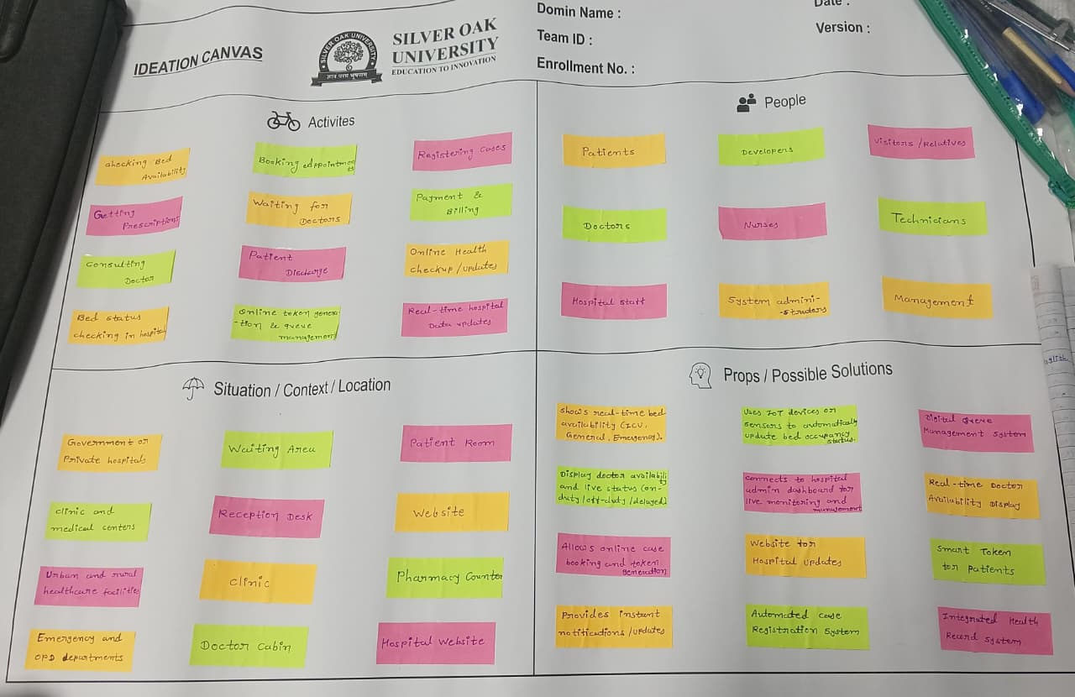
Ideation Canvas

Slide 9
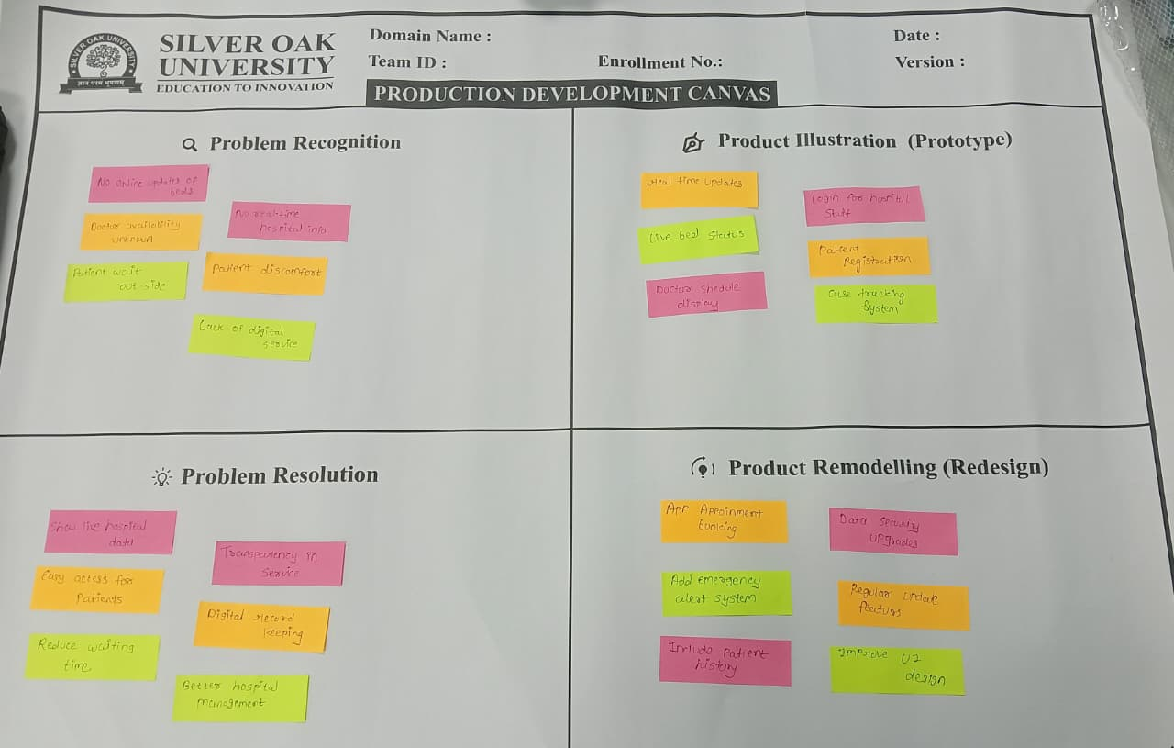
Product Canvas

Slide 10
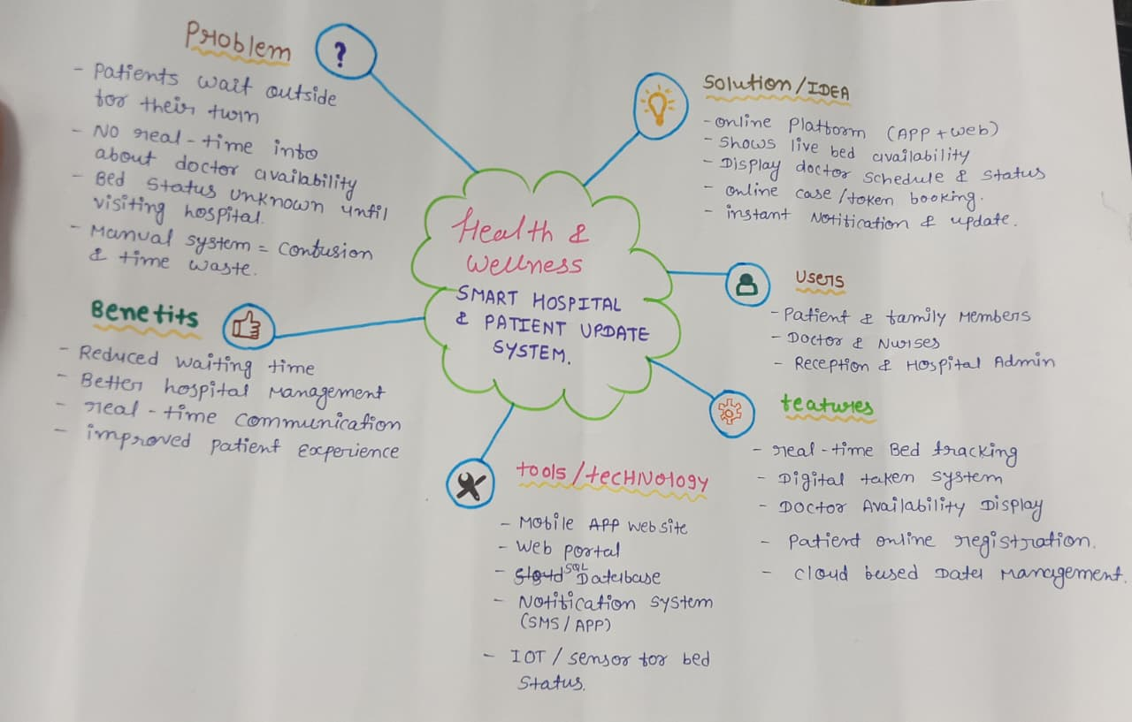
Mind map

Slide 11
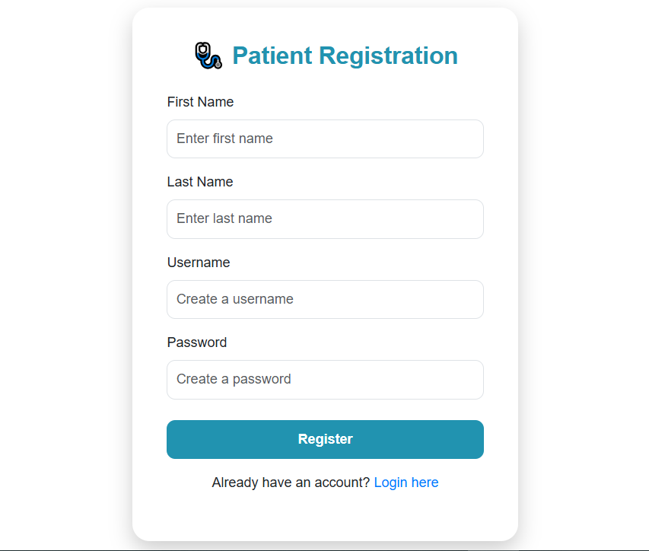
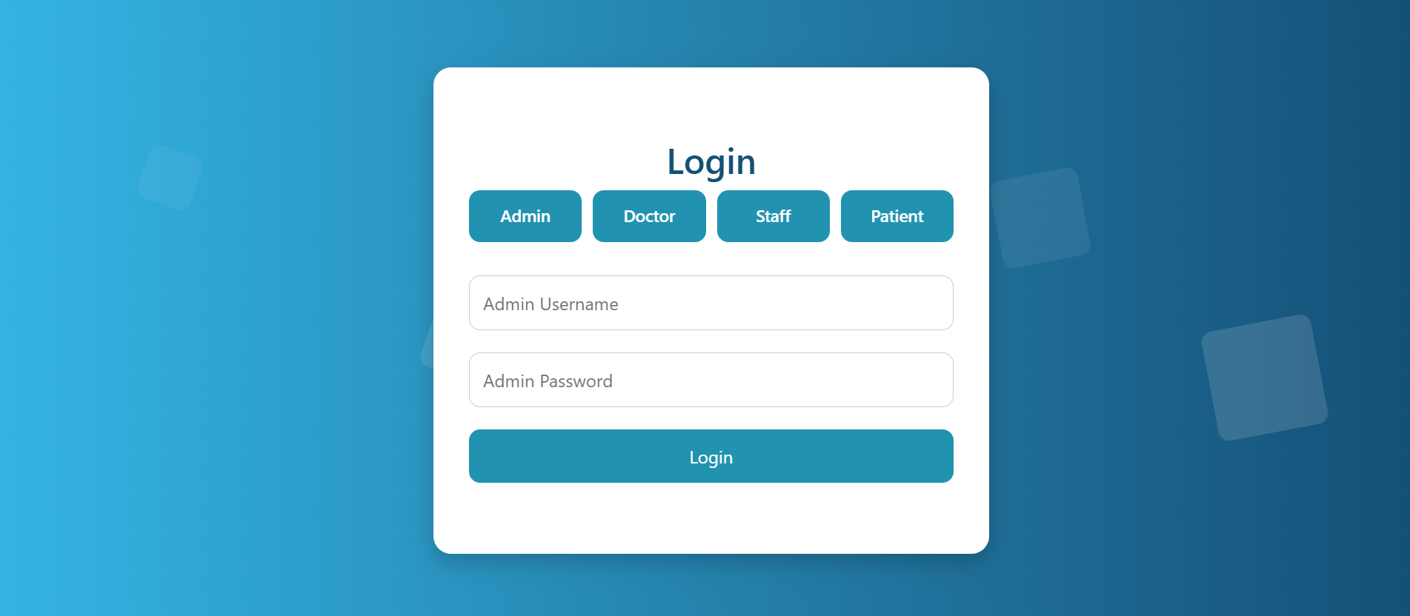
Prototype

Slide 12
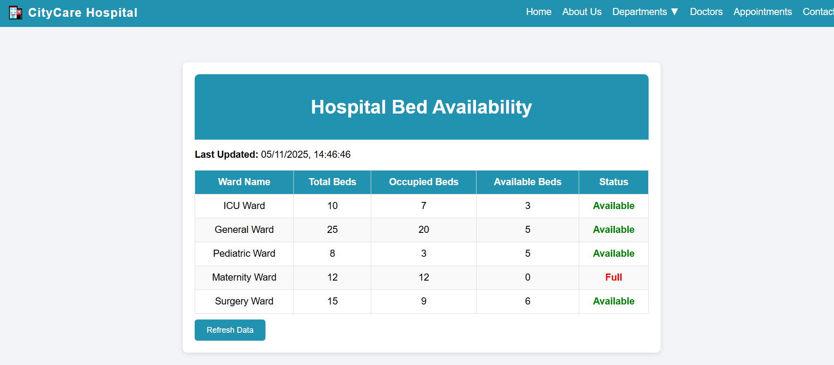
Prototype

Slide 13
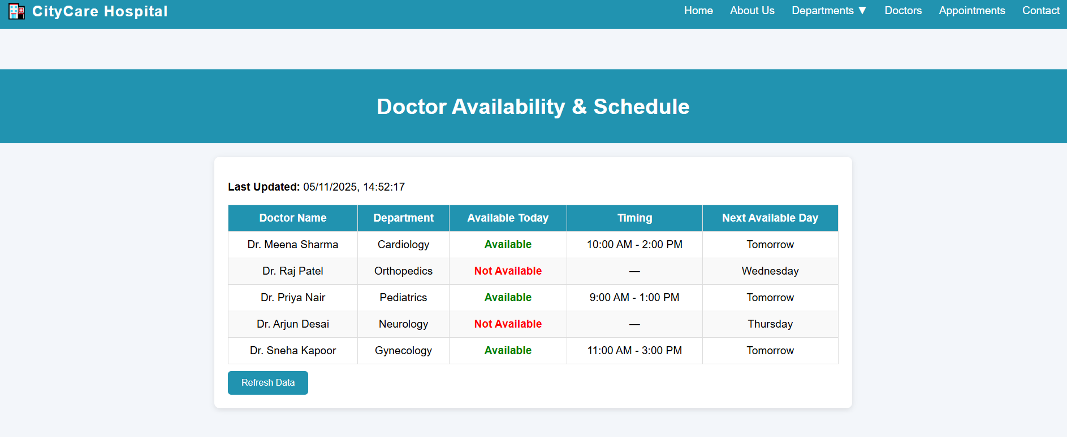
Prototype

Slide 14
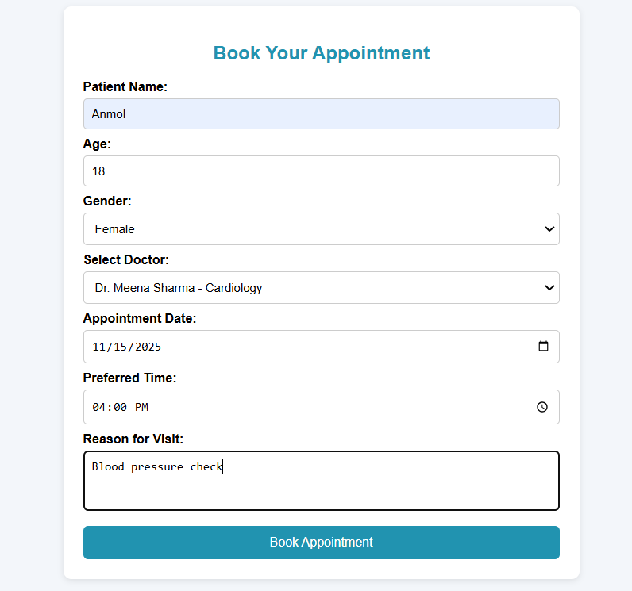
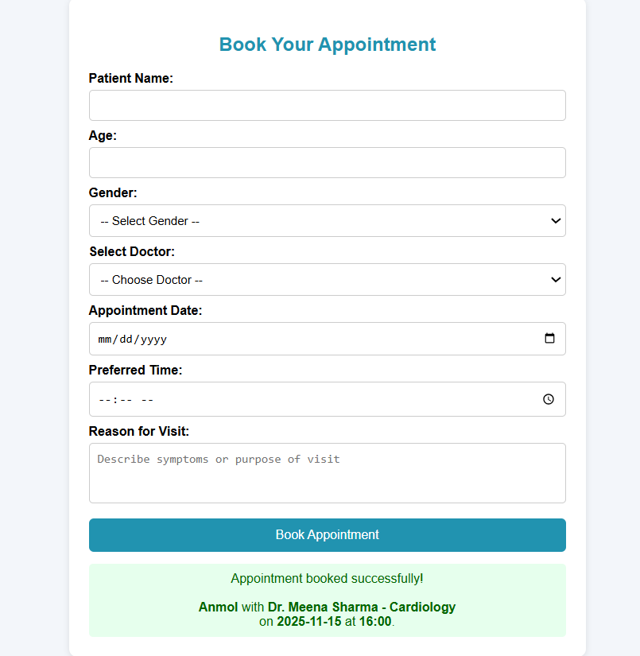
Prototype

Slide 15
Problem
Bed Availability: Patients do not know if beds are available in hospitals until they visit physically.
Long Waiting Queues: Patients have to stand outside the hospital for a long time to get their case number or appointment.
Doctor Availability: Patients are not informed about which doctors are present or when they will arrive.
No Real-time Updates: There is no system to give immediate updates about hospital changes or doctor schedules.

Slide 16
Novelty of Definition
Provides real-time hospital data directly on mobile phones.
Combines doctor timing, bed info, and patient queue in one platform.
Uses automatic updates and notifications for patients and staff.
Improves both healthcare access and wellness experience for users.

Slide 17
Solution
Develop an online healthcare management system that shows:
Live bed status on a mobile app or website.
Doctor’s schedule and availability in real time.
Digital queue system for patients to take tokens online.
Instant notifications for any update or change in hospital information.
Helps reduce waiting time and improve hospital transparency.

Slide 18
Work carried out till date
Work Done | Description | Status
Problem Analysis | Studied issues in hospital management | Completed
Design Phase | Planned layout for mobile/web system | Completed
Prototype | Created demo for bed & doctor updates | In Progress
Testing | Collecting sample data for testing | Pending

Slide 19
Future Work & Conclusion
Future Work:
Add features like online appointment booking and patient report tracking.
Connect multiple hospitals to one platform for better reach.
Include AI suggestions for patient wellness and health tips.
Conclusion:
The system helps hospitals and patients stay connected in real time.
It reduces crowding, saves time, and ensures better communication.
A small step toward smart, digital healthcare and wellness.

Slide 20
References
WHO – Smart Health and Wellness Reports
IEEE Research on Hospital Management Systems
Online Healthcare Monitoring using IoT – ResearchGate
National Health Portal (India)

Slide 21
Thank you

