Slide 1
User Interface
User Experience
&
Consumer Persona
TIRTH JOSHI
1262242889
F1-18

Slide 2
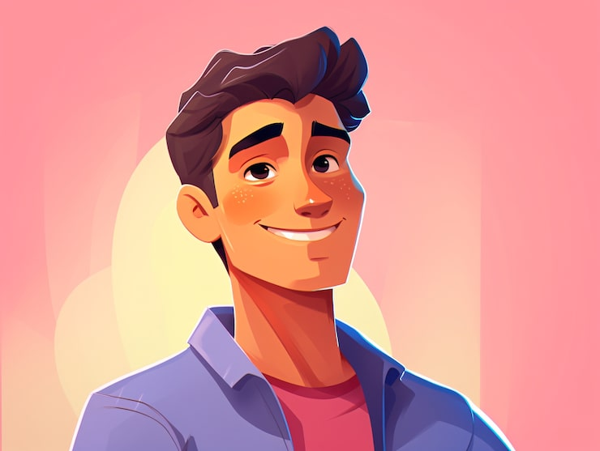
“I want to explore as much as I can”
Goals:
Find out more about new genres and artists
Listen without interruptions
Find music that matches his mood
Raghav singh
23 YEARS OLD
Frustrations:
Hates advertisements
Can not discover music that matches his taste
A student who loves music and enjoys exploring different genres and artists. He values uninterrupted listening and personalized recommendations

Slide 3

“I want to enjoy my old favourites, but on my mobile.”
Goals:
Listen to old songs from his younger days
Easily find favorite singers and songs
Shift from radio to mobile music
Ramesh sharma
60 YEARS OLD
Frustrations:
Finds music apps confusing
Has difficulty finding songs
Does not like complex features
A retired professional who enjoys listening to classic songs and old Bollywood music. He is comfortable with his mobile phone but prefers simple apps and wants an easy way to enjoy his favourite songs without relying on the radio

Slide 4
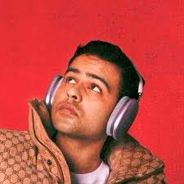
“I want my music to reach the right audience”
Goals:
Upload and publish music easily
Reach a wider audience.
Build a loyal listener base.
Frustrations:
Complicated music uploading process
Difficulty getting discovered by new listeners
ARPIT BALA
27 YEARS OLD
An independent artist who creates and releases his own music. He wants a simple platform to upload his tracks, connect with listeners, and grow his presence as an artist.

Slide 5
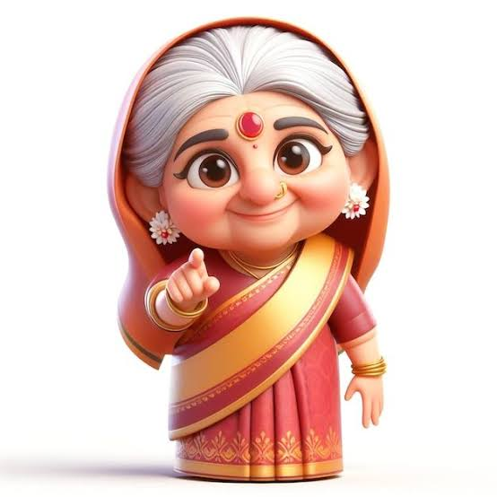
“I want to listen to my favourite bhajans whenever I want.”
Goals:
Choose exactly which song to play and when
Move from television to mobile for music.
Frustrations:
Searching for specific songs can be difficult
Finds music apps difficult and confusing to navigate.
GEETA MISHRA
71 YEARS OLD
A 72-year-old homemaker who enjoys listening to bhajans and religious music on television. She wants the freedom to choose her own songs on mobile but prefers a simple experience where she can control everything through voice commands

Slide 6
Thank you

