Slide 1

Cognitive Document Translation Application
With Azure Service

Slide 2
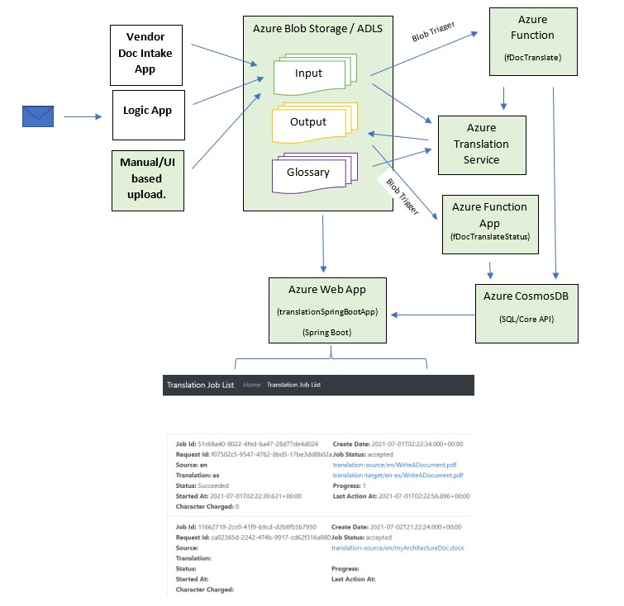
Architecture
The Application automatically kick start translation upon arrival of new documents in Blob Store, keep links and records of original & translated documents in Cosmos DB and display information in a Spring Boot Web App in Azure App Service
Modules implemented with code in github
Modules not yet implemented (Logic App, Vendor App)

